Slide 1
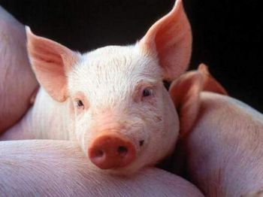
Ulf Müller und Ralf Fischer
5th International Workshop on Data Management and Genetic Evaluation in Swine

Slide 2
outline
- introduction
- problems / objectivs
- general output format
- self parameterizing
- applications
- summary

Slide 3
problems
1. The whole process of breeding value estimation
is very expensive so it is not done very often
2. A lot of specialized knowledge is necessary,
therefore these steps were usually developed
through projects in universities. However the
universities are not interested in continuing with
these projects.
3. There are a lot of applications for each single
action - scientific software or applications
created by individuals.

Slide 4
objectivs
- combine different applications
- automize the whole process of breeding value estimation
- use standard software instead individual software

Slide 5
applications
PopulationReport
- reports on population structure under biodiversity aspects
- support for small and endangered populations
arroundVCE
- parser for vce-runs
- produce parameterfile for vce runs
- format matrices
postEST
- detect weak spots and systematic problems
- change of BLUP were observed over time
- genetic trend can be computed
- produce parameterfile for calcTBV
calcTBV
- aggregate breeding values are computed
- produce parameterfile for ZwISSS

Slide 6
stages of animal breeding
performance testing
selection
mating
necessary information
- animal
- performances
- breeding program
- heritabilities
- genetic variances
- grouping, basis
- breedings values
- total breeding values
- standard errors
- breeding values
- change of inbreeding
- change of population parameters
actions
variance
components
estimation
breeding
value
estimation
total
breeding
values
storage
controlling
publication
applications
postgres
oracle
...
VCE
ASReml
...
PEST
PigBlup
...
individual Software

Slide 7
hierarchical structure of information
variance
components
estimation
breeding
value
estimation
total
breeding
values
storage
controlling
publication
- type of information are known
- conditions between information are known
- structure of results are known
- configuration parameters are known
using of previous configuration and currently results to create the following configuration

Slide 8
general output format
data
configuration
breeding value estimation
method
output
A1
A2
A3
applications
parser
for A3
for A2
for A1
new applications with new aggregations

Slide 9
self parameterizing
data
configuration
total breeding values
method
output
A1
A2
A3
B1
B2
applications
parser
for A3
for B1
for A2
for B2
for A1

Slide 10
Schema
VCE
VCEmanage
PEST
Aggregate Genotype
APIIS
Around BLUP
ZwISSS

Slide 11
VCEmanage
problem
- x-trait-model
- to large to solve in one run
- a lot of model variations
objective
- management of estimators from various runs
- full qualified matrices for using in pest
- triangle matrices for publishing
- general structure for statistics

Slide 12
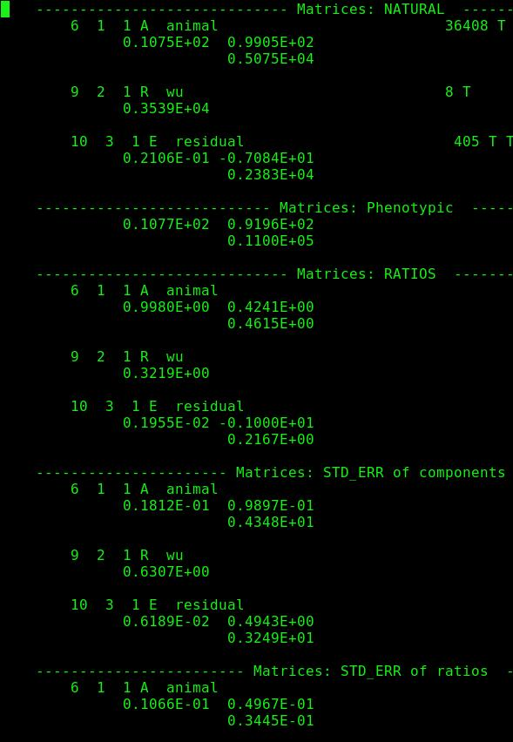
VCEmanage
publishing
0,99+-0,01 0,42+-0,049
0,46+-0,034
estimation
10.75 99.05
99.05 5075.0

Slide 13
info_ped.pl
fix pedigree loops
  ex: info_ped.pl -p leicoma -d ralf -w fwihbv -s -r loops
  results:
    automated cutting of pedigree for batch run
    position of cuting is stochastic
    The following loops are inside:
    'PI|1|2:::16301' (2816) -> 'PI|1|20:::31150' (4156) -> 'PI|2|2:::1094' (10263) -> 'PI|2|2:::3264' (16134) -> 'PI|2|2:::4013' (18214) -> 'PI|2|2:::4142' (18429) -> ':::' (25930) -> ':::' (8582) -> ':::' (9772) -> 'PI|2|2:::2563' (14014) -> ':::' (19292) -> 'PI|1|2:::16301' (2816)
    the dam of animal 4156 would be set to unknown!
    'DE|2|30:::49064.5' (5855) -> 'DE|2|30:::9325.11' (27821) -> 'DE|2|30:::9393' (27889) -> 'DE|2|30:::9461' (28010) -> 'DE|1|30:::122297' (5089) -> 'DE|1|30:::132064' (5769) -> 'DE|2|30:::2204' (12904) -> 'DE|2|30:::47800' (34230) -> 'DE|1|30:::134016' (5854) -> 'DE|2|30:::49064.5' (5855)
    the dam of animal 27821 would be set to unknown!

Slide 14
extract_for_blup.pl
ex: extract_for_blup.pl -p leicoma -d ralf -w fwihbv -f mslmr_extract.par
for BVE we can principle get the internal codes from APIIS
1 SQL-statement for each trait or effect
could also used for repeated records (only define each record exactly)
tab 1
ped
PEST
tab 2
dat
tab 3

Slide 15
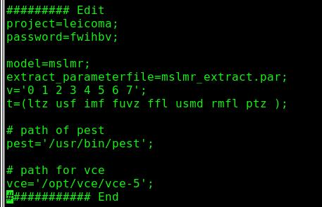
VCEmanage 1
- copy VCEmanage from apiis/contrib/zwisss
- set local parameter in VCEmanage
- execute „VCEmanage 1“ to extract data
==> - structure.txt
- blupdata.txt
- blupped.txt

Slide 16
VCEmanage 2
prepare pest
- cp mslmr.pest template.pest
- modify template.pest
- copy model information to mslmr.config
- modify mslmr.config
=> execute „VCEmanage 2“ to run pest
prepare vce
- cp mslmr.vce template.vce
- modify template.vce
- copy model information to mslmr.config

Slide 17
VCEmanage 3
Pest Parameterfile
Pest Parameterfile
Pest Template
DATA
MODEL
TRANSFORMATION
SOLVER
DATA
MODEL
TRANSFORMATION
SOLVER
DATA
MODEL
TRANSFORMATION
SOLVER
estimates.config
@traits
$pest_model
@treated
VCE Parameterfile
VCE Parameterfile
VCE Template
@vce_model
DATA
MODEL
SYSTEM
DATA
MODEL
SYSTEM
DATA
MODEL
SYSTEM
DATA
MODEL
SYSTEM

Slide 18
VCEmanage 4
perl $APIIS_HOME/contrib/zwisss/ParseVCE -f vce.results.all;
Models.csv
1 - identifier for model
2 - path for VCE-modelfile
3-6 - names of subdirectory
Statistics.csv
1 - identifier of model
2 - name of trait
3 - n
4 - average
5 - standarddeviation
6 - minimum
7 - maximum
Effects.csv
1 - identifier of model
2 - name of effect
3 - type of effect
4 - number of classes
Generals.csv
1 - identifier of model
2 - day of week
3 - date
4 - time of start
5 - time of cpu
6 - likelihood
7 - status
8 - rounds first value
9 - rounds second value
Estimates.csv
1 - identifier of model
2 - name of matrizes
3 - name of effect
4 - type of effect (random, animal, error)
5 - name of first trait
6 - name of second trait
7 - value of estimation

Slide 19
VCEmanage 5
perl $APIIS_HOME/contrib/zwisss/CreateParameterMatrices -p mslmr.config
$config->[0] = [ 'animal', 'RATIOS', '2', 't', 'r', '', 't' ];
$config->[1] = [ 'residual', 'RATIOS', '5', 'f', '', '', ' ' ];
$config->[2] = [ 'residual', 'NATURAL', '5', 'f', '', '', ' ' ];
$config->[3] = [ 'wu', 'NATURAL', '5', 'f', '', '', ' ' ];
$config->[4] = [ 'animal', 'NATURAL', '5', 'f', '', '', ' ' ];
- Column 1: Name of the random/residual effect (Column 3 in table Estimates)
- Colunn 2: Kind of matrices (Column 2 in table Estimates)
- Column 3: Counts of decimals
- Column 4: Kind of matrices
- t = triangle
- f = full
- p = with phenotypic values
- Column 5: Position of errors
- r = right (+- $value)
- b = bottom (new row)
- Column 6: Average of Variances or Heritabilities
- a = average
- '' or other = nothing
- Column 7: Character for distance
- t = tabulator
- '' or other = blank

Slide 20
VCEmanage 5
openoffice
- einlesen parameter
- einlesen matrizzen

Slide 21
MATDEF
but no longer positiv definite matrices
MATDEF (Norbert Mielenz)
  objective of the program
    The aim of the program is the determination of a positive definite matrix, which has a minimum distance to a given non-positive matrix. To calculate a distance function the correlations before and after correction can be used. The program is specially concepted for the correction of correlation matrices.
other bending allgorithm
... (eg?)

Slide 22
Schema
VCE
VCEmanage
PEST
Aggregate Genotype
APIIS
Around BLUP
ZwISSS

Slide 23
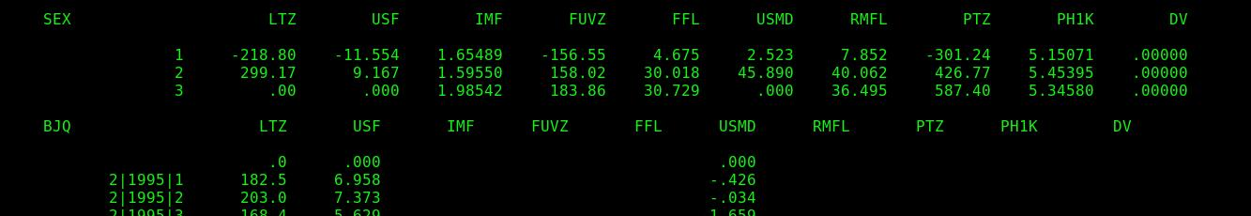
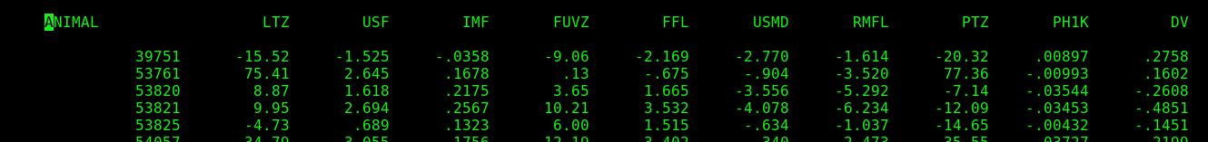
pest results
- breeding values
- information values
- weighting
- total breeding values
- accuracy
- groups

Slide 24
Types of groups
total
breeding
value
breeding
values
estimations
1 2
groups
(farm, sex, breed, society)
basis
+
+
+
+
+
+
+
+
-
-
-
-
-
-
-
-

Slide 25
calc_tbv
~/apiis/contrib/zwisss/calc_tbv.pl -r 'fb/fb.par,mslmr/mslmr.pest' -cm test.model
Sections:
TABLES: - $model_$no_bv
- $model_$no_daten
- $model_$no_effects
TBVS: configuration for each total breeding value
GROUPS: definition of groups

Slide 26
calc_tbv
~/apiis/contrib/zwisss/calc_tbv.pl
-afdbr 'fb/fb.par,mslmr/mslmr.pest'
-m leicoma.model
-u $USER
-w $password
-l leicoma

Slide 27
Schema
VCE
VCEmanage
PEST
Aggregate Genotype
APIIS
Around BLUP
ZwISSS

Slide 28
Around BLUP
analyse the incomming data and the results of an breeding value estimation
PERL scripte
  based on the same modelfile as step bevore
  after_pest
    general informations
    some statistics about the effects and covariables
    information about the changing BLUPs from run before
  after_pest_breeder
    genetic progress over years
    additionally some timedependent BLUE values (require parametrisation in the model file)

Slide 29
Informationstream
blupdata
parameterfile
PEST
PESTERG.lst
blupped
modelfile
pestanalyse.pdf
farm.pdf

Slide 30
after_pest.pl
run
  after_pest.pl -a -m projekt.model -p projekt -u user -w xxxxx
    -a use APIIS else also MySQL possible
    -m modelfiel name from step before
    -p projectname as given in apiisrc
    -u database user
    -w database passwort
    -o without comparing old estimation
    -x run only on pest parameterfile
    -t use same external animalidentifications (if run historic data always before estimatin than you get differnt internal dbs)

Slide 31
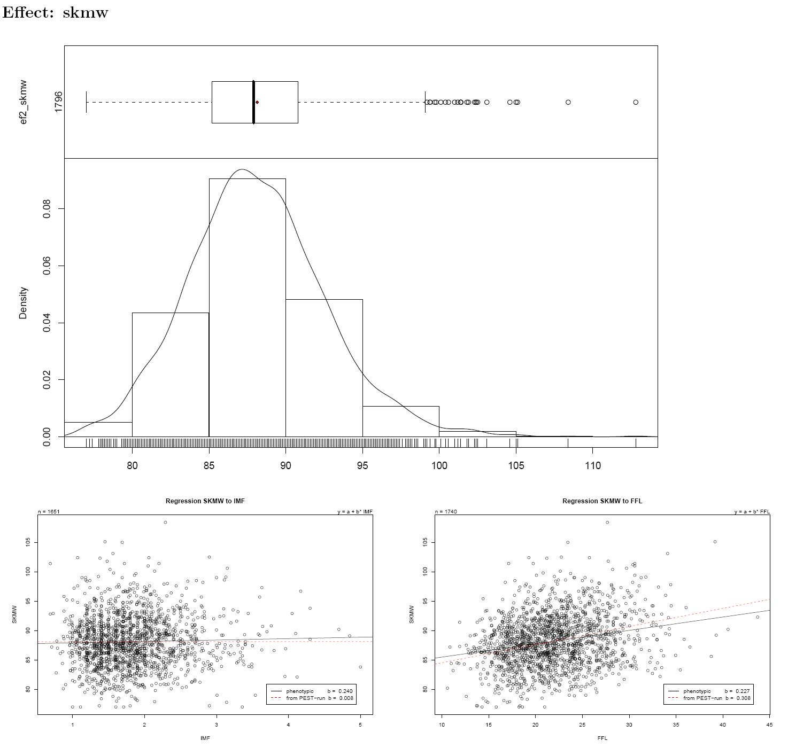
examples

Slide 32
after_pest_breeder.pl
run
  after_pest_breeder.pl -a -m projekt.model -p projekt -u user -w xxxxx -e
    -a use APIIS else also MySQL possible
    -m modelfiel name from step before
    -p projectname as given in apiisrc
    -u database user
    -w database passwort
    -e also some timedependent BLUEs
    -z for given breednames

Slide 33
next steps
all configurations in XML
configure some critical points which will aggregated for the user
  often not possible to read all 1000 pages each week :-)
  differences to old estimation
    maximal difference to new BLUPs for given group of animals
    more than x new animals arrive in new estimation
    missing ancstors /descendants

Slide 34
Schema
VCE
VCEmanage
PEST
Aggregate Genotype
APIIS
Around BLUP
ZwISSS

Slide 35
ZwISSS

Slide 36
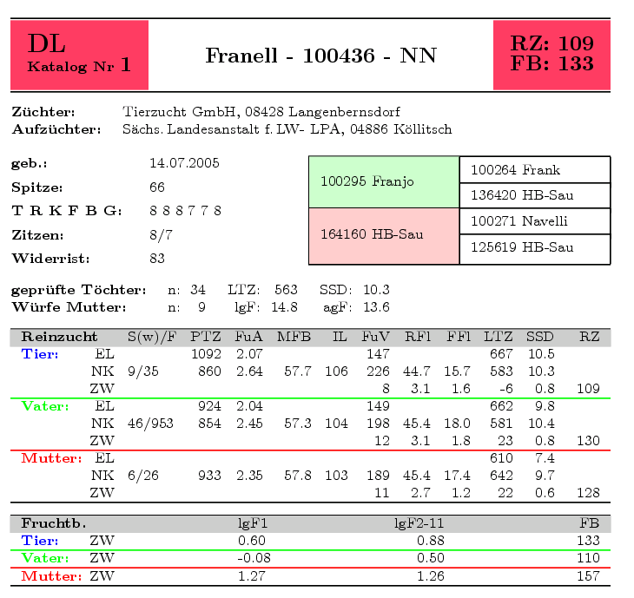
ZwISSS

Slide 37
summary
Parsers were developed to put results into a general
structure in a database by using the extracted information
about configuration and results from a given application.
Configurable and general software is developed to publish
breeding values via webaccess and to control the whole
continous process of breeding value estimation.

