Slide 1
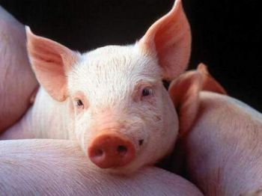
Ulf Müller und Ralf Fischer
5th International Workshop on Data Management and Genetic Evaluation in Swine

Slide 2
applications
PopulationReport
- reports on population structure under biodiversity aspects
- support for small and endangered populations
arroundVCE
- parser for vce-runs
- produce parameterfile for vce runs
- format matrices
postEST
- detect weak spots and systematic problems
- change of BLUP were observed over time
- genetic trend can be computed
- produce parameterfile for calcTBV
calcTBV
- aggregate breeding values are computed
- produce parameterfile for ZwISSS

Slide 3
Schema
VCE
VCEmanage
PEST
Aggregate Genotype
APIIS
Around BLUP
ZwISSS

Slide 4
info_ped.pl
fix pedigree loops
  ex: info_ped.pl -p leicoma -d ralf -w fwihbv -s -r loops
  results:
    automated cutting of pedigree for batch run
    position of cuting is stochastic
    The following loops are inside:
    'PI|1|2:::16301' (2816) -> 'PI|1|20:::31150' (4156) -> 'PI|2|2:::1094' (10263) -> 'PI|2|2:::3264' (16134) -> 'PI|2|2:::4013' (18214) -> 'PI|2|2:::4142' (18429) -> ':::' (25930) -> ':::' (8582) -> ':::' (9772) -> 'PI|2|2:::2563' (14014) -> ':::' (19292) -> 'PI|1|2:::16301' (2816)
    the dam of animal 4156 would be set to unknown!
    'DE|2|30:::49064.5' (5855) -> 'DE|2|30:::9325.11' (27821) -> 'DE|2|30:::9393' (27889) -> 'DE|2|30:::9461' (28010) -> 'DE|1|30:::122297' (5089) -> 'DE|1|30:::132064' (5769) -> 'DE|2|30:::2204' (12904) -> 'DE|2|30:::47800' (34230) -> 'DE|1|30:::134016' (5854) -> 'DE|2|30:::49064.5' (5855)
    the dam of animal 27821 would be set to unknown!

Slide 5
extract_for_blup.pl
ex: extract_for_blup.pl -p leicoma -d ralf -w fwihbv -f mslmr_extract.par
for BVE we can principle get the internal codes from APIIS
1 SQL-statement for each trait or effect
could also used for repeated records (only define each record exactly)
tab 1
ped
PEST
tab 2
dat
tab 3

Slide 6
extract_for_blup.pl
program to get out some informations especially for breeding value estimation. therefore use internal numbers. this require that the results get back to teh APIIS database which can than create an output with the wanted external representations.
create a datafile, a pedigree file and a structure file which could be used in PEST
for each trait / effect use one sql which return db_animal and one or more items (if there more than one item prg concatenate this values)
for all options and little description try 'perldoc extract_for_blup.pl'

Slide 7
MATDEF
but no longer positiv definite matrices
MATDEF (Norbert Mielenz)
  objective of the program
    The aim of the program is the determination of a positive definite matrix, which has a minimum distance to a given non-positive matrix. To calculate a distance function the correlations before and after correction can be used. The program is specially concepted for the correction of correlation matrices.
other bending allgorithm
... (eg?)

Slide 8
Around BLUP
analyse the incomming data and the results of an breeding value estimation
PERL scripte
  based on the same modelfile as step before
  after_pest
    general informations
    some statistics about the effects and covariables
    information about the changing BLUPs from run before
  after_pest_breeder
    genetic progress over years
    additionally some timedependent BLUE values (require parametrisation in the model file)

Slide 9
Informationstream
blupdata
parameterfile
PEST
PESTERG.lst
blupped
modelfile
pestanalyse.pdf
farm.pdf

Slide 10
after_pest.pl
run
  after_pest.pl -a -m projekt.model -p projekt -u user -w xxxxx
    -a use APIIS else also MySQL possible
    -m modelfiel name from step before
    -p projectname as given in apiisrc
    -u database user
    -w database passwort
    -o without comparing old estimation
    -x run only on pest parameterfile
    -t use same external animalidentifications (if run historic data always before estimatin than you get differnt internal dbs)

Slide 11
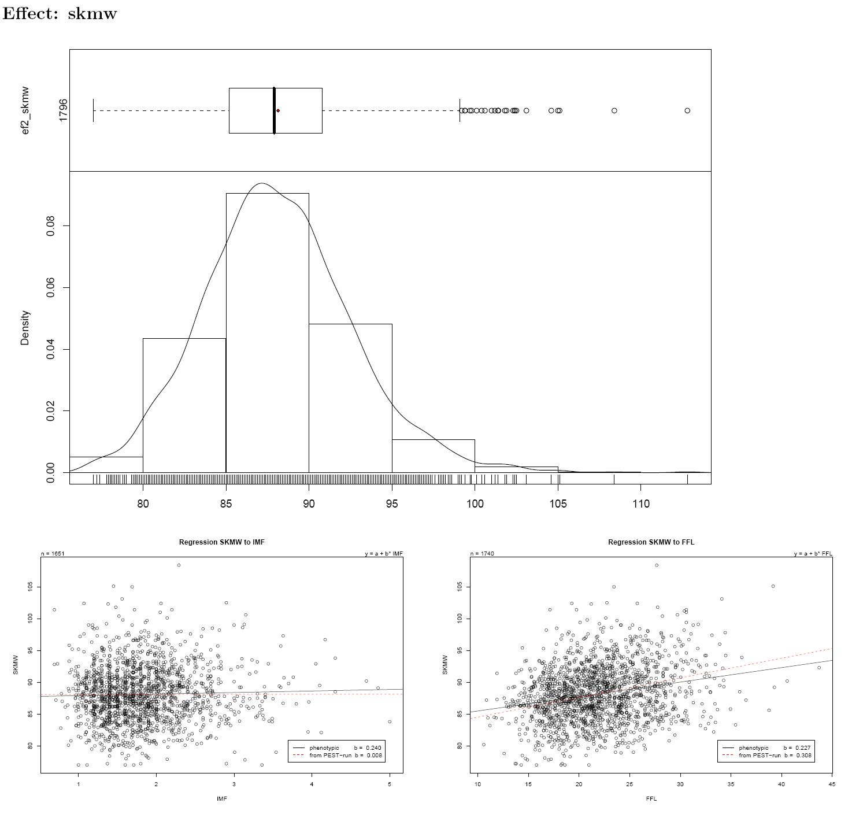
examples

Slide 12
after_pest_breeder.pl
run
  after_pest_breeder.pl -a -m projekt.model -p projekt -u user -w xxxxx -e
    -a use APIIS else also MySQL possible
    -m modelfiel name from step before
    -p projectname as given in apiisrc
    -u database user
    -w database passwort
    -e also some timedependent BLUEs
    -z for given breednames

Slide 13
next steps
all configurations in XML
configure some critical points which will aggregated for the user
  often not possible to read all 1000 pages each week :-)
  differences to old estimation
    maximal difference to new BLUPs for given group of animals
    more than x new animals arrive in new estimation
    missing ancstors /descendants

