Slide 1
MusicalStocks
Andrew Piispanen

Slide 2


How Does It Work?
Interface Input
Authorizes
Enters Key
Returns information
Stores information

Slide 3
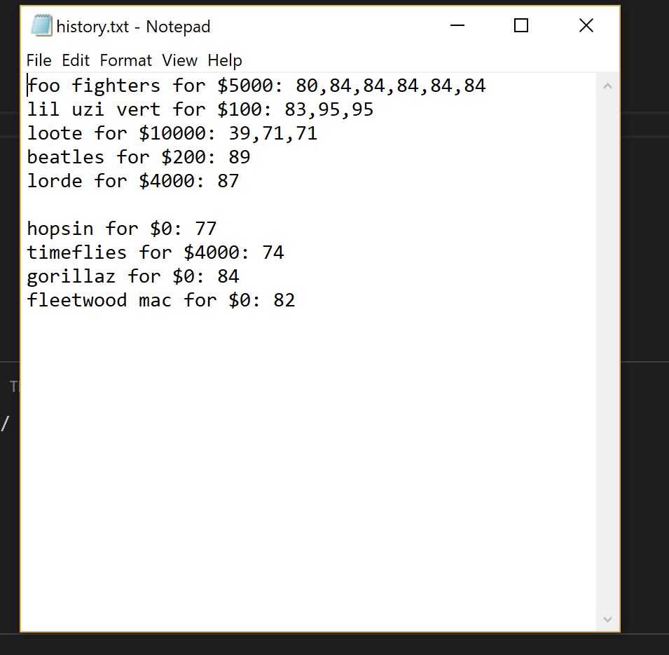
How the Data is Stored

