Slide 1
Airblock drone experiments
Experimental Monday 5.6.2017
Philippe
Matti

Slide 2
Goal
To get familiar with drone Airblock
  Assemble drone
  Get the control program
    Makeblock by xeecos (Android version used)
  Make connection between control device and drone
    Control device: Samsung J5
  Make the drone move
Learn how to program it

Slide 3
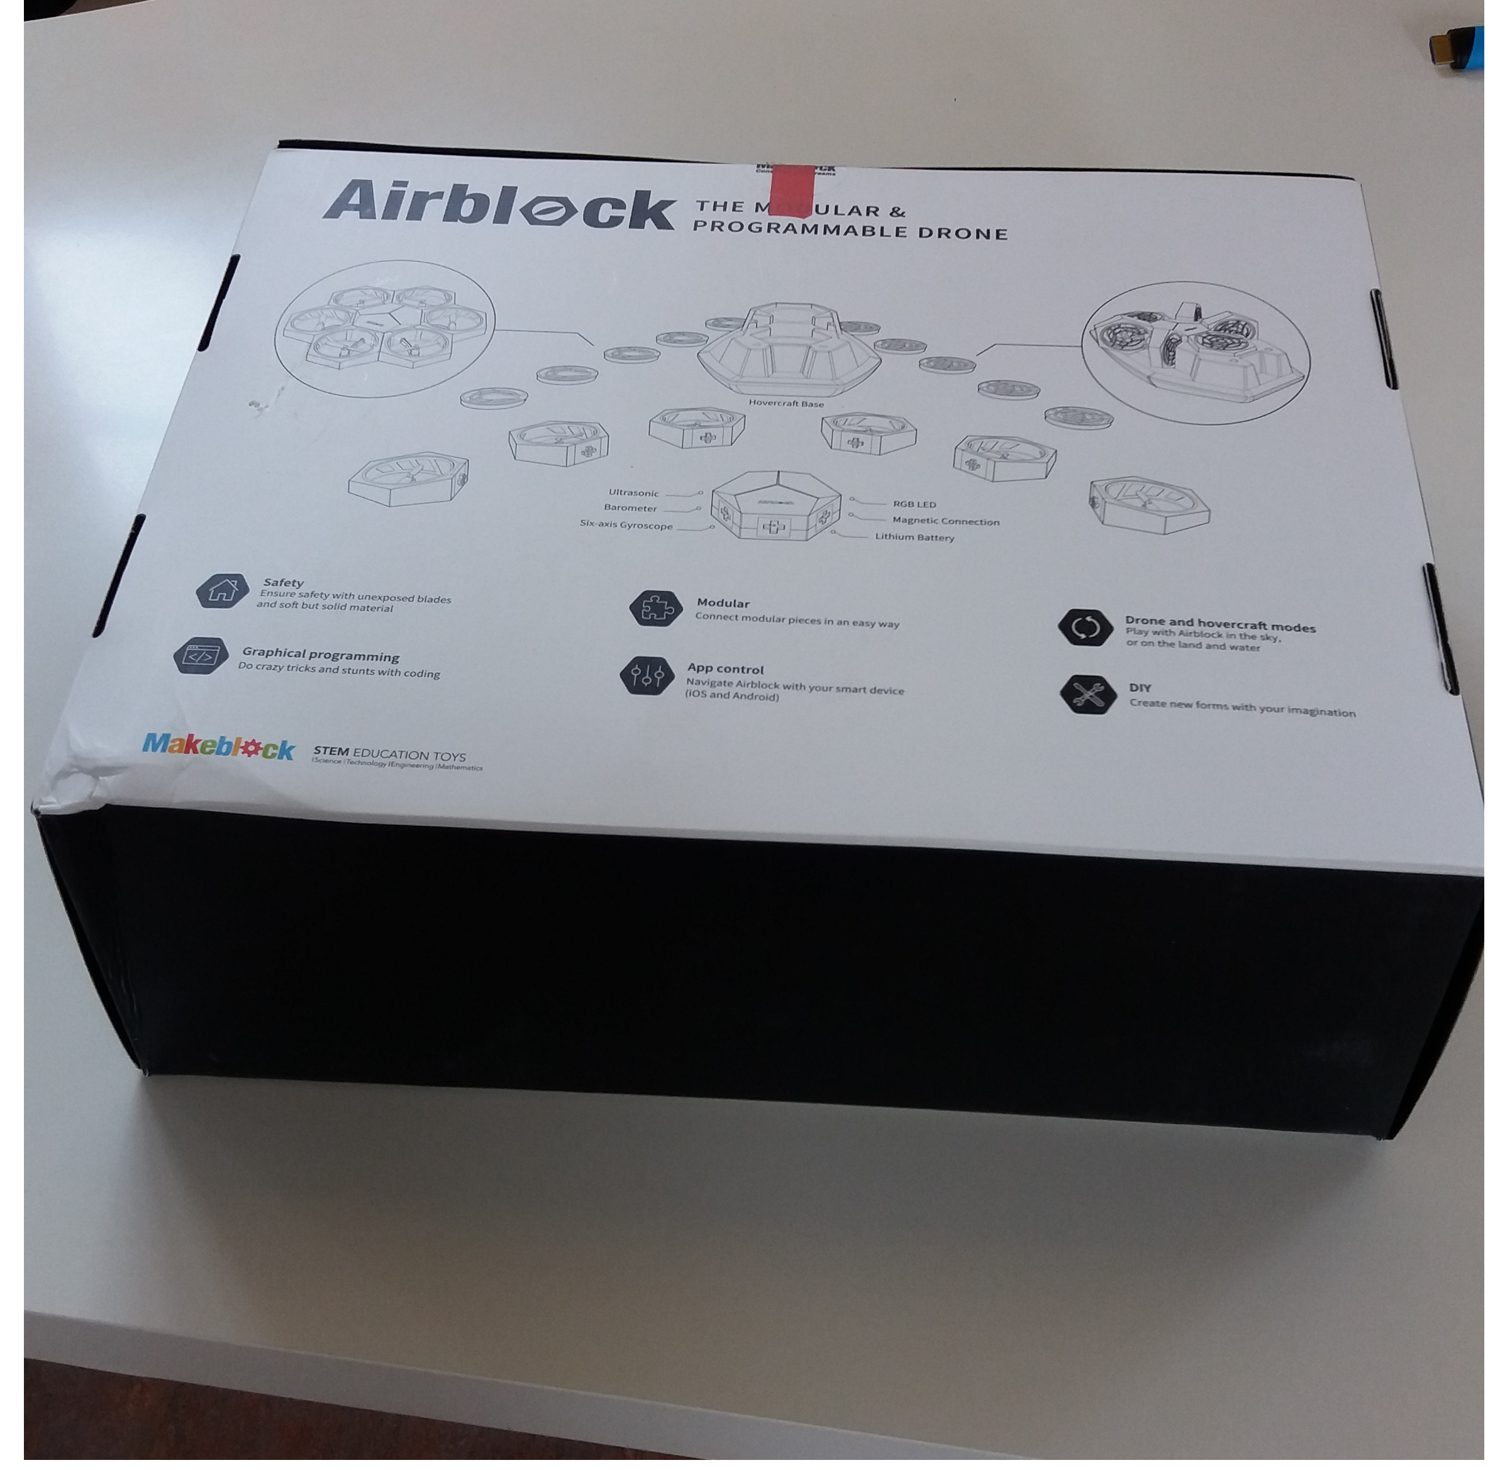
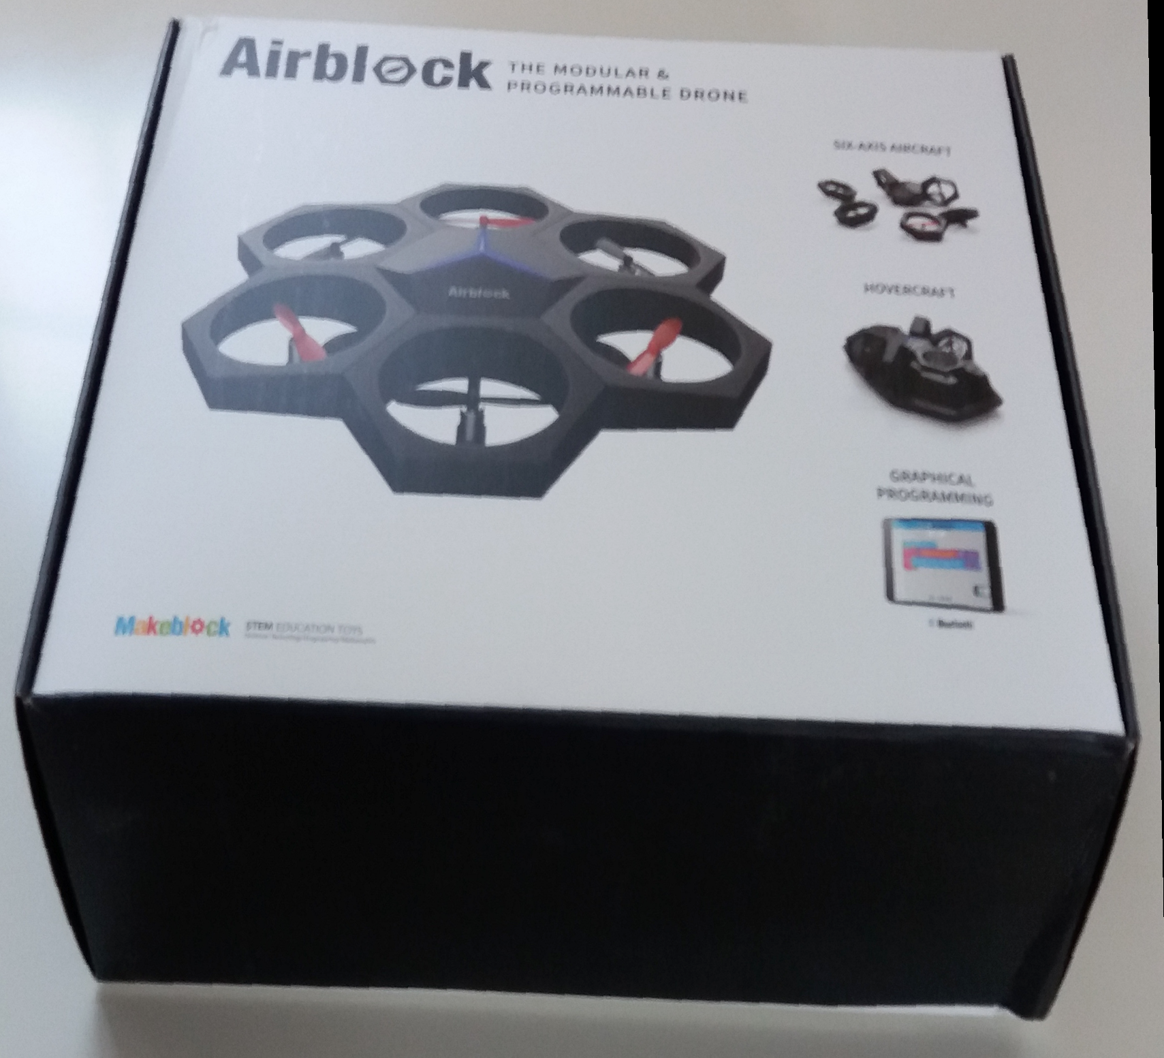
Parts of drone 1
Drone box

Slide 4
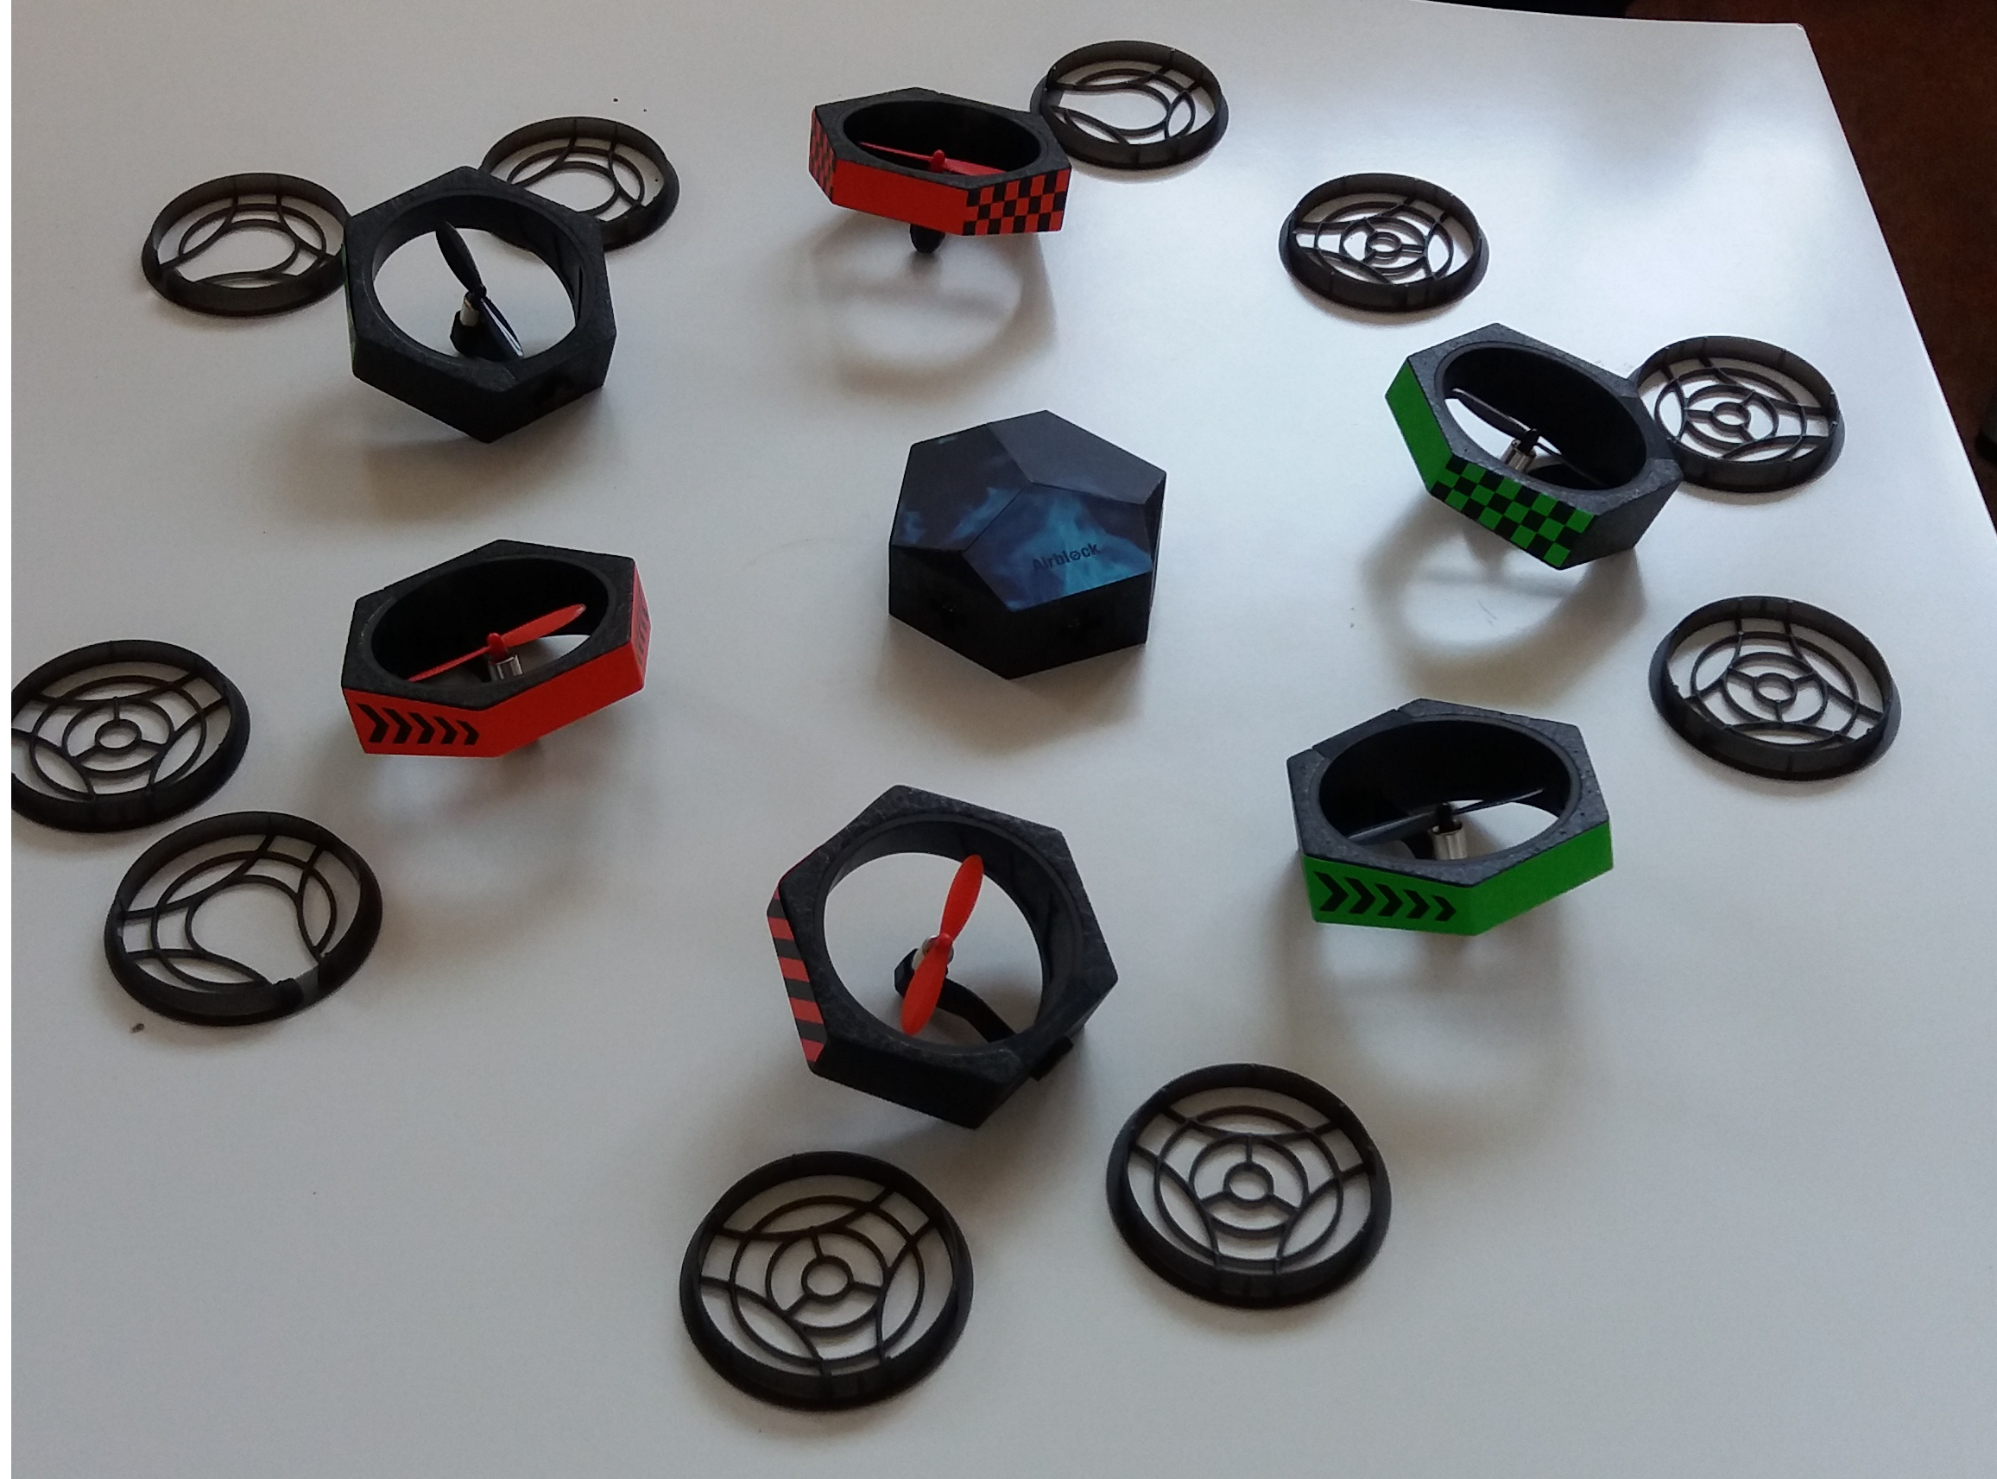
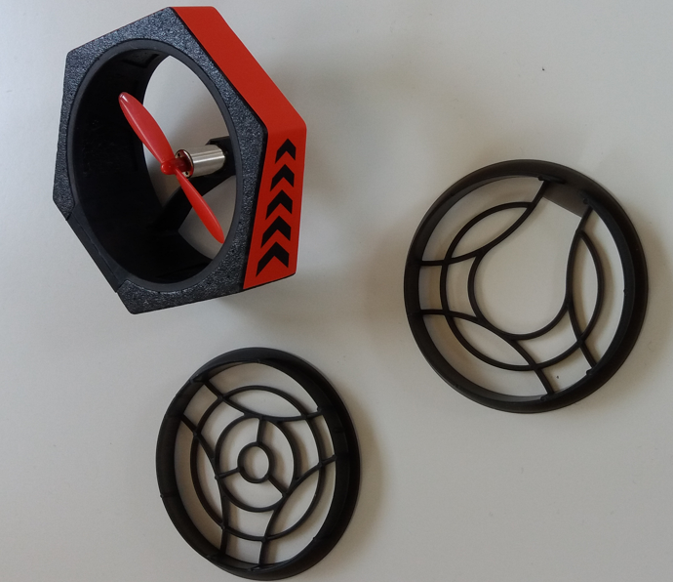
Parts of drone 2
Drone parts

Slide 5
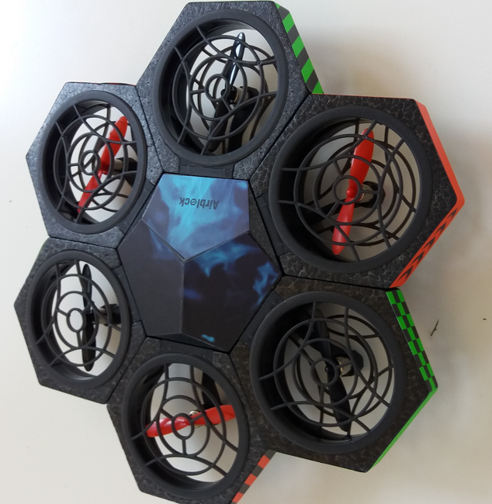
Parts of drone 3
Drone assembled

Slide 6
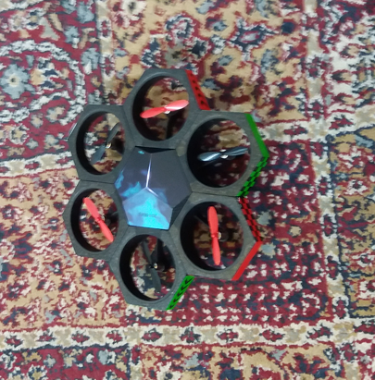
Test drive the drone 1
Drone, leave the carpet and fly!

Slide 7
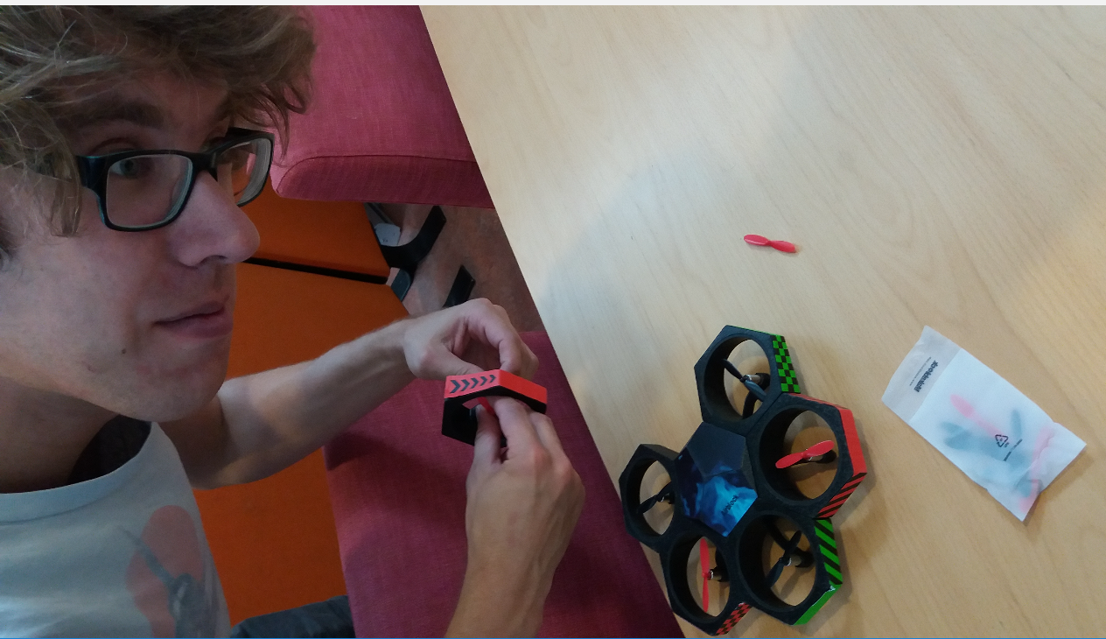
Test drive the drone 2
Something in Drone needs a little fix, but I can not put a finger on it...

Slide 8
Sometimes drone did submit to human mind
...and sometimes it didn’t
More information available in YouTube near you:
  https://youtu.be/8Bi_tJmYNmU

Slide 9
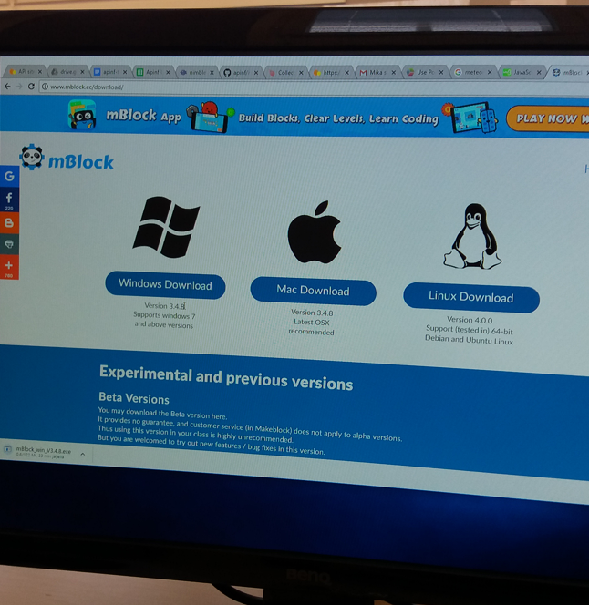
Get familiar with drone control application programming
Pick a version of mBlock

Slide 10
Get familiar with drone control application programming
The makeblock application consists of two parts:
  Ready made control program for driving the drone
    In different places: air, land, water
  Application programming environment
    Simple graphic environment, where elements (buttons, sliders, etc.) are set on canvas and functionalies are attached to elements as sequences
    move drone forward , turn drone, stop moving, power on/off, detect values from sensors, display (set leds),
    Program flow commands

Slide 11
Conclusion
Although the drone control program is relatively easy to use, it takes some time to get used to the control program and develop the skill to master the drone
Although the application program is mentioned to be suitable for kids 8 years old and above, it takes some time find out the logic.
The drone is a nice toy

