Slide 1


Smart Data Analytics Challenge 2018

Slide 2
Competition Submission Instructions
Use this powerpoint template to create a standardized view of the analysis so that the judges have uniform entries for the review process.
In addition to providing this high level summary, use the GitHub repository to store relevant code, analysis methods, results and other related information.
The prize for competing is your information in the repository as a contribution to the wealth of data available for the State of Colorado.
Your goal should be to create good analysis and documentation of your project and process so others can visit the GitHub Organization and see all the great work from teams.
2018 Submission Template

Slide 3
Problem Solved
Problem :
How do we compare and contrast different road segments, highways, access egress ramps.
How can we have metrics that take into account context?
How do we connect diverse data sources (census data, traffic data, sign data, topology, gis polygons, income levels) and identify clusters that share common characteristics in an automated fashion?
How can we use such connected diverse data to make a recommendation for a subsequent action
2018 Submission Template

Slide 4
Problem Solved
Context 1
Segment1
Identify similar roadway segments, intersections based on different contexts (traffic, topology, number of lanes etc)
Use similarity to drive action recommendations.
Identify anomalies in real time
Context 2
Segment2
Context 3
Segment3
Context 4

Slide 5
2. Impact
Dollar savings through Better Decisions
Better experience for Citizens and businesses a portal that allows them to figure out what to expect and when to travel. Recommender system for travel time for trucks.
2018 Submission Template

Slide 6
3. Methodology
Multi-Partite Graph Analytics for creating Context
Scoring Metrics for Roadways – (Smart Cities)
Building a graph ( a set of nodes and vertices) that connects contiguous cities, zipcodes (that share borders), with demographic data, traffic data to create a database that allows us to embed context.
Each node and relationship is then enriched with vectors that embed ccontext.
Example – A vector of 24 elements that represents traffic speeds for each hour for each weekday.
MONDAY_TRAFFIC : [14,23,32, …….]
TUESDAY_TRAFFIC:[10,12,24,…..]
Metrics can be used to identify similarities, make recommendations and detect anomalies in real time.
2018 Submission Template

Slide 7
2. The Data
Used the census data sets and the CDOT data sets for traffic, accidents, roadway signs etc.
2018 Submission Template

Slide 8
3. Feasibility
The analysis is not complete.
The graph can be built by state or local subject matter experts. Some mathematical understanding of Graph theory, graph databases and graph algorithms are required.
Cloud resources can be leveraged to scale the analysis. Any amount of data can be used and diverse data sources can be connected.
2018 Submission Template

Slide 9
4. Results
Please check out the following site.
URL:
Graph Data base : http://34.214.149.148:7474/browser/
Password : nottest123
Application :
http://54.201.4.75:5000/
Or
http://34.214.149.148:5000/
2018 Submission Template

Slide 10
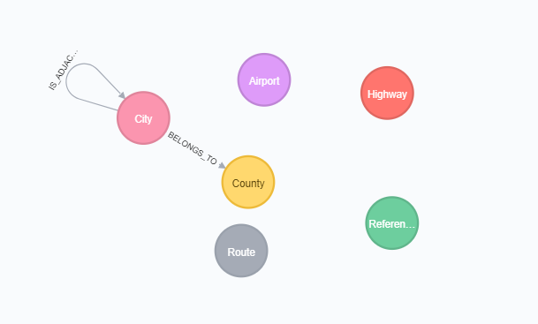
Meta graph:

Slide 11
Smart Data Analytics Challenge 2018

