Slide 1
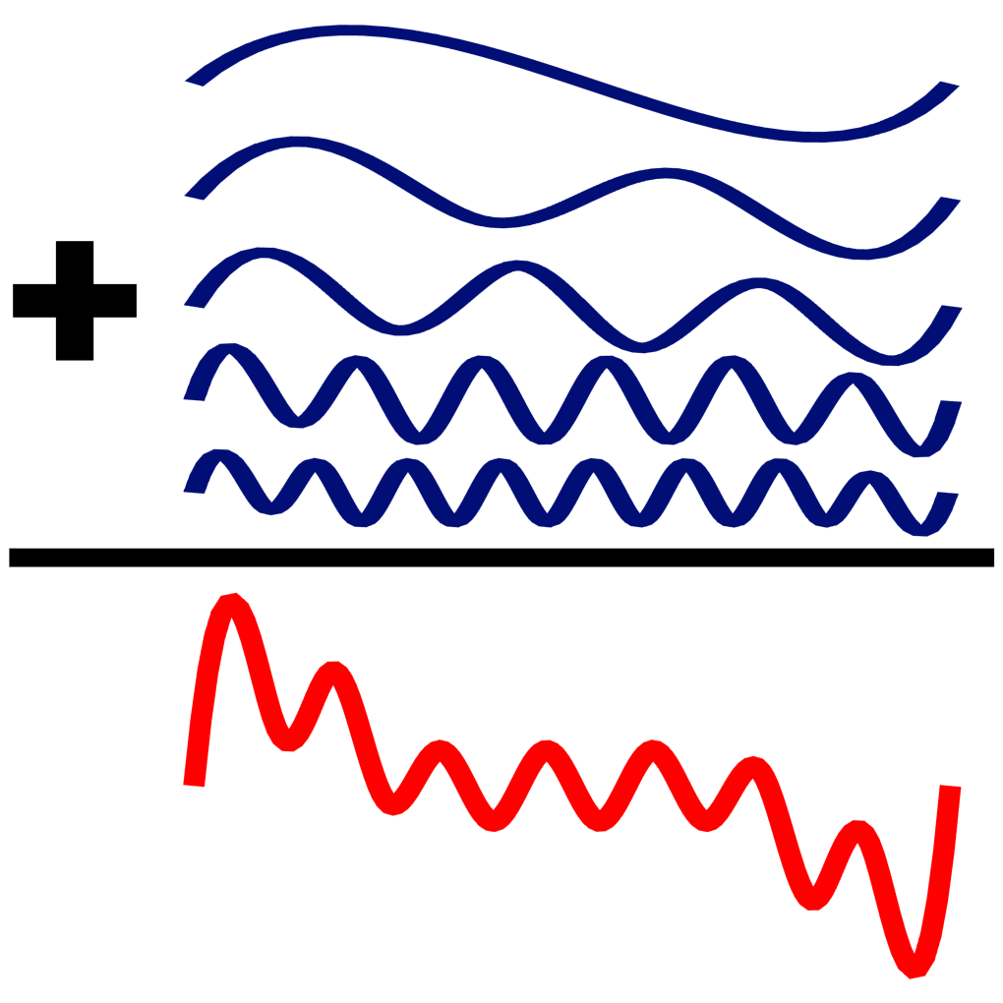
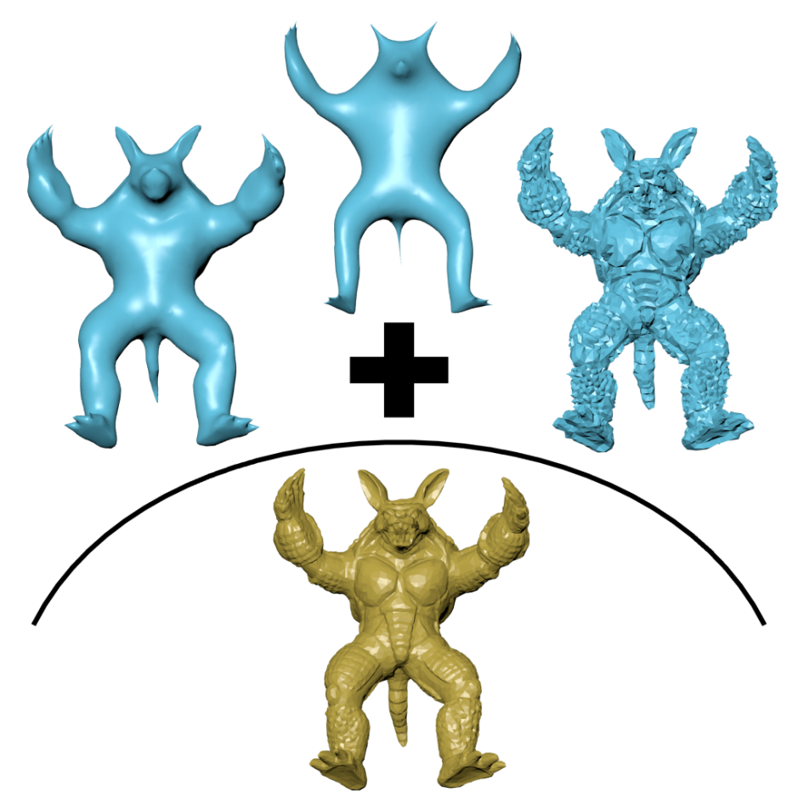
Fourier Transform
Laplacian Eigen-Decomposition

