Slide 1
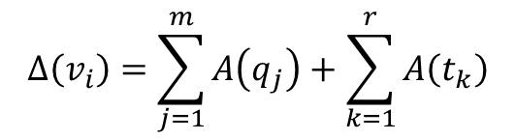
$$Δ\left(v_{i}\right)=\sum_{j=1}^{m}{A\left(q_{j}\right)}+\sum_{k=1}^{r}{A\left(t_{k}\right)}$$

Slide 2
Nosotros construimos todas las posibles triangulaciones de una malla hibrida y calculamos el laplaciano en cada triangulacion y usamos la media promedio para estimar el laplaciano en un vertice.
Luego de construir todas las triangulaciones posibles y usar la MAA reducimos todas las posibilidades a solo 5 configuraciones basicas.

Slide 3
Proposed Operator
Mathematical framework
Curvature
2d curvature
3D Sectional curvature
3D Principal curvatures
3D Mean curvature normal
Gradient fo voronoi region
Laplace beltrami operator
Mean average area

Slide 4
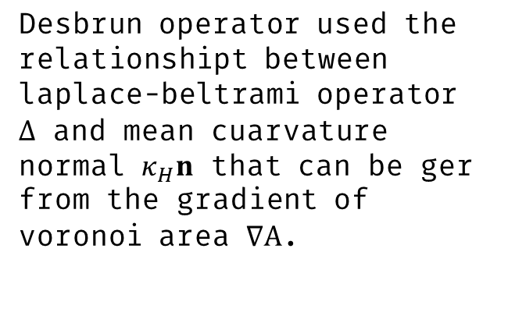
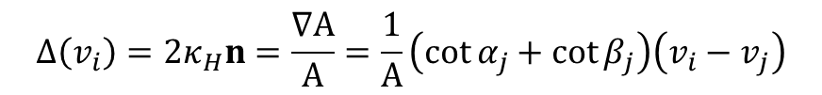
Xiong’s operator
Desbrun’s operator
Desbrun operator used the relationshipt between laplace-beltrami operator $Δ$ and mean cuarvature normal $κ_{H}n$ that can be ger from the gradient of voronoi area $∇A$.
$$Δ\left(v_{i}\right)=2κ_{H}n=\frac{∇A}{A}=\frac{1}{A}\left(\cot{α_{j}}+\cot{β_{j}}\right)\left(v_{i}−v_{j}\right)$$

Slide 5
Desbrun’s operator
Xiong’s operator
Xiong’s operator

Slide 6

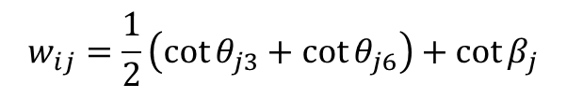
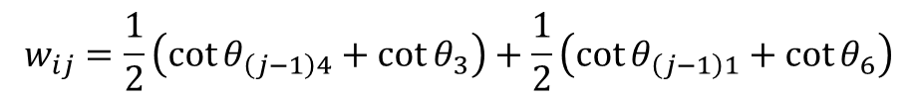
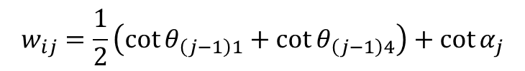

$$w_{ij}=\cot{θ_{j2}}+\cot{θ_{j5}}$$
$$w_{ij}=\frac{1}{2}\left(\cot{θ_{\left(j−1\right)4}}+\cot{θ_{3}}\right)+\frac{1}{2}\left(\cot{θ_{\left(j−1\right)1}}+\cot{θ_{6}}\right)$$
$$w_{ij}=\cot\left(α_{j}\right)+\cot\left(β_{j}\right)$$
$$w_{ij}=\frac{1}{2}\left(\cot{θ_{j3}}+\cot{θ_{j6}}\right)+\cot{β_{j}}$$
$$w_{ij}=\frac{1}{2}\left(\cot{θ_{\left(j−1\right)1}}+\cot{θ_{\left(j−1\right)4}}\right)+\cot{α_{j}}$$

Slide 7

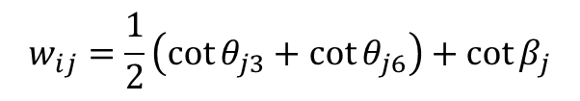
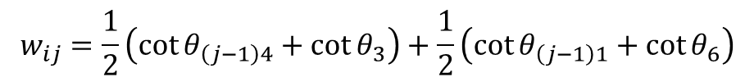
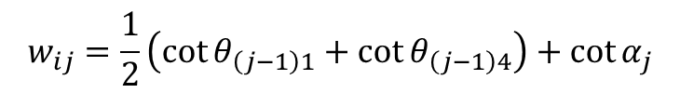

(a)
$$w_{ij}=\cot{θ_{j2}}+\cot{θ_{j5}}$$
$$w_{ij}=\frac{1}{2}\left(\cot{θ_{\left(j−1\right)4}}+\cot{θ_{3}}\right)+\frac{1}{2}\left(\cot{θ_{\left(j−1\right)1}}+\cot{θ_{6}}\right)$$
(b)
(c)
$$w_{ij}=\cot\left(α_{j}\right)+\cot\left(β_{j}\right)$$
$$w_{ij}=\frac{1}{2}\left(\cot{θ_{j3}}+\cot{θ_{j6}}\right)+\cot{β_{j}}$$
(d)
$$w_{ij}=\frac{1}{2}\left(\cot{θ_{\left(j−1\right)1}}+\cot{θ_{\left(j−1\right)4}}\right)+\cot{α_{j}}$$
(e)

Slide 8
(a)
$$w_{ij}=\cot{θ_{j2}}+\cot{θ_{j5}}$$
$$w_{ij}=\frac{1}{2}\left(\cot{θ_{\left(j−1\right)4}}+\cot{θ_{3}}\right)+\frac{1}{2}\left(\cot{θ_{\left(j−1\right)1}}+\cot{θ_{6}}\right)$$
(b)
(c)
$$w_{ij}=\cot\left(α_{j}\right)+\cot\left(β_{j}\right)$$
$$w_{ij}=\frac{1}{2}\left(\cot{θ_{j3}}+\cot{θ_{j6}}\right)+\cot{β_{j}}$$
(d)
$$w_{ij}=\frac{1}{2}\left(\cot{θ_{\left(j−1\right)1}}+\cot{θ_{\left(j−1\right)4}}\right)+\cot{α_{j}}$$
(e)

Slide 9
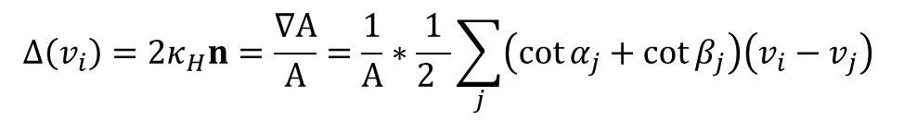

2011 XION’S MLBO OERATOR FOR QUAD MESHES
Desbrun’s operator for
triangle meshes
Gradient of voronoi area $∇A$
$$Δ\left(v_{i}\right)=2κ_{H}n=\frac{∇A}{A}=\frac{1}{A}∗\frac{1}{2 }\sum_{j}{\left(\cot{α_{j}}+\cot{β_{j}}\right)\left(v_{i}−v_{j}\right)}$$
Area around vi
Mean curvature
normal

Slide 10
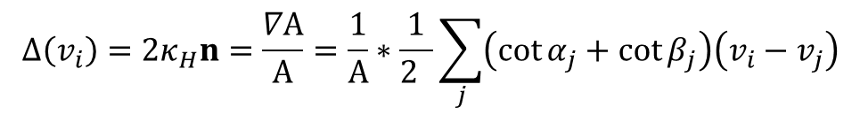

2011 XION’S MLBO OERATOR FOR QUAD MESHES
Desbrun’s operator for
triangle meshes
Gradient of voronoi area $∇A$
$$Δ\left(v_{i}\right)=2κ_{H}n=\frac{∇A}{A}=\frac{1}{A}∗\frac{1}{2 }\sum_{j}{\left(\cot{α_{j}}+\cot{β_{j}}\right)\left(v_{i}−v_{j}\right)}$$
Area around vi
Mean curvature
normal

Slide 11
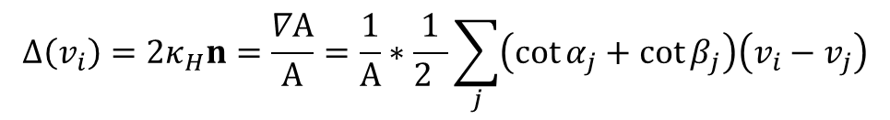

2011 XION’S MLBO OERATOR FOR QUAD MESHES
Desbrun’s operator for
triangle meshes
Gradient of voronoi area $∇A$
$$Δ\left(v_{i}\right)=2κ_{H}n=\frac{∇A}{A}=\frac{1}{A}∗\frac{1}{2 }\sum_{j}{\left(\cot{α_{j}}+\cot{β_{j}}\right)\left(v_{i}−v_{j}\right)}$$
Area around vi
Mean curvature
normal

Slide 12
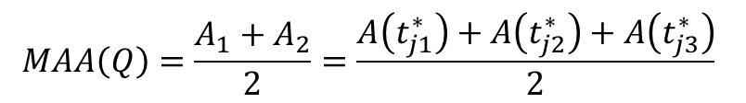
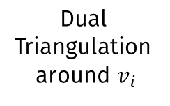
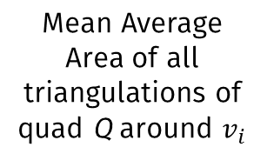
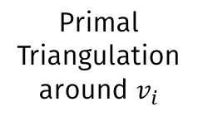
Mean Average Area of all triangulations of quad Q around $v_{i}$
Primal
Triangulation
around $v_{i}$
Dual
Triangulation
around $v_{i}$
$$MAA\left(Q\right)=\frac{A_{1}+A_{2}}{2}=\frac{A\left(t_{j1}^{∗}\right)+A\left(t_{j2}^{∗}\right)+A\left(t_{j3}^{∗}\right)}{2}$$

Slide 13

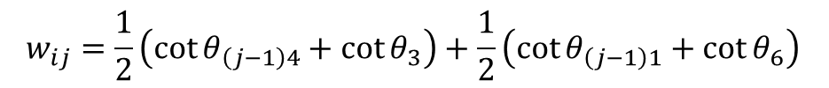
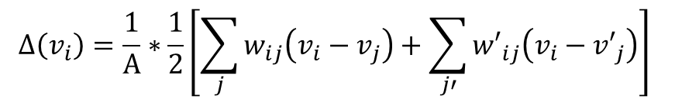
2011 XION’S MLBO OERATOR FOR QUAD MESHES
Primal
triangulation
Dual
triangulation
Xiong’s operator for
quad meshes
$$Δ\left(v_{i}\right)=\frac{1}{A}∗\frac{1}{2}\left[\sum_{j}{w_{ij}\left(v_{i}−v_{j}\right)}+\sum_{j′}{{w′}_{ij}\left(v_{i}−{v′}_{j}\right)}\right]$$
$$w_{ij}=\frac{1}{2}\left(\cot{θ_{\left(j−1\right)4}}+\cot{θ_{3}}\right)+\frac{1}{2}\left(\cot{θ_{\left(j−1\right)1}}+\cot{θ_{6}}\right)$$
$${w′}_{ij}=\cot{θ_{j2}}+\cot{θ_{j3}}$$

Slide 14

2011 XION’S MLBO OERATOR FOR QUAD MESHES
Primal
triangulation
Dual
triangulation
Xiong’s operator for
triangle meshes
$$Δ\left(v_{i}\right)=\frac{1}{A}∗\frac{1}{2}\left[\sum_{j}{w_{ij}\left(v_{i}−v_{j}\right)}+\sum_{j′}{{w′}_{ij}\left(v_{i}−{v′}_{j}\right)}\right]$$
$$w_{ij}=\frac{1}{2}\left(\cot{θ_{\left(j−1\right)4}}+\cot{θ_{3}}\right)+\frac{1}{2}\left(\cot{θ_{\left(j−1\right)1}}+\cot{θ_{6}}\right)$$
$${w′}_{ij}=\cot{θ_{j2}}+\cot{θ_{j5}}$$

Slide 16

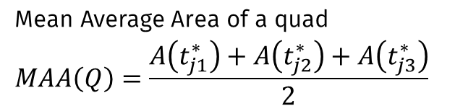
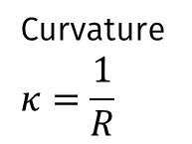
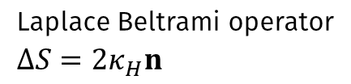
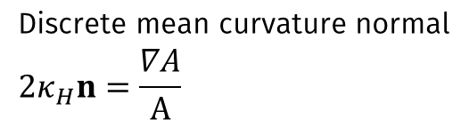
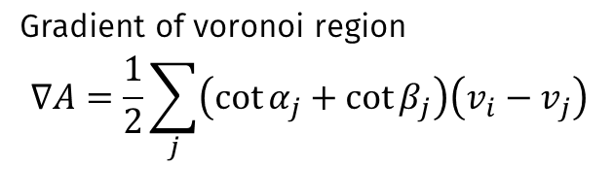
2011 XION’S MLBO OERATOR FOR QUAD MESHES
Curvature
$$κ=\frac{1}{R}$$
Mean Curvature
$$κ_{H}=\frac{κ_{1}+κ_{2}}{2}$$
Gradient of voronoi region
$$∇A=\frac{1}{2}\sum_{j}{\left(\cot{α_{j}}+\cot{β_{j}}\right)\left(v_{i}−v_{j}\right)}$$
Discrete mean curvature normal
$${2κ}_{H}n=\frac{∇A}{A}$$
Mean Average Area of a quad
$$MAA\left(Q\right)=\frac{A\left(t_{j1}^{∗}\right)+A\left(t_{j2}^{∗}\right)+A\left(t_{j3}^{∗}\right)}{2}$$
Laplace Beltrami operator
$${∆S=2κ}_{H}n$$

Slide 17
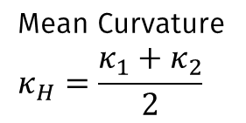
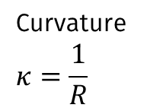

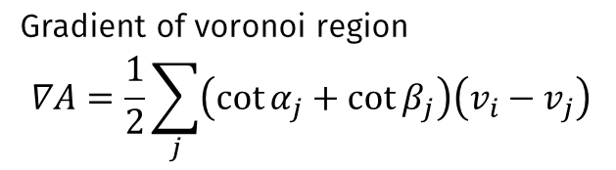
2011 XION’S MLBO OERATOR FOR QUAD MESHES
Curvature
$$κ=\frac{1}{R}$$
Mean Curvature
$$κ_{H}=\frac{κ_{1}+κ_{2}}{2}$$
Gradient of voronoi region
$$∇A=\frac{1}{2}\sum_{j}{\left(\cot{α_{j}}+\cot{β_{j}}\right)\left(v_{i}−v_{j}\right)}$$
Discrete mean curvature normal ${2κ}_{H}n=\frac{∇A}{A}$
Laplace Beltrami operator ${∆S=2κ}_{H}n$

Slide 18
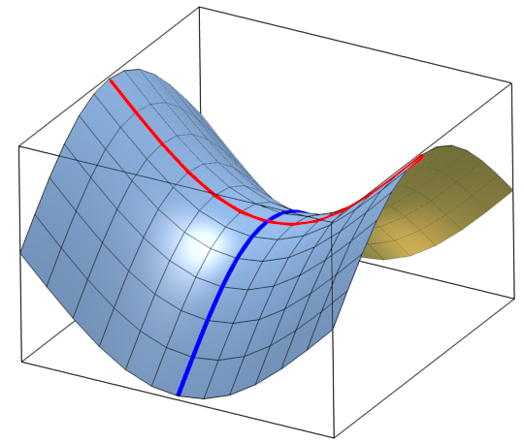
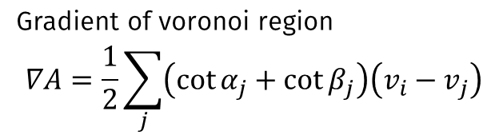

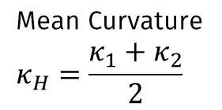

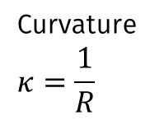

2011 XION’S MLBO OERATOR FOR QUAD MESHES
$$κ_{1}$$
$$κ_{2}$$
Curvature
$$κ=\frac{1}{R}$$
Mean Curvature
$$κ_{H}=\frac{κ_{1}+κ_{2}}{2}$$
Gradient of voronoi region
$$∇A=\frac{1}{2}\sum_{j}{\left(\cot{α_{j}}+\cot{β_{j}}\right)\left(v_{i}−v_{j}\right)}$$
Discrete mean curvature normal ${2κ}_{H}n=\frac{∇A}{A}$
Laplace Beltrami operator ${∆S=2κ}_{H}n$

Slide 19
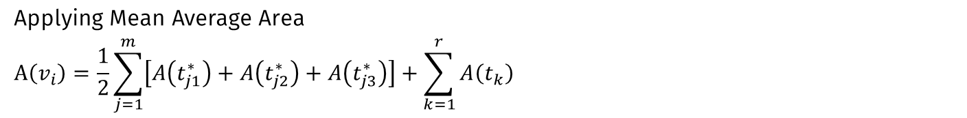
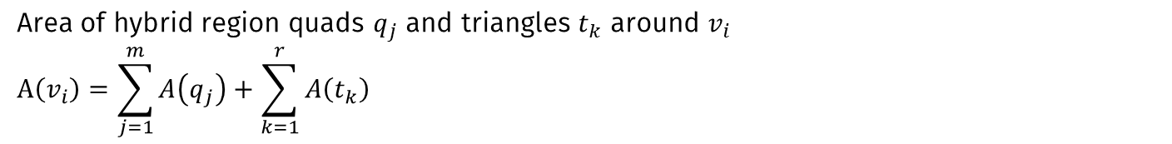
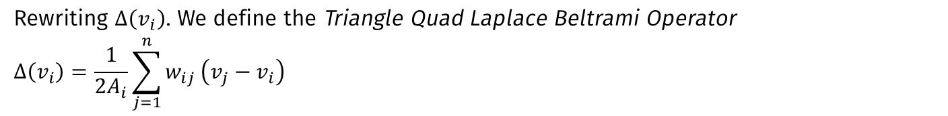
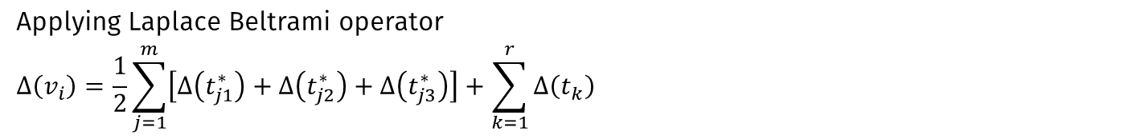
2011 XION’S MLBO OERATOR FOR QUAD MESHES
Area of hybrid region quads $q_{j}$ and triangles $t_{k}$ around $v_{i}$
$$A\left(v_{i}\right)=\sum_{j=1}^{m}{A\left(q_{j}\right)}+\sum_{k=1}^{r}{A\left(t_{k}\right)}$$
Applying Mean Average Area
$$A\left(v_{i}\right)=\frac{1}{2}\sum_{j=1}^{m}{\left[A\left(t_{j1}^{∗}\right)+A\left(t_{j2}^{∗}\right)+A\left(t_{j3}^{∗}\right)\right]}+\sum_{k=1}^{r}{A\left(t_{k}\right)}$$
Applying Laplace Beltrami operator
$$∆\left(v_{i}\right)=\frac{1}{2}\sum_{j=1}^{m}{\left[∆\left(t_{j1}^{∗}\right)+∆\left(t_{j2}^{∗}\right)+∆\left(t_{j3}^{∗}\right)\right]}+\sum_{k=1}^{r}{∆\left(t_{k}\right)}$$
Rewriting $∆\left(v_{i}\right)$. We define the Triangle Quad Laplace Beltrami Operator
$$∆\left(v_{i}\right)=\frac{1}{{2A}_{i}}\sum_{j=1}^{n}{w_{ij}}\left(v_{j}−v_{i}\right)$$

Slide 20
2011 XION’S MLBO OERATOR FOR QUAD MESHES
Area of hybrid region quads $q_{j}$ and triangles $t_{k}$ around $v_{i}$
$$A\left(v_{i}\right)=\sum_{j=1}^{m}{A\left(q_{j}\right)}+\sum_{k=1}^{r}{A\left(t_{k}\right)}$$
Applying Mean Average Area
$$A\left(v_{i}\right)=\frac{1}{2}\sum_{j=1}^{m}{\left[A\left(t_{j1}^{∗}\right)+A\left(t_{j2}^{∗}\right)+A\left(t_{j3}^{∗}\right)\right]}+\sum_{k=1}^{r}{A\left(t_{k}\right)}$$
Applying Laplace Beltrami operator
$$∆\left(v_{i}\right)=\frac{1}{2}\sum_{j=1}^{m}{\left[∆\left(t_{j1}^{∗}\right)+∆\left(t_{j2}^{∗}\right)+∆\left(t_{j3}^{∗}\right)\right]}+\sum_{k=1}^{r}{∆\left(t_{k}\right)}$$
Rewriting $∆\left(v_{i}\right)$. We define the Triangle Quad Laplace Beltrami Operator
$$∆\left(v_{i}\right)=\frac{1}{{2A}_{i}}\sum_{j=1}^{n}{w_{ij}}\left(v_{j}−v_{i}\right)$$

Slide 21
2011 XION’S MLBO OERATOR FOR QUAD MESHES
Area of hybrid region quads $q_{j}$ and triangles $t_{k}$ around $v_{i}$
$$A\left(v_{i}\right)=\sum_{j=1}^{m}{A\left(q_{j}\right)}+\sum_{k=1}^{r}{A\left(t_{k}\right)}$$
Applying Mean Average Area
$$A\left(v_{i}\right)=\frac{1}{2}\sum_{j=1}^{m}{\left[A\left(t_{j1}^{∗}\right)+A\left(t_{j2}^{∗}\right)+A\left(t_{j3}^{∗}\right)\right]}+\sum_{k=1}^{r}{A\left(t_{k}\right)}$$
Applying Laplace Beltrami operator
$$∆\left(v_{i}\right)=\frac{1}{2}\sum_{j=1}^{m}{\left[∆\left(t_{j1}^{∗}\right)+∆\left(t_{j2}^{∗}\right)+∆\left(t_{j3}^{∗}\right)\right]}+\sum_{k=1}^{r}{∆\left(t_{k}\right)}$$
Rewriting $∆\left(v_{i}\right)$. We define the Triangle Quad Laplace Beltrami Operator
$$∆\left(v_{i}\right)=\frac{1}{{2A}_{i}}\sum_{j=1}^{n}{w_{ij}}\left(v_{j}−v_{i}\right)$$

Slide 22
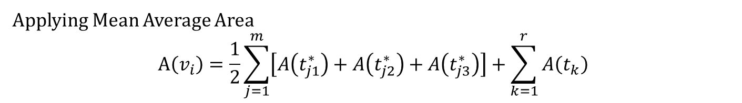
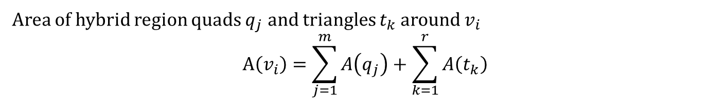
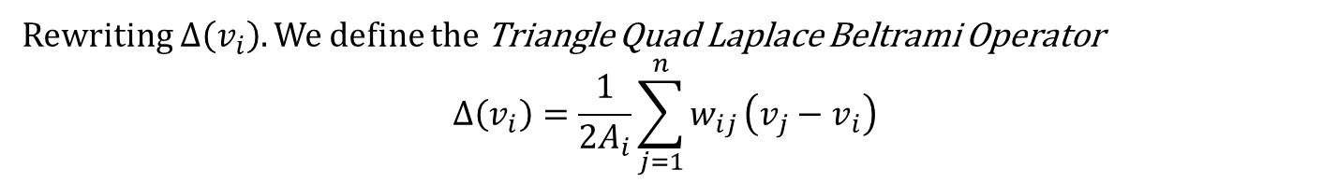
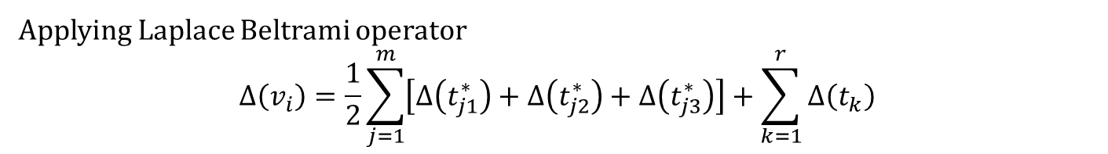
2011 XION’S MLBO OERATOR FOR QUAD MESHES
Area of hybrid region quads $q_{j}$ and triangles $t_{k}$ around $v_{i}$
$$A\left(v_{i}\right)=\sum_{j=1}^{m}{A\left(q_{j}\right)}+\sum_{k=1}^{r}{A\left(t_{k}\right)}$$
Applying Mean Average Area
$$A\left(v_{i}\right)=\frac{1}{2}\sum_{j=1}^{m}{\left[A\left(t_{j1}^{∗}\right)+A\left(t_{j2}^{∗}\right)+A\left(t_{j3}^{∗}\right)\right]}+\sum_{k=1}^{r}{A\left(t_{k}\right)}$$
Applying Laplace Beltrami operator
$$∆\left(v_{i}\right)=\frac{1}{2}\sum_{j=1}^{m}{\left[∆\left(t_{j1}^{∗}\right)+∆\left(t_{j2}^{∗}\right)+∆\left(t_{j3}^{∗}\right)\right]}+\sum_{k=1}^{r}{∆\left(t_{k}\right)}$$
Rewriting $∆\left(v_{i}\right)$. We define the Triangle Quad Laplace Beltrami Operator
$$∆\left(v_{i}\right)=\frac{1}{{2A}_{i}}\sum_{j=1}^{n}{w_{ij}}\left(v_{j}−v_{i}\right)$$

