Slide 1
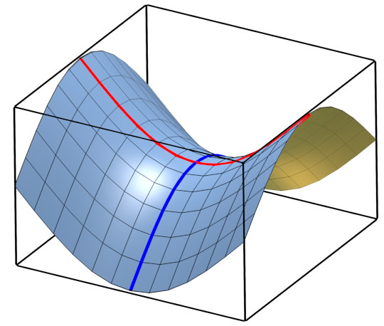
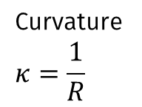

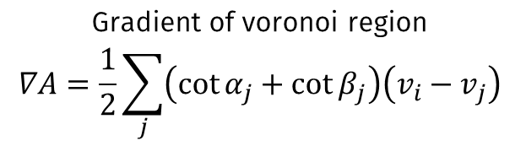

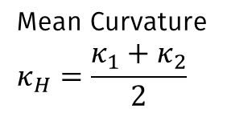

$$κ_{1}$$
$$κ_{2}$$
Curvature
$$κ=\frac{1}{R}$$
Mean Curvature
$$κ_{H}=\frac{κ_{1}+κ_{2}}{2}$$
Gradient of voronoi region
$$∇A=\frac{1}{2}\sum_{j}{\left(\cot{α_{j}}+\cot{β_{j}}\right)\left(v_{i}−v_{j}\right)}$$
Discrete mean curvature normal ${2κ}_{H}n=\frac{∇A}{A}$
Laplace Beltrami operator ${∆S=2κ}_{H}n$

