Slide 1
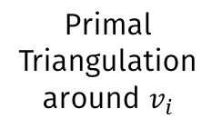
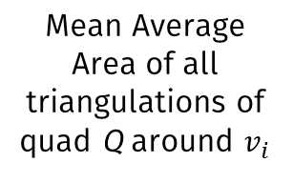
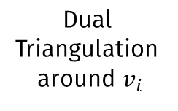
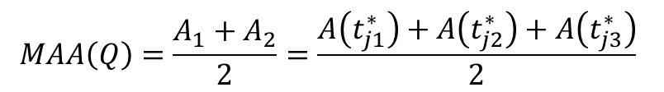
Mean Average Area of all triangulations of quad Q around $v_{i}$
Primal
Triangulation
around $v_{i}$
Dual
Triangulation
around $v_{i}$
$$MAA\left(Q\right)=\frac{A_{1}+A_{2}}{2}=\frac{A\left(t_{j1}^{∗}\right)+A\left(t_{j2}^{∗}\right)+A\left(t_{j3}^{∗}\right)}{2}$$

