Slide 1
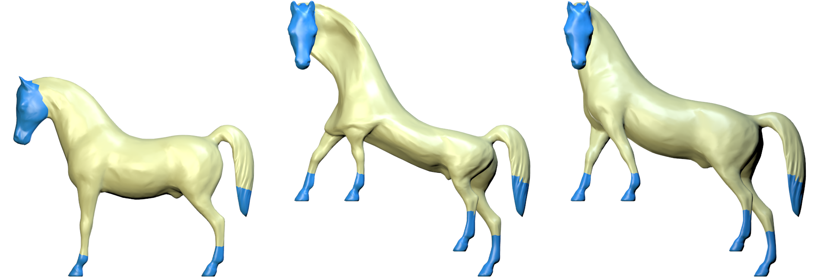
g
g
g
(a)
(b)
(c)

