Slide 1
Sequence

Slide 2
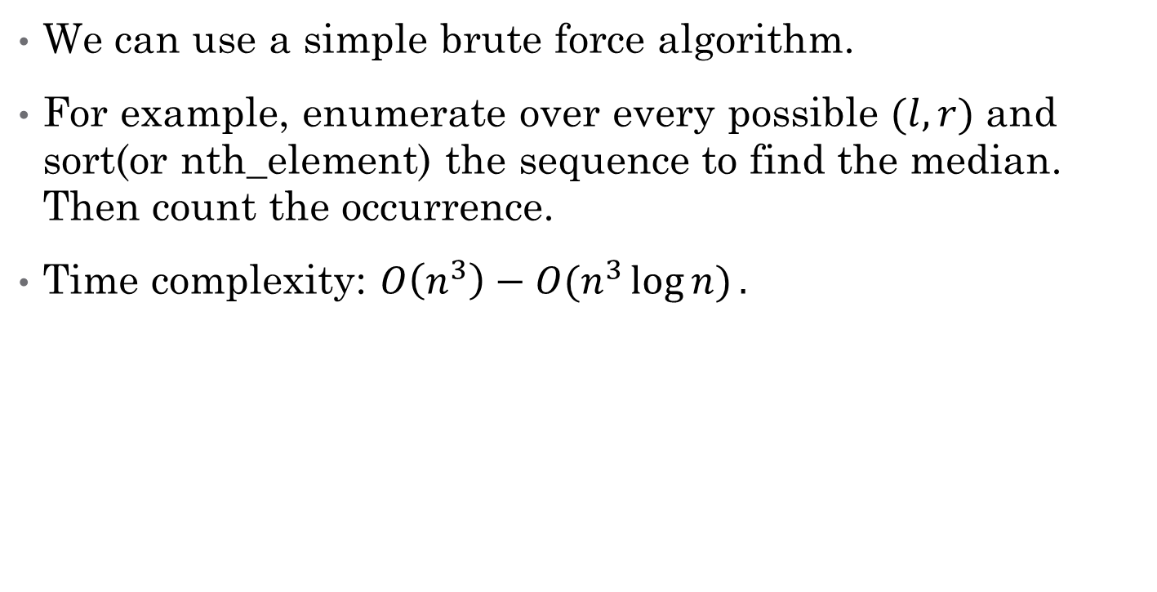
Subtask1
We can use a simple brute force algorithm.
For example, enumerate over every possible $(l,r)$ and sort(or nth_element) the sequence to find the median. Then count the occurrence.
Time complexity: $O\left(n^{3}\right)−O(n^{3}\log{n)}.$

Slide 3
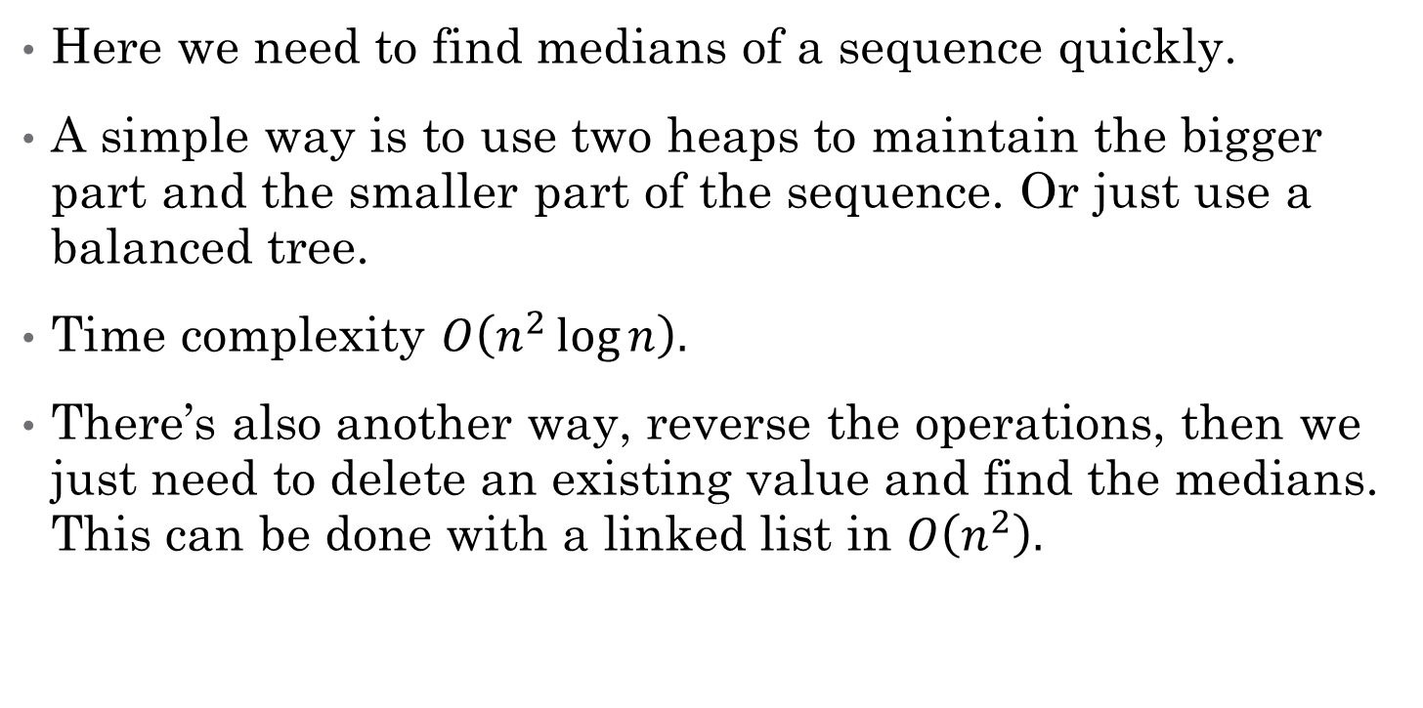
Subtask2
Here we need to find medians of a sequence quickly.
A simple way is to use two heaps to maintain the bigger part and the smaller part of the sequence. Or just use a balanced tree.
Time complexity $O\left(n^{2}\log{n}\right).$
There’s also another way, reverse the operations, then we just need to delete an existing value and find the medians. This can be done with a linked list in $O\left(n^{2}\right).$

Slide 4
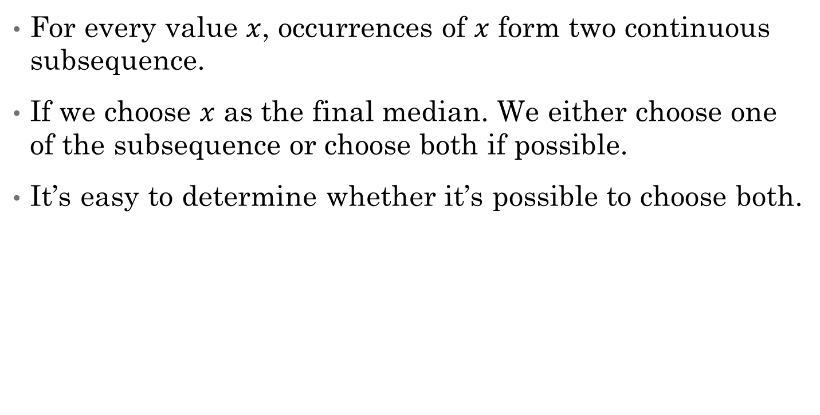
Subtask3
For every value $x$, occurrences of $x$ form two continuous subsequence.
If we choose $x$ as the final median. We either choose one of the subsequence or choose both if possible.
It’s easy to determine whether it’s possible to choose both.

Slide 5
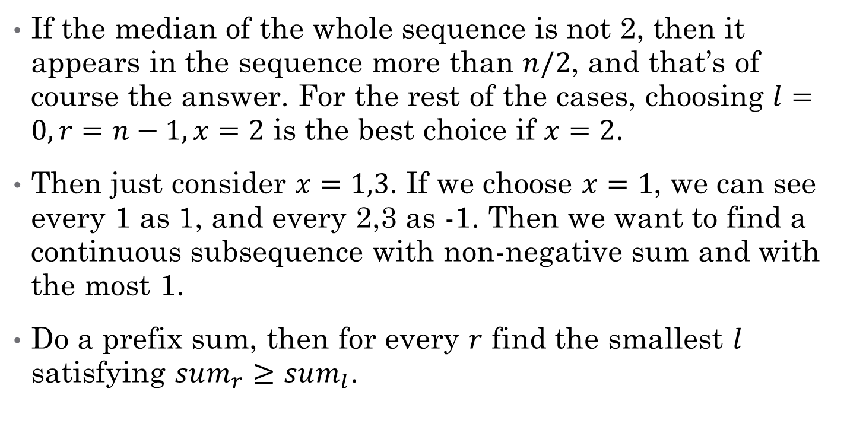
Subtask4
If the median of the whole sequence is not 2, then it appears in the sequence more than $n/2$, and that’s of course the answer. For the rest of the cases, choosing $l=0,r=n−1,x=2$ is the best choice if $x=2$.
Then just consider $x=1,3$. If we choose $x=1$, we can see every 1 as 1, and every 2,3 as -1. Then we want to find a continuous subsequence with non-negative sum and with the most 1.
Do a prefix sum, then for every $r$ find the smallest $l$ satisfying $sum_{r}≥sum_{l}$.

Slide 6
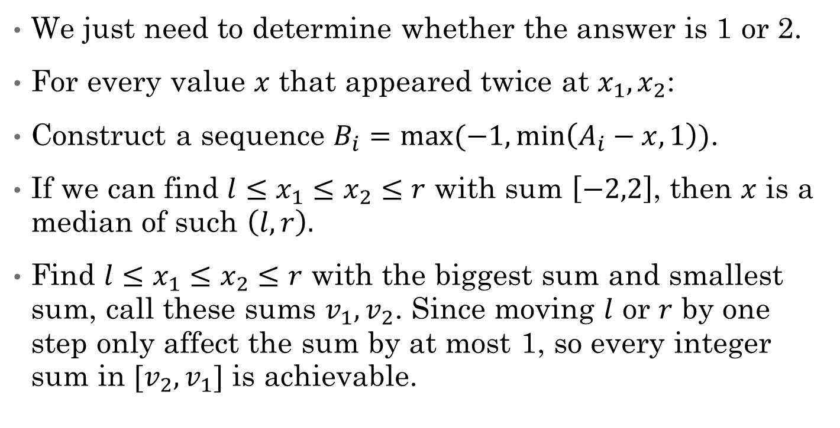
Subtask5
We just need to determine whether the answer is 1 or 2.
For every value $x$ that appeared twice at $x_{1},x_{2}$:
Construct a sequence $B_{i}=max⁡(−1,\min\left(A_{i}−x,1\right))$.
If we can find $l≤x_{1}≤x_{2}≤r$ with sum $\left[−2,2\right]$, then $x$ is a median of such $\left(l,r\right).$
Find $l≤x_{1}≤x_{2}≤r$ with the biggest sum and smallest sum, call these sums $v_{1},v_{2}$. Since moving $l$ or $r$ by one step only affect the sum by at most 1, so every integer sum in $[v_{2},v_{1}]$ is achievable.

Slide 7
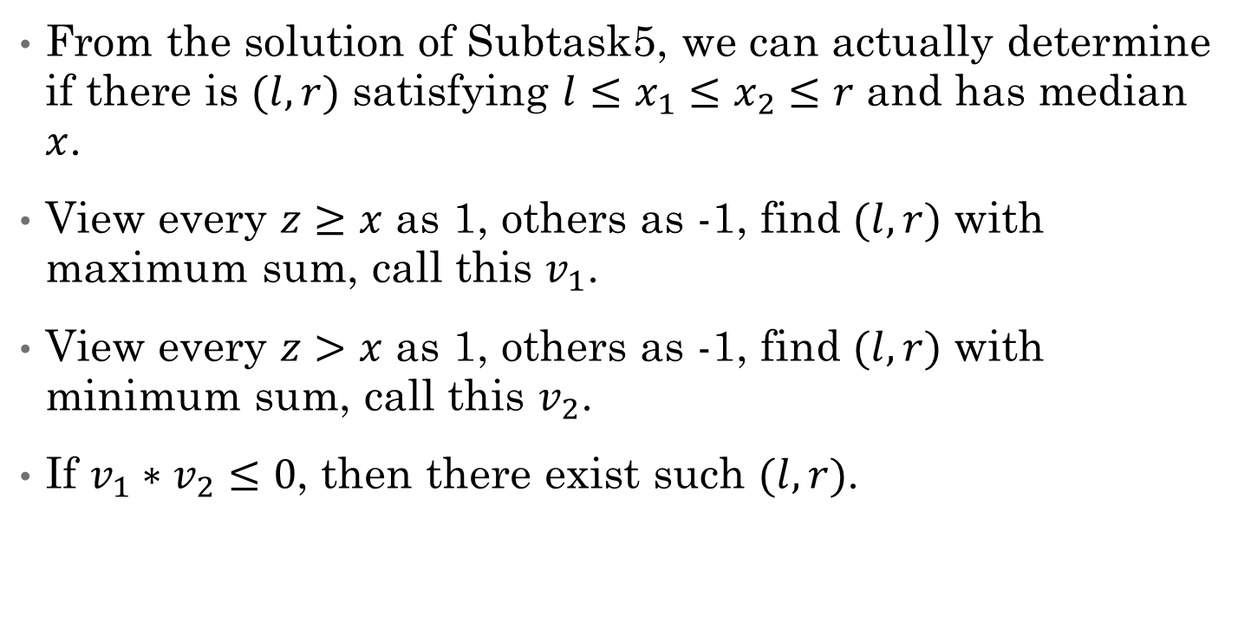
Subtask 6&7
From the solution of Subtask5, we can actually determine if there is $(l,r)$ satisfying $l≤x_{1}≤x_{2}≤r$ and has median $x$.
View every $z≥x$ as 1, others as -1, find $(l,r)$ with maximum sum, call this $v_{1}$.
View every $z>x$ as 1, others as -1, find $(l,r)$ with minimum sum, call this $v_{2}$.
If $v_{1}∗v_{2}≤0$, then there exist such $(l,r)$.

Slide 8
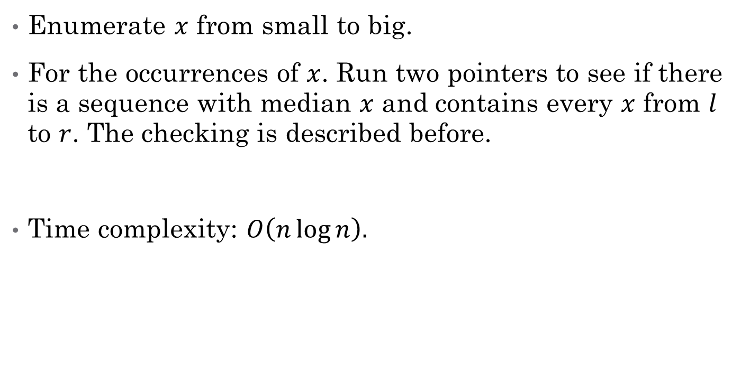
Subtask 6&7
Enumerate $x$ from small to big.
For the occurrences of $x$. Run two pointers to see if there is a sequence with median $x$ and contains every $x$ from $l$ to $r$. The checking is described before.
Time complexity: $O\left(n\log{n}\right).$

