Slide 1

Text Preprocessing and NLP Steps
WEEK 3

Slide 2
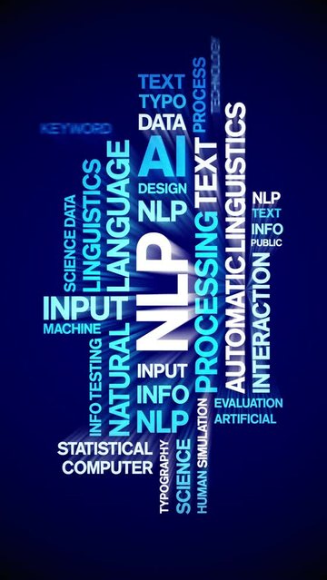
Week 2
Natural Language Processing
NLP Overview
NLP Applications
IBM Project Debater
Summary and Resources

Slide 3
NLP Steps
Segmentation
Tokenizing Removing Stop Words
Stemming Lemmatization Part of Speech Tagging
Named Entity Detection

Slide 4
Segmentation
The first action is to break down the entire text into sentences, snippets, noun phrases, most of which are already denoted by commas, semicolons, periods, and other punctuation.
Away from the city lights
Away from the city lights, we were able to see the Milky Way.
we were able to see the Milky Way

Slide 5
Segmentation Example
import nltk
from nltk.tokenize import sent_tokenize
# Download the tokenizer models (only once)
nltk.download('punkt')
# Sample paragraph
text = "Away from the city lights, we were able to see the Milky Way."
# Split into sentences
sentences = sent_tokenize(text)
# Show the segmented sentences
print("Segmented Sentences:")
for i, sentence in enumerate(sentences, 1):
print(f"{i}. {sentence}")
Segmented Sentences:
Away from the city lights,
we were able to see the Milky Way.

Slide 6
Tokenization
To help the algorithm understand a sentence, we first need to break it down into individual words and look at each one separately.
This process is called tokenizing, and each word we extract is known as a token. By doing this, we make it easier for the algorithm to process and analyze the sentence.
we were able to see the Milky Way
We
were
able
to
see
the
Milky
Way

Slide 7
Tokenized
import nltk
from nltk.stem import PorterStemmer, WordNetLemmatizer
from nltk.tokenize import word_tokenize
# Download required data
nltk.download('punkt')
nltk.download('wordnet')
nltk.download('omw-1.4')
# Initialize stemmer and lemmatizer
stemmer = PorterStemmer()
lemmatizer = WordNetLemmatizer()
# Example sentence
sentence = "The runners were running and caring about their connections."
# Tokenize the sentence
tokens = word_tokenize(sentence)
# Apply stemming
stemmed = [stemmer.stem(word) for word in tokens]
# Apply lemmatization
lemmatized = [lemmatizer.lemmatize(word) for word in tokens]
# Print results
print("Original :", tokens)
print("Stemmed :", stemmed)
print("Lemmatized :", lemmatized)
Original : ['The', 'runners', 'were', 'running', 'and', 'caring', 'about', 'their', 'connections', '.'] Stemmed : ['the', 'runner', 'were', 'run', 'and', 'care', 'about', 'their', 'connect', '.’] Lemmatized : ['The', 'runner', 'were', 'running', 'and', 'caring', 'about', 'their', 'connection', '.']

Slide 8
Removing the Stop Words
To speed up the learning process, we remove common words that don’t add much meaning to a sentence. These words—like from, the, to, the, and—are called stop words. Removing them helps the algorithm focus on the essential parts of the text.
import nltk
from nltk.corpus import stopwords
from nltk.tokenize import word_tokenize
# Download stopwords (only needed once)
nltk.download('punkt')
nltk.download('stopwords')
# Sample sentence
text = "Away from the city lights, we were able to see the Milky Way"
# Step 1: Tokenize the sentence
tokens = word_tokenize(text)
# Step 2: Remove stop words
stop_words = set(stopwords.words('english'))
filtered_tokens = [word for word in tokens if word.lower() not in stop_words]
# Print results
print("Original tokens:", tokens)
print("Filtered tokens (no stop words):", filtered_tokens)
Original tokens: ['Away', 'from', 'the', 'city', 'lights', ',', 'we', 'were', 'able', 'to', 'see', 'the', 'Milky', 'Way’] Filtered tokens (no stop words): ['Away', 'city', 'lights', ',', 'able', 'see', 'Milky', 'Way']

Slide 9
Stemming
Stemming is a common NLP technique that reduces a word to its base or root form (called the stem), often by chopping off suffixes. It helps group together words with similar meanings so they can be analyzed as one.
import nltk
from nltk.stem import PorterStemmer
from nltk.tokenize import word_tokenize
# Download necessary data if running for the first time
nltk.download('punkt')
# Create stemmer
stemmer = PorterStemmer()
# Example sentence
sentence = "we were able to see the Milky Way"
# Tokenize sentence
tokens = word_tokenize(sentence)
# Stem each word
stemmed_words = [stemmer.stem(word) for word in tokens]
# Show results
print("Original words:", tokens)
print("Stemmed words :", stemmed_words)
Stemming is fast and simple, but it sometimes over-stems (like able → abl or Milky → milki),
which is why lemmatization is sometimes preferred when accuracy matters.
Original words: ['we', 'were', 'able', 'to', 'see', 'the', 'Milky', 'Way’]
Stemmed words : ['we', 'were', 'abl', 'to', 'see', 'the', 'milki', 'way']

Slide 10
Lemmatization
import nltk
from nltk.stem import PorterStemmer, WordNetLemmatizer
from nltk.tokenize import word_tokenize
# Download required data
nltk.download('punkt')
nltk.download('wordnet')
nltk.download('omw-1.4')
# Initialize stemmer and lemmatizer
stemmer = PorterStemmer()
lemmatizer = WordNetLemmatizer()
# Example sentence
sentence = "we were able to see the Milky Way"
# Tokenize the sentence
tokens = word_tokenize(sentence)
# Apply stemming
stemmed = [stemmer.stem(word) for word in tokens]
# Apply lemmatization
lemmatized = [lemmatizer.lemmatize(word) for word in tokens]
# Print results
print("Original :", tokens)
print("Stemmed :", stemmed)
print("Lemmatized :", lemmatized)
Lemmatization is the process of finding the base or dictionary form of a word, known as the lemma.
It turns words like "running", "ran", or "runs" into "run"
The lemma is always a real word you’d find in a dictionary
It uses grammar rules (like tense, mood, or number) to choose the correct base form
For example:
"better" → "good" (because it knows "better" is a comparative form)
Original : ['we', 'were', 'able', 'to', 'see', 'the', 'Milky', 'Way’]
Stemmed : ['we', 'were', 'abl', 'to', 'see', 'the', 'milki', 'way'] Lemmatized : ['we', 'were', 'able', 'to', 'see', 'the', 'Milky', 'Way']

Slide 11
POS: Part of Speech
Every word in English sentences fall into nine major POS types. They are
adjectives,
verbs,
pronouns,
conjunctions,
prepositions,
articles (determiners),
adverbs,
nouns, and
interjections
Part-of-Speech (POS) Tagging means labeling each word in a sentence with its role or function. It answers the following questions:
What kind of word is this?
Is it a noun (thing)?
A verb (action)?
An adjective (description)?
Example:
The quick brown fox jumps over the lazy dog. → “The” = determiner, “fox” = noun, “jumps” = verb

Slide 12
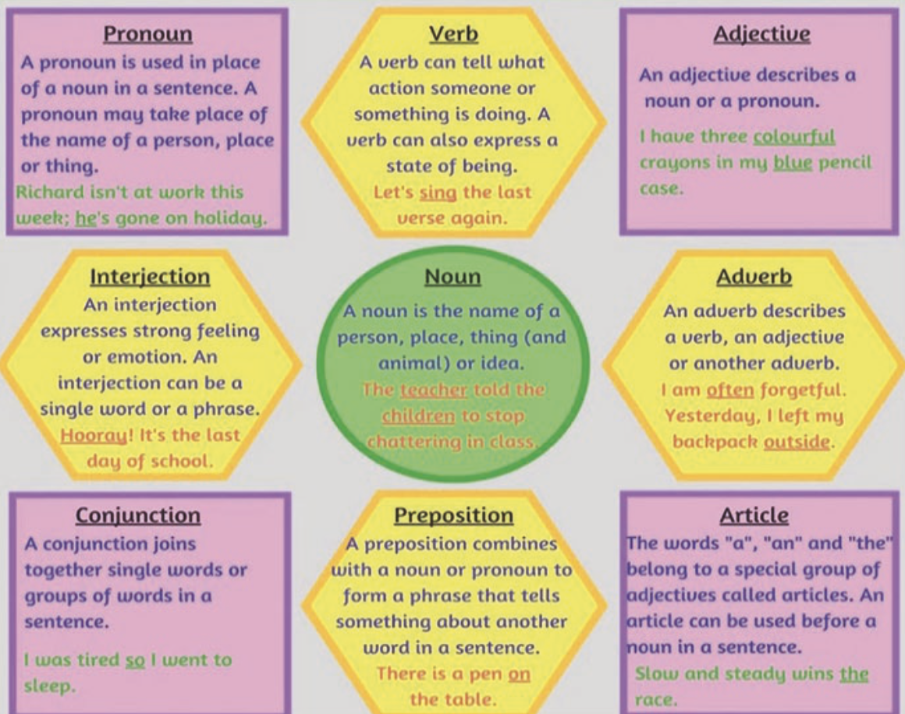
Example of POS tagging
Word | Part of Speech | Why?
Wow | Interjection | Expresses emotion/surprise
The | Article (Determiner) | Points to a specific noun
excited | Adjective | Describes the noun "dog"
dog | Noun | Person/place/thing
quickly | Adverb | Describes how the dog ran
ran | Verb | Action word
across | Preposition | Shows relationship (direction)
the | Article (Determiner) | Again points to a specific noun
yard | Noun | Place
because | Conjunction | Connects clauses
it | Pronoun | Replaces "dog"
saw | Verb | Action (past tense)
another | Adjective | Describes "cat"
cat | Noun | Thing
Wow! The excited dog quickly ran across the yard because it saw another cat.

Slide 13
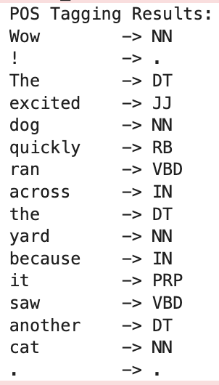
Example of POS Tagging
Run this code in Anaconda:
import nltk
from nltk import word_tokenize, pos_tag
# Download necessary data (only the first time)
nltk.download('punkt')
nltk.download('averaged_perceptron_tagger')
# Sample sentence
sentence = "Wow! The excited dog quickly ran across the yard because it saw another cat."
# Step 1: Tokenize the sentence
tokens = word_tokenize(sentence)
# Step 2: POS tagging
tagged = pos_tag(tokens)
# Output results
print("POS Tagging Results:")
for word, tag in tagged:
print(f"{word:10} -> {tag}")
You’ll see tags like:
NN – Noun
VB – Verb (base)
VBD – Verb (past tense)
JJ – Adjective
RB – Adverb
DT – Determiner
IN – Preposition
PRP – Pronoun
UH – Interjection
CC – Conjunction

Slide 14
Named Entity Recognition
What is Named Entity Recognition (NER)?
Named Entity Recognition (NER) is a process in NLP where we identify and classify proper nouns in a sentence into predefined categories, such as:
🧑 Person (e.g., "Barack Obama")
🏙️ Location (e.g., "New York")
🏢 Organization (e.g., "Google")
📅 Date/Time (e.g., "January 1st", "next week")
💲 Money/Percentage (e.g., "$1,000", "20%")
Why is NER Important?
NER helps machines understand real-world entities in text, making it essential for:
✉️ Email filtering
📰 News categorization
🏛️ Legal and medical document analysis
💬 Chatbots and digital assistants
📊 Search engines and summarization tools
It’s how a computer knows that "Amazon" is a company, not just a forest.

Slide 15
LECTURE 3
Natural Language Processing and Virtual Agents
NLP Overview
Virtual Agents Overview
IBM Project Debater
Resources

Slide 16
Resources
Beginner Guide to Natural Language Processing https://developer.ibm.com/articles/a-beginners-guide-to-natural-language-processing/
IBM Project Debater
https://youtu.be/3_yy0dnIc58
What is NLP (Natural Language Processing)?
https://www.youtube.com/watch?v=fLvJ8VdHLA0
NLP vs NLU vs NLG
https://www.youtube.com/watch?v=1I6bQ12VxV0
The History of Natural Language Processing (NLP)
https://www.youtube.com/watch?v=Uuz8ZTV5vdA
Types of Natural Language Processing (NLP)
https://www.youtube.com/watch?v=oxzhX_XaEI8
16

