Slide 1
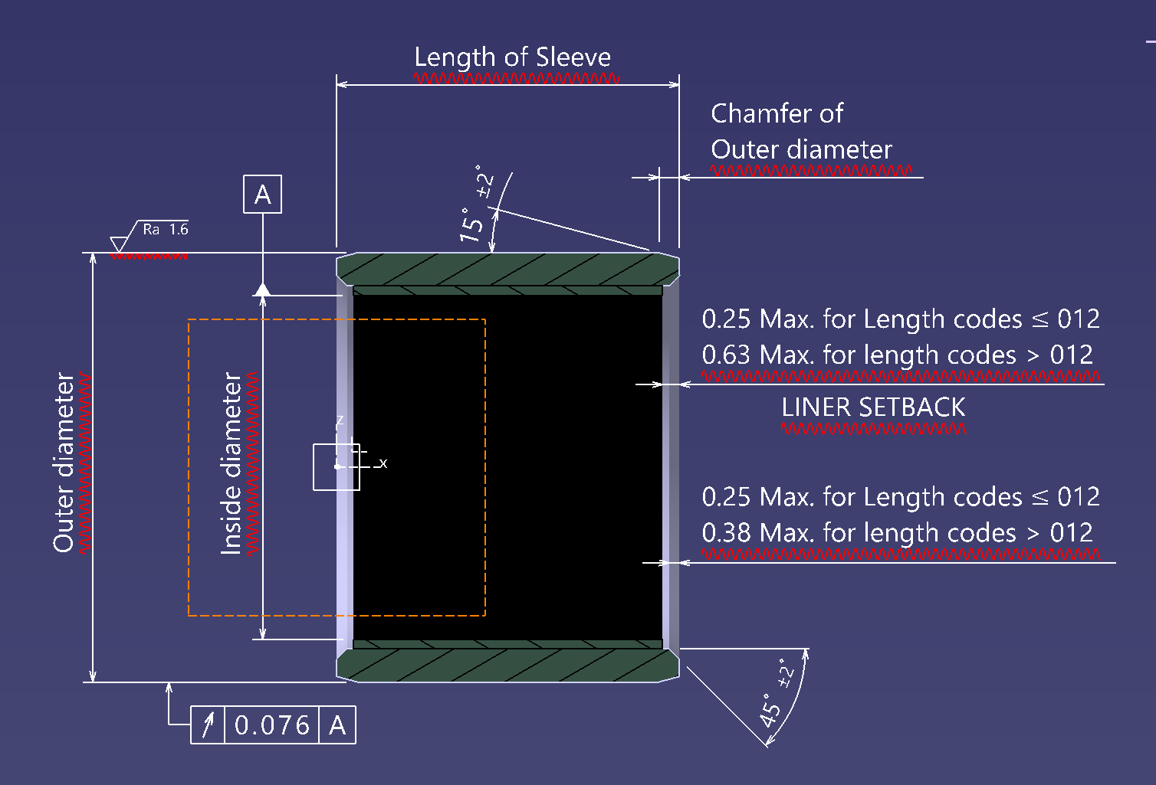
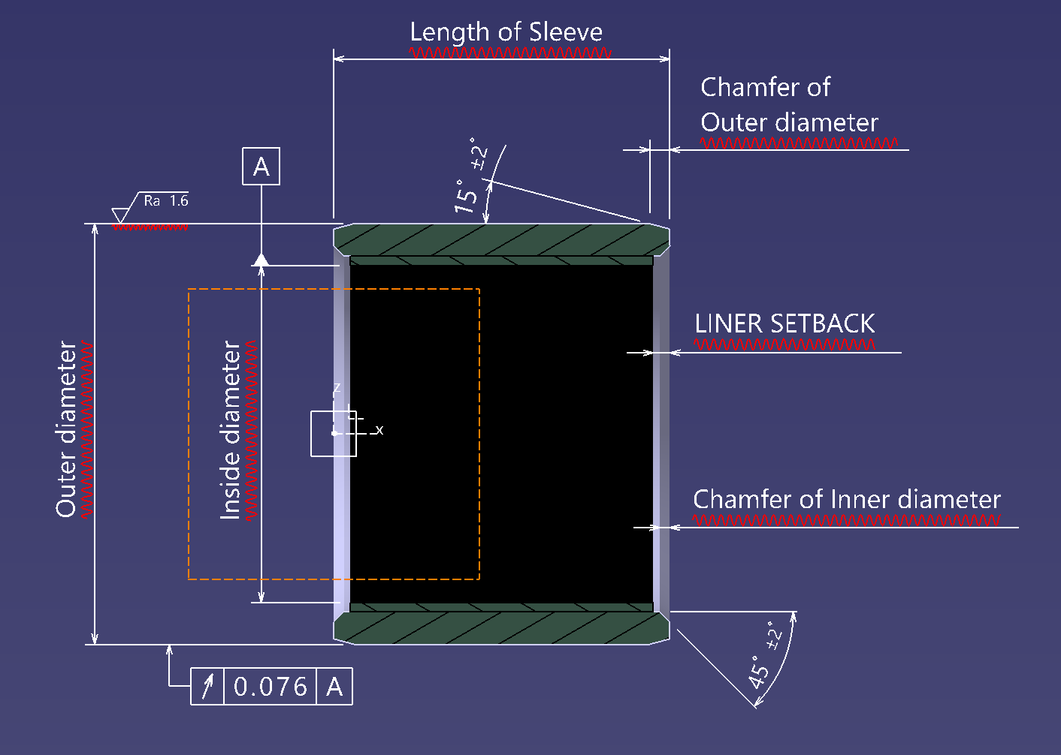
Final Drawing: AS81934/1

Slide 2
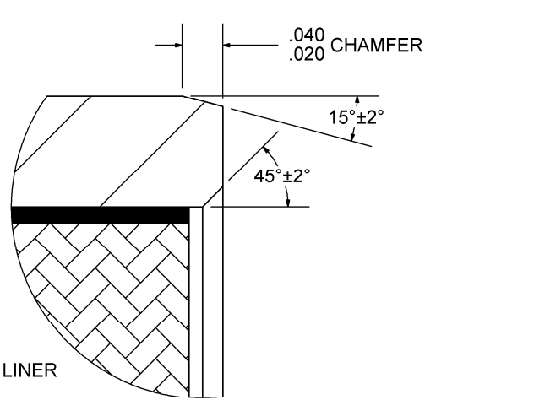
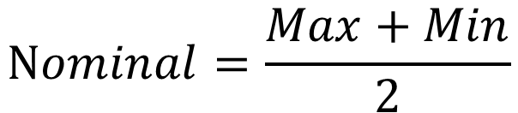
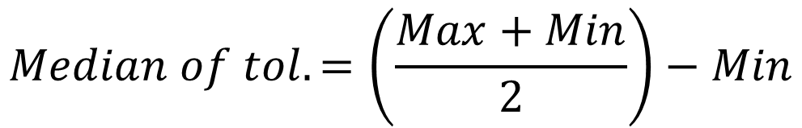
Final Drawing: AS81934/1
$$Nominal=\frac{Max+Min}{2}$$
$$Median of tol. =\left(\frac{Max+Min}{2}\right)−Min$$

Slide 3
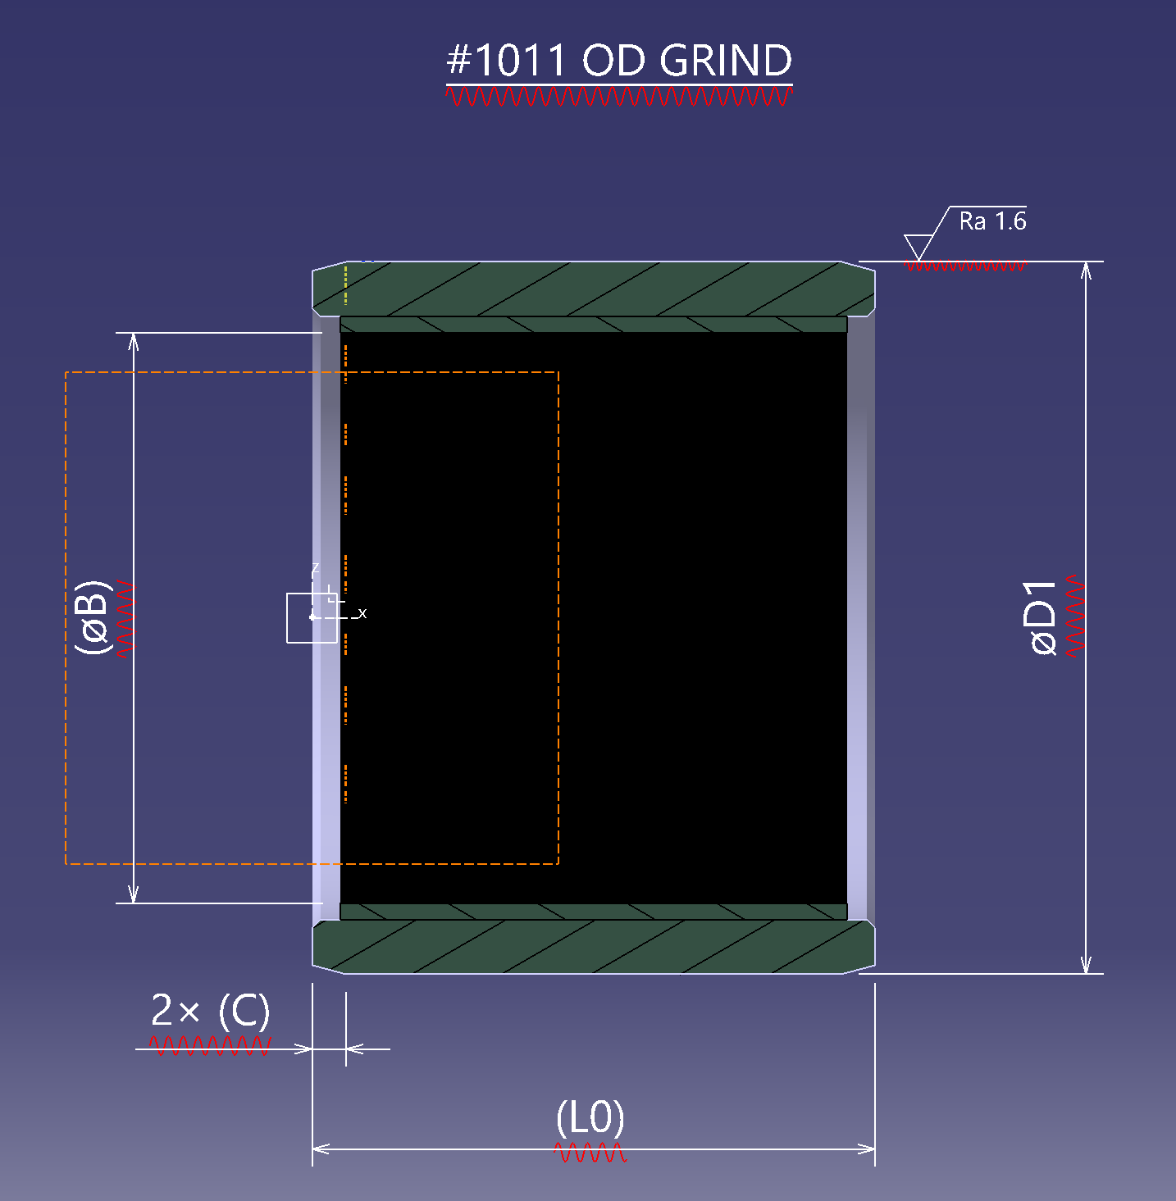
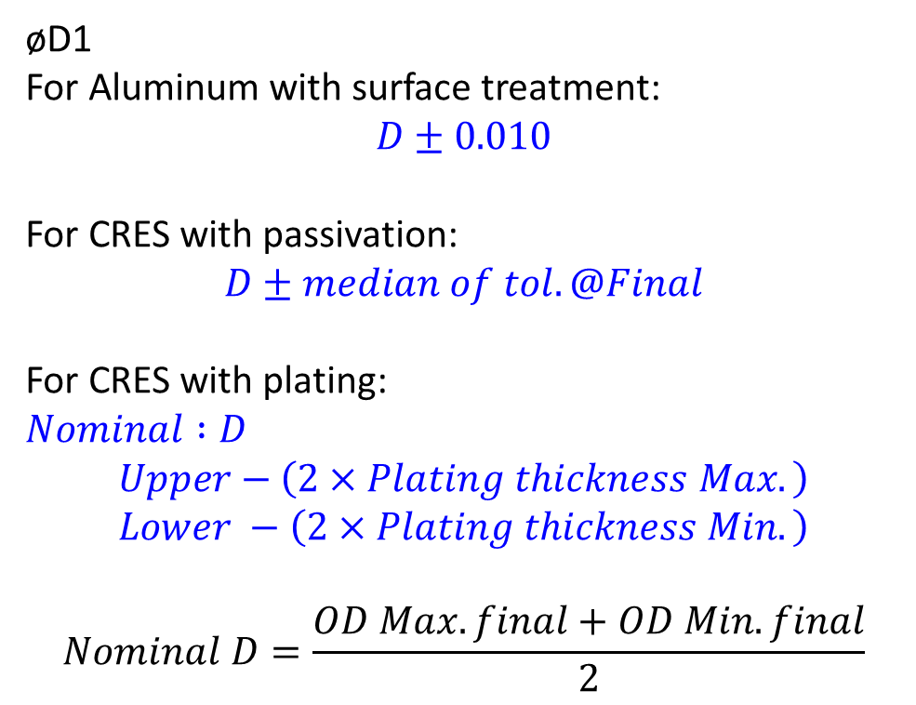
#1011 OD GRIND: AS81934/1
øD1
For Aluminum with surface treatment:
$$D±0.010$$
For CRES with passivation:
$$D±median of tol. @Final$$
For CRES with plating:
$$Nominal :D$$
$$Upper−\left(2×Plating thickness Max.\right)$$
$$Lower −\left(2×Plating thickness Min.\right)$$
$$Nominal D=\frac{OD Max. final+OD Min. final}{2}$$

Slide 4
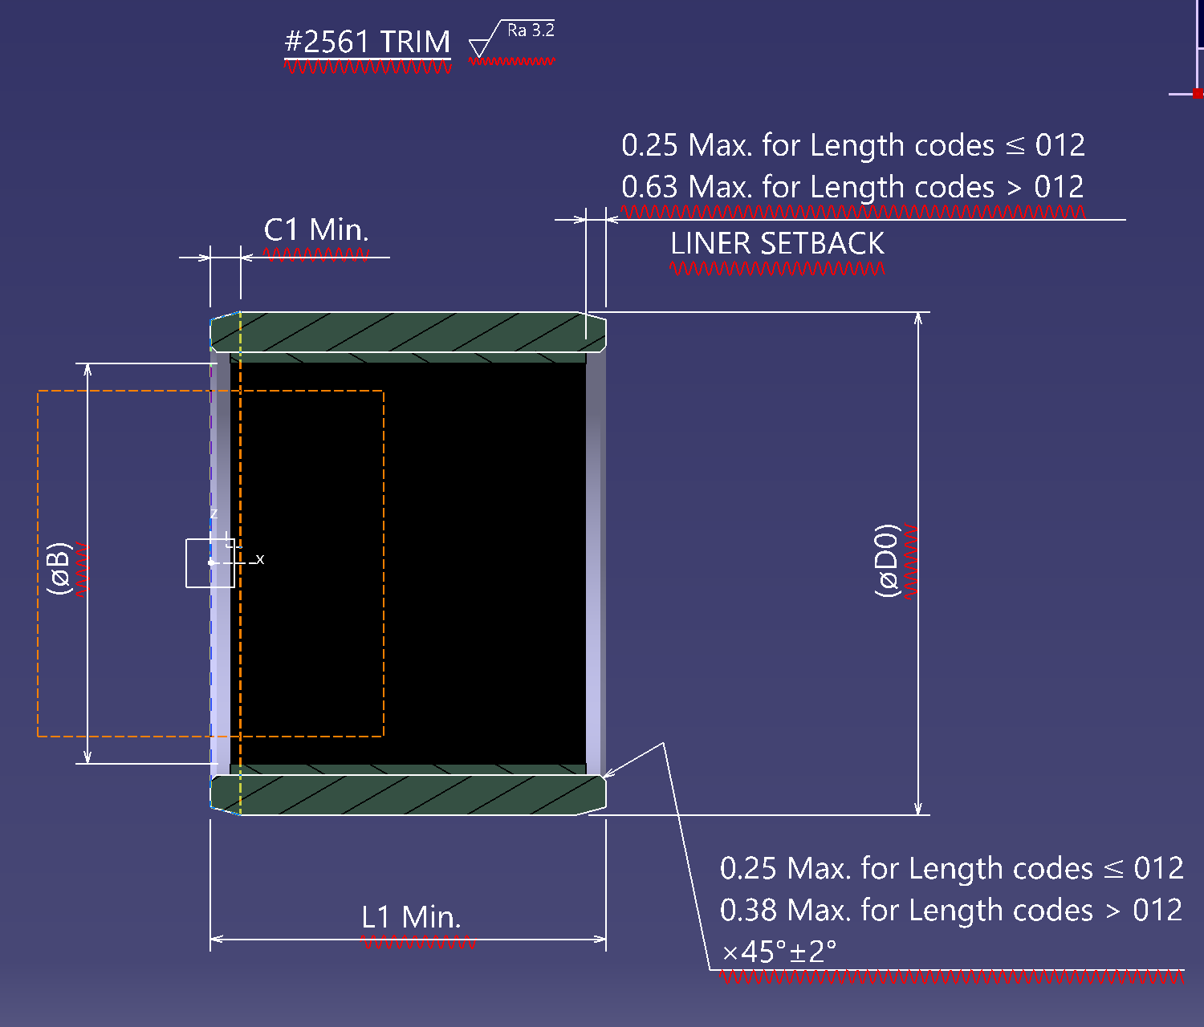
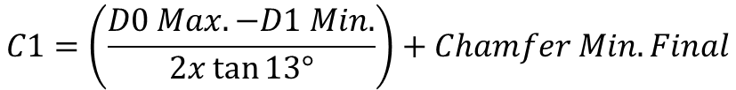
#2561 TRIM: AS81934/1
$$C1=\left(\frac{D0 Max. −D1 Min.}{2x\tan{13°}}\right)+Chamfer Min.Final$$
$$L1 Min=Minimum value of final length$$

Slide 5
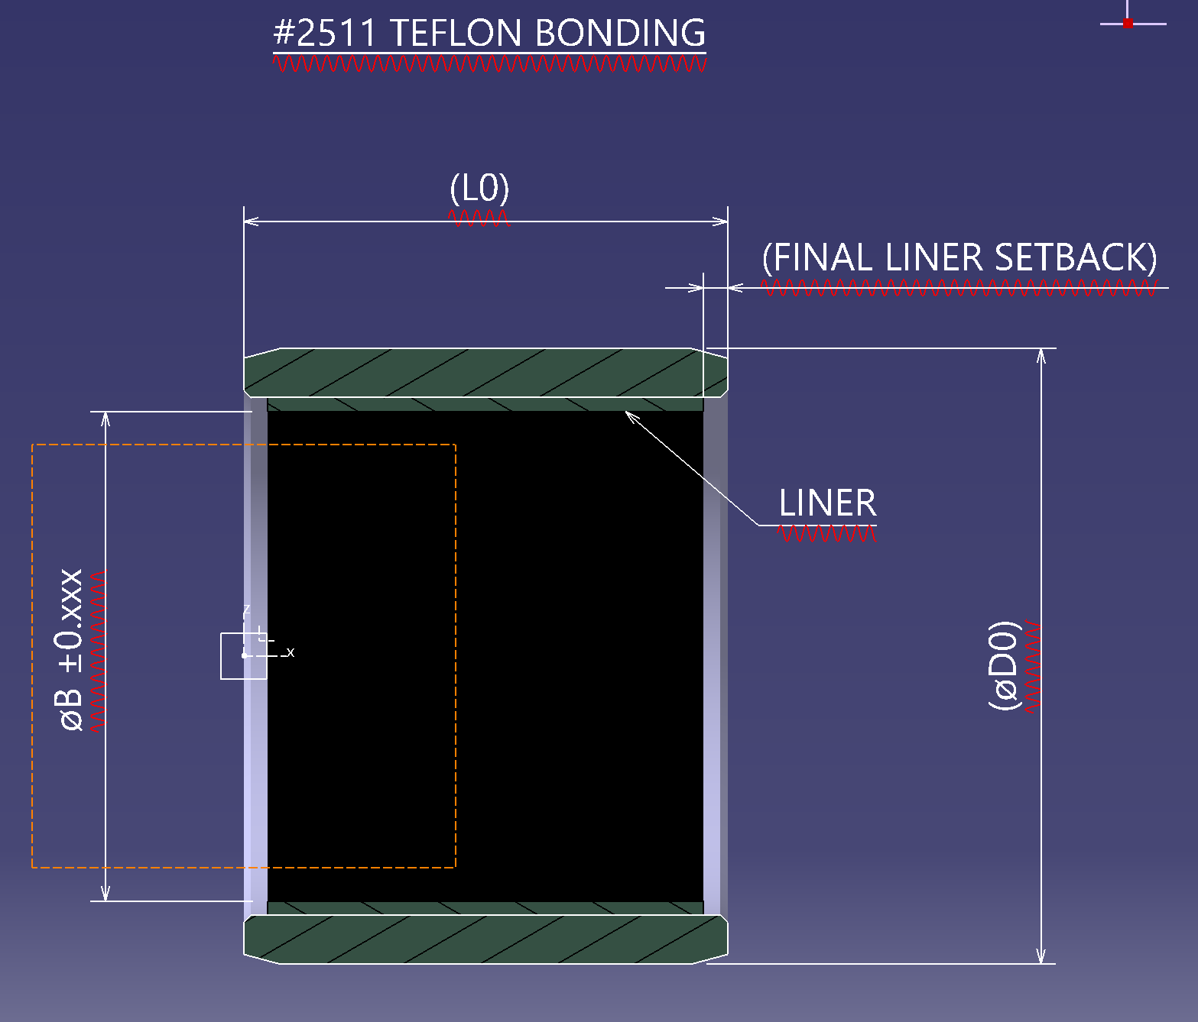


#2511 TEFLON BONDING: AS81934/1
$$Nominal of ∅B=\left(\frac{∅B Max. final+∅B Min final}{2}\right)$$
$$Tol. = \frac{Tol. Max. +Tol. Min}{2}$$

Slide 6
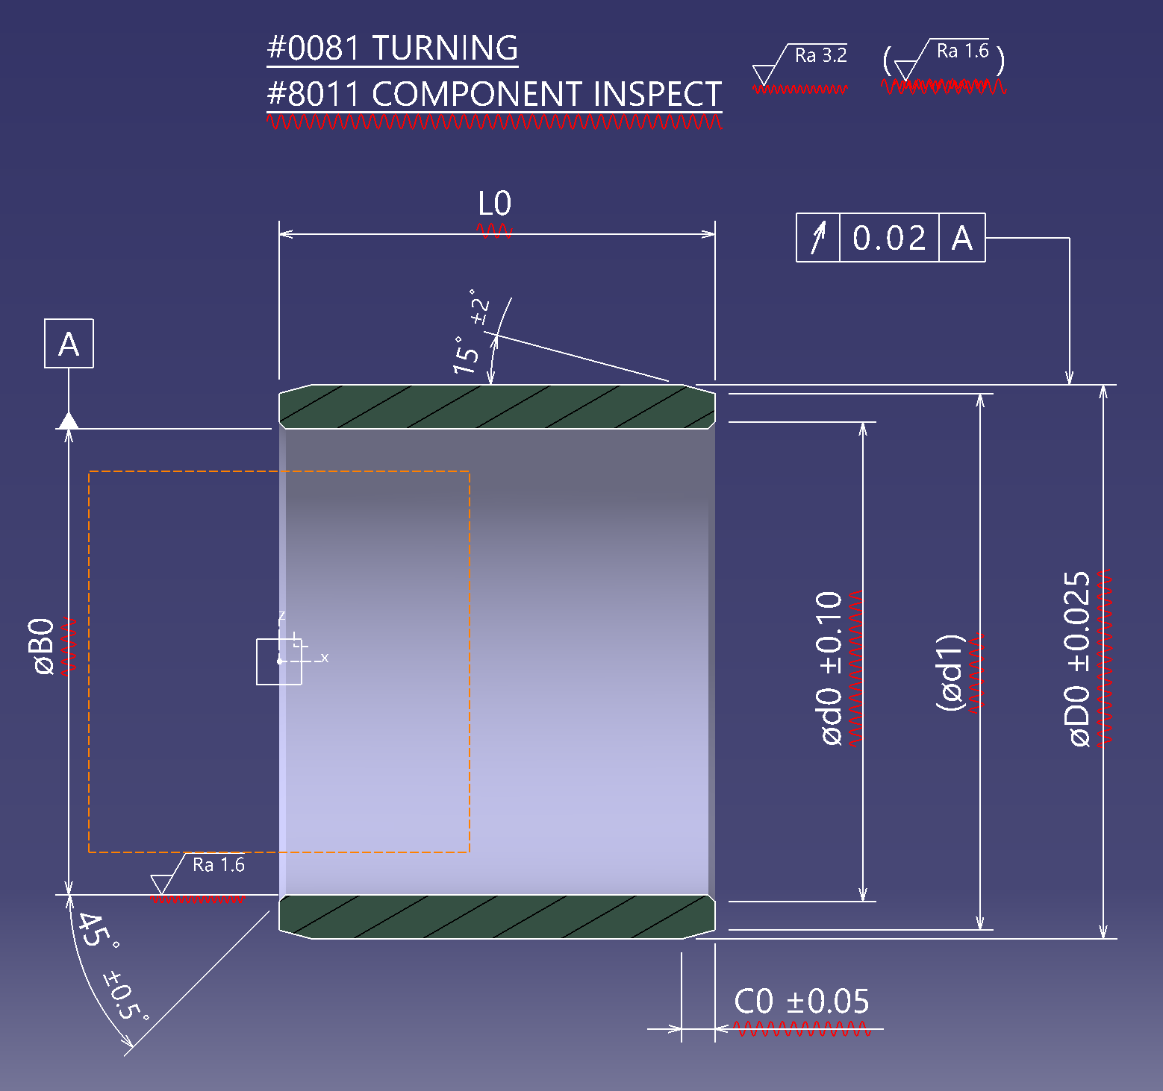
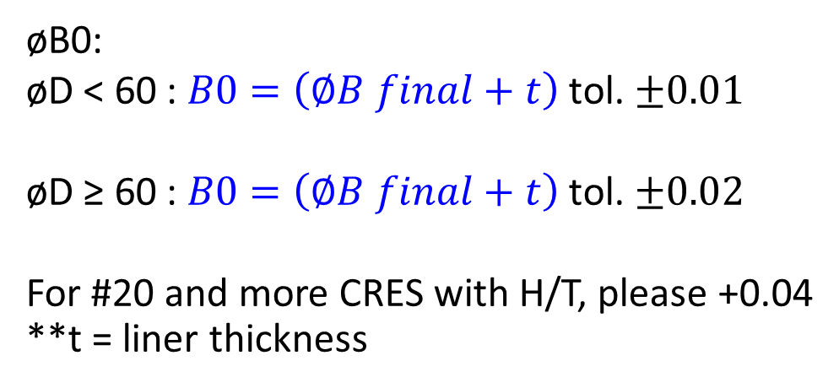
#0081 TURNING: AS81934/1
øB0:
øD < 60 : $B0=\left(∅B final+t\right)$ tol. $±0.01$
øD ≥ 60 : $B0=\left(∅B final+t\right)$tol. $±0.02$
For #20 and more CRES with H/T, please +0.04
**t = liner thickness
Teflon Material | t
X-1118 | 0.540
X-1820 | 0.734
X-1820ENR | 0.600
RE23020, RE23016

Slide 7
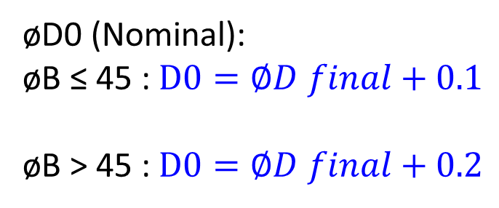
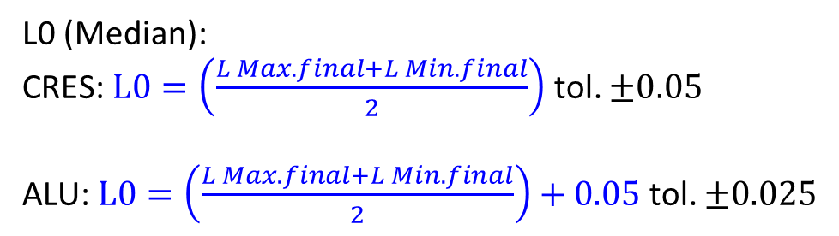
#0081 TURNING: AS81934/1
øD0 (Nominal):
øB ≤ 45 : $D0=∅D final+0.1$
øB > 45 : $D0=∅D final+0.2$
L0 (Median):
CRES: $L0=\left(\frac{L Max. final+L Min. final}{2}\right)$ tol. $±0.05$
ALU: $L0=\left(\frac{L Max. final+L Min. final}{2}\right)+0.05$ tol. $±0.025$

Slide 8

#0081 TURNING: AS81934/1
øD0 (Nominal):
øB ≤ 45 : $D0=∅D final+0.1$
øB > 45 : $D0=∅D final+0.2$

Slide 9
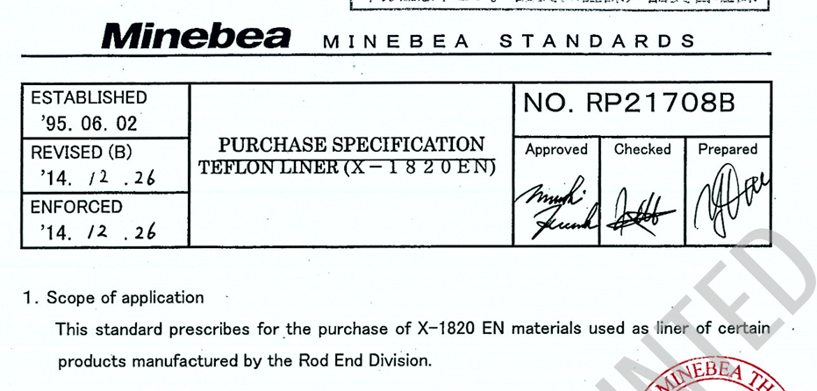
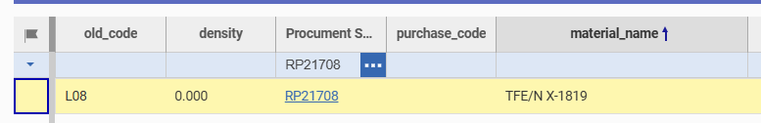
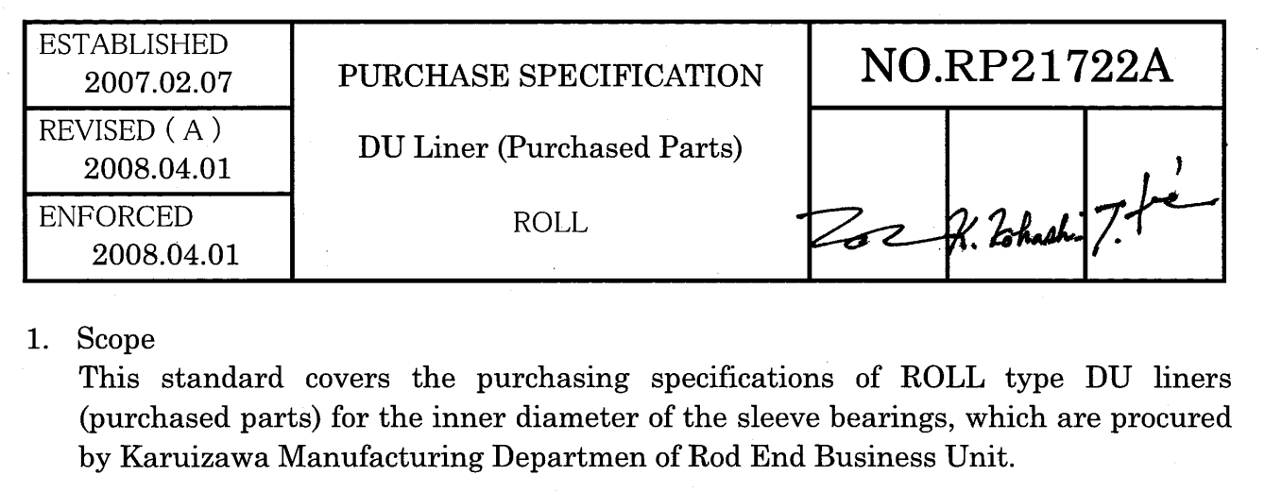
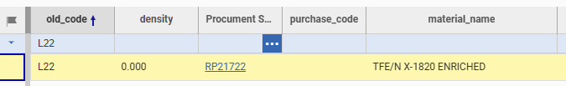
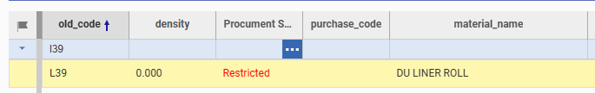
The document title and number do not match.
No attached file

Slide 10
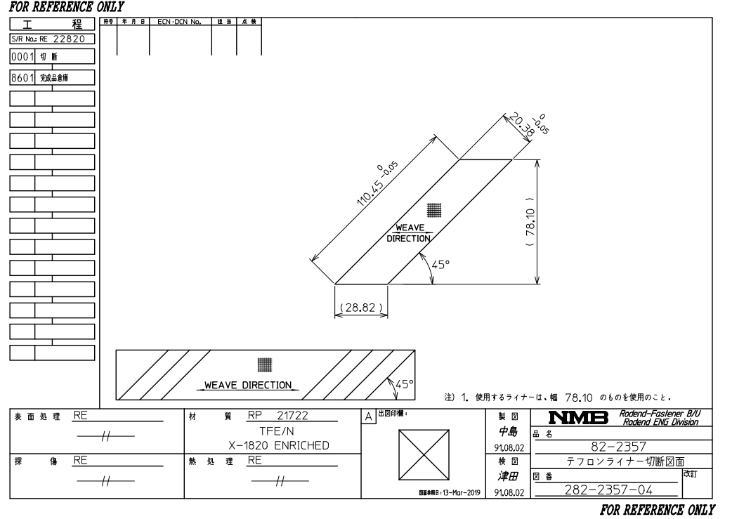
Drawing liner specifies with RP21722 for X-1820 ENR

