Slide 1
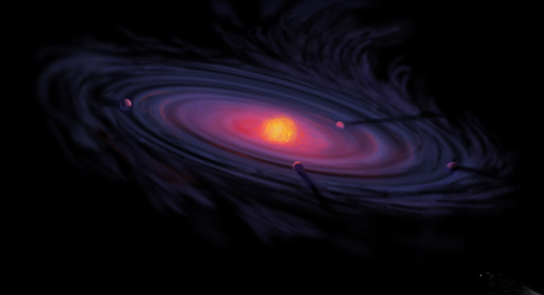
The Role of Ice Composition and Morphology for Snowlines and the C/N/O Ratios in Active Disks
Ana-Maria Piso¹
Karin Öberg¹, Ruth Murray-Clay², Til Birnstiel^{1,3}
ITC Luncheon: February 18th, 2016
¹Harvard-Smithsonian Center for Astrophysics
²University of California Santa Barbara
³MPIA, Heidelberg

Slide 2
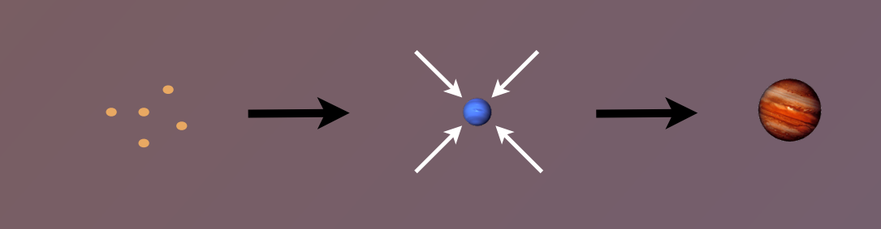
Core Accretion Model
The composition of planets is determined by and tightly linked to the disk composition

Slide 3
Disk Compositions Regulate Planet Compositions
Understand the disk well enough to:
Predict what kind of planet compositions result from planet formation in different parts of the disk
Back-track the planet formation location based on the planet composition

Slide 4
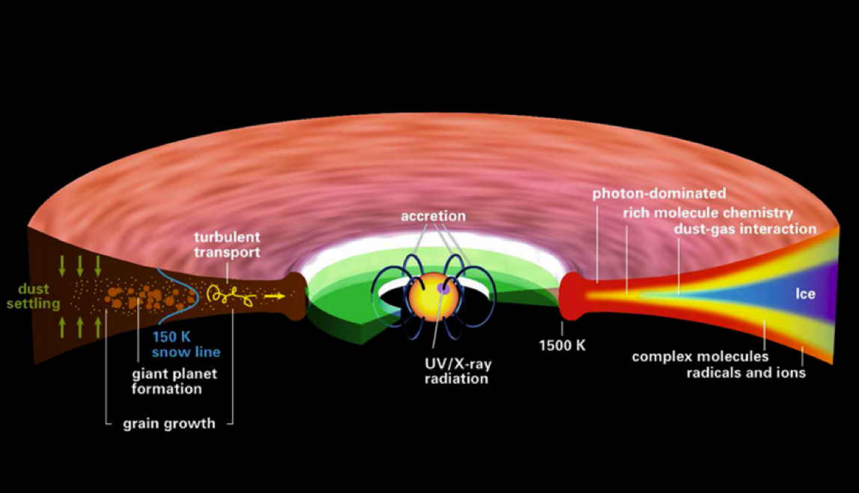
Disk structure is complex!
Henning&Semenov (2013)
Notes:
Remove the while and make the figure bigger.

Slide 5
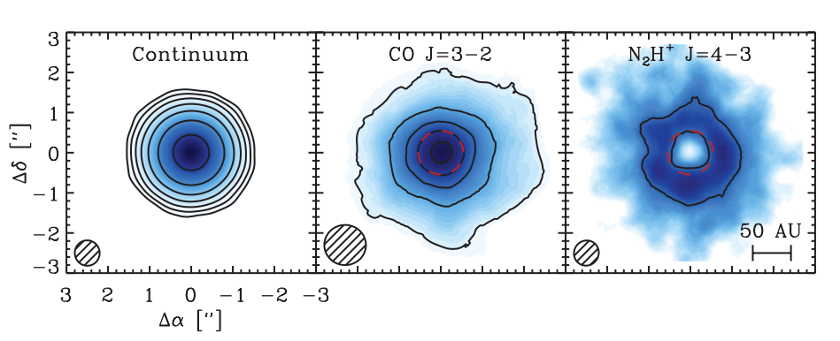
Snowlines of volatile molecules have been detected in disks
Qi+13

Slide 6
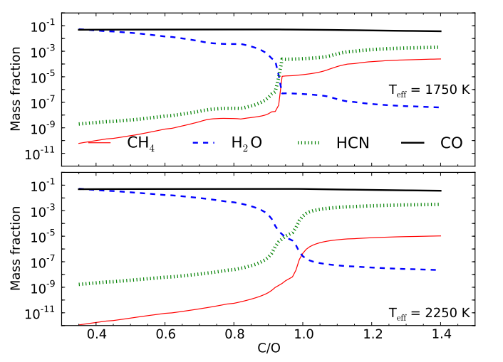
C/O ratio is an important signature of atmospheric chemistry
Molliere+15

Slide 7
C/O ratios in gas and dust are different at different radii
Main carriers of C and O, i.e. H₂O, CO₂ and CO, have different condensation temperatures => variations in the abundances of C and O in solids and gas between the snow lines of these volatiles

Slide 8
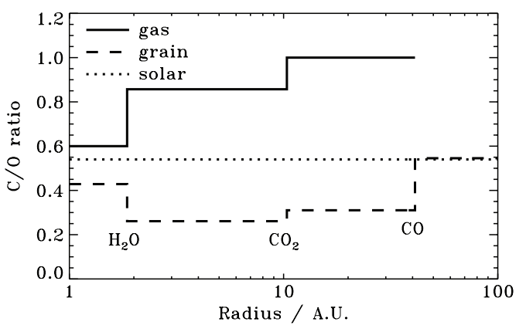
Oberg+11
After Oberg+11

Slide 9
Understand how particle composition, morphology and disk dynamics (RADIAL DRIFT AND VISCOUS GAS ACCRETION) affect snowline locations, and thus the C/N/O ratios in gas and dust throughout the disk
GOAL

Slide 10
Timescales for desorption, radial drift and gas accretion ARE comparable
Piso, Oberg, Birnstiel, Murray-Clay (2015)

Slide 11
We determined upper limits for the C/O ratio across the disk
Piso, Oberg, Birnstiel, Murray-Clay (2015)

Slide 12
Volatile snowline locations depend on the binding environment
Piso, Oberg, Pegues (2016, in prep)

Slide 13
N/O ratios may be used as tracers of atmospheric chemistry
Piso, Oberg, Pegues (2016, in prep)

Slide 14
Summary
Radial drift and gas accretion affect desorption and move the snowline locations compared to a static disk
The H₂O, CO₂ and CO snowlines are created by the largest drifting particles in our model, i.e. s ~ 7 m
H₂O, CO₂, CO snowlines move inwards as the particle size increases by up to 50-60%
The N/O ratio is more enhanced than the C/O ratio in the outer disk compared to the stellar value
The morphology of CO and N₂ ices may change their snowline locations by ~70%

