Slide 1
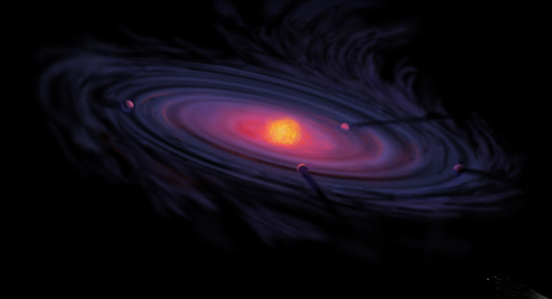
Giant Planet Formation and Snowlines in Protoplanetary Disks
Ana-Maria Piso¹
Karin Öberg¹, Ruth Murray-Clay², Til Birnstiel^{1,3}, Andrew Youdin⁴
CfA Small Scale Seminar: February 22nd, 2016
¹Harvard-Smithsonian Center for Astrophysics
²University of California Santa Barbara
³MPIA, Heidelberg
⁴University of Arizona

Slide 2
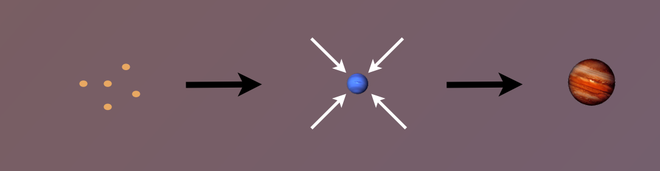
Core Accretion Model
The composition of planets is determined by and tightly linked to the disk composition

Slide 3
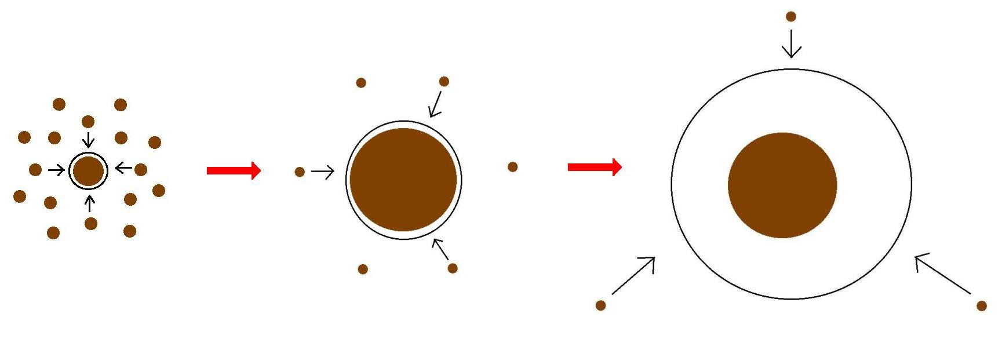
Minimum Core Masses for Giant Planet Formation

Slide 4
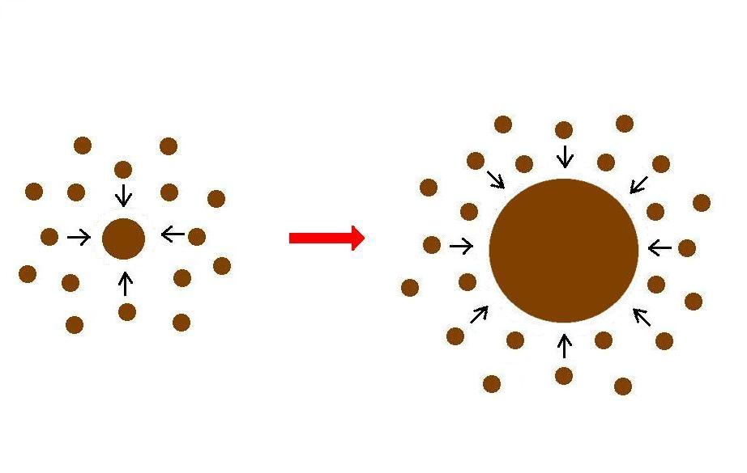
Giant planet formation requires fast core growth

Slide 5
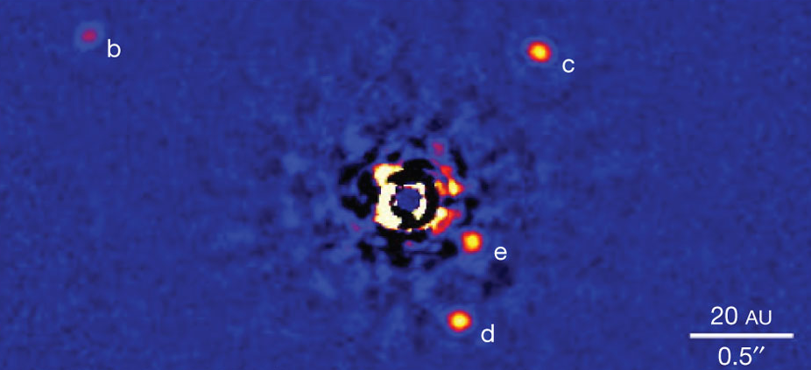
Marois+2010

Slide 6
Lowest M_{crit} requires the solid core to no longer grow
M_{atm} << M_{core}
HIGH dM_{core}/dt
M_{atm} << M_{core}
dM_{core}/dt goes down
M_{atm} ≤ M_{core}
LOW dM_{core}/dt
Notes:
MAYBE

Slide 7
M_{crit} LOWER than 10 M_{E} for an ideal gas polytrope
t_disk ~ 3 Myr, ISM opacity
Piso & Youdin (2014)

Slide 8
Non-ideal Equation Of State (EOS) effects INCREASE M_{crit}
t_disk ~ 3 Myr, ISM opacity
Piso, Youdin, & Murray-Clay (2015)

Slide 9
Grain growth opacities DECREASE M_{crit}
t_disk ~ 3 Myr, realistic EOS
t_disk ~ 3 Myr, realistic EOS
Piso, Youdin, & Murray-Clay (2015)
Piso, Youdin, & Murray-Clay (2015)

Slide 10
Grain growth opacities DECREASE M_{crit}
M_{crit}:
~8 M_{E} @ 5 AU
~5 M_{E} @ 100 AU
t_disk ~ 3 Myr, realistic EOS
t_disk ~ 3 Myr, realistic EOS
Piso, Youdin, & Murray-Clay (2015)
Piso, Youdin, & Murray-Clay (2015)

Slide 11
Grain growth opacities DECREASE M_{crit}
M_{crit}:
~8 M_{E} @ 5 AU
~5 M_{E} @ 100 AU
coagulation
t_disk ~ 3 Myr, realistic EOS
Piso, Youdin, & Murray-Clay (2015)

Slide 12
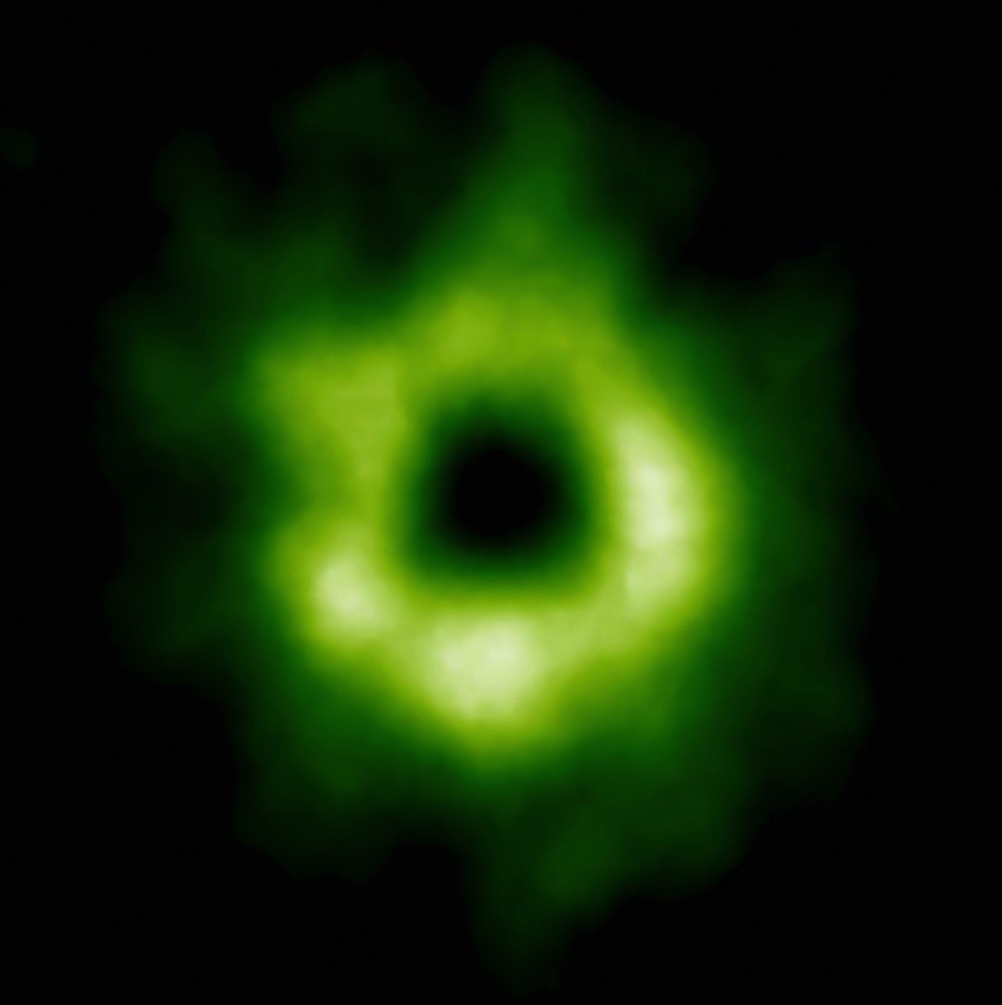
Snowline Locations in Protoplanetary Disks and C/O ratios
Notes:
Put the green TWHya figure instead.

Slide 13
Disk Compositions Regulate Planet Compositions
Understand the disk well enough to:
Predict what kind of planet compositions result from planet formation in different parts of the disk
Back-track the planet formation location based on the planet composition

Slide 14
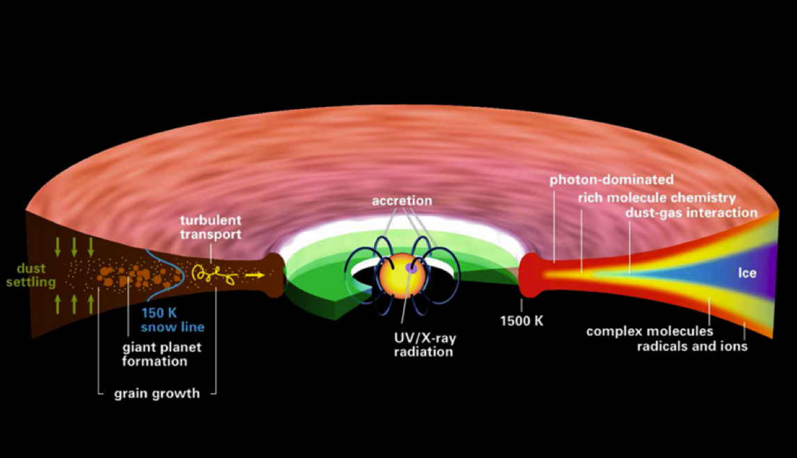
Disk structure is complex!
Henning&Semenov (2013)
Notes:
Remove the while and make the figure bigger.

Slide 15
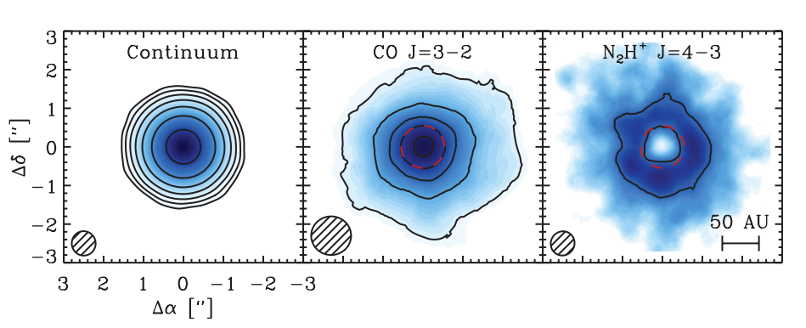
Snowlines of volatile molecules have been detected in disks
Qi+13

Slide 16
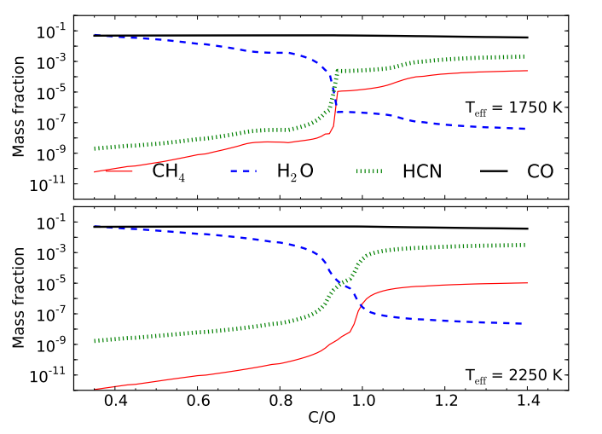
C/O ratio is an important signature of atmospheric chemistry
Molliere+15

Slide 17
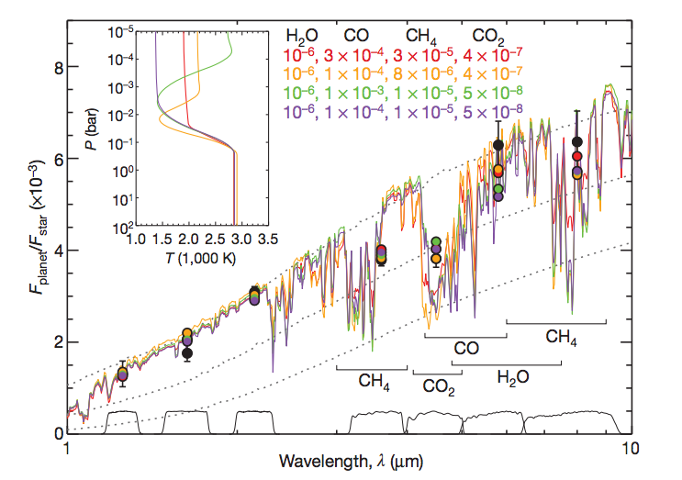
Some giant planets may have C/O ratios different from the stellar value of 0.54
Madhusudhan+11
Notes:
MAYBE

Slide 18
C/O ratios in gas and dust are different at different radii
Main carriers of C and O, i.e. H₂O, CO₂ and CO, have different condensation temperatures => variations in the abundances of C and O in solids and gas between the snow lines of these volatiles

Slide 19
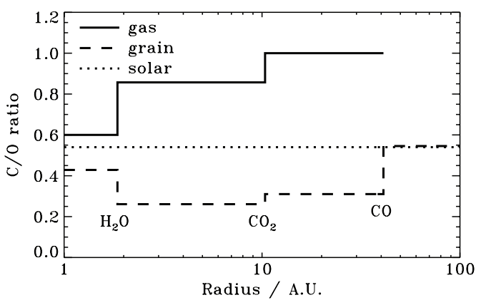
Oberg+11
After Oberg+11

Slide 20
Understand how radial drift and gas accretion affect snowline locations, and thus the C/O ratio in gas and dust throughout the disk
GOAL

Slide 21
Radial drift of solids
Gas moves at sub-Keplerian velocity:
v_{gas} ~ v_{K} (1-c_{s}² / v_{k}²)
Small particles (~micron size) move with the gas
Large particles (~km size) are unaffected by gas drag
“Intermediate sized” particles (~cm-m size) experience a headwind and drift towards the star
Notes:
MAYBE

Slide 22
Timescales for desorption, radial drift and gas accretion ARE comparable
Piso, Oberg, Birnstiel, Murray-Clay (2015)

Slide 23
Radial drift affects snowline location
Piso, Oberg, Birnstiel, Murray-Clay (2015)
Notes:
MAYBE

Slide 24
We determined upper limits for the C/O ratio across the disk
Piso, Oberg, Birnstiel, Murray-Clay (2015)

Slide 25
The desorption distance for transition disks agrees with observations
Piso, Oberg, Birnstiel, Murray-Clay (2015)
Notes:
Cite TWHya paper

Slide 26
Summary
The minimum core mass for giant planet formation is ~8 M_{E} @ 5 AU decreasing to ~5 M_{E} @ 100 AU and may be as low as ~1 M_{E}
Radial drift and gas accretion affect desorption and move the snowline locations compared to a static disk
The H₂O, CO₂ and CO snowlines are created by the largest drifting particles in our model, i.e. s ~ 7 m
H₂O, CO₂, CO snowlines move inwards as the particle size increases by up to 50-60%
Our results for a transition disk are consistent with observations

