Slide 1
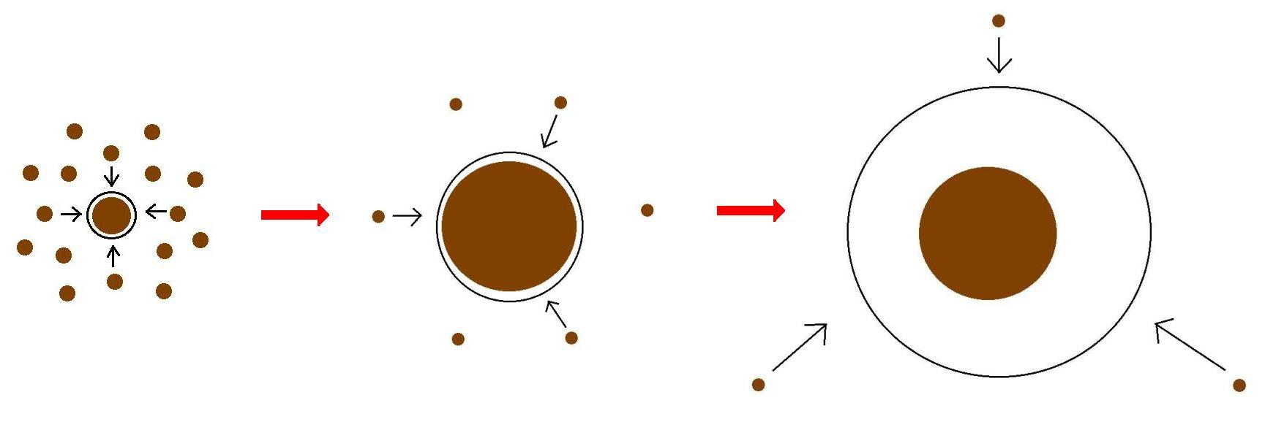
Minimum Core Masses for Giant Planet Formation with Realistic Equations of State and Opacities
Piso, Youdin, & Murray-Clay (ApJ, 2015, in press); Piso & Youdin (ApJ, 2014, 786, 21)
Core Accretion Model
We determine the minimum core mass, M_crit, to form a giant planet before the gas in the protoplanetary disk dissipates, assuming the limiting case in which the solid cores no longer accrete planetesimals and the cores’ atmospheres are dominated by Kelvin-Helmholtz contraction. We explore the effects of a non-ideal equation of state (EOS) and grain growth opacities on atmospheric evolution.
ATMOSPHERIC MODEL SUMMARY
Quasi-static evolution of spherically symmetric atmospheres in hydrostatic balance and embedded in a gas disk
Negligible planetesimal accretion => solid core of fixed mass
Constant luminosity throughout the radiative region
L ~ -dE/dt
Adiabatic gradient relates P, T, rho => determines atmospheric profile and parametrizes EOS

Slide 2
Atmospheric evolution and M_crit are highly dependent on EQUATION OF STATE and DUST OPACITY
H2 spin isomers ORTHOHYDROGEN and PARAHYDROGEN can be in thermal equilibrium or fixed ratio
H2 dissociation
H ionization
Saumon+95
Ideal gas
Our extension
Partially excited H2 rotational states

