Slide 1
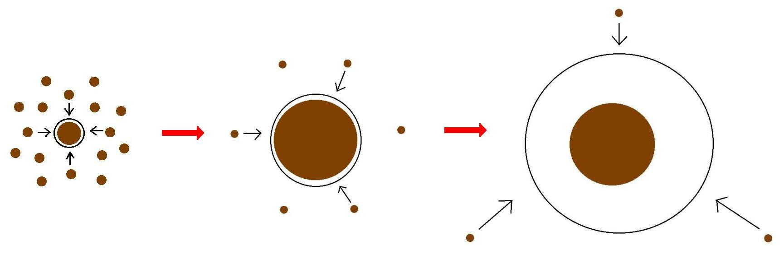
Minimum Core Masses for Giant Planet Formation
Ana-Maria Piso¹
Andrew Youdin², Ruth Murray-Clay^{1,3}
¹Harvard-Smithsonian Center for Astrophysics
²Steward Observatory, University of Arizona
³University of California Santa Barbara
Notes:
…and what I would like to talk about today is the minimum core mass for giant planet formation. Now, when we think of minimum core mass, we think core accretion. In core accretion, we know that for a giant planet to form it needs a solid core, that grows, and once it becomes massive enough it can then accumulate a significant atmosphere. How big of a core do we need? Well, typically this value is believed to be around 10 Me. However, this is not a constant, and it not only depends on where we are in the disk but also on how fast the core grows. Now why do we care about this? We have seen throughout this week giant planets imaged at wide separations. Now, we don’t know whether these planets formed through core accretion or not; but if they do, and if core accretion works at large separations, then it’s very important to understand how it works, and more importantly to be able to place a robust absolut minimum for a giant planet to form within the lifetime of the protoplanetary disk. And this is what I am going to talk about today.

Slide 2
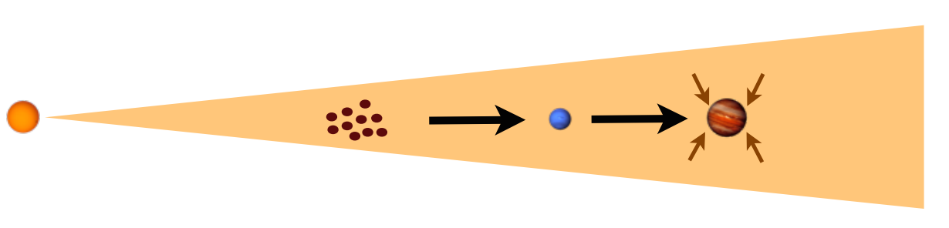
Core Accretion
Credit: Ruth Murray-Clay

Slide 3
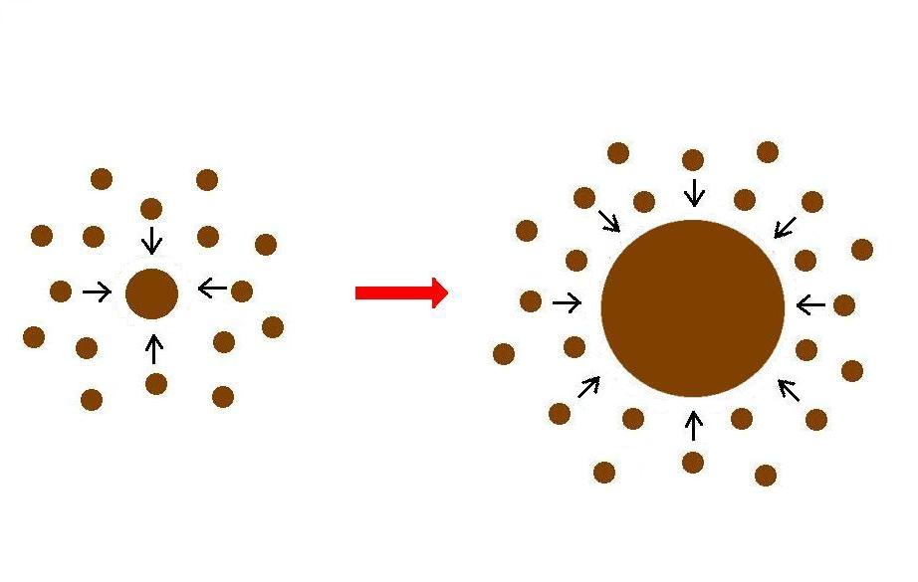
Giant planet formation requires fast core growth

Slide 4
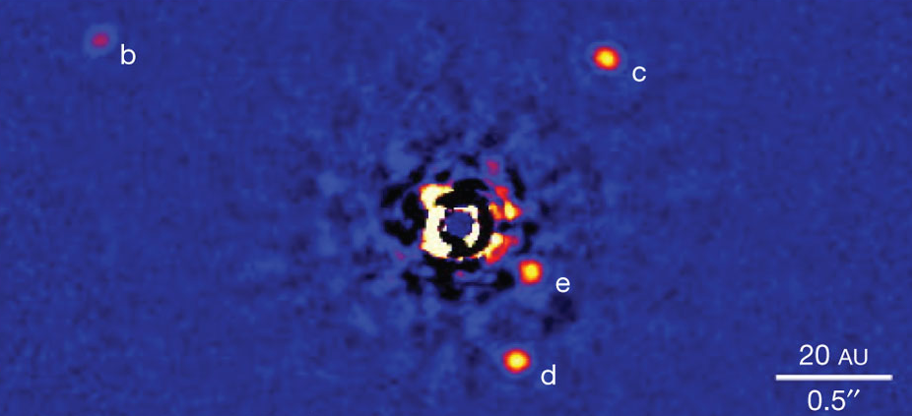
Marois+2010

Slide 5
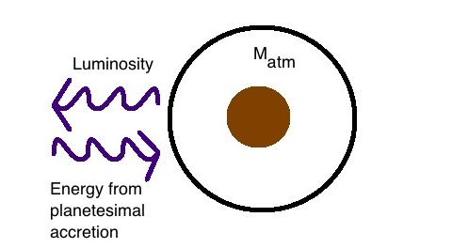
Core Accretion at high planetesimal accretion rates yields steady state
=> M_{atm} is a function of M_{core}
M_{core}
Notes:
Let’s start with the standard model. In order to grow a core massive enough to accumulate an atmosphere, you need, on average, a high planetesimal accretion rate. The incoming planetesimals therefore heat up the atmosphere and this energy is radiated away resulting in a high luminosity. As such, the atmosphere is in a steady state at all times, in which all the energy from the incoming planetesimals is radiated away by the atmopshere. The core and the atmosphere grow together, and the mass of the atmosphere is a function of the core mass.

Slide 6
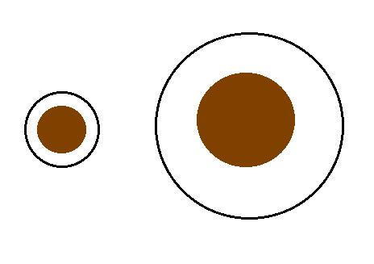
Planetesimal accretion
ONE M_{atm} for each M_{core}
=> ONE core mass for which M_{atm} ~ M_{core} = “critical core mass”
M_{atm,2}
M_{atm,1}
M_{core,1}
M_{core,2}
larger cores hold fractionally larger atmospheres
Notes:
So let’s look at this a bit more closely: since the mass of the atmosphere is a function of the core mass, every core mass will uniquley map to one atmosphere mass; moreover, as the core grows larger, it will hold a fractionally larger atmosphere mass; so at some point in this evolution, the masses of the atmosphere and core will become roughly equal, at which point a process of rapid gas accretion starts and a massive atmosphere is accumulated; this core mass is well defined for a set of disk conditions, and it’s called the critical core mass. Now, this is the story when planetesimal accretion occurs at the standard rate.

Slide 7
Planetesimal accretion is not constant at a given location throughout disk life
e.g., Pollack+96, Ikoma+00
M_{atm} << M_{core}
HIGH dM_{core}/dt
M_{atm} << M_{core}
dM_{core}/dt goes down
M_{atm} ≤ M_{core}
LOW dM_{core}/dt
Notes:
However, planetesimal accretion need not be constant at given location in the disk throughout the disk life, and there are studies that have made this assumptions. So let’s imagine a different scenario. First, we are in the standard case; we have a high planetesimal accretion rate, so the core grows, but the atmosphere remains small; then at some point later on, the core has grown more massive, but the atmosphere remains small by comparison. At this point, planetesimal accretion slows down. So now the core no longer grows significantly; the atmosphere still loses energy but is not gaining any from planetesimals anymore. Instead, now the energy is given by the contraction of the envelope due to gas accretion.

Slide 8
Planetesimal accretion is not constant at a given location throughout disk life
e.g., Pollack+96, Ikoma+00
M_{atm} << M_{core}
HIGH dM_{core}/dt
M_{atm} << M_{core}
dM_{core}/dt goes down
M_{atm} ≤ M_{core}
LOW dM_{core}/dt
Notes:
However, planetesimal accretion need not be constant at given location in the disk throughout the disk life, and there are studies that have made this assumptions. So let’s imagine a different scenario. First, we are in the standard case; we have a high planetesimal accretion rate, so the core grows, but the atmosphere remains small; then at some point later on, the core has grown more massive, but the atmosphere remains small by comparison. At this point, planetesimal accretion slows down. So now the core no longer grows significantly; the atmosphere still loses energy but is not gaining any from planetesimals anymore. Instead, now the energy is given by the contraction of the envelope due to gas accretion.

Slide 9
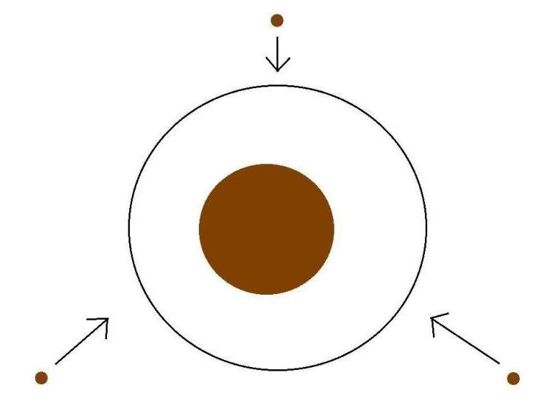
Low planetesimal accretion regime
Atmospheric evolution dominated by
Kelvin-Helmholtz contraction
M_{atm}
M_{core}
M_{atm} ≤ M_{core}
LOW dM_{core}/dt
Notes:
So if we’re in this scenario of low planetesimal accretion, the luminosity evolution of the atmosphere will be dominated by KH contraction.

Slide 10
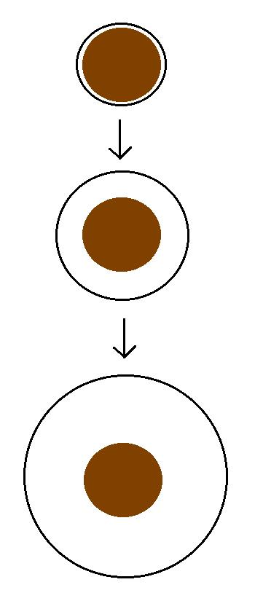
Kelvin-Helmholtz contraction
M_{atm} is a function of time
=> EVERY core can have
M_{atm} ~ M_{core}
“critical core mass”
M_{crit} = M_{core} for which
M_{atm}(t_{disk}) ~ M_{core}
M_{atm}(t₁)
M_{core}
M_{atm}(t₂)
M_{core}
M_{atm}(t₃) ~ M_{core}
M_{core}
Notes:
So in this regime, there is no longer a steady state, but rather the atmosphere mass is a function of time; now core growth is negligible; so you start with a small atmosphere that gradually grows until it become comparable to the core mass; so in this scenario, every core can have an atmosphere equal to its own and become critical

Slide 11
GOAL
Determine the minimum core mass, M_{crit}, to form a giant planet during the disk lifetime in the low planetesimal accretion regime when atmosphere dominated by KH contraction
Calculate M_{crit} with
REALISTIC EQUATION OF STATE (EOS)
REALISTIC DUST OPACITIES
Notes:
Why Lacc=0?
- to get around the difficulty to form a giant planet a large distances throigh core acc
- you can depleted zone of planetesimals
- move the core

Slide 12
Model Assumptions
Negligible planetesimal accretion => solid core of fixed mass M_{c}
Atmosphere is embedded in the gas disk, spherically symmetric and in hydrostatic balance
Two layer atmosphere: inner convective region and outer radiative region
Constant luminosity throughout the radiative region

Slide 13
Static profiles connected by global cooling equation
L ~ -dE/dt
a = 10 AU, M_{c} = 5 M_{E}
Adiabatic gradient relates P, T, rho => determines atmospheric profile and parametrizes EOS
a = 10 AU, M_{c} = 5 M_{E}

Slide 14
Atmospheric evolution and M_{crit} are highly dependent on
EQUATION OF STATE
DUST OPACITY

Slide 15
Atmospheric evolution and M_{crit} are highly dependent on
EQUATION OF STATE
DUST OPACITY

Slide 16
Adiabatic gradient is variable for realistic EOS
H2 dissociation
H ionization
Saumon+95
Ideal gas
Our extension

Slide 17
Adiabatic gradient is variable for realistic EOS
H2 dissociation
H ionization
Saumon+95
Ideal gas
Our extension
Partially excited H₂ rotational states

Slide 18
Adiabatic gradient is variable for realistic EOS
H₂ spin isomers ORTHOHYDROGEN and PARAHYDROGEN can be in thermal equilibrium or fixed ratio
H2 dissociation
H ionization
Saumon+95
Ortho-para equilibrium
Fixed 3:1 ortho-to-para ratio
Ideal gas
Our extension
Partially excited H₂ rotational states

Slide 19
Variations in due to non-ideal EOS effects INCREASE M_{crit}
ad
t_disk ~ 3 Myr, ISM opacity
Piso, Youdin, & Murray-Clay (2015)
Notes:
Here I am plotting the critical core mass as a function of semimajor axis for an ideal diatomic gas. So you can see already that this value is smaller than the standard 10 Me even in the more inner parts of the disk; in a few moments I will show how this critical core mass compares to results from standard studies. But let’s first see what Mcrit depends on.

Slide 20
Atmospheric evolution and M_{crit} are highly dependent on
EQUATION OF STATE
DUST OPACITY

Slide 21
Atmospheric evolution and M_{crit} are highly dependent on
EQUATION OF STATE
DUST OPACITY

Slide 22
Grain growth opacity DECREASES M_{crit}
dN/ds ~ s^{-p}
p = 3.5
s_{max} = 1 cm
t_disk ~ 3 Myr, realistic EOS
t_disk ~ 3 Myr, realistic EOS
Piso, Youdin, & Murray-Clay (2015)
Piso, Youdin, & Murray-Clay (2015)

Slide 23
Grain growth opacity DECREASES M_{crit}
dN/ds ~ s^{-p}
p = 3.5
s_{max} = 1 cm
M_{crit}:
~8 M_{E} @ 5 AU
~5 M_{E} @ 100 AU
t_disk ~ 3 Myr, realistic EOS
Piso, Youdin, & Murray-Clay (2015)

Slide 24
Coagulation p=2.5 may decrease M_{crit} by up to one order of magnitude!
M_{c} = 4 M_{E}
Realistic EOS
Piso, Youdin, & Murray-Clay (2015)

Slide 25
Summary
H₂ dissociation and variable occupation of H₂ rotational states INCREASE M_{crit} when compared to an ideal gas polytrope
Grain growth opacity DECREASES M_{crit} compared to ISM opacity
M_{crit} ~ 8 M_{E} at 5 AU and ~ 5 M_{E} at 100 AU for a realistic EOS with H₂ spin isomers in thermal equilibrium and grain growth opacity with standard collisional cascade (p=3.5) and s_{max}=1 cm
M_{crit} may decrease by up to one order of magnitude if coagulation is taken into account (p=2.5)

