Slide 1
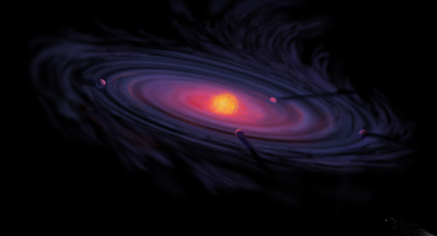
C/O and Snowline Locations in Protoplanetary Disks: The Effect of Radial Drift and Viscous Gas Accretion
Ana-Maria Piso¹
Karin Öberg¹, Til Birnstiel^{1,2}, Ruth Murray-Clay³
¹Harvard-Smithsonian Center for Astrophysics
²MPIA, Heidelberg
³University of California Santa Barbara

Slide 2

Core Accretion Model
The composition of planets is determined by and tightly linked to the disk composition

Slide 3
BASIC IDEA
Understand the disk well enough to:
Predict what kind of planet compositions result from planet formation in different parts of the disk
Back-track the planet formation location based on the planet composition

Slide 4
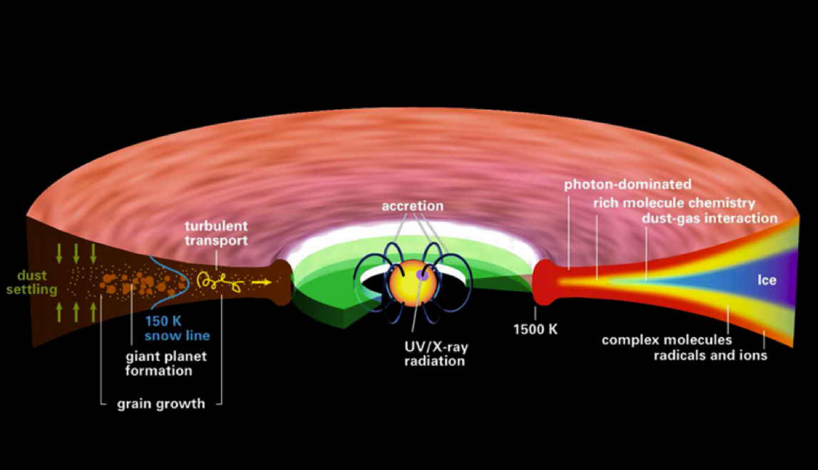
Disk structure is complex!
Henning&Semenov (2013)
Notes:
Remove the while and make the figure bigger.

Slide 5
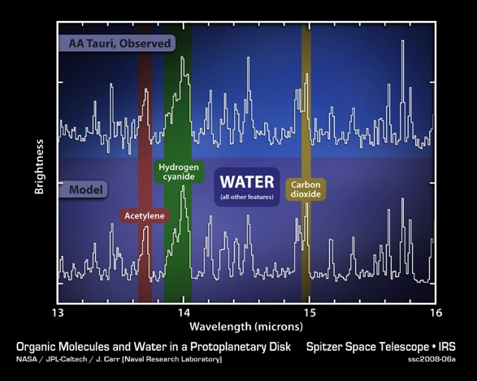
Volatile compounds have been detected in protoplanetary disks
Oberg+11
Notes:
Replace with spitzer water in disks spectrum image and DCO+ image.

Slide 6
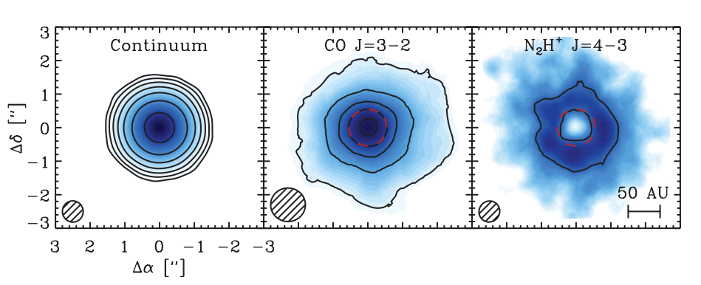
Snowlines of volatile molecules have been detected in disks
Qi+13

Slide 7
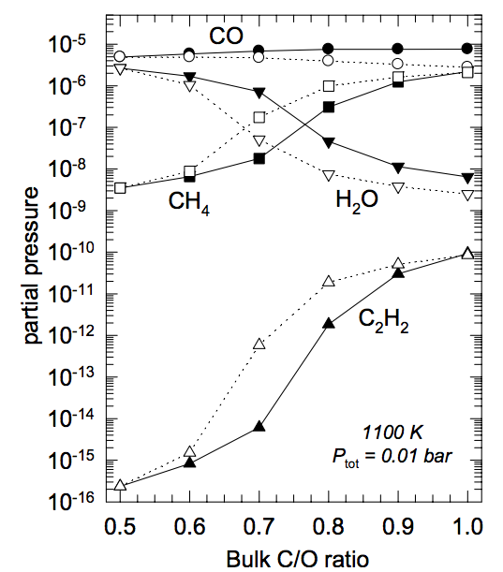
C/O ratio is an important signature of atmospheric chemistry
Lodders 2009

Slide 8
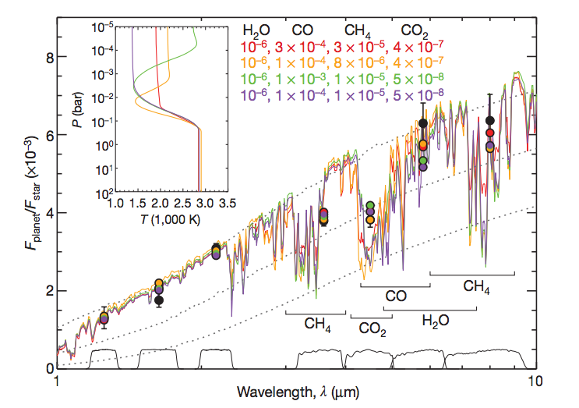
Some giant planets may have C/O ratios different from the stellar value of 0.54
Madhusudhan+11
Notes:
Show a slide before this with model predictions. Arxiv paper by katherine lodders.2009 figure 1.8

Slide 9
WHY?
Possible explanation: main carriers of C and O, i.e. H₂O, CO₂ and CO, have different condensation temperatures => variations in the abundances of C and O in solids and gas between the snow lines of these volatiles (Oberg+11)

Slide 10
Understand how radial drift and gas accretion affect snowline locations, and thus the C/O ratio in gas and dust throughout the disk
GOAL

Slide 11
Timescales for desorption, radial drift and gas accretion ARE comparable
Piso, Oberg, Birnstiel, Murray-Clay (2015)
Piso+15

Slide 12
Radial drift affects snowline location
Piso, Oberg, Birnstiel, Murray-Clay (2015)

Slide 13
We determined upper limits for the C/O ratio across the disk
Piso, Oberg, Birnstiel, Murray-Clay (2015)

Slide 14
The desorption distance for transition disks agrees with observations
Piso, Oberg, Birnstiel, Murray-Clay (2015)
Notes:
Cite TWHya paper

Slide 15
Summary
Radial drift and gas accretion affect desorption and move the snowline locations compared to a static disk
The H₂O, CO₂ and CO snowlines are created by the largest drifting particles in our model, i.e. s ~ 7 m
Snowlines move inwards as the particle size increases
~60% for H₂O
~60% for CO₂
~50% for CO
Our results for a transition disk are consistent with observations

Slide 16
TAKEAWAY POINT
Radial drift and viscous gas accretion move the snowline locations inwards. This affects the C/O ratio in gas and dust throughout the disk, and thus has direct implications in shaping the compositions of nascent giant planets.
Notes:
Add one slides 20, 21, 31 before this.

