Slide 1
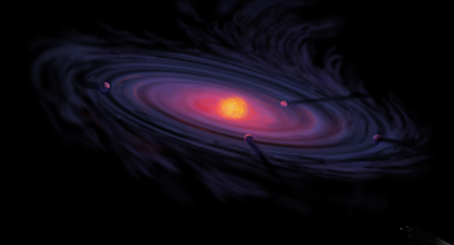
The Role of Disk Volatile Chemistry and Dynamics in Shaping the Compositions of Nascent Planets
Ana-Maria Piso¹
Karin Öberg¹, Ruth Murray-Clay², Til Birnstiel^{1,3}, Andrew Youdin⁴
AAS 227th Meeting, Kissimmee, Florida: January 7th, 2016
¹Harvard-Smithsonian Center for Astrophysics
²University of California Santa Barbara
³MPIA, Heidelberg
⁴University of Arizona

Slide 2
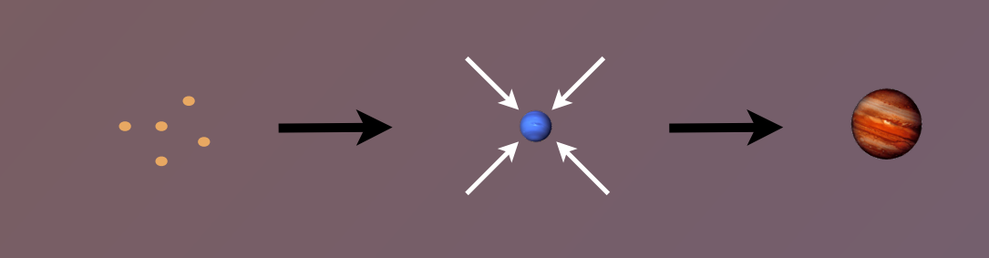
Core Accretion Model
The composition of planets is determined by and tightly linked to the disk composition

Slide 3
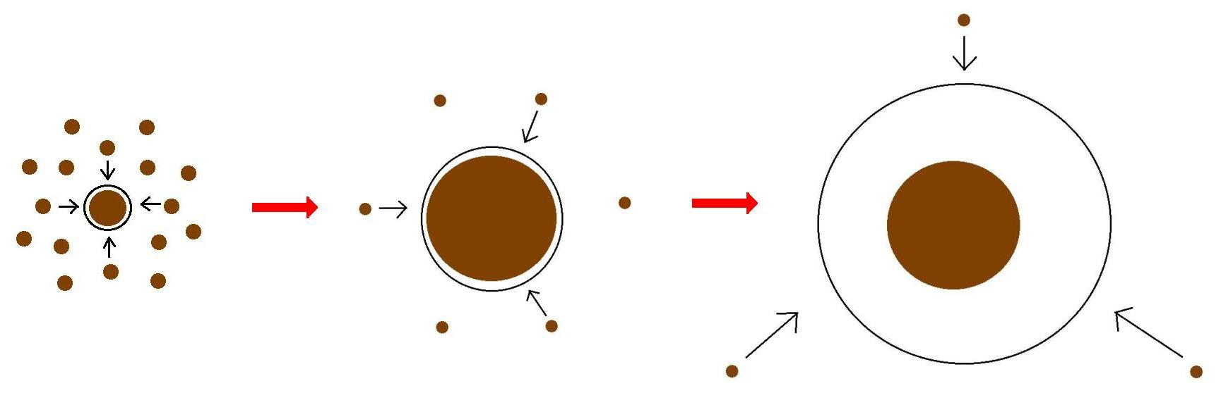
Minimum Core Masses for Giant Planet Formation

Slide 4
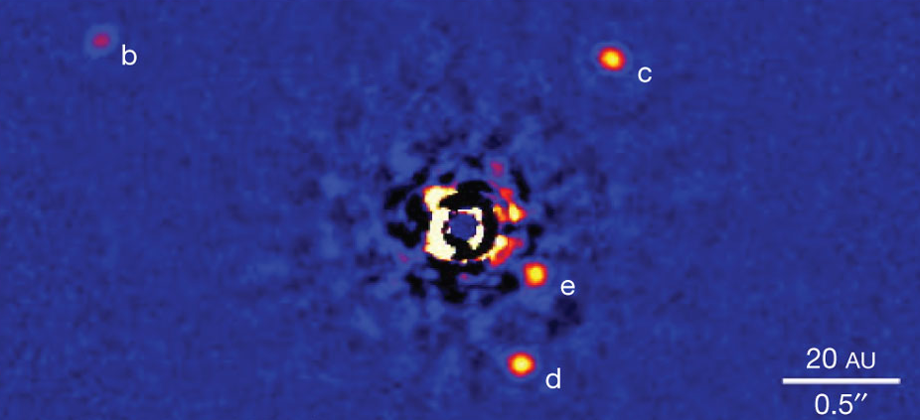
Marois+2010

Slide 5
M_{crit} LOWER than 10 M_{E} for an ideal gas polytrope
t_disk ~ 3 Myr, ISM opacity
Piso & Youdin (2014)

Slide 6
Non-ideal Equation Of State (EOS) effects INCREASE M_{crit}
t_disk ~ 3 Myr, ISM opacity
Piso, Youdin, & Murray-Clay (2015)

Slide 7
Grain growth opacities DECREASE M_{crit}
t_disk ~ 3 Myr, realistic EOS
t_disk ~ 3 Myr, realistic EOS
Piso, Youdin, & Murray-Clay (2015)
Piso, Youdin, & Murray-Clay (2015)

Slide 8
Grain growth opacities DECREASE M_{crit}
M_{crit}:
~8 M_{E} @ 5 AU
~5 M_{E} @ 100 AU
t_disk ~ 3 Myr, realistic EOS
t_disk ~ 3 Myr, realistic EOS
Piso, Youdin, & Murray-Clay (2015)
Piso, Youdin, & Murray-Clay (2015)

Slide 9
Grain growth opacities DECREASE M_{crit}
M_{crit}:
~8 M_{E} @ 5 AU
~5 M_{E} @ 100 AU
coagulation
t_disk ~ 3 Myr, realistic EOS
Piso, Youdin, & Murray-Clay (2015)

Slide 10
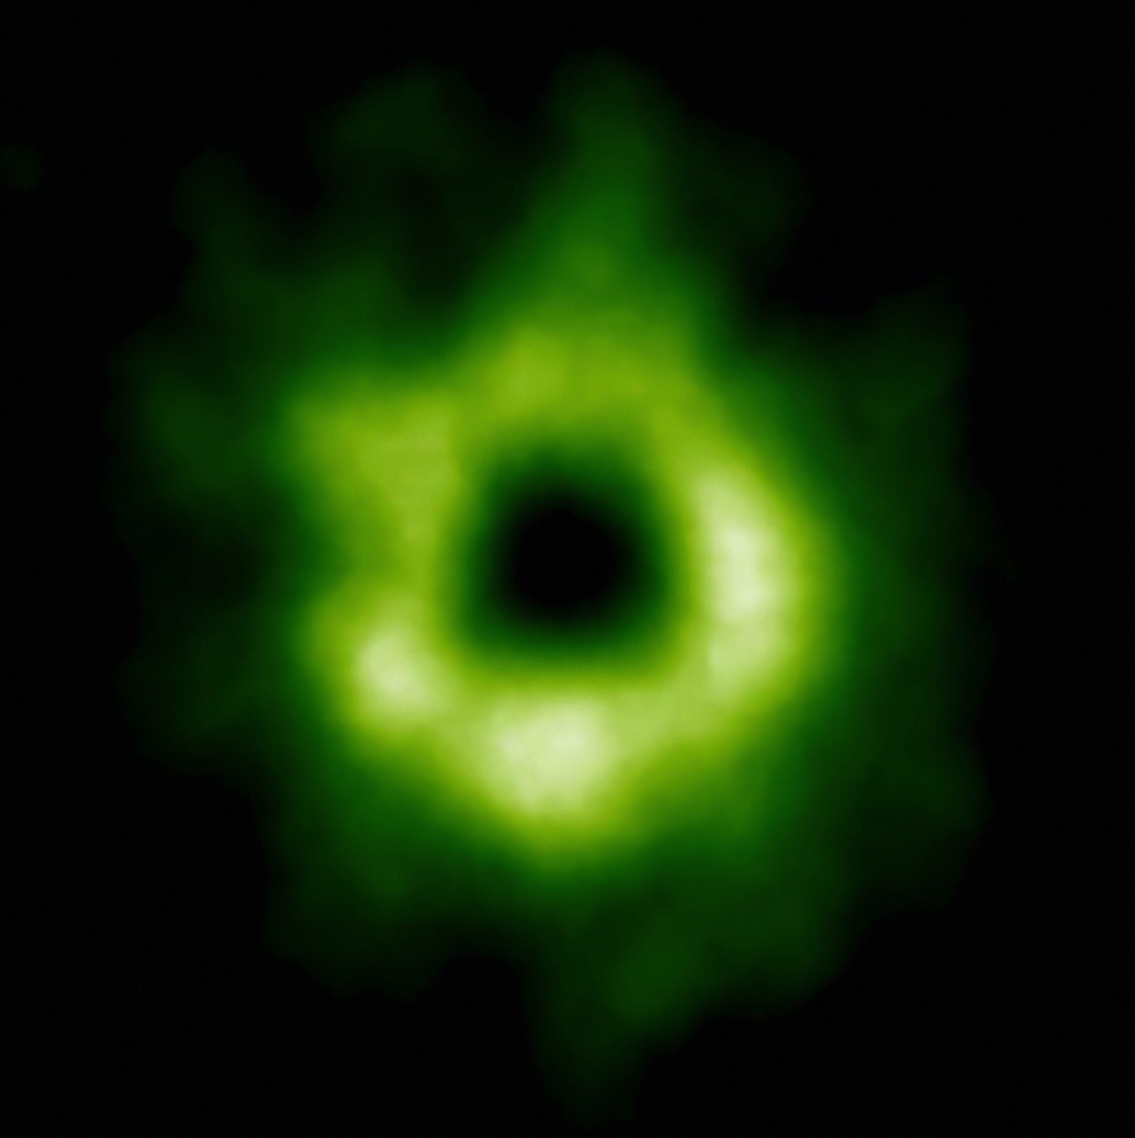
Snowline Locations in Protoplanetary Disks and C/O/N ratios
Notes:
Put the green TWHya figure instead.

Slide 11
Disk Compositions Regulate Planet Compositions
Understand the disk well enough to:
Predict what kind of planet compositions result from planet formation in different parts of the disk
Back-track the planet formation location based on the planet composition

Slide 12
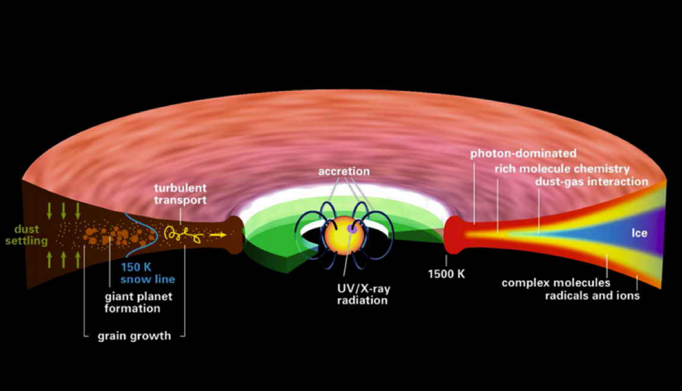
Disk structure is complex!
Henning&Semenov (2013)
Notes:
Remove the while and make the figure bigger.

Slide 13
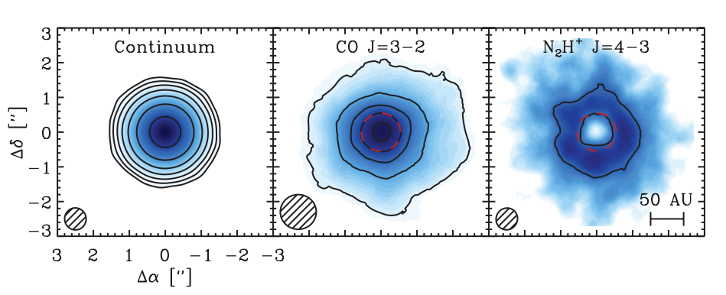
Snowlines of volatile molecules have been detected in disks
Qi+13

Slide 14
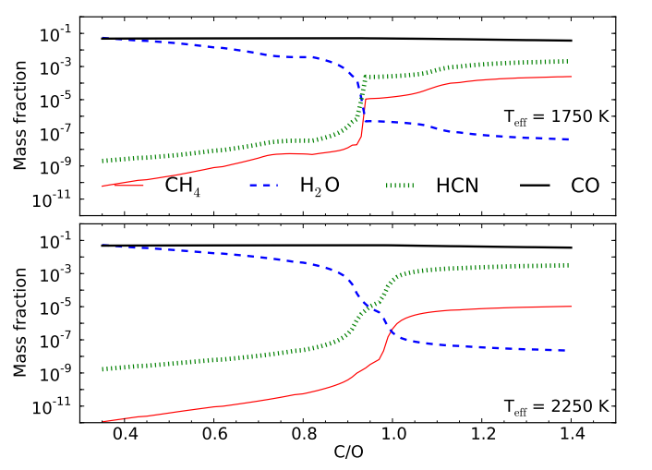
C/O ratio is an important signature of atmospheric chemistry
Molliere+15

Slide 15
C/O ratios in gas and dust are different at different radii
Main carriers of C and O, i.e. H₂O, CO₂ and CO, have different condensation temperatures => variations in the abundances of C and O in solids and gas between the snow lines of these volatiles

Slide 16
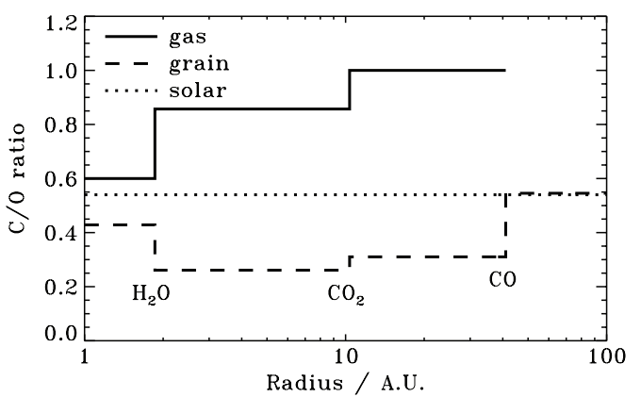
Oberg+11
After Oberg+11

Slide 17
Understand how radial drift and gas accretion affect snowline locations, and thus the C/O ratio in gas and dust throughout the disk
GOAL

Slide 18
Timescales for desorption, radial drift and gas accretion ARE comparable
Piso, Oberg, Birnstiel, Murray-Clay (2015)

Slide 19
We determined upper limits for the C/O ratio across the disk
Piso, Oberg, Birnstiel, Murray-Clay (2015)

Slide 20
More volatile snowlines in disks
Piso, Oberg, Pegues (2016, in prep)

Slide 21
N/O ratios may be used as tracers of atmospheric chemistry
Piso, Oberg, Pegues (2016, in prep)

Slide 22
Summary
The minimum core mass for giant planet formation is ~8 M_{E} @ 5 AU decreasing to ~5 M_{E} @ 100 AU and may be as low as ~1 M_{E}
Radial drift and gas accretion affect desorption and move the snowline locations compared to a static disk
The H₂O, CO₂ and CO snowlines are created by the largest drifting particles in our model, i.e. s ~ 7 m
H₂O, CO₂, CO snowlines move inwards as the particle size increases by up to 50-60%
The N/O ratio is more enhanced than the C/O ratio in the outer disk compared to the stellar value

Slide 24
The desorption distance for transition disks agrees with observations
Piso, Oberg, Birnstiel, Murray-Clay (2015)
Notes:
Cite TWHya paper

Slide 25
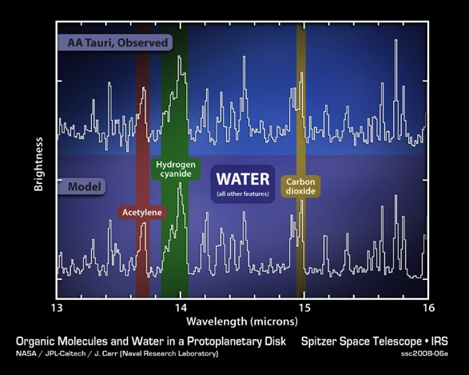
Volatile compounds have been detected in protoplanetary disks
Oberg+11
Notes:
Replace with spitzer water in disks spectrum image and DCO+ image.

Slide 26
Radial drift affects snowline location
Piso, Oberg, Birnstiel, Murray-Clay (2015)

Slide 27
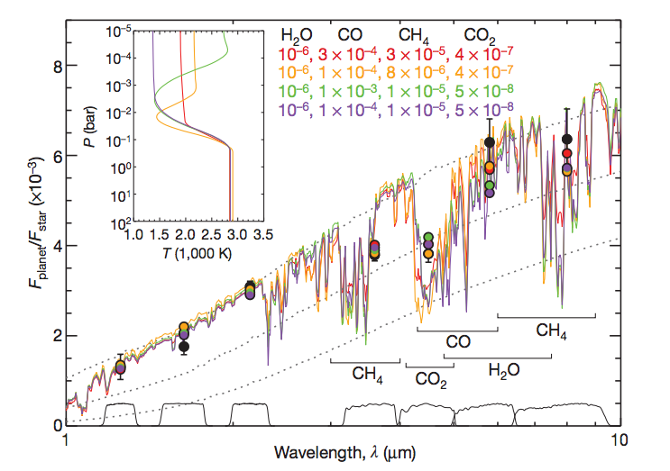
Some giant planets may have C/O ratios different from the stellar value of 0.54
Madhusudhan+11
Notes:
Show a slide before this with model predictions. Arxiv paper by katherine lodders.2009 figure 1.8

Slide 28
The Minimum Core Mass to form Gas Giants depends sensitively on disk physics and chemistry

Slide 29
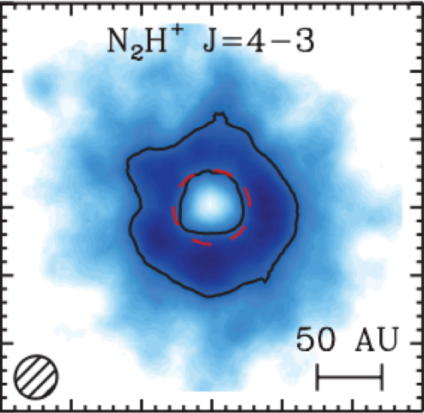
Snowlines of volatile molecules have been detected in disks
Qi+13

