Slide 1
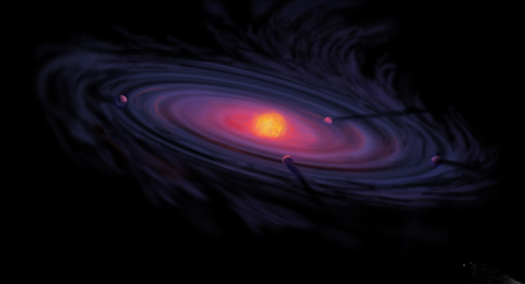
The Role of Disk Volatile Chemistry and Dynamics in Shaping the Compositions of Nascent Planets
Ana-Maria Piso¹
Karin Öberg¹, Til Birnstiel^{1,2}, Ruth Murray-Clay³
AAS 227th Meeting, Kissimmee, Florida: January 7th, 2016
¹Harvard-Smithsonian Center for Astrophysics
²MPIA, Heidelberg
³University of California Santa Barbara

Slide 2

Core Accretion Model
The composition of planets is determined by and tightly linked to the disk composition

Slide 3
BASIC IDEA
Understand the disk well enough to:
Predict what kind of planet compositions result from planet formation in different parts of the disk
Back-track the planet formation location based on the planet composition

Slide 4
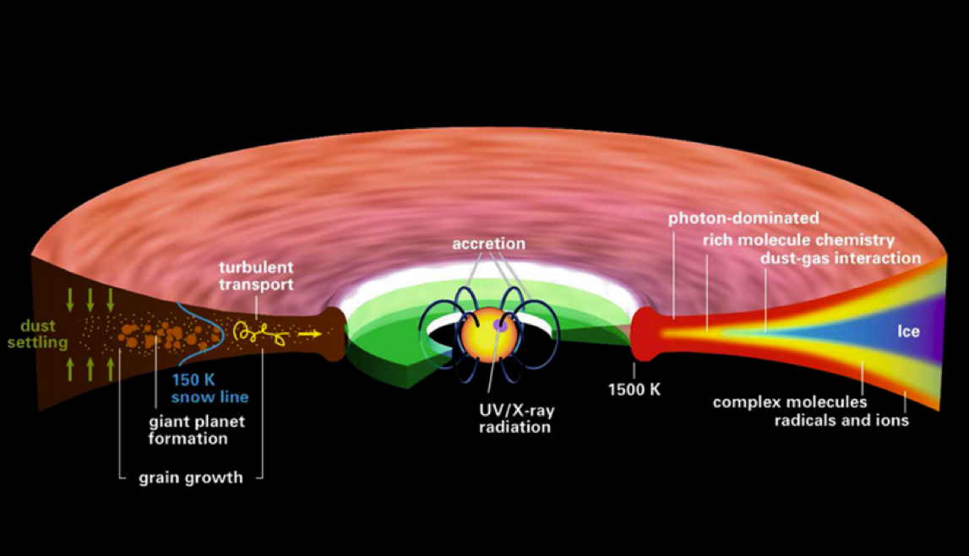
Disk structure is complex!
Henning&Semenov (2013)
Notes:
Remove the while and make the figure bigger.

Slide 5
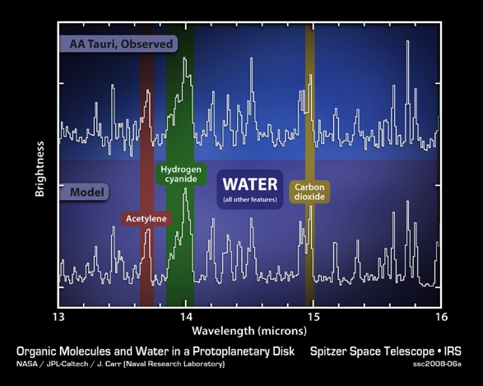
Volatile compounds have been detected in protoplanetary disks
Oberg+11
Notes:
Replace with spitzer water in disks spectrum image and DCO+ image.

Slide 6
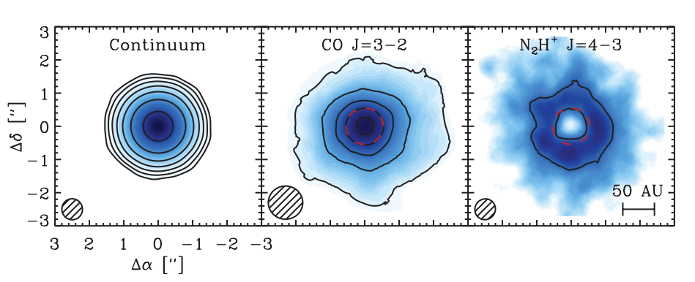
Snowlines of volatile molecules have been detected in disks
Qi+13

Slide 7
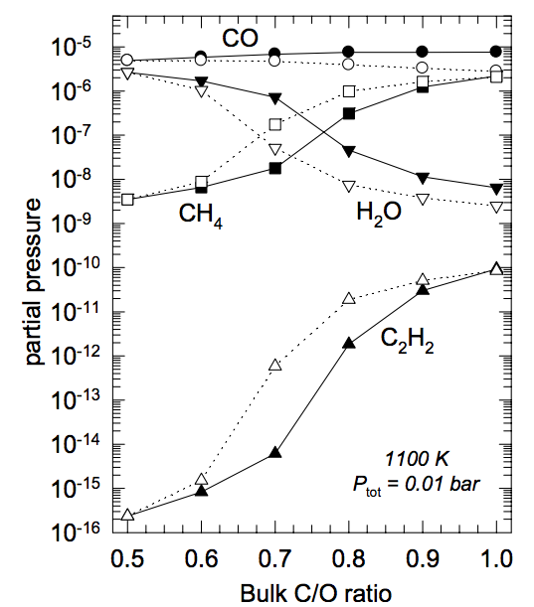
C/O ratio is an important signature of atmospheric chemistry
Lodders 2009

Slide 8
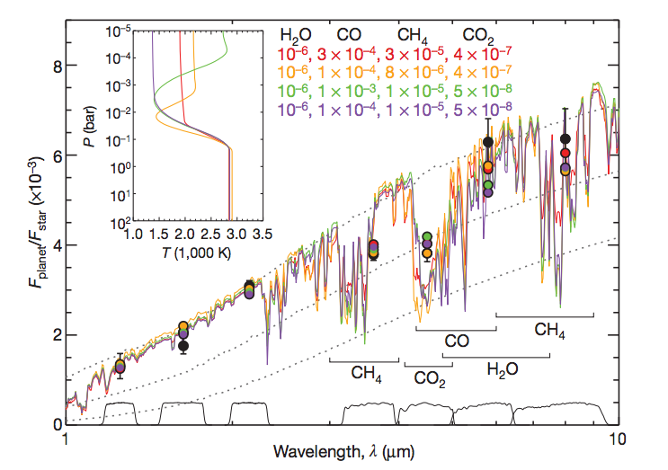
Some giant planets may have C/O ratios different from the stellar value of 0.54
Madhusudhan+11
Notes:
Show a slide before this with model predictions. Arxiv paper by katherine lodders.2009 figure 1.8

Slide 9
WHY?
Possible explanation: main carriers of C and O, i.e. H₂O, CO₂ and CO, have different condensation temperatures => variations in the abundances of C and O in solids and gas between the snow lines of these volatiles

Slide 10
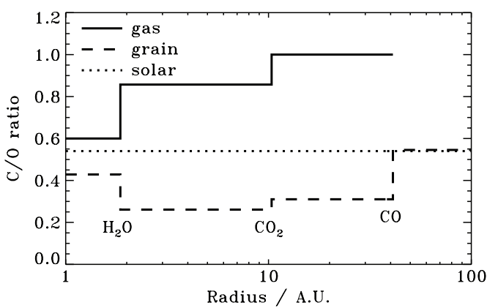
Oberg+11
After Oberg+11

Slide 11
Understand how radial drift and gas accretion affect snowline locations, and thus the C/O ratio in gas and dust throughout the disk
GOAL

Slide 12
Timescales for desorption, radial drift and gas accretion ARE comparable
Piso, Oberg, Birnstiel, Murray-Clay (2015)
Piso+15

Slide 13
Radial drift affects snowline location
Piso, Oberg, Birnstiel, Murray-Clay (2015)

Slide 14
We determined upper limits for the C/O ratio across the disk
Piso, Oberg, Birnstiel, Murray-Clay (2015)

Slide 15
The desorption distance for transition disks agrees with observations
Piso, Oberg, Birnstiel, Murray-Clay (2015)
Notes:
Cite TWHya paper

Slide 16
N/O ratios can be used as tracers of atmospheric chemistry
Piso, Oberg, Pegues (2016, in prep)

Slide 17
Summary
Radial drift and gas accretion affect desorption and move the snowline locations compared to a static disk
The H₂O, CO₂ and CO snowlines are created by the largest drifting particles in our model, i.e. s ~ 7 m
Snowlines move inwards as the particle size increases
~60% for H₂O
~60% for CO₂
~50% for CO
Our results for a transition disk are consistent with observations
The N/O ratio is more enhanced than the C/O ratio in the outer disk compared to the stellar value

Slide 18
TAKEAWAY POINT
Radial drift and viscous gas accretion move the snowline locations inwards. This affects the C/N/O ratio in gas and dust throughout the disk, and thus has direct implications in shaping the compositions of nascent giant planets.
Notes:
Add one slides 20, 21, 31 before this.

