Slide 1
<Title In Progress>
Ana-Maria Piso
Advisor: Karin Öberg
Collaborators: Ruth Murray-Clay, Til Birnstiel, Andrew Youdin, Jamila Pegues
Thesis Advisory Committee: Matthew Holman, Sean Andrews, Dimitar Sasselov
TAC Meeting Presentation: March 9th , 2016
Notes:
…and what I would like to talk about today is the minimum core mass for giant planet formation. Now, when we think of minimum core mass, we think core accretion. In core accretion, we know that for a giant planet to form it needs a solid core, that grows, and once it becomes massive enough it can then accumulate a significant atmosphere. How big of a core do we need? Well, typically this value is believed to be around 10 Me. However, this is not a constant, and it not only depends on where we are in the disk but also on how fast the core grows. Now why do we care about this? We have seen throughout this week giant planets imaged at wide separations. Now, we don’t know whether these planets formed through core accretion or not; but if they do, and if core accretion works at large separations, then it’s very important to understand how it works, and more importantly to be able to place a robust absolut minimum for a giant planet to form within the lifetime of the protoplanetary disk. And this is what I am going to talk about today.

Slide 2
Outline
Brief Background Info
Research Accomplished Since Last Meeting
Next Steps and Proposed Defense Timeline

Slide 3
Outline
Brief Background Info
Research Accomplished Since Last Meeting
Next Steps and Proposed Defense Timeline

Slide 4
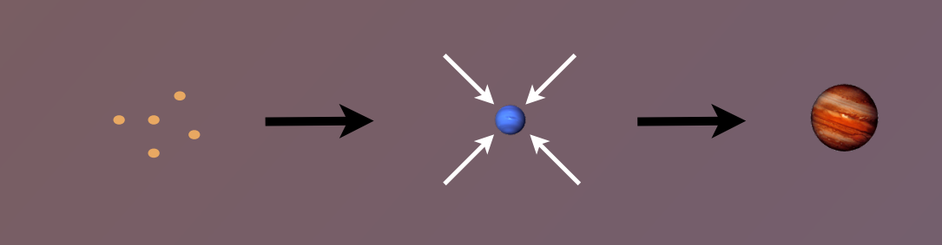
Core Accretion Model
The composition of planets is determined by and tightly linked to the disk composition

Slide 5
Disk Compositions Regulate Planet Compositions
Understand the disk well enough to:
Predict what kind of planet compositions result from planet formation in different parts of the disk
Back-track the planet formation location based on the planet composition

Slide 6
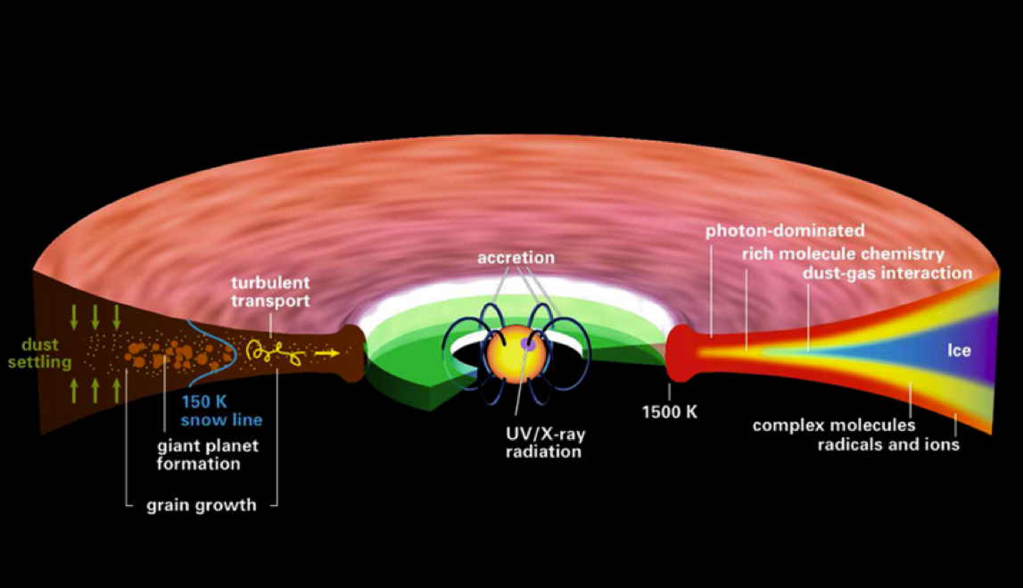
Disk structure is complex!
Henning&Semenov (2013)
Notes:
Remove the while and make the figure bigger.

Slide 7
GOAL
Explore and understand the dynamical (and chemical) processes occurring in disks, and their relative importance in shaping disk compositions
Primarily focus on understanding how all these processes affect the snowline locations of volatile species

Slide 8
Outline
Brief Background Info
Research Accomplished Since Last Meeting
Next Steps and Proposed Defense Timeline

Slide 9
Understand how DISK DYNAMICS and ICE MORPHOLOGY affect the snowline locations of the main C, O, N carriers, and thus the C/N/O ratios in gas and dust throughout the disk
GOAL

Slide 10
We determined upper limits for the C/O ratio across the disk
Piso, Oberg, Birnstiel, Murray-Clay (2015)

Slide 11
More volatile snowlines in disks
Piso, Oberg, Pegues (2016, in prep)

Slide 12
Expected abundances of CH4 do not change C/O results significantly
Piso, Oberg, Pegues (2016, in prep)

Slide 13
N/O ratios may be used as tracers of atmospheric chemistry
Piso, Oberg, Pegues (2016, in prep)

Slide 14
Disk dynamics and ice morphology may change the CO and N₂ snowline locations by a factor of 7!
Piso, Oberg, Pegues (2016, in prep)
Piso, Oberg, Pegues (2016, in prep)

Slide 15
Main Results
Gas phase N/O ratios are highly enhanced throughout most of the disk compared to the average value, and more enhanced than the C/O ratio
The locations of the CO and N₂ snowlines are highly uncertain and can span several tens of AU due to disk dynamics and ice morphology

Slide 16
Outline
Brief Background Info
Research Accomplished Since Last Meeting
Next Steps and Proposed Defense Timeline

Slide 17
Next Steps
Calculate the C/N/O ratios self-consistently
Basic idea: treat each species in gaseous and solid form as two fluids that are interchanging and use advection-like equations to solve for their separate time-dependent abundance
Preliminary results expected BEFORE defense
Incorporate simple chemical evolution in radial drift model
Collaboration with Ilse Cleeves
Results expected AFTER defense

Slide 18

GOOD NEWS
I have a job!

Slide 19
Thesis Outline
MAIN IDEA
The formation and composition of giant planets highly depends on disk location and properties.

Slide 20
Thesis Outline
Introduction
Minimum Core Masses for Giant Planet Formation at Wide Separations
Piso & Youdin 2014, ApJ, 786, 21
Piso, Youdin, & Murray-Clay 2015, ApJ, 800, 82
The Role of Disk Dynamics, Composition and Ice Morphology in Shaping Volatile Snowlines and the C/N/O Ratio
Piso, Oberg, Birnstiel, & Murray-Clay 2015, ApJ, 815, 109
Piso, Oberg, & Pegues 2016 (final stages)
The Effect of Time-Dependent Disk Dynamics on the C/N/O Ratio
Piso et al. 2016 (preliminary results as part of thesis)
Conclusion

Slide 21
Suggestions for External Examiner
Prof. Fred Ciesla (University of Chicago)
Dr. Margaret Pan (MIT)
Prof. Hilke Schlichting (MIT)

Slide 22
Thesis Timeline (and beyond)
GOAL
Officially graduate in spring 2016 => need to submit thesis to the registrar by May 13th

Slide 23
Thesis Timeline (and beyond)
By March 15th -> submit C/N/O paper
By March 25th -> apply for degree
March 15th – ~April 15th -> have some preliminary results for the last thesis chapter
~April 15th – ~April 30th -> write thesis
Some time between April 25th and May 9th -> THESIS DEFENSE!
Mid-May – end of August -> develop intuition for chemistry and start developing a simple parameterized chemical network to implement in my dynamical model (collaborate closely with Ilse Cleeves)
End of August – early fall -> finish paper on last thesis chapter
September 1st -> START POSTDOC!

Slide 24
Conferences + Talks During Grad School
Past – 6 conferences (3 talks + 3 posters), 3 invited talks, 3 seminar talks
MIT Planetary Lunch Colloquium, Cambridge, MA, March 2016 -> Invited Talk
CfA Small Scale Seminar, Cambridge, MA, February 2016 -> Invited Talk
AAS 227th Meeting, Kissimmee, FL, January 2016 -> Dissertation Talk
Extreme Solar Systems III, Waikoloa, HI, December 2015 -> Poster
University of Michigan Lunch Talk, Ann Arbor, MI, November 2015 -> Contributed Talk
University of Chicago Exoplanet Journal Club, Chicago, IL, November 2015 -> Contributed Talk
MIT Exoplanet Tea, Cambridge, MA, September 2015 -> Contributed Talk
CIPS Seminar, Berkeley, CA, September 2015 -> Invited Talk
Star and Planet Formation in the Southwest, Oracle, AZ, March 2015 -> Contributed Talk
Protostars and Planets VI, Heidelberg, Germany, July 2013 -> Poster
IAUS 299: Exploring the Formation and Evolution of Planetary Systems, Victoria, BC, June 2013 -> Contributed Talk
Exoplanets in Multi-body Systems in the Kepler Era, Aspen, CO, February 2013 -> Poster
Future
ITC Luncheon, Cambridge, MA, April 2016 -> Invited Talk
Exoplanets I, Davos, Switzerland -> Contributed Talk (hopefully)

