Slide 1
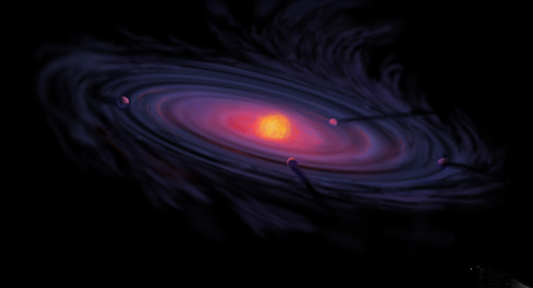
Giant Planet Formation and Snowlines in Protoplanetary Disks
Ana-Maria Piso¹
Karin Öberg¹, Ruth Murray-Clay², Andrew Youdin³, Til Birnstiel^{1,4}
MIT Exoplanet Tea: October 7th, 2015
¹Harvard-Smithsonian Center for Astrophysics
²University of California Santa Barbara
³Steward Observatory, University of Arizona
⁴MPIA, Heidelberg

Slide 2
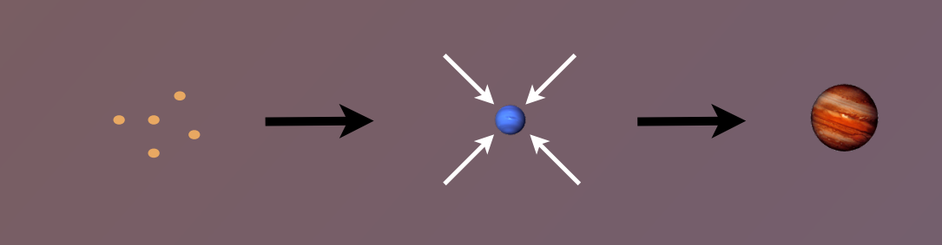
Core Accretion Model
The composition of planets is determined by and tightly linked to the disk composition

Slide 3
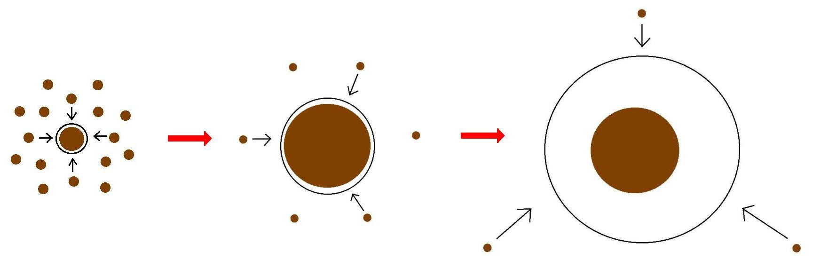
Minimum Core Masses for Giant Planet Formation
Part I

Slide 4
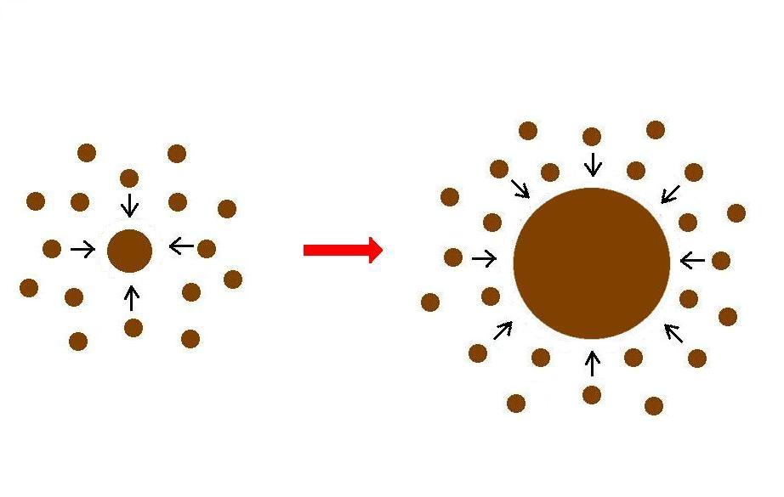
Giant planet formation requires fast core growth

Slide 5
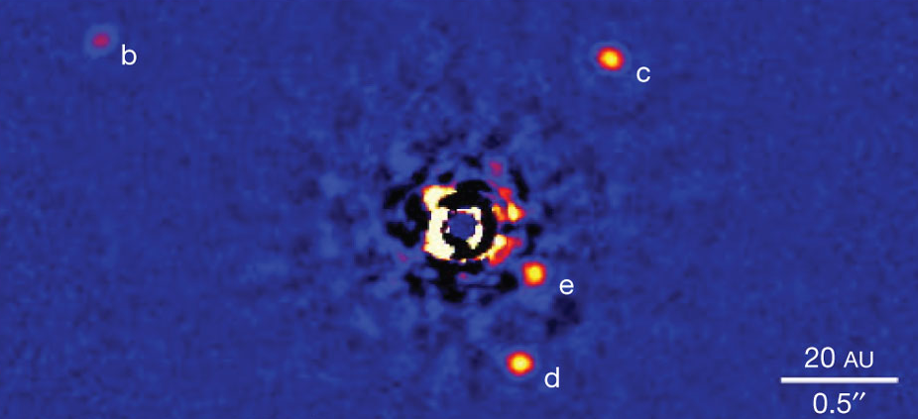
Marois+2010

Slide 6
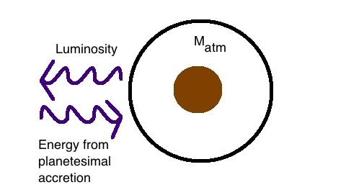
Core Accretion at high planetesimal accretion rates yields steady state
=> M_{atm} is a function of M_{core}
M_{core}

Slide 7

High planetesimal accretion
ONE M_{atm} for each M_{core}
=> ONE core mass for which M_{atm} ~ M_{core} = “critical core mass”
M_{atm,2}
M_{atm,1}
M_{core,1}
M_{core,2}

Slide 8
Planetesimal accretion is not constant at a given location throughout disk life
e.g., Pollack+96, Ikoma+00
M_{atm} << M_{core}
HIGH dM_{core}/dt
M_{atm} << M_{core}
dM_{core}/dt goes down
M_{atm} ≤ M_{core}
LOW dM_{core}/dt

Slide 9
Planetesimal accretion is not constant at a given location throughout disk life
e.g., Pollack+96, Ikoma+00
M_{atm} << M_{core}
HIGH dM_{core}/dt
M_{atm} << M_{core}
dM_{core}/dt goes down
M_{atm} ≤ M_{core}
LOW dM_{core}/dt

Slide 10
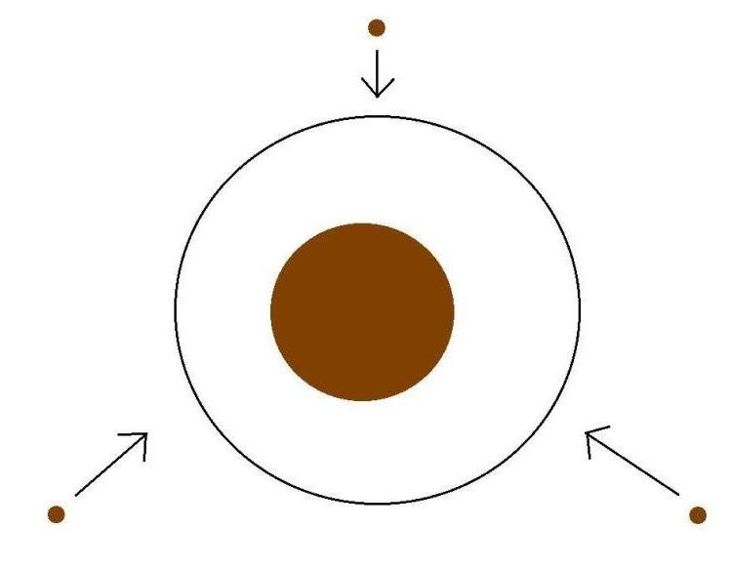
Low planetesimal accretion regime
Atmospheric evolution dominated by
Kelvin-Helmholtz contraction
M_{atm}
M_{core}
M_{atm} ≤ M_{core}
LOW dM_{core}/dt

Slide 11
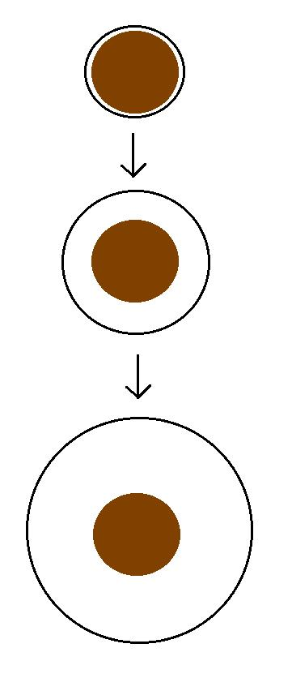
Kelvin-Helmholtz contraction
M_{atm} is a function of time
=> EVERY core can have
M_{atm} ~ M_{core}
“critical core mass”
M_{crit} = M_{core} for which
M_{atm}(t_{disk}) ~ M_{core}
M_{atm}(t₁)
M_{core}
M_{atm}(t₂)
M_{core}
M_{atm}(t₃) ~ M_{core}
M_{core}

Slide 12
GOAL
Determine the minimum core mass, M_{crit}, to form a giant planet during the disk lifetime in the low planetesimal accretion regime when atmosphere dominated by KH contraction
Calculate M_{crit} with
REALISTIC EQUATION OF STATE (EOS)
REALISTIC DUST OPACITIES

Slide 13
Model Assumptions
Negligible planetesimal accretion => solid core of fixed mass M_{c}
Atmosphere is embedded in the gas disk, spherically symmetric and in hydrostatic balance
Two layer atmosphere: inner convective region and outer radiative region
Constant luminosity throughout the radiative region
see Piso & Youdin (2014) for details

Slide 14
Static profiles connected by global cooling equation
CONVECTIVE
RADIATIVE
L ~ -dE/dt
a = 10 AU, M_{c} = 5 M_{E}
Adiabatic gradient relates P, T, rho => determines atmospheric profile and parametrizes EOS
a = 10 AU, M_{c} = 5 M_{E}

Slide 15
Atmospheric evolution and M_{crit} are highly dependent on
EQUATION OF STATE
DUST OPACITY

Slide 16
Atmospheric evolution and M_{crit} are highly dependent on
EQUATION OF STATE
DUST OPACITY

Slide 17
Adiabatic gradient is variable for realistic EOS
Piso, Youdin, & Murray-Clay (2015)

Slide 18
Adiabatic gradient is variable for realistic EOS
Saumon+95
Piso, Youdin, & Murray-Clay (2015)
Our extension

Slide 19
Adiabatic gradient is variable for realistic EOS
Piso, Youdin, & Murray-Clay (2015)
H2 dissociation
H ionization
Ideal gas

Slide 20
Adiabatic gradient is variable for realistic EOS
Piso, Youdin, & Murray-Clay (2015)
Partially excited H₂ rotational states

Slide 21
Adiabatic gradient is variable for realistic EOS
H₂ spin isomers ORTHOHYDROGEN and PARAHYDROGEN can be in thermal equilibrium or fixed ratio
Piso, Youdin, & Murray-Clay (2015)
Ortho-para equilibrium
Fixed 3:1 ortho-to-para ratio
Partially excited H₂ rotational states

Slide 22
Adiabatic gradient is variable for realistic EOS => M_{crit} > 10 M_{E}!
H₂ spin isomers ORTHOHYDROGEN and PARAHYDROGEN can be in thermal equilibrium or fixed ratio
Piso, Youdin, & Murray-Clay (2015)
Ortho-para equilibrium
Fixed 3:1 ortho-to-para ratio
Partially excited H₂ rotational states

Slide 23
Atmospheric evolution and M_{crit} are highly dependent on
EQUATION OF STATE
DUST OPACITY

Slide 24
Atmospheric evolution and M_{crit} are highly dependent on
EQUATION OF STATE
DUST OPACITY

Slide 25
Grain growth opacity DECREASES M_{crit}
dN/ds ~ s^{-p}
p = 3.5
s_{max} = 1 cm

Slide 26
Grain growth opacity DECREASES M_{crit}
dN/ds ~ s^{-p}
p = 3.5
s_{max} = 1 cm
t_disk ~ 3 Myr, realistic EOS
t_disk ~ 3 Myr, realistic EOS
Piso, Youdin, & Murray-Clay (2015)
Piso, Youdin, & Murray-Clay (2015)

Slide 27
Grain growth opacity DECREASES M_{crit}
dN/ds ~ s^{-p}
p = 3.5
s_{max} = 1 cm
M_{crit}:
~8 M_{E} @ 5 AU
~5 M_{E} @ 100 AU
t_disk ~ 3 Myr, realistic EOS
Piso, Youdin, & Murray-Clay (2015)

Slide 28
Grain growth opacity DECREASES M_{crit}
dN/ds ~ s^{-p}
p = 3.5
s_{max} = 1 cm
M_{crit}:
~8 M_{E} @ 5 AU
~5 M_{E} @ 100 AU
coagulation (p = 2.5)
t_disk ~ 3 Myr, realistic EOS
Piso, Youdin, & Murray-Clay (2015)

Slide 29
Summary of Part I
H₂ dissociation and variable occupation of H₂ rotational states INCREASE M_{crit} when compared to an ideal gas polytrope
Grain growth opacity DECREASES M_{crit} compared to ISM opacity
M_{crit} ~ 8 M_{E} at 5 AU and ~ 5 M_{E} at 100 AU for a realistic EOS with H₂ spin isomers in thermal equilibrium and grain growth opacity with standard collisional cascade (p=3.5) and s_{max}=1 cm
M_{crit} may decrease by up to one order of magnitude if coagulation is taken into account (p=2.5)

Slide 30
Core Accretion Model
The composition of planets is determined by and tightly linked to the disk composition

Slide 31
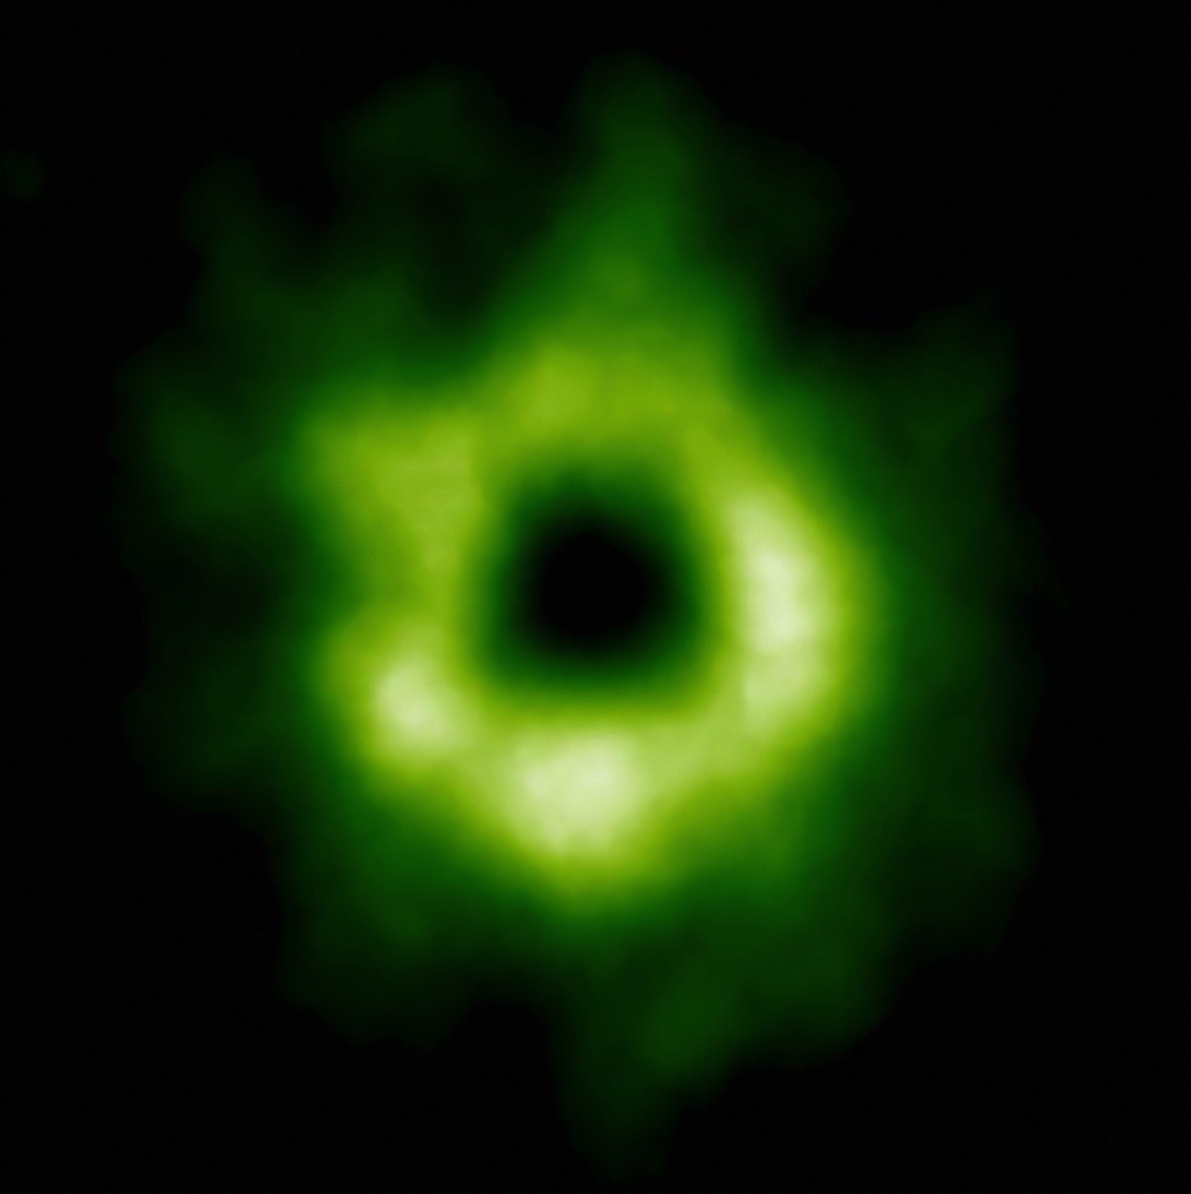
Snowline Locations in Protoplanetary Disks and C/O ratios
Part II
Notes:
Put the green TWHya figure instead.

Slide 32
BASIC IDEA
Understand the disk well enough to:
Predict what kind of planet compositions result from planet formation in different parts of the disk
Back-track the planet formation location based on the planet composition

Slide 33
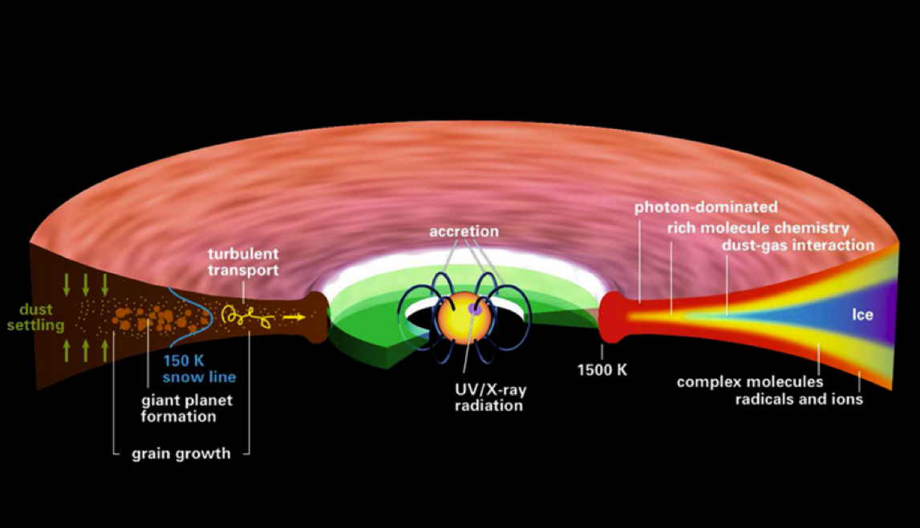
Disk structure is complex!
Henning&Semenov (2013)
Notes:
Remove the while and make the figure bigger.

Slide 34
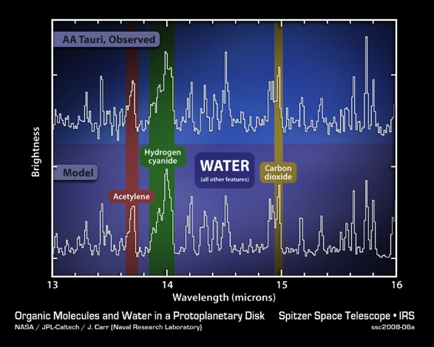
Volatile compounds have been detected in protoplanetary disks
Oberg+11
Notes:
Replace with spitzer water in disks spectrum image and DCO+ image.

Slide 35
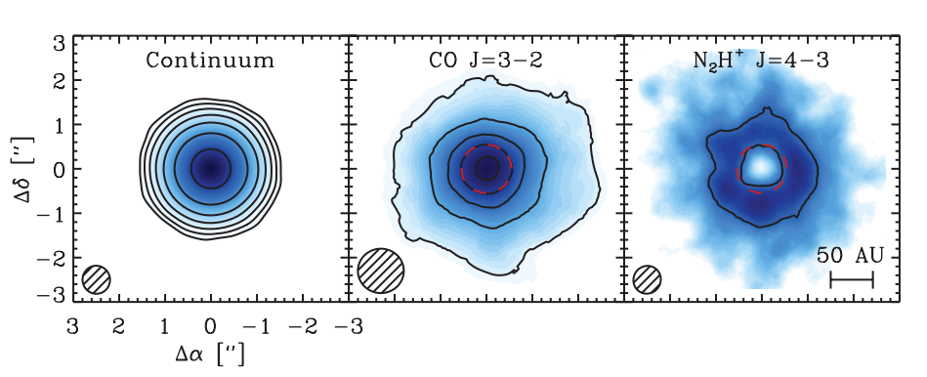
Snowlines of volatile molecules have been detected in disks
Qi+13

Slide 36
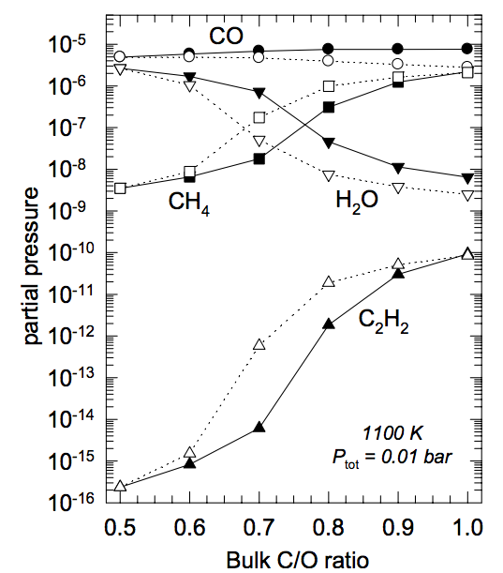
C/O ratio is an important signature of atmospheric chemistry
Lodders 2009

Slide 37
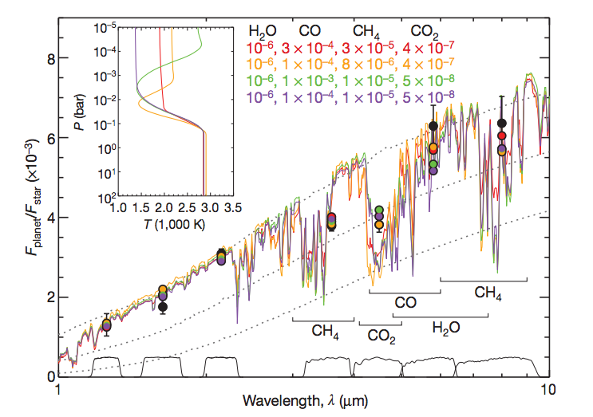
Some giant planets may have C/O ratios different from the stellar value of 0.54
Madhusudhan+11
Notes:
Show a slide before this with model predictions. Arxiv paper by katherine lodders.2009 figure 1.8

Slide 38
WHY?
Possible explanation: main carriers of C and O, i.e. H₂O, CO₂ and CO, have different condensation temperatures => variations in the abundances of C and O in solids and gas between the snow lines of these volatiles

Slide 39
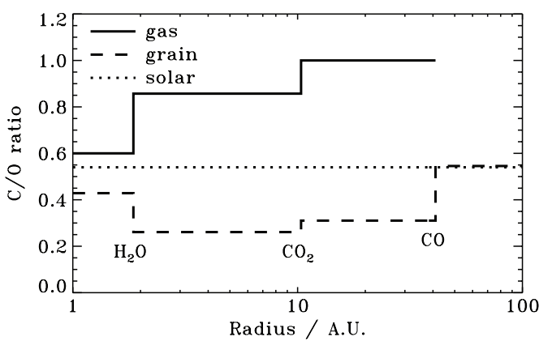
Oberg+11
After Oberg+11

Slide 40
Understand how radial drift and gas accretion affect snowline locations, and thus the C/O ratio in gas and dust throughout the disk
GOAL

Slide 41
Radial drift of solids
Gas moves at sub-Keplerian velocity:
v_{gas} ~ v_{K} (1-c_{s}² / v_{k}²)
Small particles (~micron size) move with the gas
Large particles (~km size) are unaffected by gas drag
“Intermediate sized” particles (~cm-m size) experience a headwind and drift towards the star

Slide 42
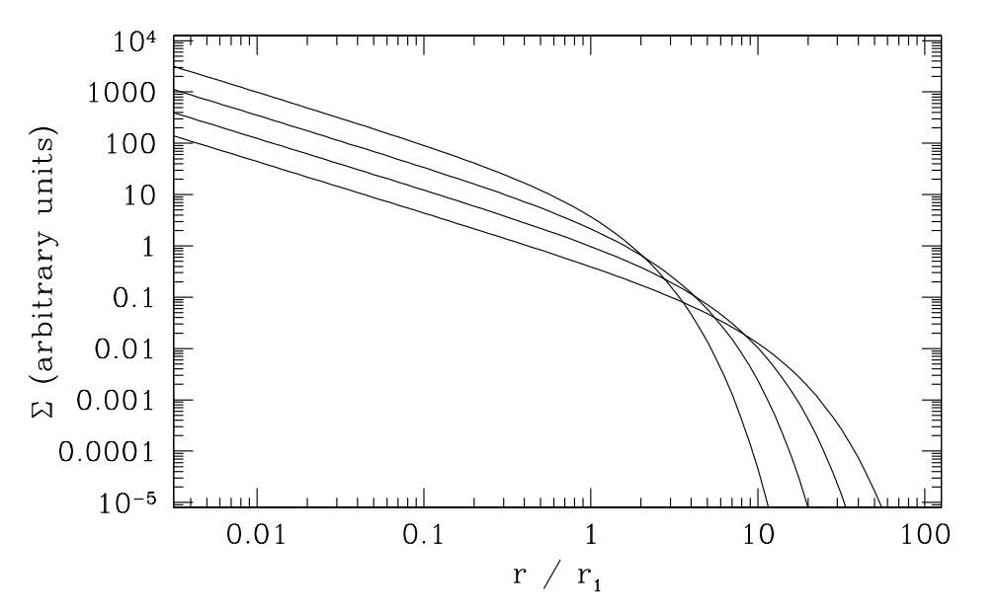
Gas disk accretes onto the central star
alpha-disk prescription: ν = α c_{s} H
Armitage 2009

Slide 43
Timescales for desorption, radial drift and gas accretion ARE comparable
Piso, Oberg, et al. (2015)
Piso+15

Slide 44
Radial drift affects snowline location
Piso, Oberg, et al. (2015)

Slide 45
We determined upper limits for the C/O ratio across the disk
Piso, Oberg, et al. (2015)

Slide 46
Summary of Part II
Radial drift and gas accretion affect desorption and move the snowline locations compared to a static disk
The H₂O, CO₂ and CO snowlines are created by the largest drifting particles in our model, i.e. s ~ 7 m
Snowlines move inwards as the particle size increases
~60% for H₂O
~60% for CO₂
~50% for CO

Slide 47
NEXT STEPS
Henning&Semenov (2013)

Slide 48
Nitrogen gas is highly abundant compared to oxygen gas

Slide 49
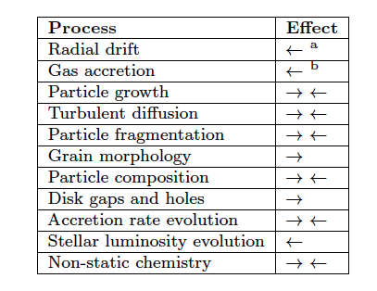
Additional chemical and dynamical processes to be explored
Piso+15

Slide 50
TAKEAWAY POINT
Radial drift and viscous gas accretion move the snowline locations inwards. This affects the C/O ratio in gas and dust throughout the disk, and thus has direct implications in shaping the compositions of nascent giant planets.
Notes:
Add one slides 20, 21, 31 before this.

