Slide 1
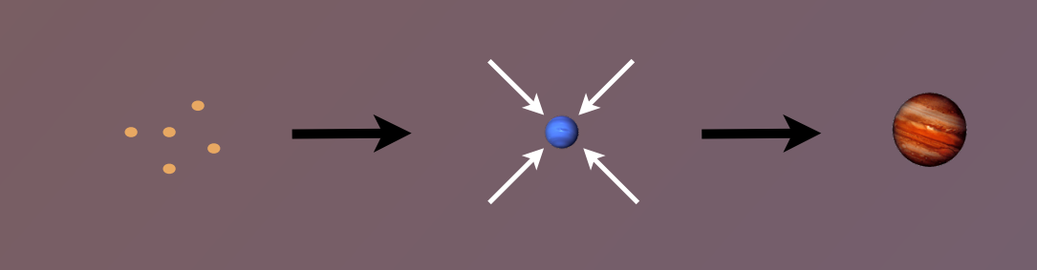
Origins of Gas Giant Compositions Ana-Maria Piso, EPSS Department
PLANET COMPOSITIONS
determined by and tightly linked to
DISK COMPOSITION

Slide 2
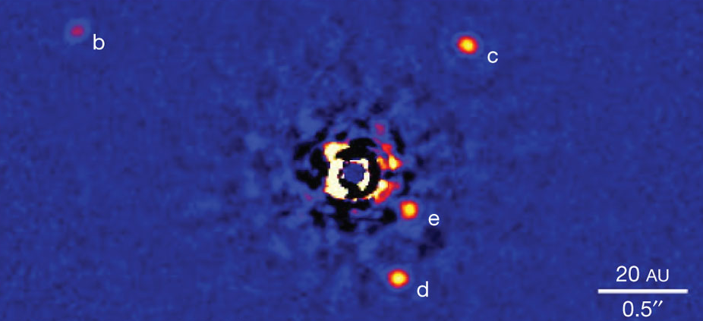
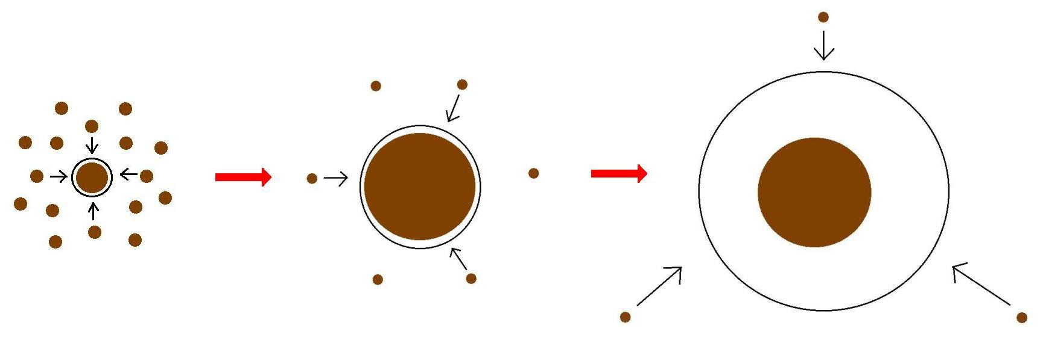
Where in the disk can giant planets form?
What is the
MINIMUM CORE MASS
required to form a gas giant through
CORE ACCRETION?

Slide 3
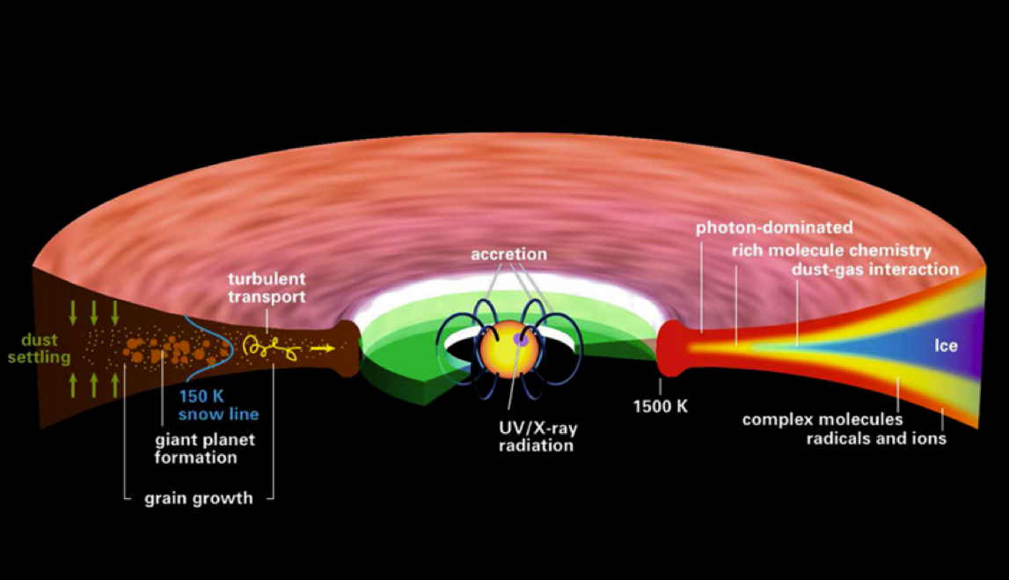
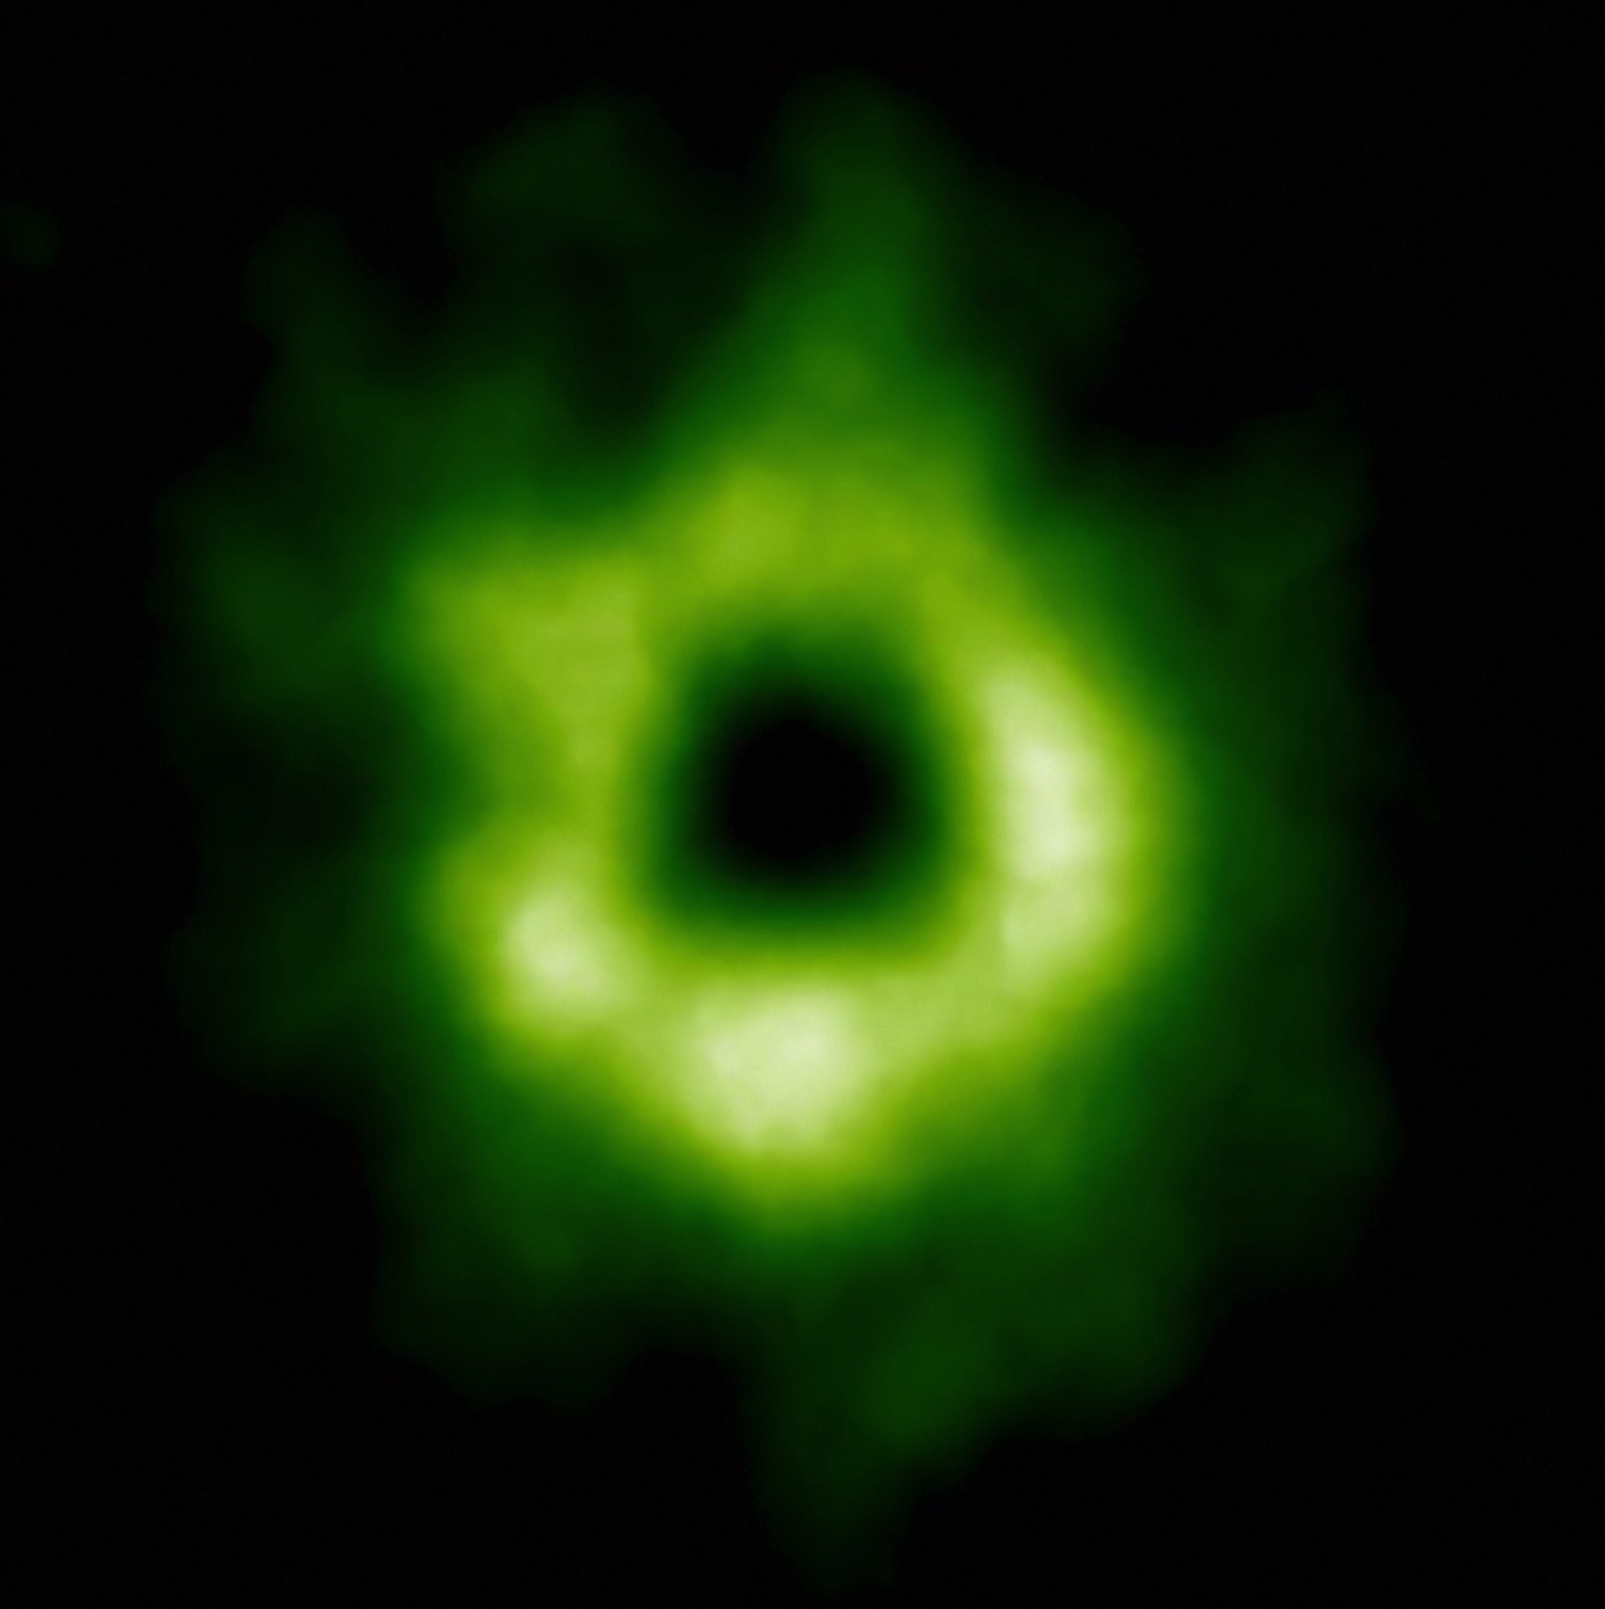
What compositions will the formed giant planets have obtained?
What is the effect of DISK COMPOSITION and
DYNAMICS
on …
… SNOWLINE LOCATIONS
and
ELEMENTARY RATIOS (C/N/O)
in disks and planets?

