Slide 1
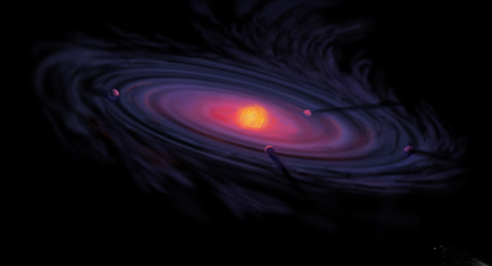
Giant Planet Formation and Snowlines in Protoplanetary Disks
Ana-Maria Piso
Harvard-Smithsonian Center for Astrophysics
CIPS Seminar: September 30th , 2015

Slide 2
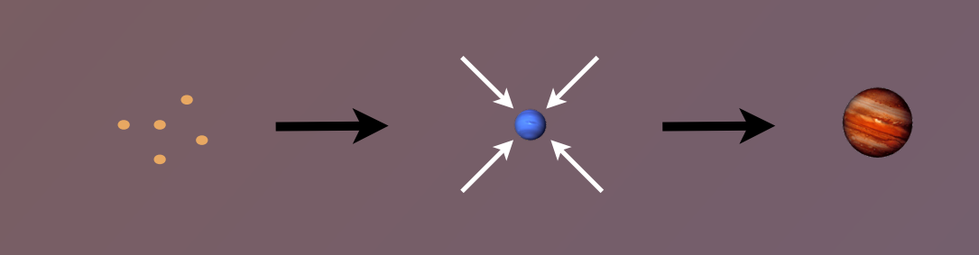
Core Accretion Model
The composition of planets is determined by and tightly linked to the disk composition

Slide 3
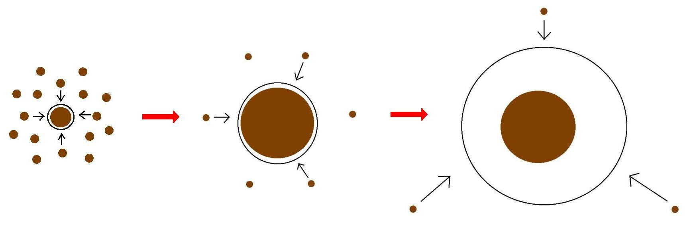
Minimum Core Masses for Giant Planet Formation
Part I

Slide 4
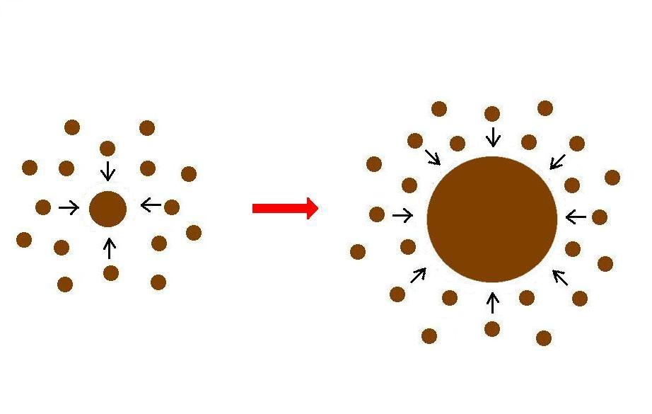
Giant planet formation requires fast core growth

Slide 5
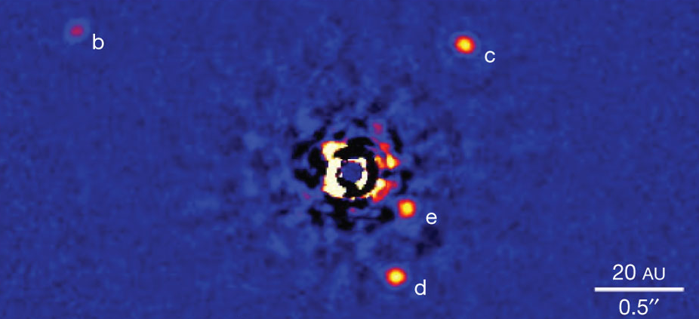
Marois+2010

Slide 6
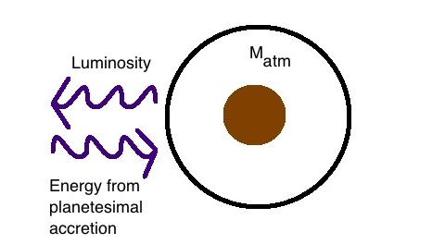
Core Accretion at high planetesimal accretion rates yields steady state
=> M_{atm} is a function of M_{core}
M_{core}

Slide 7

High planetesimal accretion
ONE M_{atm} for each M_{core}
=> ONE core mass for which M_{atm} ~ M_{core} = “critical core mass”
M_{atm,2}
M_{atm,1}
M_{core,1}
M_{core,2}
Notes:
So let’s look at this a bit more closely: since the mass of the atmosphere is a function of the core mass, every core mass will uniquley map to one atmosphere mass; moreover, as the core grows larger, it will hold a fractionally larger atmosphere mass; so at some point in this evolution, the masses of the atmosphere and core will become roughly equal, at which point a process of rapid gas accretion starts and a massive atmosphere is accumulated; this core mass is well defined for a set of disk conditions, and it’s called the critical core mass. Now, this is the story when planetesimal accretion occurs at the standard rate.

Slide 8
Planetesimal accretion is not constant at a given location throughout disk life
e.g., Pollack+96, Ikoma+00
M_{atm} << M_{core}
HIGH dM_{core}/dt
M_{atm} << M_{core}
dM_{core}/dt goes down
M_{atm} ≤ M_{core}
LOW dM_{core}/dt
Notes:
However, planetesimal accretion need not be constant at given location in the disk throughout the disk life, and there are studies that have made this assumptions. So let’s imagine a different scenario. First, we are in the standard case; we have a high planetesimal accretion rate, so the core grows, but the atmosphere remains small; then at some point later on, the core has grown more massive, but the atmosphere remains small by comparison. At this point, planetesimal accretion slows down. So now the core no longer grows significantly; the atmosphere still loses energy but is not gaining any from planetesimals anymore. Instead, now the energy is given by the contraction of the envelope due to gas accretion.

Slide 9
Planetesimal accretion is not constant at a given location throughout disk life
e.g., Pollack+96, Ikoma+00
M_{atm} << M_{core}
HIGH dM_{core}/dt
M_{atm} << M_{core}
dM_{core}/dt goes down
M_{atm} ≤ M_{core}
LOW dM_{core}/dt
Notes:
However, planetesimal accretion need not be constant at given location in the disk throughout the disk life, and there are studies that have made this assumptions. So let’s imagine a different scenario. First, we are in the standard case; we have a high planetesimal accretion rate, so the core grows, but the atmosphere remains small; then at some point later on, the core has grown more massive, but the atmosphere remains small by comparison. At this point, planetesimal accretion slows down. So now the core no longer grows significantly; the atmosphere still loses energy but is not gaining any from planetesimals anymore. Instead, now the energy is given by the contraction of the envelope due to gas accretion.

Slide 10
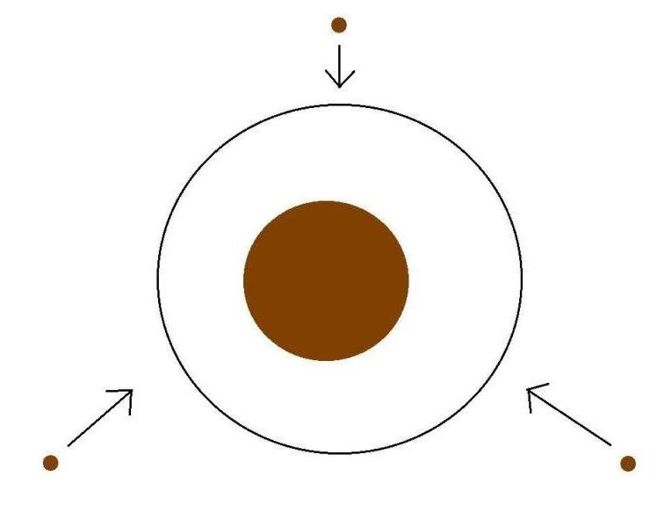
Low planetesimal accretion regime
Atmospheric evolution dominated by
Kelvin-Helmholtz contraction
M_{atm}
M_{core}
M_{atm} ≤ M_{core}
LOW dM_{core}/dt
Notes:
So if we’re in this scenario of low planetesimal accretion, the luminosity evolution of the atmosphere will be dominated by KH contraction.

Slide 11
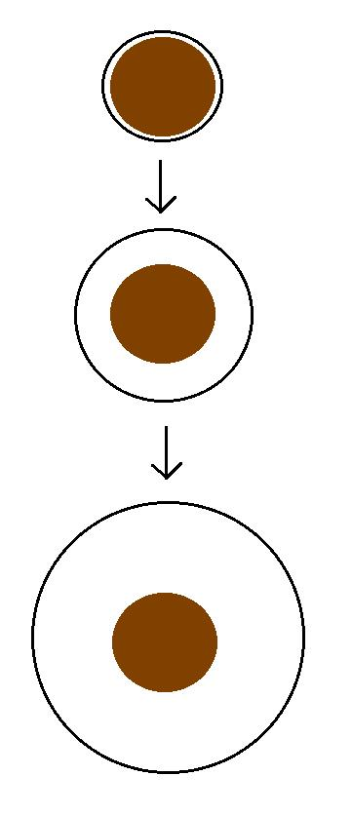
Kelvin-Helmholtz contraction
M_{atm} is a function of time
=> EVERY core can have
M_{atm} ~ M_{core}
“critical core mass”
M_{crit} = M_{core} for which
M_{atm}(t_{disk}) ~ M_{core}
M_{atm}(t₁)
M_{core}
M_{atm}(t₂)
M_{core}
M_{atm}(t₃) ~ M_{core}
M_{core}
Notes:
So in this regime, there is no longer a steady state, but rather the atmosphere mass is a function of time; now core growth is negligible; so you start with a small atmosphere that gradually grows until it become comparable to the core mass; so in this scenario, every core can have an atmosphere equal to its own and become critical

Slide 12
GOAL
Determine the minimum core mass, M_{crit}, to form a giant planet during the disk lifetime in the low planetesimal accretion regime when atmosphere dominated by KH contraction
Calculate M_{crit} with
REALISTIC EQUATION OF STATE (EOS)
REALISTIC DUST OPACITIES
Notes:
Why Lacc=0?
- to get around the difficulty to form a giant planet a large distances throigh core acc
- you can depleted zone of planetesimals
- move the core

Slide 13
Model Assumptions
Negligible planetesimal accretion => solid core of fixed mass M_{c}
Atmosphere is embedded in the gas disk, spherically symmetric and in hydrostatic balance
Two layer atmosphere: inner convective region and outer radiative region
Constant luminosity throughout the radiative region
see Piso & Youdin (2014) for details

Slide 14
Static profiles connected by global cooling equation
CONVECTIVE
RADIATIVE
L ~ -dE/dt
a = 10 AU, M_{c} = 5 M_{E}
Adiabatic gradient relates P, T, rho => determines atmospheric profile and parametrizes EOS
a = 10 AU, M_{c} = 5 M_{E}

Slide 15
Atmospheric evolution and M_{crit} are highly dependent on
EQUATION OF STATE
DUST OPACITY

Slide 16
Atmospheric evolution and M_{crit} are highly dependent on
EQUATION OF STATE
DUST OPACITY

Slide 17
Adiabatic gradient is variable for realistic EOS
Piso, Youdin, & Murray-Clay (2015)

Slide 18
Adiabatic gradient is variable for realistic EOS
Saumon+95
Piso, Youdin, & Murray-Clay (2015)
Our extension

Slide 19
Adiabatic gradient is variable for realistic EOS
Piso, Youdin, & Murray-Clay (2015)
H2 dissociation
H ionization
Ideal gas

Slide 20
Adiabatic gradient is variable for realistic EOS
Piso, Youdin, & Murray-Clay (2015)
Partially excited H₂ rotational states

Slide 21
Adiabatic gradient is variable for realistic EOS
H₂ spin isomers ORTHOHYDROGEN and PARAHYDROGEN can be in thermal equilibrium or fixed ratio
Piso, Youdin, & Murray-Clay (2015)
Ortho-para equilibrium
Fixed 3:1 ortho-to-para ratio
Partially excited H₂ rotational states

Slide 22
Variations in due to non-ideal EOS effects INCREASE M_{crit}
ad
t_disk ~ 3 Myr, ISM opacity
Piso, Youdin, & Murray-Clay (2015)
Notes:
Here I am plotting the critical core mass as a function of semimajor axis for an ideal diatomic gas. So you can see already that this value is smaller than the standard 10 Me even in the more inner parts of the disk; in a few moments I will show how this critical core mass compares to results from standard studies. But let’s first see what Mcrit depends on.

Slide 23
Atmospheric evolution and M_{crit} are highly dependent on
EQUATION OF STATE
DUST OPACITY

Slide 24
Atmospheric evolution and M_{crit} are highly dependent on
EQUATION OF STATE
DUST OPACITY

Slide 25
Grain growth opacity DECREASES M_{crit}
dN/ds ~ s^{-p}
p = 3.5
s_{max} = 1 cm
t_disk ~ 3 Myr, realistic EOS
t_disk ~ 3 Myr, realistic EOS
Piso, Youdin, & Murray-Clay (2015)
Piso, Youdin, & Murray-Clay (2015)

Slide 26
Grain growth opacity DECREASES M_{crit}
dN/ds ~ s^{-p}
p = 3.5
s_{max} = 1 cm
M_{crit}:
~8 M_{E} @ 5 AU
~5 M_{E} @ 100 AU
t_disk ~ 3 Myr, realistic EOS
Piso, Youdin, & Murray-Clay (2015)

Slide 27
Coagulation p=2.5 may decrease M_{crit} by up to one order of magnitude!
M_{c} = 4 M_{E}
Realistic EOS
Piso, Youdin, & Murray-Clay (2015)

Slide 28
Summary of Part I
H₂ dissociation and variable occupation of H₂ rotational states INCREASE M_{crit} when compared to an ideal gas polytrope
Grain growth opacity DECREASES M_{crit} compared to ISM opacity
M_{crit} ~ 8 M_{E} at 5 AU and ~ 5 M_{E} at 100 AU for a realistic EOS with H₂ spin isomers in thermal equilibrium and grain growth opacity with standard collisional cascade (p=3.5) and s_{max}=1 cm
M_{crit} may decrease by up to one order of magnitude if coagulation is taken into account (p=2.5)

Slide 29
Core Accretion Model
The composition of planets is determined by and tightly linked to the disk composition

Slide 30
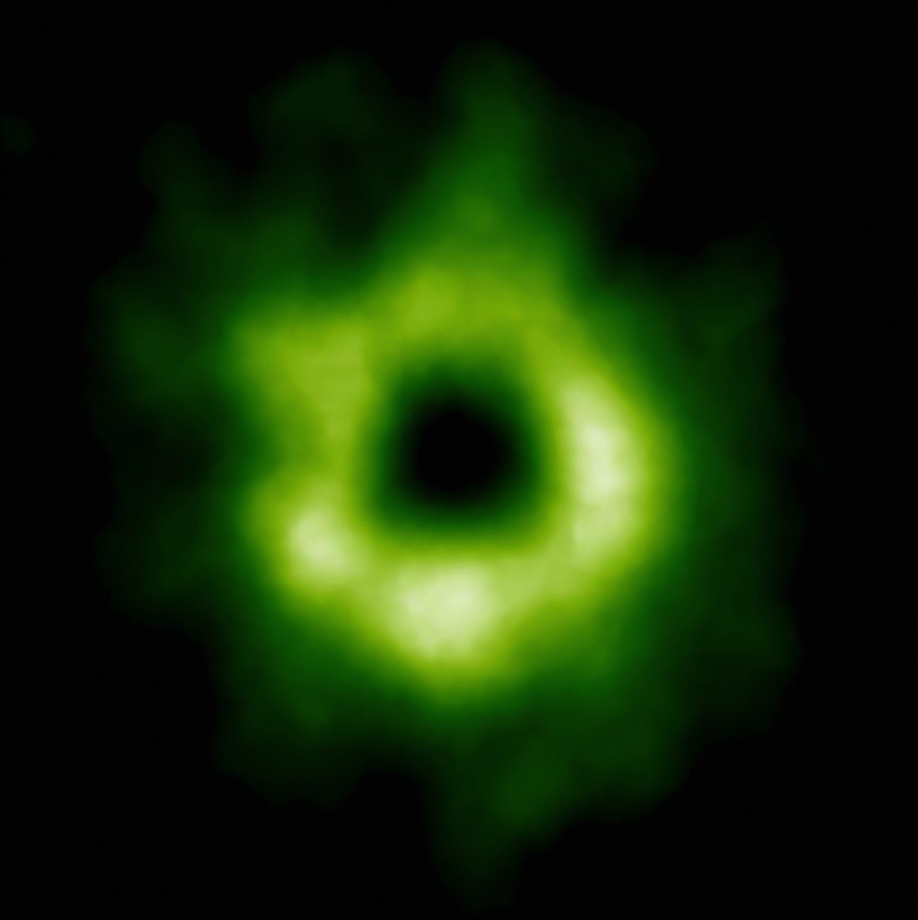
Snowline Locations in Protoplanetary Disks and C/O ratios
Part II
Notes:
Put the green TWHya figure instead.

Slide 31
BASIC IDEA
Understand the disk well enough to:
Predict what kind of planet compositions result from planet formation in different parts of the disk
Back-track the planet formation location based on the planet composition

Slide 32
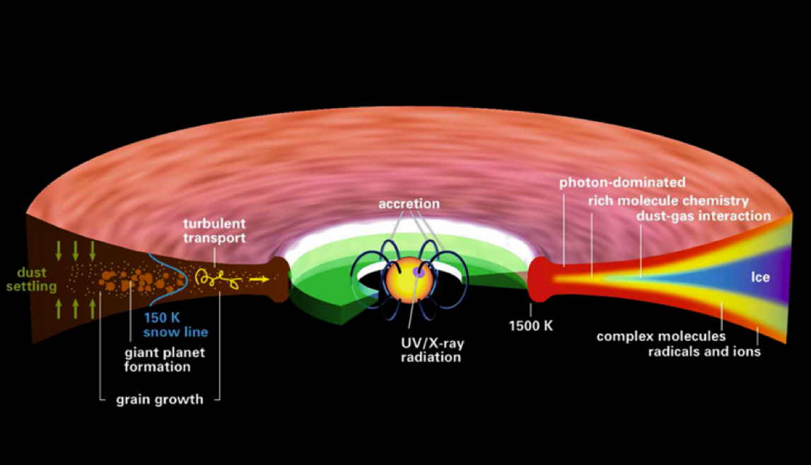
Disk structure is complex!
Henning&Semenov (2013)
Notes:
Remove the while and make the figure bigger.

Slide 33
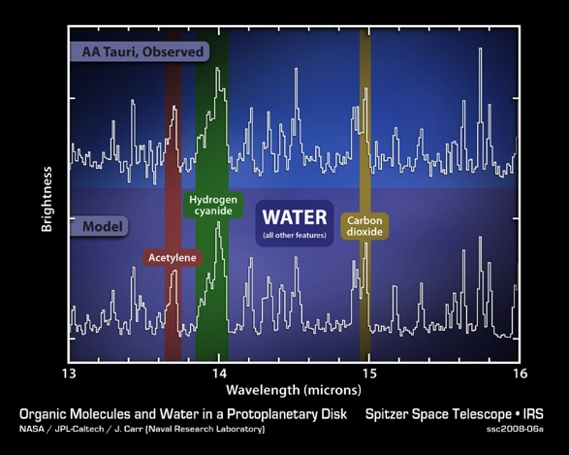
Volatile compounds have been detected in protoplanetary disks
Oberg+11
Notes:
Replace with spitzer water in disks spectrum image and DCO+ image.

Slide 34
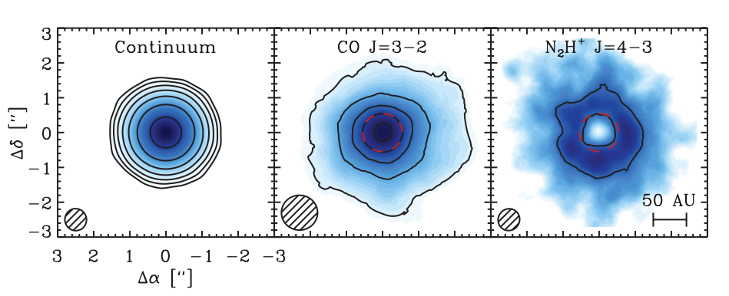
Snowlines of volatile molecules have been detected in disks
Qi+13

Slide 35
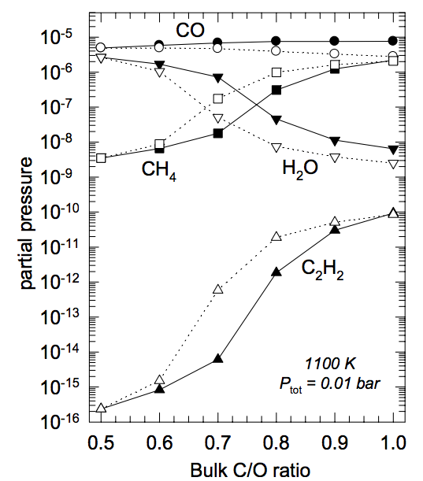
C/O ratio is an important signature of atmospheric chemistry
Lodders 2009

Slide 36
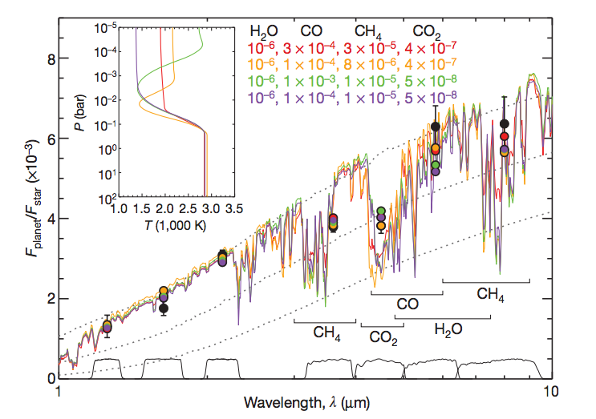
Some giant planets may have C/O ratios different from the stellar value of 0.54
Madhusudhan+11
Notes:
Show a slide before this with model predictions. Arxiv paper by katherine lodders.2009 figure 1.8

Slide 37
WHY?
Possible explanation: main carriers of C and O, i.e. H₂O, CO₂ and CO, have different condensation temperatures => variations in the abundances of C and O in solids and gas between the snow lines of these volatiles

Slide 38
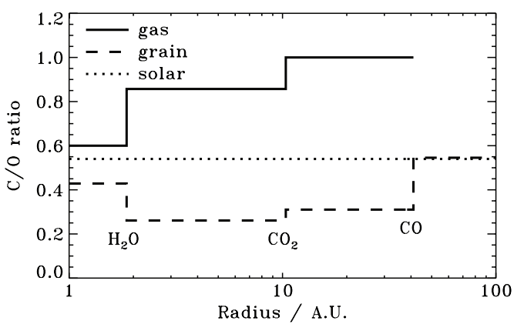
Oberg+11
After Oberg+11

Slide 39
Understand how radial drift and gas accretion affect snowline locations, and thus the C/O ratio in gas and dust throughout the disk
GOAL

Slide 40
Radial drift of solids
Gas moves at sub-Keplerian velocity:
v_{gas} ~ v_{K} (1-c_{s}² / v_{k}²)
Small particles (~micron size) move with the gas
Large particles (~km size) are unaffected by gas drag
“Intermediate sized” particles (~cm-m size) experience a headwind and drift towards the star

Slide 41
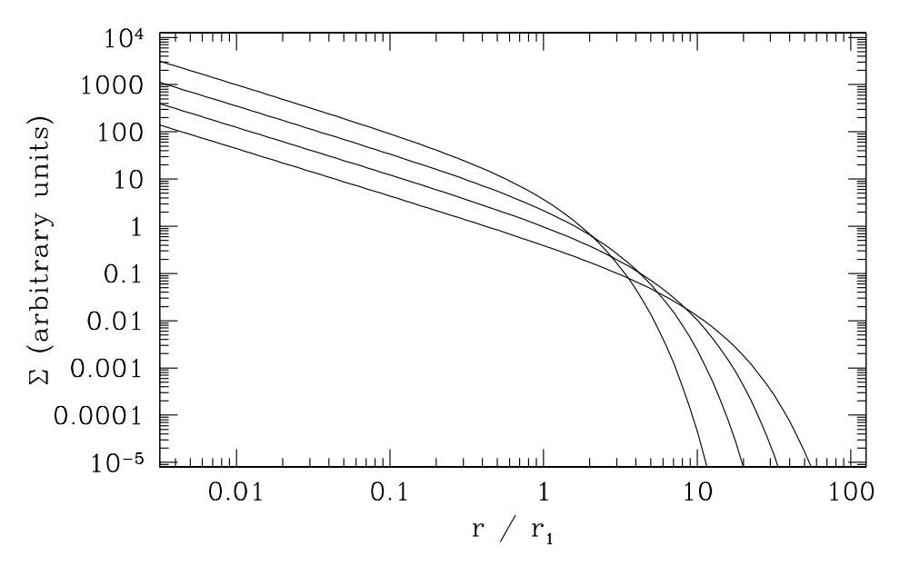
Gas disk accretes onto the central star
alpha-disk prescription: ν = α c_{s} H
Armitage 2009

Slide 42
Timescales for desorption, radial drift and gas accretion ARE comparable
Piso+15
Piso+15

Slide 43
Radial drift affects snowline location
Piso+15

Slide 44
We determined upper limits for the C/O ratio across the disk
Piso+15

Slide 45
The desorption distance for transition disks agrees with observations
Piso+15
Notes:
Cite TWHya paper

Slide 46
Summary of Part II
Radial drift and gas accretion affect desorption and move the snowline locations compared to a static disk
The H₂O, CO₂ and CO snowlines are created by the largest drifting particles in our model, i.e. s ~ 7 m
Snowlines move inwards as the particle size increases
~60% for H₂O
~60% for CO₂
~50% for CO
Our results for a transition disk are consistent with observations

Slide 47
NEXT STEPS

Slide 48
Nitrogen Abundance
Nitrogen is abundant in the Solar System and in disks, but its dominant form is largely unknown
Primarily found as N₂, but ~10% of nitrogen abundance may be carried by NH₃ (e.g., Lahuis & van Dishoeck 2000)
Can use abundance patterns both from the Solar System and from disk chemistry models (e.g., Schwarz & Bergin 2014) to define the range of abundance of different nitrogen carriers

Slide 49
Expected abundances of NH3 do not change N/O results significantly

Slide 50
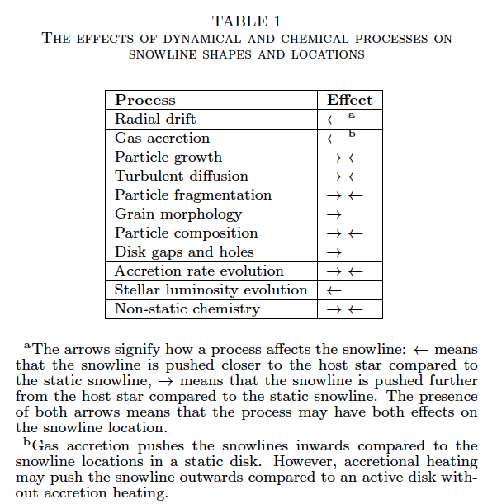
Additional chemical and dynamical processes to be explored
Piso+15

Slide 51
TAKEAWAY POINT
Radial drift and viscous gas accretion move the snowline locations inwards. This affects the C/O ratio in gas and dust throughout the disk, and thus has direct implications in shaping the compositions of nascent giant planets.
Notes:
Add one slides 20, 21, 31 before this.

