Slide 1
C/O and Snowline Locations in Protoplanetary Disks: The Effect of Radial Drift and Viscous Gas Accretion
Ana-Maria Piso
September 25th, 2015
Notes:
…and what I would like to talk about today is the minimum core mass for giant planet formation. Now, when we think of minimum core mass, we think core accretion. In core accretion, we know that for a giant planet to form it needs a solid core, that grows, and once it becomes massive enough it can then accumulate a significant atmosphere. How big of a core do we need? Well, typically this value is believed to be around 10 Me. However, this is not a constant, and it not only depends on where we are in the disk but also on how fast the core grows. Now why do we care about this? We have seen throughout this week giant planets imaged at wide separations. Now, we don’t know whether these planets formed through core accretion or not; but if they do, and if core accretion works at large separations, then it’s very important to understand how it works, and more importantly to be able to place a robust absolut minimum for a giant planet to form within the lifetime of the protoplanetary disk. And this is what I am going to talk about today.

Slide 2
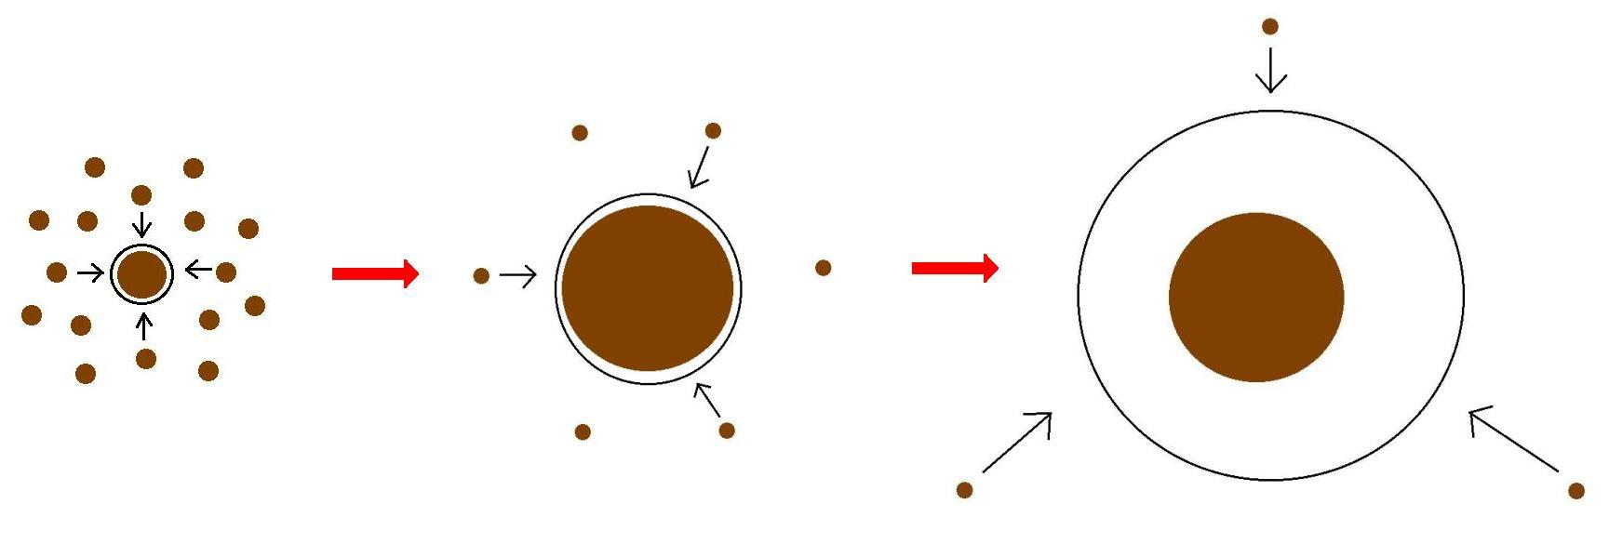
Core Accretion Model
The composition of planets is determined by and tightly linked to the disk composition

Slide 3
BASIC IDEA
Understand the disk well enough to:
Predict what kind of planet compositions result from planet formation in different parts of the disk
Back-track the planet formation location based on the planet composition

Slide 4
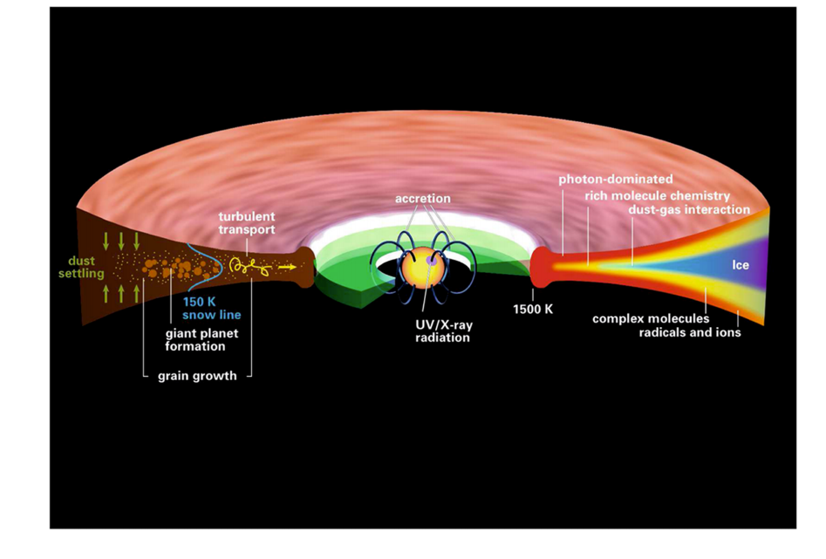
Disk structure is complex!
Henning&Semenov (2013)

Slide 5
MAIN GOAL
Explore and understand the dynamical and chemical processes occurring in disks, and their relative importance in shaping disk compositions throughout time
Primarily focus on understanding how all these processes affect the snowline location of volatile species

Slide 6
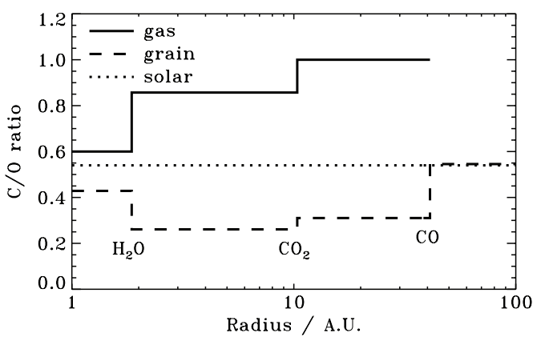
Oberg+11
After Oberg+11

Slide 7
Understand how radial drift and gas accretion affect snowline locations, and thus the C/O ratio in gas and dust throughout the disk
“SUB”-GOAL

Slide 8
Radial drift of solids
Gas moves at sub-Keplerian velocity:
v_{gas} ~ v_{K} (1-c_{s}² / v_{k}²)
Small particles (~micron size) move with the gas
Large particles (~km size) are unaffected by gas drag
“Intermediate sized” particles (~cm-m size) experience a headwind and drift towards the star

Slide 9
Timescales for desorption, radial drift and gas accretion ARE comparable
Piso+15
Piso+15

Slide 10
We determined upper limits for the C/O ratio across the disk
Piso+15

Slide 11
The desorption distance for transition disks agrees with observations
Piso+15

Slide 12
Summary
Radial drift and gas accretion affect desorption and move the snowline locations compared to a static disk
The H₂O, CO₂ and CO snowlines are created by the largest drifting particles in our model, i.e. s ~ 7 m
Snowlines move inwards as the particle size increases
Our results for a transition disk are consistent with observations

