Slide 1
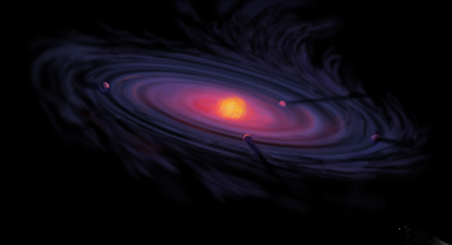
Origins of Gas Giant Compositions: The Role of Disk Location and Dynamics
Ana-Maria Piso

Slide 2
Fundamental Questions
Where in the disk can giant planets form?
What compositions will the formed giant planets have obtained?

Slide 3
Plot of exoplanets discovered to date

Slide 4
Picture of e.g. Jupiter and discuss why gas giants are important, and why we preferentially look at giant planets atmospheric spectra; there are also more problematic to form

Slide 5
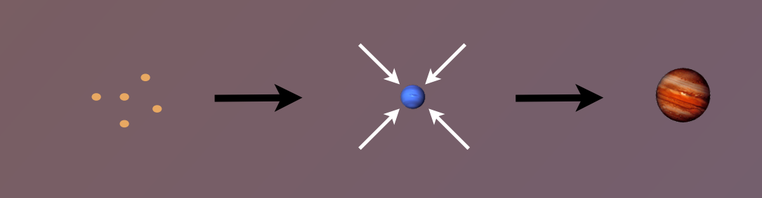
Maybe better to show standard molecular cloud to disk to planets plot from Karin’s thesis; better artist’s impression of disk
The composition of planets is determined by and tightly linked to the disk composition

Slide 6
The role of disk location in the formation of wide separation gas giants (Piso et al. 2014, 2015a)
The effect of disk structure and composition at different radii on the eventual composition of giant planets (Piso et al. 2015b, Piso et al. 2016)

Slide 7
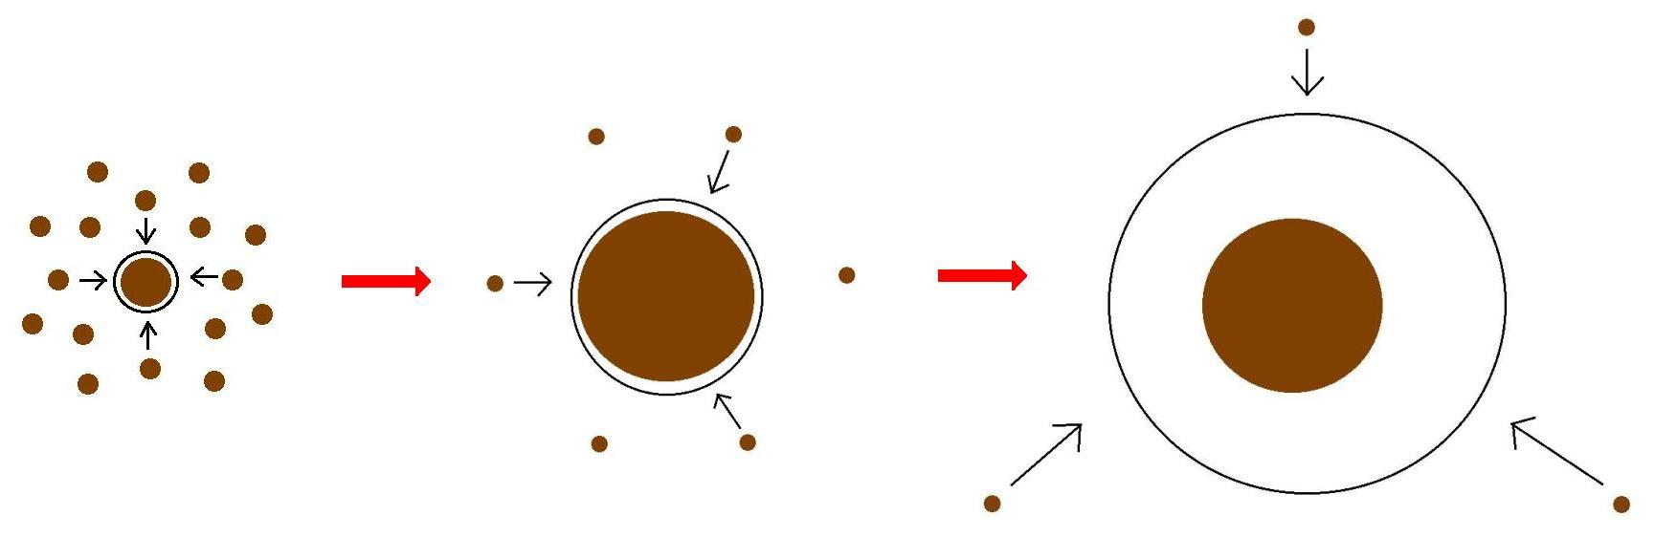
Minimum Core Masses for Giant Planet Formation

Slide 8
Core accretion sketches and intro from previous talks
Summary of model assumptions
Have delad plots
Show result for polytropic EOS, then realistic EOS, then grain growth; either show plot for grain growth with coagulation or mention that coagulation will significantly decrease Mcrit
Takeaway point: Mcrit is highly dependent on disk location and properties, and may be as low as 1 ME; have Hr 8799 plot again

Slide 9
The Role of Disk Dynamics and Ice Morphology for Snowlines and the C/N/O Ratios
Restate that disk compositions regulat planet compositions; show image of planet accreting disk material
Introductory slides with disk processes, volatile detections in disk, CO snowline, WASP 12 b C/O “detection” and show show a picture of JWST; put disk cartoon later, C/O theoretical model
Introduce the idea of Oberg+11 and show plot
We expand this model by… introductory drift slide and gas accretion slide
Show timescales plot?
Show C/O plot from Paper I
Lead with ice morphology for CO; show Edith’s plot, then C/O plot; at the end mentuon that CH4 doesn’t really matter; then go to nitrogen
But, other volatile to consider besides H2O, CO2, CO if we want to better constrain disk/planet compositions; i.e. nitrogen carriers; at the end mentuon that CH4 doesn’t really matter
Show top part of snowlines plot
Explain that nitrogen is abundant in the solar system and why it is primarily N2 (show e.g. comet abundance plot and Karin’s 2011 paper); N2 highly volatile hence N/O ratio may be more enhanced than C/O; moreover, there’s also some NH3
Snow N/O static disk plot and mention high enhancement
Snowlines are also highly dependent on ice morphology; show plot from Edith’s paper
Show N/O ratio plot (in stages) to demonstrate how disk dynamics and ice morphology affect snowline locations
Takeaway point 1: N/O ratio enhanced throughout most of the disk, more enhanced than C/O; thus could be used to a trace a planet’s formation origin
Takeaway point 2: CO and N2 snowline locations highly uncertain and can span several tens of AU due to disk dynamics and ice morphology; need observations

Slide 10
Summary slide restating results both from core accretion and snowlines papers
Future directions: table from paper I and chemical timescale plot from Semenov & Wiebe 2011 plot

Slide 11
Private defense
Show EOS plots
Show final vs initial distance plots
Show fractional mass vs distance/time plots?
Discuss time-dependent C/N/O ratios; show plot for steady state disk if it exists; show equations on how to further expand model for evolving disk

Slide 12
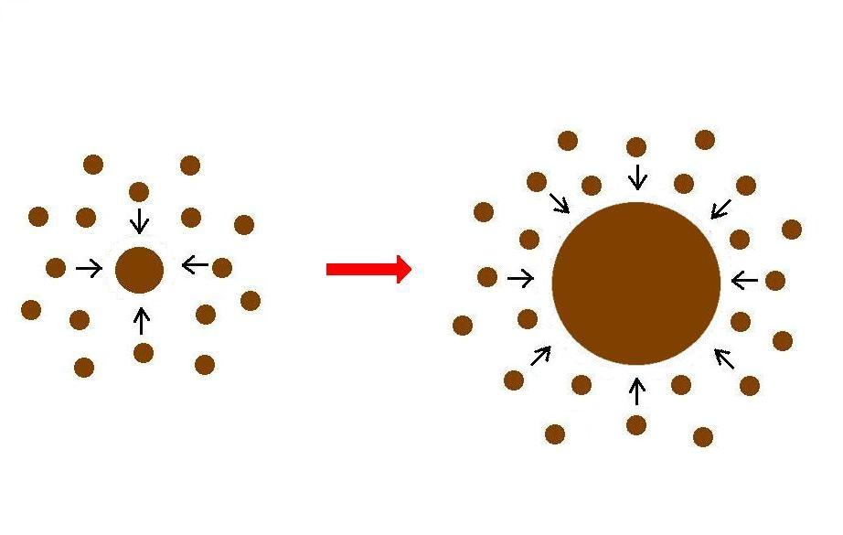
Giant planet formation requires fast core growth

Slide 13
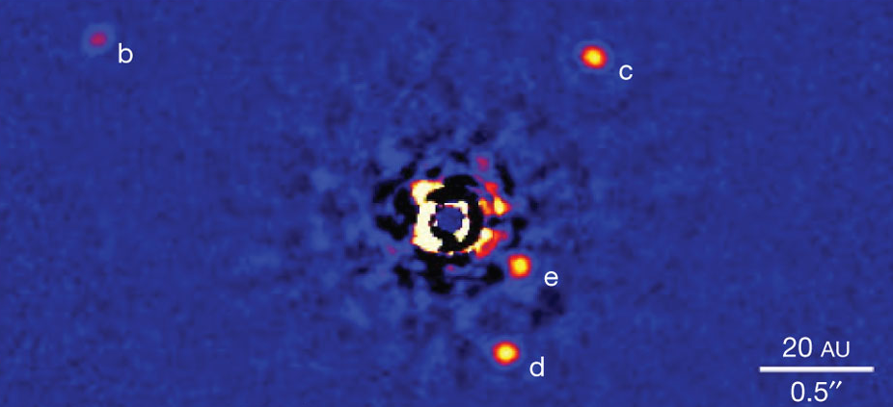
Marois+2010

Slide 14
Lowest M_{crit} requires the solid core to no longer grow
M_{atm} << M_{core}
HIGH dM_{core}/dt
M_{atm} << M_{core}
dM_{core}/dt goes down
M_{atm} ≤ M_{core}
LOW dM_{core}/dt

Slide 15
M_{crit} LOWER than 10 M_{E} for an ideal gas polytrope
t_disk ~ 3 Myr, ISM opacity
Piso & Youdin (2014)

Slide 16
Non-ideal Equation Of State (EOS) effects INCREASE M_{crit}
t_disk ~ 3 Myr, ISM opacity
Piso, Youdin, & Murray-Clay (2015)

Slide 17
Grain growth opacities DECREASE M_{crit}
t_disk ~ 3 Myr, realistic EOS
t_disk ~ 3 Myr, realistic EOS
Piso, Youdin, & Murray-Clay (2015)
Piso, Youdin, & Murray-Clay (2015)

Slide 18
Grain growth opacities DECREASE M_{crit}
M_{crit}:
~8 M_{E} @ 5 AU
~5 M_{E} @ 100 AU
t_disk ~ 3 Myr, realistic EOS
t_disk ~ 3 Myr, realistic EOS
Piso, Youdin, & Murray-Clay (2015)
Piso, Youdin, & Murray-Clay (2015)

Slide 19
Grain growth opacities DECREASE M_{crit}
M_{crit}:
~8 M_{E} @ 5 AU
~5 M_{E} @ 100 AU
coagulation
t_disk ~ 3 Myr, realistic EOS
Piso, Youdin, & Murray-Clay (2015)

Slide 20
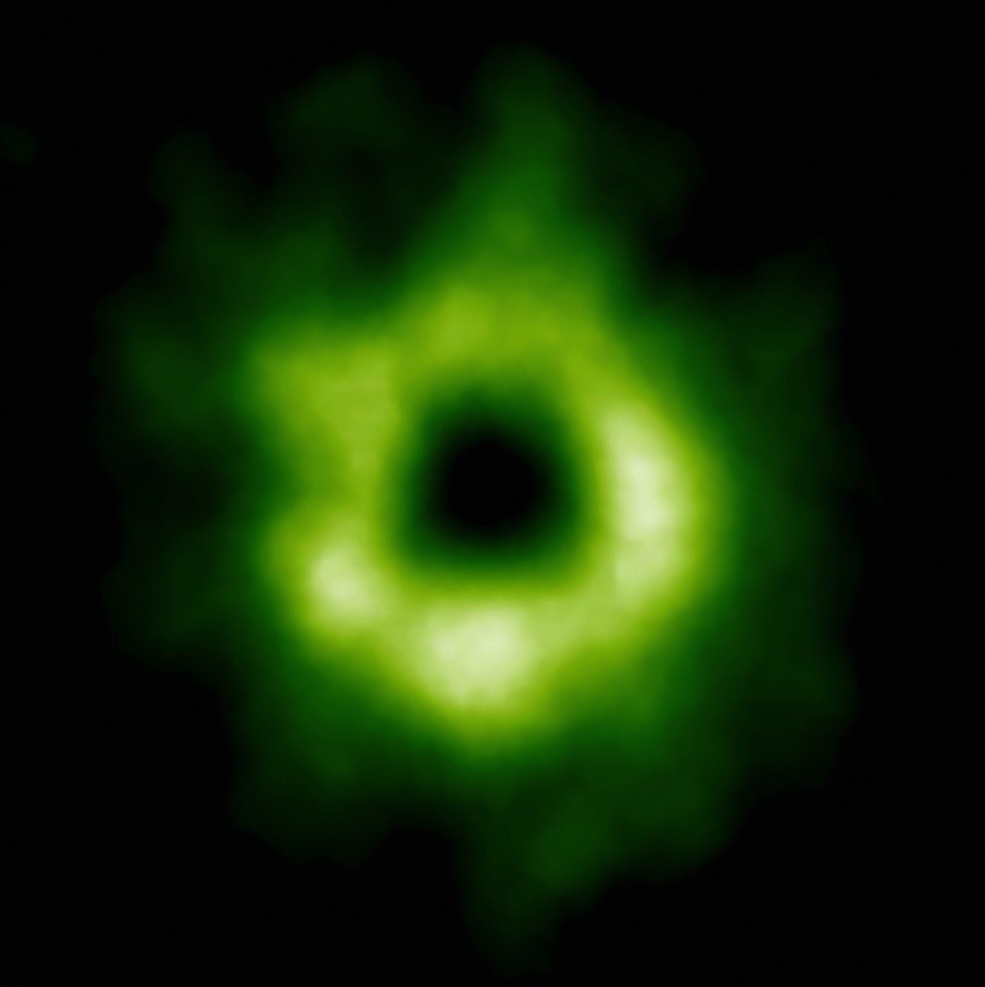
Snowline Locations in Protoplanetary Disks and C/O ratios

Slide 21
Disk Compositions Regulate Planet Compositions
Understand the disk well enough to:
Predict what kind of planet compositions result from planet formation in different parts of the disk
Back-track the planet formation location based on the planet composition

Slide 22
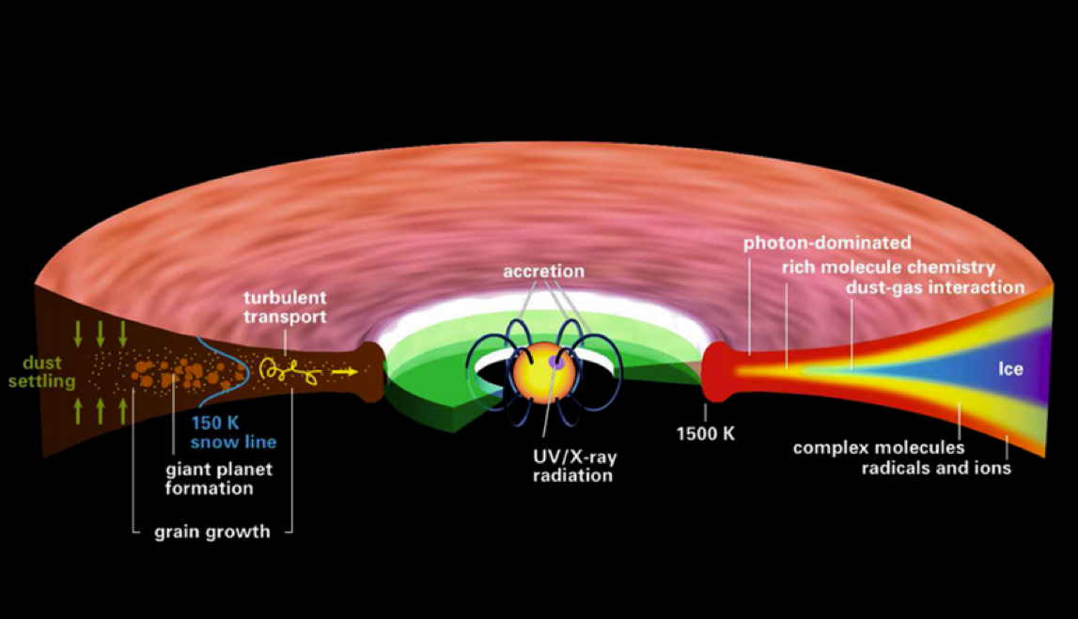
Disk structure is complex!
Henning&Semenov (2013)

Slide 23
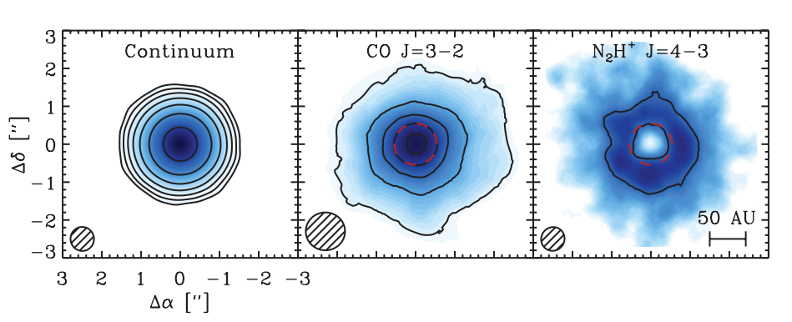
Snowlines of volatile molecules have been detected in disks
Qi+13

Slide 24
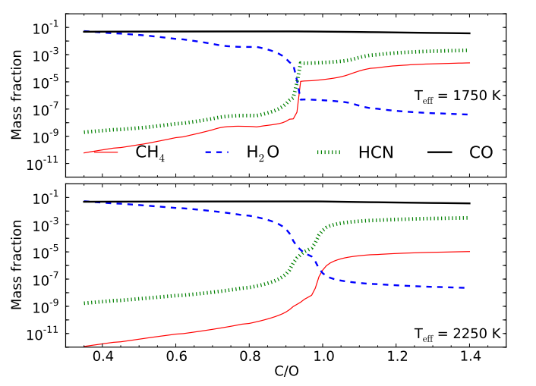
C/O ratio is an important signature of atmospheric chemistry
Molliere+15

Slide 25
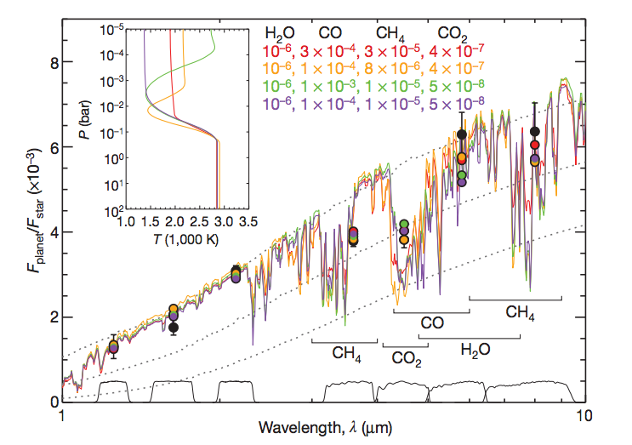
Some giant planets may have C/O ratios different from the stellar value of 0.54
Madhusudhan+11

Slide 26
C/O ratios in gas and dust are different at different radii
Main carriers of C and O, i.e. H₂O, CO₂ and CO, have different condensation temperatures => variations in the abundances of C and O in solids and gas between the snow lines of these volatiles

Slide 27
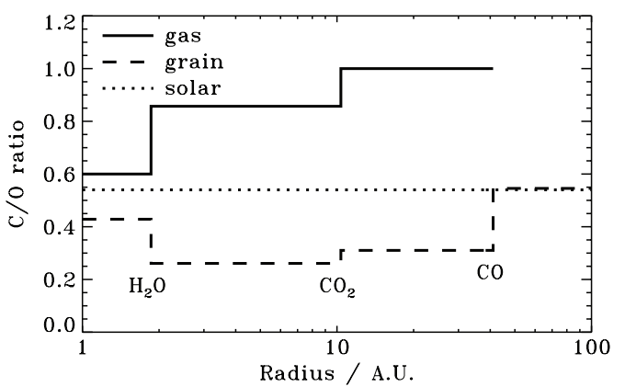
Oberg+11
After Oberg+11

Slide 28
Understand how radial drift and gas accretion affect snowline locations, and thus the C/O ratio in gas and dust throughout the disk
GOAL

Slide 29
Radial drift of solids
Gas moves at sub-Keplerian velocity:
v_{gas} ~ v_{K} (1-c_{s}² / v_{k}²)
Small particles (~micron size) move with the gas
Large particles (~km size) are unaffected by gas drag
“Intermediate sized” particles (~cm-m size) experience a headwind and drift towards the star

Slide 30
Timescales for desorption, radial drift and gas accretion ARE comparable
Piso, Oberg, Birnstiel, Murray-Clay (2015)

Slide 31
Radial drift affects snowline location
Piso, Oberg, Birnstiel, Murray-Clay (2015)

Slide 32
We determined upper limits for the C/O ratio across the disk
Piso, Oberg, Birnstiel, Murray-Clay (2015)

Slide 33
The desorption distance for transition disks agrees with observations
Piso, Oberg, Birnstiel, Murray-Clay (2015)
Notes:
Cite TWHya paper

Slide 34
Summary
The minimum core mass for giant planet formation is ~8 M_{E} @ 5 AU decreasing to ~5 M_{E} @ 100 AU and may be as low as ~1 M_{E}
Radial drift and gas accretion affect desorption and move the snowline locations compared to a static disk
The H₂O, CO₂ and CO snowlines are created by the largest drifting particles in our model, i.e. s ~ 7 m
H₂O, CO₂, CO snowlines move inwards as the particle size increases by up to 50-60%
Our results for a transition disk are consistent with observations

