Slide 1

DGMD14: WEARABLE DEVICES & COMPUTER VISION
FINAL PROJECT: VIRTUAL REALITY OPERATING ROOM
Type of Project: Engineering
Level: Graduate
Group Members:
Nicholas Weber
Ali PiyarAli
Josef Svoboda
DGMD14: WEARABLE DEVICES & COMPUTER VISION

Slide 2
PROJECT SUMMARY & KEY RESULTS
Development of a 3D operating room using Unity which is integrated with a VR wearable (Meta Quest 2) for potential use in medical education:
Creation of the operating room scene with relevant prefabs
Scripting scene creation, object placement, and player movement within the level
Scripting object pick-up and drop actions using physics libraries and raycasting
Scripting object collection in the center of the scene with visual feedback
Integration with Meta Quest 2
DGMD14: WEARABLE DEVICES & COMPUTER VISION

Slide 3
BACKGROUND REVIEW & PREVIOUS WORK IN THE SPACE
Virtual Reality (VR) is a quickly growing field with wide range of applications, mainly entertainment and education
Unity 3D is a real-time editor with physics, graphics, and input handling libraries.
Some previous VR applications in the medical field include:
Exposure therapy for phobias
AR autism treatment to interpret human emotions
An anatomy teaching platform in VR
A surgical teaching platform
DGMD14: WEARABLE DEVICES & COMPUTER VISION

Slide 4
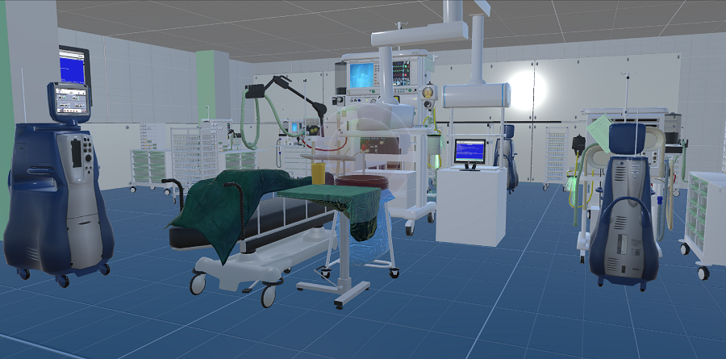
METHODOLOGY
Requirements: Unity, Oculus (Quest Link), Meta Quest 2 (VR Wearable), and C#
Operating Room Scene
Scene Graph
Entity-Component Architecture
Prefabs
DGMD14: WEARABLE DEVICES & COMPUTER VISION

Slide 5
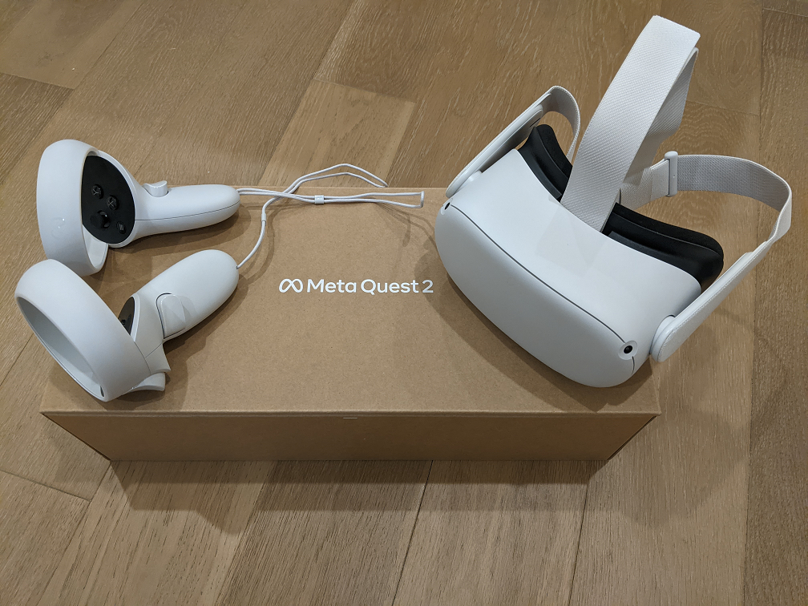
METHODOLOGY
Components & Scripting
Object Placement/Spawning (Poisson Disk Sampling)
Player Movement (Custom & Unity Standard Assets)
Picking Up and Dropping Objects
Collecting Object with Visual Feedback
Hardware Integration: Meta Quest 2
DGMD14: WEARABLE DEVICES & COMPUTER VISION

Slide 6
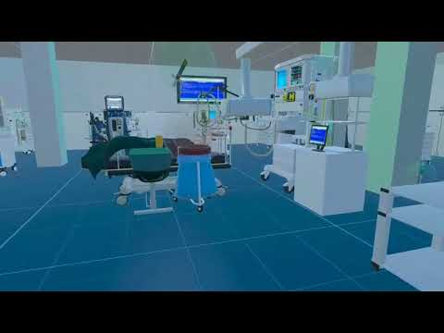
DEMO & RESULTS
This video was cast from Meta Quest 2 headset to a mobile device for recording.
DGMD14: WEARABLE DEVICES & COMPUTER VISION

Slide 7
CONCLUSION & POTENTIAL NEXT STEPS
We have developed a Unity 3D game of an operating room setting with movement and object manipulation for simulating surgery preparation
This can be further extended for specific surgeries with a tutorial interface, specific order of object interaction, non-random object creation, and/or educational aspects.
Improvement of complex VR controls.
Gamification systems, such as scoring and achievements, could promote skill training.
DGMD14: WEARABLE DEVICES & COMPUTER VISION

