Slide 1
Suicide Rate Analysis
By:
Mallory Olajide
Adriana Pizana
Esteban Quintanilla
Albert Alvarado

Slide 2
Research Questions
How are the US suicide rates compared to the World for years 2015 - 2020?
What are some potential contributors to suicide rates?
What are methods that can be implemented to improve suicide rates?

Slide 3
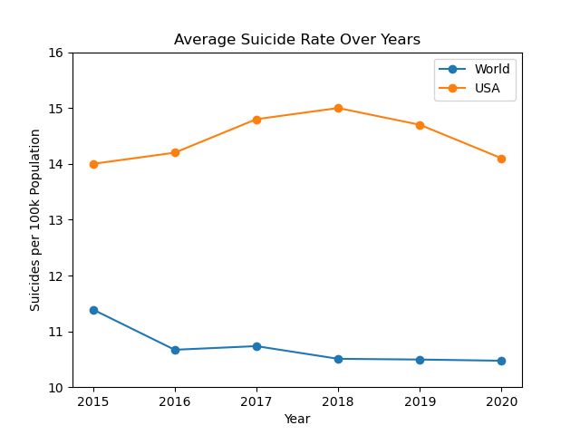
US Suicide Rates Compared To The World
It was decided to use this comparison per 100 thousand people. We believed it was a better comparison because of difference in populations throughout various countries.

Slide 4
Possible Contributors?
Why is the United States rate consistently higher? What could the causes be?
The team attempted to identify potential contributors by searching for correlations between different attributes that could affect these numbers. The attributes that the team pursued were:
Unemployment
Household Income
Mental Health
Access to Firearms

Slide 5
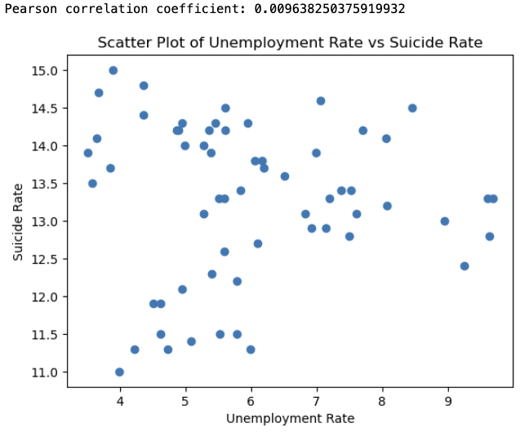
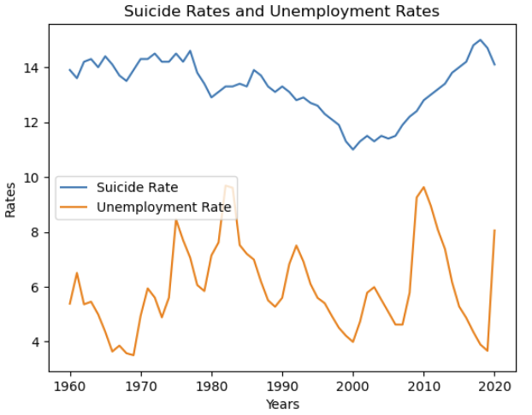
Unemployment
Is there a correlation between Suicide Rates and Unemployment?
Chi2 value: 1952.0 P-value: 0.3000348897198931

Slide 6
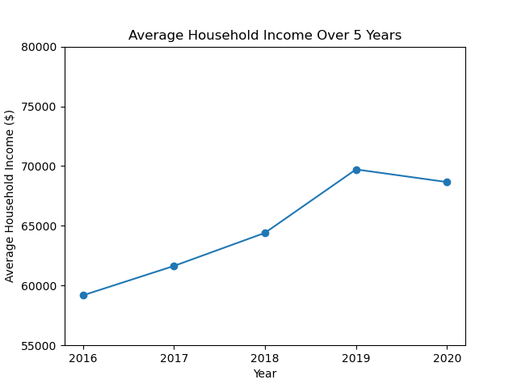
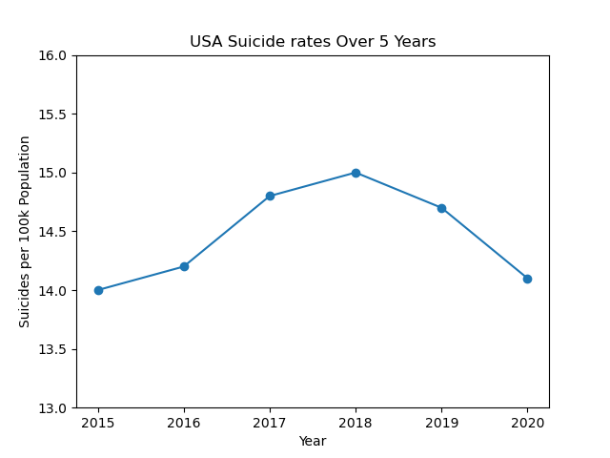
House Hold Income
Logic: Financial struggles can lead to suicide.

Slide 7
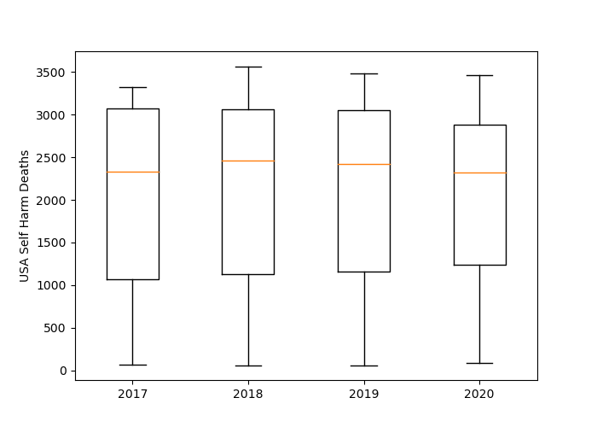
Mental Health
Potential Outliers
2017 -1937 6076.12
2018 -1782 5974.5
2019 -1672 5886.25
2020 -1236 5361.5
Notes:
We analyze the data set for the Unites States for self-harm deaths. We decided to see if there were outliers.
We found for potential outliers for the years 2017 thru 2020 the lower bounds were between negative 1236 and negative 1937 and the upper bound were between 5361 and 6076.
Self-harm deaths had many outliers, so therefore we went ahead and omitted this from our analysis. We decided to continue our analysis with firearm

Slide 8
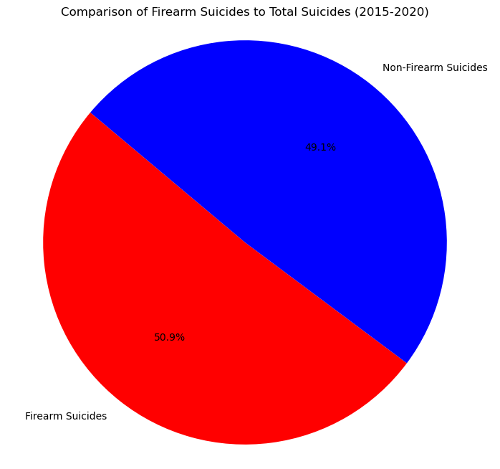
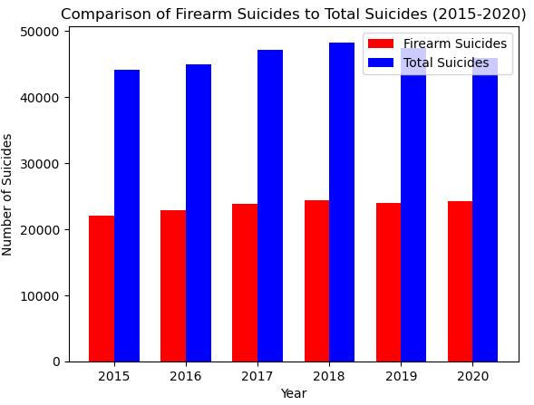
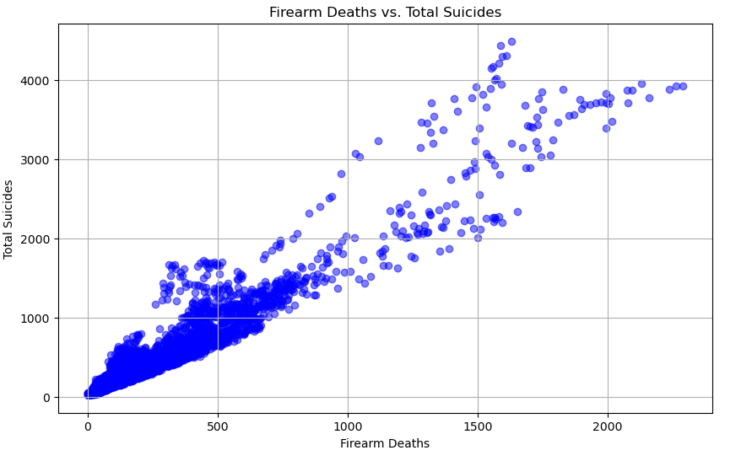
Firearms
Notes:
Pearson Correlation Coefficient: 0.952390378750439 P-value: 0.0

Slide 9
Hypothesis
Hypothesis: If we adjust gun accessibility, the rate of suicide will decrease by 2%.
Null Hypothesis : Changing the access to guns the suicide rate will have no effect.

Slide 10
What are methods that can improve suicide rates?
Mental health screenings when purchasing firearms.
Bring more awareness towards the high rates of suicide that includes the use of a firearm.

Slide 11
Conclusion
Firearms and gun control is a tricky subject to cover to begin with. However the data informs us that the mortality rate surrounding firearms as opposed to other means was greater. Therefore in order to bring down the suicide rate of the United States implementing a plan that can reduce accessibility to firearms is the most feasible option.

Slide 12

If you or a loved one is struggling with mental health, please reach out.
Available 24/7 to call or text

Slide 13
Works Cited
https://data-explorer.oecd.org/
https://www.oecd-ilibrary.org/
https://www.kaggle.com/
Firearm Suicide Proxy for Household Gun Ownership, 1949-2020
Kang
https://dataverse.harvard.edu/dataset.xhtml?persistentId=doi%3A10.7910%2FDVN%2FQVYDUD
gun_violence_us(2013/2014). Data Sets. (n.d.). https://www.openintro.org/book/statdata/index.php?data=gun_violence_us
https://sprc.org/news/unemployment-and-suicide/#:~:text=The%20research%20revealed%20that%20being,for%20more%20than%20six%20months.

