Slide 1
Controlling Angular Velocity of a DC Motor Using PID Controller and Kalman Filter Observer

Slide 2
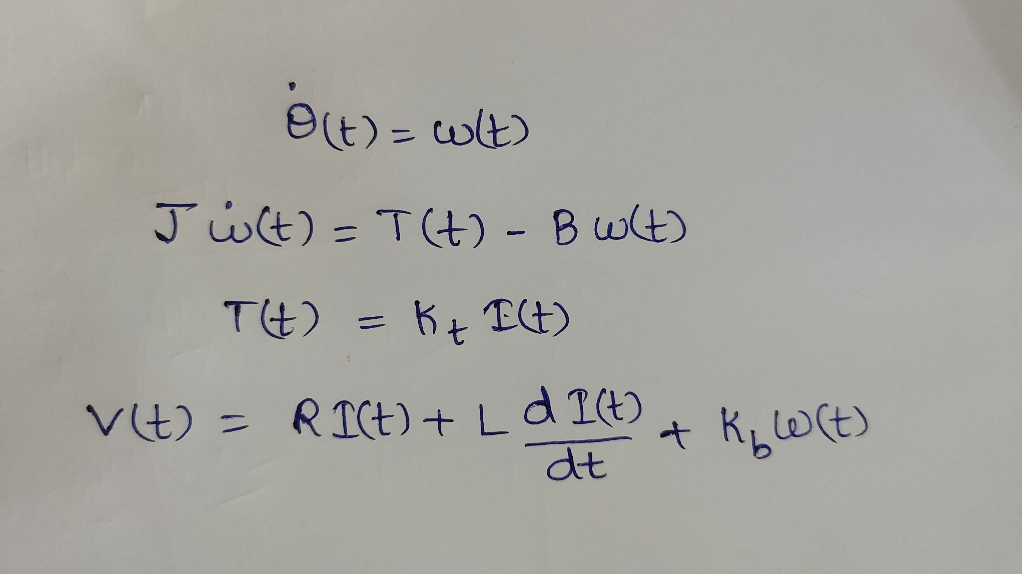
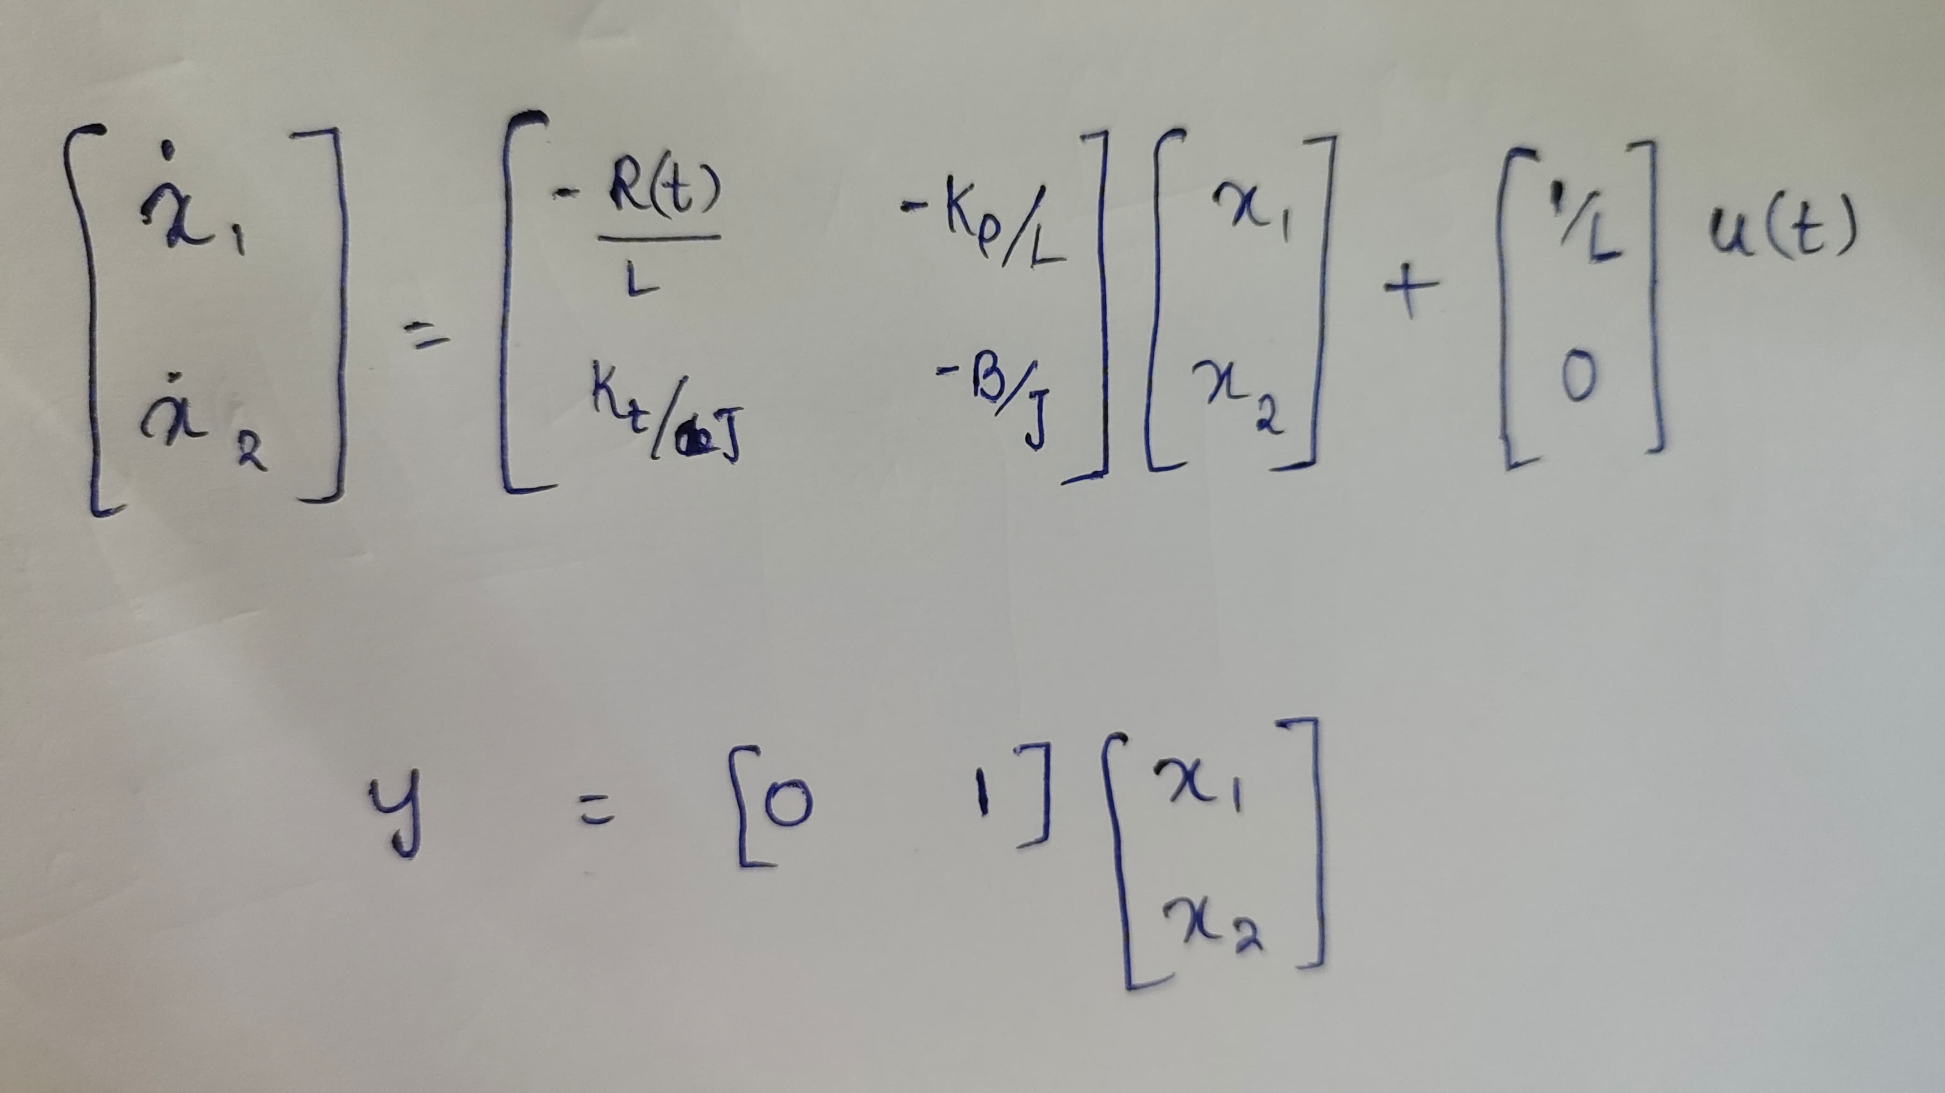
System dynamics
The dynamics of a DC motor are typically described using the following differential equations, which relate the motor's input voltage V(t)V(t)V(t) to its angular velocity ω(t)\omega(t)ω(t) and current I(t):

Slide 3
Pid controller
To control the motor's angular velocity, we use a PID controller. This controller adjusts the motor's input voltage based on the difference between the desired speed (setpoint) and the actual measured speed (feedback)
Proportional (P): Reacts to the current error, determining the immediate response to changes.
Integral (I): Accumulates past errors over time to eliminate steady-state error.
Derivative (D): Predicts future error trends based on current rate of change.

Slide 4

Controller equations
Kp​: Proportional gain
Ki​: Integral gain
Kd​: Derivative gain
e(t)=r(t)−y(t)e(t) = r(t) - y(t)e(t)=r(t)−y(t): Error, i.e., the difference between the reference (setpoint) r(t)r(t)r(t) and the measured output y(t)y(t)y(t)

Slide 5
explanation
Proportional term: P(t) = Kp . e(t)
This term corrects the error in real-time, based on how far the current output is from the desired setpoint.
Integral Term : I(t)=Ki​∫​e(τ)dτ
This accumulates the error over time to eliminate any steady-state error.
Derivative Term : D(t)=Kd​. de(t)​/d(t)
This term predicts future errors based on the current rate of change of the error, helping to reduce overshoot.

Slide 6
Kalman Filter Observer
Alongside the PID controller, we employ a Kalman filter observer. This advanced technique estimates the internal state variables of the motor, such as angular velocity, using noisy sensor measurements and system dynamics
Functionality:
State Estimation: Provides accurate estimates of the motor's internal state.
Noise Handling: Filters out sensor noise to improve measurement accuracy.
Adaptive: Adjusts estimates based on both predictions and new measurements.

Slide 7

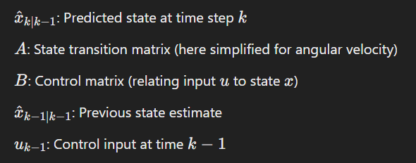
Observer equation
Prediction Step:
The Kalman filter first predicts the next state of the system (in this case, the angular velocity) based on the previous state estimate:
Where:

Slide 8


Cont…..
The prediction also includes the error covariance update:
Where:
$P_{{\text{k}\text{|}\text{k}\text{−1}}^{}}$​: Predicted error covariance
$P_{{\text{k}\text{−1}\text{|}\text{k}\text{−1}}^{}}$: Previous error covariance
Q : Process noise covariance (represents uncertainty in the model)

Slide 9




Updation Step:
Once a new measurement zkz_kzk​ is available, the Kalman filter updates its estimate:
Where:
$K_{k}$​: Kalman gain (determines the balance between prediction and measurement)
H: Measurement matrix (maps state to the measurement)
R: Measurement noise covariance
The state estimate is then updated:
And the error covariance is updated as well:
Where:
${x^}_{k|k}$: Updated state estimate
$p_{k|k}$: Updated error covariance
$z_{k}$: Measured state (e.g., angular velocity)
I: Identity matrix

Slide 10

Other works Using Ultrasonic Sensor
Prediction Step: The Kalman filter first predicts the state based on the previous state and assumes some level of process noise (Q).
Update Step: The Kalman gain is computed to balance the trust between the predicted state and the new measurement. The filtered estimate is then updated by incorporating the measured distance, and the error covariance is updated accordingly.
This implementation will help reduce the noise in the ultrasonic sensor readings and provide smoother distance measurements.
The prediction also includes the error covariance update:
Where:
$P_{{\text{k}\text{|}\text{k}\text{-1}}^{}}$​: Predicted error covariance
$P_{{\text{k}\text{-1}\text{|}\text{k}\text{−1}}^{}}$: Previous error covariance
Q : Process noise covariance (represents uncertainty in the model)

Slide 11
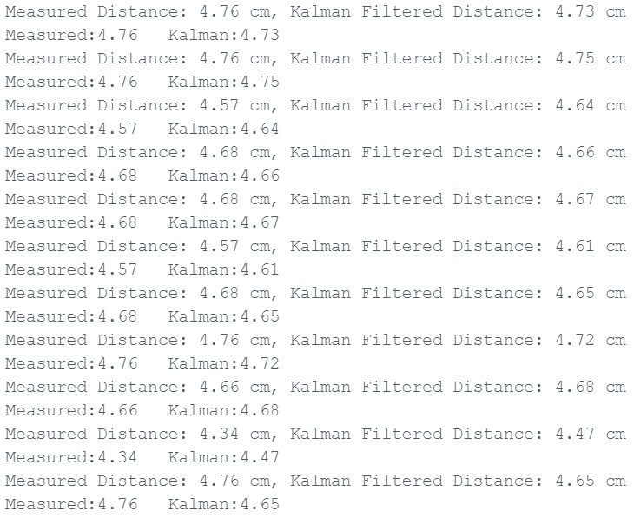
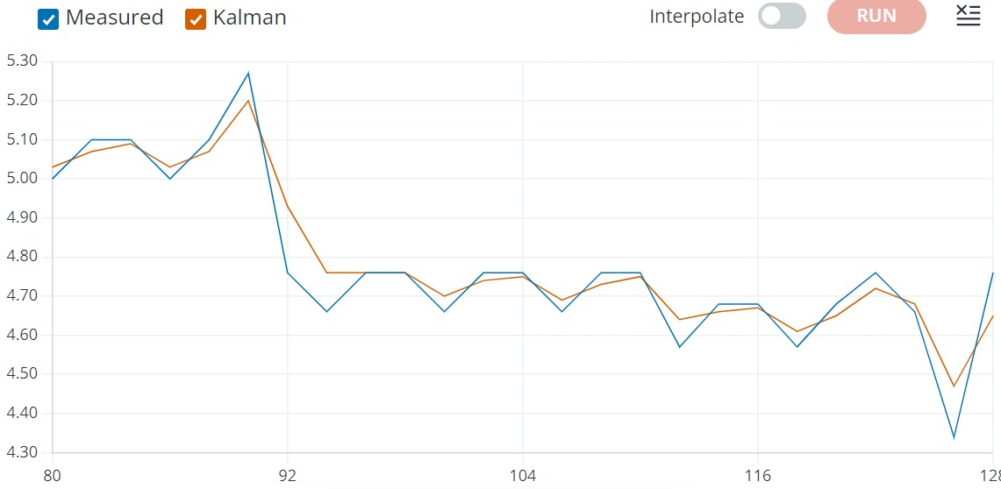
Result of Ultrasonic sensor where it reduces error using itrations

Slide 12
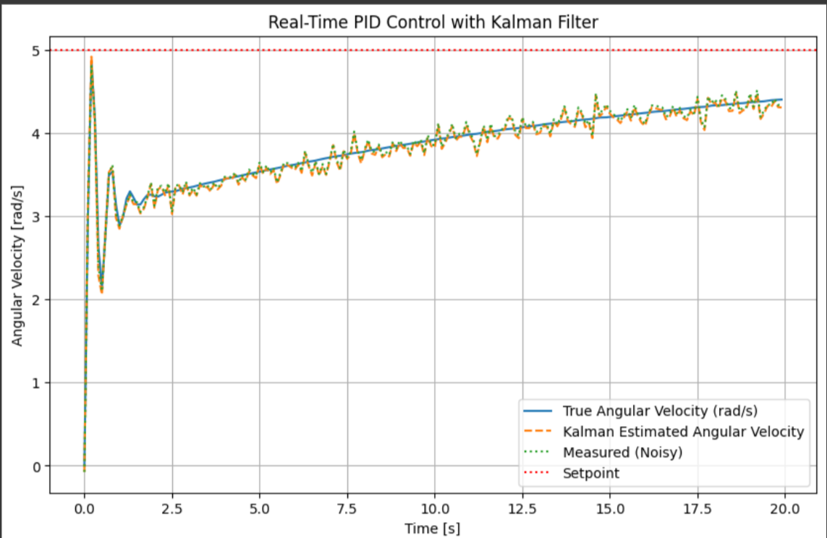
Result of Controller and observer using kalmans filter

