Slide 1
Yet one more Installer
Installing openSUSE with a bit of Salt
Alberto Planas
A Python guy
aplanas@suse.de

Slide 2
What is Yomi

Slide 3

Source: https://www.flickr.com/photos/artprojectteam/

Slide 4
What is Yomi
A new type of installer for the [open]SUSE family (~AutoYaST)
For parallel installations on networks where the nodes have different hardware configurations
  Unattended
  Simple (YAML) and smart (Jinja2) configuration files
  Easy to orchestrate (single decision point)
Idempotent (Salt states)
Can work alone or integrated into a big solution

Slide 5
Use cases for Yomi
Unattended installation on a cluster with different profiles
  Roles like: control plane, storage, computation (OpenStack, k8s)
  Certain nodes needs to wait until other nodes are installed
When provisioning of nodes is part of your workflow, and you already use Salt
  DevOps oriented (Git, CMS, …)
  Easy to integrate and extend

Slide 6
Installer 101

Slide 7
How Installers Work
Mostly the same stages
  Partitioning
  Volume (RAID/LVM)
  File System
  Subvolumes (BtrFS)
  Software
  Users
  Configuration (network, services, etc)
  Bootloader
  Post installation tasks (snapper, BtrFS RO, etc)
Easy to do from CLI
Easy to express in shell script
Gets complicate very fast
  Organically growth
  Abstractions limit the changes

Slide 8
Partitioning (partition table)
set -e
# TODO: detect the devices
for dev in '/dev/sda', '/dev/sdb'; do
parted -s ${dev} mklabel gpt
done

Slide 9
Partitioning (no LVM / RAID)
# TODO:
# - calculate the size better
# - detect if the partition is already there
parted -s /dev/sda mkpart primary 2048s 8MiB
parted -s /dev/sda set 1 bios_grub on
parted -s -a optimal /dev/sda mkpart primary \
linux-swap 8MiB 1GiB
parted -s -a optimal /dev/sda mkpart primary \
ext4 1GiB 100%
parted -s -a optimal /dev/sdb mkpart primary \
btrfs 0 100%

Slide 10
File System
# TODO: do not format if there is already data!
mkswap /dev/sda2
mkfs.ext4 /dev/sda3
mkfs.btrfs /dev/sdb1

Slide 11
Subvolumes
# TODO:
# - do not recreate subvols
# - add prefix subvol for snapper
# - evaluate CoW flags?
mount /dev/sdb1 /mnt
btrfs subvolume create /mnt/var
umount /mnt

Slide 12
/etc/fstab
# TODO:
# - detect already present lines
# - update btrfs lines if we use a prefix
# - snapper will add a new entry if used
mount /dev/sda3 /mnt
mkdir /mnt/etc
echo '/dev/sda2 swap swap defaults 0 0' >> /mnt/etc/fstab
echo '/dev/sda3 / ext4 defaults,noatime 0 1' >> /mnt/etc/fstab
UUID=$(blkid -s UUID -o value /dev/sdb1)
echo "UUID=${UUID} /var btrfs subvol=/var 0 0" >> /mnt/etc/fstab

Slide 13
Software
# TODO: configure /etc/zypp/zypp.conf
URL=http://download.opensuse.org/tumbleweed/repo/oss
OPTS="--non-interactive --gpg-auto-import-keys \
--root /mnt"
zypper ${OPTS} addrepo --check --gpgcheck \
--refresh ${URL} repo-oss
zypper ${OPTS} install pattern:enhanced_base \
kernel-default grub2

Slide 14
Bootloader
# TODO: configure for EFI and snapper
mount -t devtmpfs devtmpfs /mnt/dev
mount -t proc proc /mnt/proc
mount -t sysfs sysfs /mnt/sys
chroot /mnt mkinitrd -b /boot
echo 'GRUB_CMDLINE_LINUX_DEFAULT="splash=silent quiet"' \
>> /mnt/etc/default/grub
echo 'GRUB_TERMINAL=gfxterm' >> /mnt/etc/default/grub
chroot /mnt grub2-mkconfig -o /boot/grub2/grub.cfg
chroot /mnt grub2-install --force /dev/sda

Slide 15
Reboot
# TODO: kexec … maybe?
chroot /mnt systemctl set-default multi-user.target
umount -R /mnt
systemctl reboot

Slide 16
TODO
This will produce a bootable image!
Soooooo many missing “details” (check the TODO in the comments!):
  No parameterization (disks, partitions, file systems, LVM/RAID config)
  No snapper nor BtrFS configuration
  No EFI or Secure Boot
  No users, services or extra software
  No safe way to interact with chroot

Slide 17
SaltStack 101

Slide 18
SaltStack 101
Is a Configuration Management Software, like Chef or Ansible
Very modular and easy to re-architecture
  Master / minion by default
  SSH (minion-less)
  Local execution (master-less)
  Reactors / miners / salt-api and other modules available

Slide 19
SaltStack basic elements
Grains: bits of public data exported by the minion
Pillars: private data created by the user, and used by the salt states as input (together with the grains)
Execution modules: code that actuate or change a property in the minion
States modules: code that guarantee, based on some minimal preconditions, a final result
Salt States: YAML description of the state module and the parameters to be applied in a minion

Slide 20
Default Architecture
bus
salt-minion
node
grains
salt-master
salt-minion
node
grains
pillars
states
salt-minion
node
grains
states
modules
execution
modules

Slide 21
Execution Module
Validate the input data (parameters)
Execute a single action, if possible
If not, report why fails
Usually returns True if succeed
Basic building block

Slide 22
Anatomy of a state module
A state module is a piece of code that will
  Validate input / validate expected preconditions in the environment
  Identify and plan the needed changes to reach the target configuration
    Difference between the current and expected configuration
  Optionally, execute the planned actions via execution modules (test execution)
  Re-calculate the difference between the current and expected configuration to identify deviations
  Report the actions and changes done
Ideally they can be used to fix a wrong configuration

Slide 23
Salt states
Are declared in a YAML document, as the pillars
Are only declarations, as the code lives in a state module
Can use Jinja2 templates to include some high level logic, but caution with the execution order!

Slide 24
Example of salt states
mount_create_fstab:
mount.mounted:
- name: /mnt
- device: /dev/sda1
- fstype: ext4
- persist: False
{% set filesystems = pillar['filesystems'] %}
{% for device, info in filesystems.items() %}
mkfs_partition_{{ device }}:
formatted.formatted:
- name: {{ device }}
- fs_type: {{ info.filesystem }}
{% if info.filesystem in ('fat', 'vfat') and info.get('fat') %}
- fat: {{ info.fat }}
{% endif %}
{% endfor %}
prepare_kexec:
cmd.run:
- name: kexec -a -l /mnt/boot/vmlinuz --initrd=/mnt/boot/initrd --command-line="`cat /tmp/command_line`"
- onlyif: "[ -e /tmp/command_line ]"

Slide 25
Pillars as data
A Salt pillar is a YAML document that contains the data required by the states
  Lives in the salt-master node
Used as a unique data structure to represent all the data
You can assign to several nodes different pillars, based on local features (grains), and a query language
  We can use the top.sls pillar, or any other Salt mechanism
Inside the pillar we can add logic via a template language (Jinja2)

Slide 26
Example of a pillar
filesystems:
/dev/sda1:
filesystem: vfat
mountpoint: /boot/efi
/dev/sda2:
filesystem: btrfs
mountpoint: /
subvolumes:
prefix: '@'
subvolume:
- path: home
- path: opt
- path: root
- ...
filesystems:
...
{% let id = grains[‘id’] %}
{% if id.startswith(‘controller’) %}
/dev/sda2:
filesystem: btrfs
mountpoint: /
{% elif id.startswith(‘compute’) %}
/dev/sda2:
filesystem: ext4
mountpoint: /var/lib/images
{% endif %}
...

Slide 27
Yomi is a Salt State

Slide 28
The master plan
For each action in the installer build an execution module
  Reuse and extend the ones from Salt
  Implement the missing components
For each high level action build a state that call one or more execution modules
  Same rule here: reuse, extend, implement; all upstream
Write the SLS states that drive the installation
Parameterize all the data via pillar
…
Profit! Yomi!

Slide 29
[Detour] Demo time!

Slide 30
Two node installation
Node 1
  BIOS
  Single HD
  Grub partition and SWAP
  Btrfs
  Subvolumes (/home)
Node 2
  UEFI
  No secure boot
  Two HDs
  EFI partition and SWAP
  LVM
  Btrfs for root
  XFS for /home

Slide 31
[Back] Yomi is a Salt State

Slide 32
Three levels of abstraction
Execution Modules
SaltStack
States
SLS States
Yomi

Slide 33
Upstream all the code!
Parted
  Bugs, missing information, etc
Zypper
  Root parameter, pattern: and product:, etc
Hardware Information
  Hwinfo, blkid, lsblk
Btrfs
  Subvolumes, add a new state, etc
chroot / freeze
cmdmod.run_chroot
Mount / fstab
Lvm
Mdadm
Systemd
...

Slide 34
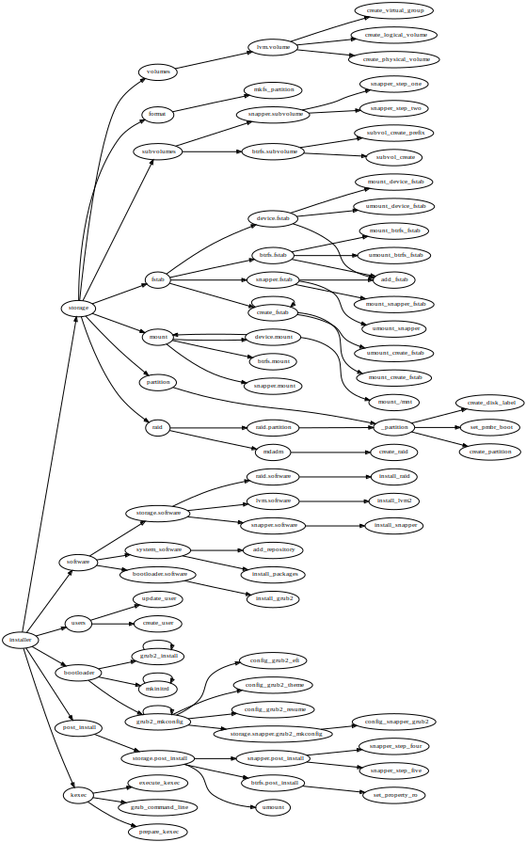
Organization of states in Yomi
Installer
  Storage
    Partition
      …
    RAID
    Volumes
    …
  Software
    …
Installer (cont.)
  Users
    …
  Bootloader
  Post-install
    …
  Kexec
    …

Slide 35
Yomi as composition of Salt states
Each Salt state is a piece that can be composed of other pieces (states and modules) and can be part of a bigger one
Yomi is a Salt state
  … that is composed by other salt states
  … and can be itself a piece of a bigger state (provisioning)
Composability is tricky

Slide 36
Current status

Slide 37
Current Status
Can deploy very openSUSE Tubleweed, Leap, MicroOS and Kubic
Still not feature complete as YaST (partition resize, LUKS, bcache, better network configuration, etc)
Already in integration with other products (WIP)
  Kubic (kubicctl)
  SUSE Manager (Uyuni)

Slide 38
Where is Yomi
SaltStack: https://github.com/saltstack/salt
Yomi: https://github.com/openSUSE/yomi
OBS:https://build.opensuse.org/project/show/systemsmanagement:yomi

Slide 39
Q & A
?

