Slide 1
Yet one more installer
Installing openSUSE with a bit of Salt
Alberto Planas
Python guy
aplanas@suse.de

Slide 2
What is Yomi
A new type of installer for the [open]SUSE family
Designed for parallel installations with heterogeneous nodes
  Unattended
  Simple and smart configuration files (Jinja2 / YAML)
Orchestration via a centralized decision point
Build as a Salt state (idempotent), that can work alone or integrated into a big solution

Slide 3
Alternative to AutoYaST
A new type of installer not based on YaST / AutoYaST
  Opportunity to rethink the installer
Do not use specific libraries, like libstorage-ng
Build only on top of:
  All the Salt modules and states (code and data structure)
  Traditional tools like parted, chroot, btrfs or zypper
Only one requirement: salt-minion (and the CLI tools)

Slide 4
AutoYaST vs SaltStack
Less burden for the management of the data needed for the installation (AutoYaST XML vs Pillars)
  You can use Git, NFS, database or any other base to store it
  Very DevOps oriented, now the installer is a part of the CM
Installation is only one step inside the provisioning task
Clear way of inspecting, monitoring and altering the installation process (a.k.a: Salt way)

Slide 5
Use cases for Yomi
Unattended installation on a cluster with different profiles
  Roles like: control plane, storage, computation (OpenStack, k8s)
When the user requires more intelligence from the installer
  The installer needs to make decisions based on internal and external data
When provisioning of nodes is part of your workflow, and you already use Salt

Slide 6
Architecture
bus
salt-minion
node
salt-master
salt-minion
node
pillars
salt-minion
node

Slide 7
Pillars as data
A Salt pillar is a YAML document that contains the data required by the states
  Lives in the salt-master node
Used as a unique data structure to represent all the data
You can assign to several nodes different pillars, based on local features (grains), and can combined with a query language
  We can use the top.sls pillar, or any other Salt mechanism
Inside the pillar we can add logic via a template language (Jinja2)

Slide 8
Example of a pillar
filesystems:
/dev/sda1:
filesystem: vfat
mountpoint: /boot/efi
/dev/sda2:
filesystem: btrfs
mountpoint: /
subvolumes:
prefix: '@'
subvolume:
- path: home
- path: opt
- path: root
- ...
filesystems:
...
{% let id = grains[‘id’] %}
{% if id.startswith(‘controller’) %}
/dev/sda2:
filesystem: btrfs
mountpoint: /
{% elif id.startswith(‘compute’) %}
/dev/sda2:
filesystem: ext4
mountpoint: /var/lib/images
{% endif %}
...

Slide 9
States in Salt
A salt state is a piece of code that try to guarantee:
  Detection of the current configuration
  Identification and planning of needed changes to reach the target configuration
  Optionally, execution of those changes
  Report of changes
Ideally they can be used to fix a wrong configuration

Slide 10
Composability of states
Ideally a state is a piece of another, bigger, state
  Is more like a tree
… but there is not guarantee of composability
  Some states do too much
  Some units needs to be converted from one state to another
  Some exit conditions are not really a fail

Slide 11
Yomi is another Salt state
Yomi is a state that can be included in any Salt SLS file
But can also work as a single tool
  Via salt-api we can control the state (HTTP / REST protocol)
  Using macros, each inner state trigger three events:
    Enter event
    Success event
    Fail event
  We capture the events via a monitor tool
  We can disable those events

Slide 12
Organization of states in Yomi
As commented before, is more like a tree that is transverse in inorder (root / left / right)
States are grouped by functionality
  Storage
    Partitioning
    Volumes
      RAID
      LVM
    …
    Software
      Repositories
      ...
    Bootloader
      Grub
    Snapper
    …

Slide 13
Current status

Slide 14
The big plan
We defined a minimal viable product (MVP)
  https://etherpad.suse.de/p/salt-autoinstaller-mvp
TL; DR – If works for openSUSE, Kubic and SLE we are done.
Caution: we only care about installation, not the rest of provisioning (configuration of exotic devices, fancy network configurations, etc)

Slide 15
Current status (storage)
Storage
  GPT / BIOS partition
  Explicit partition schema
  Smart partitioning using linear programming (based on the control.xml constraints)
    Ask me about this! It is super cool!

Slide 16
Current status (filesystem)
Filesystem
  EFI / UEFI FAT16 / FAT32 partition
  Ext2/3/4 and swap partitions
  Btrfs subvolumes
  Snapper snapshots

Slide 17
Current status (others)
Bootloader
  GRUB 2 (with optional theme)
  UEFI / Secure Boot
  Snapshot boot
Software
  Repository registration
  Initial software installation

Slide 18
Current status (others cont.)
Users
  Initial user (password) and group management
Sysconfig integration
Full chroot control
  No Python requirement / package freeze
Initial reboot via kexec / reboot

Slide 19
Current status (integration)
Salt-API for integration via REST
Example of integration:
  External monitoring
    Create events via macros
  Salt reordering of states
    Software required for grub, snapper, etc (outside of the pillars)

Slide 20
Work in progress
Storage
  LVM (already started)
  RAID
  LUKS
  Bcache / lvmcache
  Resize
Basic network configuration
Full control.xml import
AutoYaST converter
Multi architecture
CI via openQA

Slide 21
For a full 100% AutoYaST feature
Identify features in AutoYaST book missing in SaltStack
  Better iSCSI support
  FCoE
  NIS
  Linux Audit Framework (LAF)
Push it to upstream (SaltStack Team?)

Slide 22
Development process
Implement a prototype of the feature
  https://github.com/openSUSE/yomi
Upstream the code to salt/develop
  Execution modules, salt states, grains, etc.
Refactor the Salt states of Yomi to remove complexity
Backport the Salt code to the openSUSE Fluorine version of the package
In OBS I have an ISO image and a Salt package with all the required changes

Slide 23
Q & A
?

Slide 24
You asked!

Slide 25
Linear programming applied to partitioning
Problem statement:
  Decide for a (maybe already partitioned) hard disk the best way to partition it, based on a set of constraint.
  Example of constraints:
    Σpartitions ≤ hard_disk_size
    min_root_size ≤ root_size ≤ max_root_size and
    min_swap_size ≤ swap_size ≤ max_swap_size and
    min_home_size ≤ home_size and ...

Slide 26
Linear programming (cont.)
We need and objective function
  Each violation of a constraint is a penalization
  Each resize (increase or decrease) of a present partition is a penalization
  Each space wasted is … yep, a penalization
Objective function: minimize the penalization, making sure that the constraints are meet
  Note: some penalization are worse that others
Use the simplex algorithm (no external dependency)

Slide 27
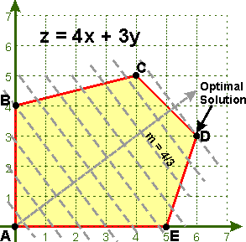
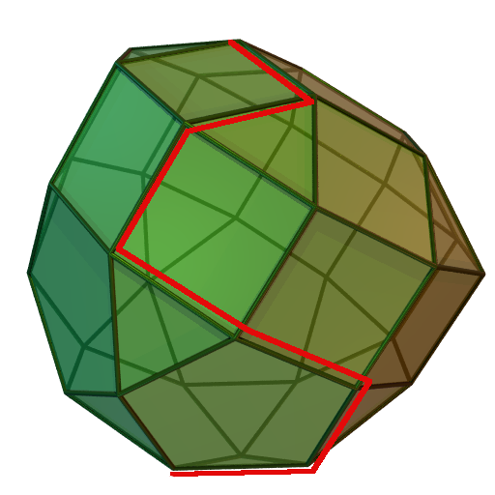
A graphical explanation

Slide 28
Expected advantages of linear programming
Good old technology applied in the correct domain
Battle field tested (literally!)
No surprises on the decisions make
  Reliable and reproducible
  Easy to explain when no feasible solution is found
No ad-hoc algorithm

Slide 29
Bad things about linear programming
The penalization is a magic number
I do not know of any other installer using this model

