Slide 1
Yet one more Installer
Installing openSUSE with a bit of Salt
Alberto Planas
Python guy
aplanas@suse.de

Slide 2
What is Yomi

Slide 3
What is Yomi
A new type of installer for the [open]SUSE family
  As an alternative to [Auto]YaST
Designed for parallel installations of heterogeneous nodes
  Unattended
  Simple and smart configuration files (Jinja2 / YAML)
Orchestration via a centralized decision point (optional)
Build as a Salt state (idempotent)
Can work alone or integrated into a big solution

Slide 4
Alternative to AutoYaST
Similar use cases than AutoYaST
Do not use specific libraries, like libstorage-ng
  This is bad and good at the same time
Build only on top of:
  All the Salt modules and states (code and data structure)
  Traditional tools like parted, chroot, btrfs or zypper

Slide 5
Alternative to AutoYaST (cont.)
Less burden for the management of the data needed for the installation (AutoYaST XML vs Pillars)
  You can use Git, NFS, database or any other base to store them
  Very DevOps oriented, now the installer is a part of the CMS
Installation is only one step inside the provisioning workflow
Clear way of inspecting, monitoring and adapting the installation process (a.k.a: Salt way)

Slide 6
Use cases for Yomi
Unattended installation on a cluster with different profiles
  Roles like: control plane, storage, computation (OpenStack, k8s)
When the user requires more intelligence from the installer
  The installer needs to make decisions based on internal and external data
When provisioning of nodes is part of your workflow, and you already use Salt

Slide 7
Salt States

Slide 8
SaltStack 101
Is a Configuration Management Software, like Chef or Ansible
Very modular and easy to re-architecture
  Master / minion by default
  SSH (minion-less)
  Local execution (master-less)
  Reactors / miners / salt-api and other modules available

Slide 9
SaltStack basic elements
Grains: bits of public data exported by the minion
Pillars: private data created by the user, and used by the salt states as input (together with the grains)
Execution modules: code that actuate or change a property in the minion
States modules: code that guarantee, based on some minimal preconditions, a final result
States: YAML description of the state module and the parameters to be applied in a minion

Slide 10
Default Architecture
bus
salt-minion
node
grains
salt-master
salt-minion
node
grains
pillars
states
salt-minion
node
grains
states
modules
execution
modules

Slide 11
Pillars as data
A Salt pillar is a YAML document that contains the data required by the states
  Lives in the salt-master node
Used as a unique data structure to represent all the data
You can assign to several nodes different pillars, based on local features (grains), and a query language
  We can use the top.sls pillar, or any other Salt mechanism
Inside the pillar we can add logic via a template language (Jinja2)

Slide 12
Example of a pillar
filesystems:
/dev/sda1:
filesystem: vfat
mountpoint: /boot/efi
/dev/sda2:
filesystem: btrfs
mountpoint: /
subvolumes:
prefix: '@'
subvolume:
- path: home
- path: opt
- path: root
- ...
filesystems:
...
{% let id = grains[‘id’] %}
{% if id.startswith(‘controller’) %}
/dev/sda2:
filesystem: btrfs
mountpoint: /
{% elif id.startswith(‘compute’) %}
/dev/sda2:
filesystem: ext4
mountpoint: /var/lib/images
{% endif %}
...

Slide 13
Salt states
Are declared in a YAML document, as the pillars
Are only declarations, as the code lives in a state module
Can use Jinja2 templates to include some high level logic, but caution with the execution order!

Slide 14
Example of salt states
mount_create_fstab:
mount.mounted:
- name: /mnt
- device: /dev/sda1
- fstype: ext4
- persist: False
{% set filesystems = pillar['filesystems'] %}
{% for device, info in filesystems.items() %}
mkfs_partition_{{ device }}:
formatted.formatted:
- name: {{ device }}
- fs_type: {{ info.filesystem }}
{% if info.filesystem in ('fat', 'vfat') and info.get('fat') %}
- fat: {{ info.fat }}
{% endif %}
{% endfor %}
prepare_kexec:
cmd.run:
- name: kexec -a -l /mnt/boot/vmlinuz --initrd=/mnt/boot/initrd --command-line="`cat /tmp/command_line`"
- onlyif: "[ -e /tmp/command_line ]"

Slide 15
Anatomy of a state module
A state module is a piece of code that will
  Validate input / validate expected preconditions in the environment
  Identify and plan the needed changes to reach the target configuration
    Difference between the current and expected configuration
  Optionally, execute the planned actions via execution modules (test execution)
  Re-calculate the difference between the current and expected configuration to identify deviations
  Report the actions and changes done
Ideally they can be used to fix a wrong configuration

Slide 16
Demo time!

Slide 17
Two node installation
Node 1
  BIOS
  Single HD
  Grub partition and SWAP
  Btrfs
  Subvolumes (/home)
Node 2
  UEFI
  No secure boot
  Two HDs
  EFI partition and SWAP
  LVM
  Btrfs for root
  XFS for /home

Slide 18
Yomi is a Salt State

Slide 19
Yomi as composition of Salt states
Each Salt state is a piece that can be composed of other pieces (states and modules) and can be part of a bigger one
Yomi is a Salt state
  … that is composed by other salt states
  … and can be itself a piece of a bigger state (provisioning)

Slide 20
Three levels of abstraction
Execution Modules
SaltStack
States
SLS States
Yomi

Slide 21
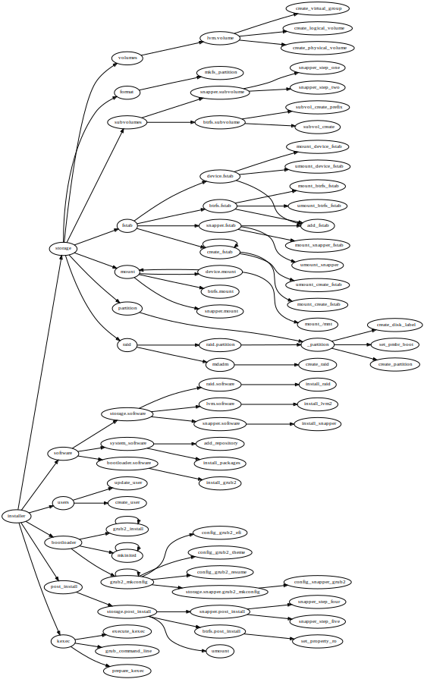
Organization of states in Yomi
Installer
  Storage
    Partition
      …
    RAID
    Volumes
    …
  Software
    …
Installer (cont.)
  Users
    …
  Bootloader
  Post-install
    …
  Kexec
    …

Slide 22
Composability is tricky
There is not guarantee of composability in SaltStack
  The pre-condition of one state must be compatible with the post-condition of a previous state
  Some basic states do too much (granularity problem)
  States parameters are expressed in different units
  Some exit conditions do not signal a real fail
  …

Slide 23
Yomi can work alone
Yomi is a state that can be included in any Salt SLS file
No need to reboot to continue the provisioning
But can also work as a single tool
  Via salt-api we can control the state (HTTP / REST protocol)
  Using macros, each inner state trigger three events:
    Enter event
    Success event
    Fail event
  We capture the events via a monitor tool
  We can disable those events

Slide 24
Current status

Slide 25
The big plan
We defined a minimal viable product (MVP)
  https://etherpad.suse.de/p/salt-autoinstaller-mvp
TL; DR – If works for openSUSE, MicroOS and SLE we are done.
Caution: we only care about installation, not the rest of provisioning (configuration of exotic devices, fancy network configurations, etc)

Slide 26
Current status (storage)
Storage
  GPT / BIOS partition
  Explicit partition schema
  Smart partitioning using linear programming (based on the control.xml constraints)
    Ask me about this! It is super cool!

Slide 27
Current status (filesystem)
Filesystem
  EFI / UEFI FAT16 / FAT32 partition
  Ext2/3/4 and swap partitions
  Btrfs subvolumes
  Snapper snapshots
  RAID (over devices and over partitions)
  LVM

Slide 28
Current status (others)
Bootloader
  GRUB 2 (with optional theme)
  UEFI / Secure Boot
  Snapshot boot
Software
  Repository registration
  Initial software installation

Slide 29
Current status (others cont.)
Users
  Initial user (password) and group management
Sysconfig integration
Full chroot control
  No Python requirement / package freeze
Initial reboot via kexec / reboot

Slide 30
Current status (integration)
Salt-API for integration via REST
Example of integration:
  External monitoring
    Create events via macros
  Salt reordering of states
    Software required for grub, snapper, etc (outside of the pillars)

Slide 31
Work in progress
Storage
  LUKS
  Bcache / lvmcache
  Resize
Basic network configuration
Full control.xml import
AutoYaST converter
Multi architecture
CI via openQA

Slide 32
For a full 100% AutoYaST feature
Identify features in AutoYaST book missing in SaltStack
  Better iSCSI support
  FCoE
  NIS
  Linux Audit Framework (LAF)

Slide 33
Development process
Implement a prototype of the feature
  https://github.com/openSUSE/yomi
Upstream the code to salt/develop
  Execution modules, salt states, grains, etc.
Refactor the Salt states of Yomi to remove complexity
Backport the Salt code to the openSUSE Fluorine version of the package
In OBS I have an ISO image and a Salt package with all the required changes

Slide 34
Q & A
?

Slide 35
You asked!

Slide 36
Linear programming applied to partitioning
Problem statement:
  Decide for a (maybe already partitioned) hard disk the best way to partition it, based on a set of constraints
  Example of constraints:
Σpartitions ≤ hard_disk_size
min_root_size ≤ root_size ≤ max_root_size and
min_swap_size ≤ swap_size ≤ max_swap_size and
min_home_size ≤ home_size and ...

Slide 37
Linear programming (cont.)
We need and objective function
  Each violation of a constraint is a penalization
  Each resize (increase or decrease) of a present partition is a penalization
  Each space wasted is … yep, a penalization
Objective function: minimize the penalization, making sure that the constraints are meet
  Note: some penalization are worse that others
Use the simplex algorithm (no external dependency)

Slide 38
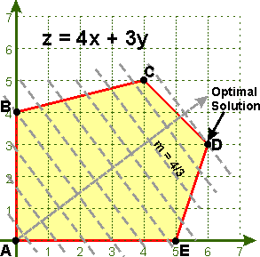
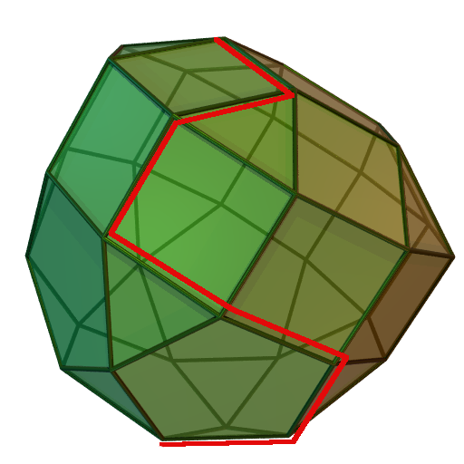
A graphical explanation

Slide 39
Expected advantages of linear programming
Good old technology applied in the correct domain
Battle field tested (literally!)
No surprises on the decisions make
  Reliable and reproducible
  Easy to explain when no feasible solution is found
No ad-hoc algorithm

Slide 40
Bad things about linear programming
The penalization is a magic number
I do not know of any other installer using this model

