Slide 1
Yet one more Installer
Installing openSUSE with a bit of Salt
Alberto Planas
Python guy
aplanas@suse.de

Slide 2
What is Yomi

Slide 3
What is Yomi
A new type of installer for the [open]SUSE family
  As an alternative to [Auto]YaST
Designed for parallel installations of heterogeneous nodes
  Unattended
  Simple and smart configuration files (Jinja2 / YAML)
Orchestration via a centralized decision point (optional)
Build as a Salt state (idempotent)
Can work alone or integrated into a big solution

Slide 4
Alternative to AutoYaST
Similar use cases than AutoYaST
Build only on top of:
  Salt modules and states (code and data structure)
  Traditional tools like parted, chroot, btrfs or zypper

Slide 5
Alternative to AutoYaST (cont.)
Less burden for the management of the data needed for the installation (AutoYaST XML vs Pillars)
  You can use Git, NFS, database or any other base to store them
  Very DevOps oriented, now the installer is a part of the CMS
Installation is only one step inside the provisioning workflow
Clear way of inspecting, monitoring and adapting the installation process (a.k.a: Salt way)

Slide 6
Use cases for Yomi
Unattended installation on a cluster with different profiles
  Roles like: control plane, storage, computation (OpenStack, k8s)
When the user requires more intelligence from the installer
  The installer needs to make decisions based on internal and external data
When provisioning of nodes is part of your workflow, and you already use Salt

Slide 7
Yomi is a Salt State

Slide 8
Default Architecture
bus
salt-minion
node
grains
salt-master
salt-minion
node
grains
pillars
states
salt-minion
node
grains
states
modules
execution
modules

Slide 9
Example of a pillar
filesystems:
/dev/sda1:
filesystem: vfat
mountpoint: /boot/efi
/dev/sda2:
filesystem: btrfs
mountpoint: /
subvolumes:
prefix: '@'
subvolume:
- path: home
- path: opt
- path: root
- ...
filesystems:
...
{% let id = grains[‘id’] %}
{% if id.startswith(‘controller’) %}
/dev/sda2:
filesystem: btrfs
mountpoint: /
{% elif id.startswith(‘compute’) %}
/dev/sda2:
filesystem: ext4
mountpoint: /var/lib/images
{% endif %}
...

Slide 10
Example of salt states
mount_create_fstab:
mount.mounted:
- name: /mnt
- device: /dev/sda1
- fstype: ext4
- persist: False
{% set filesystems = pillar['filesystems'] %}
{% for device, info in filesystems.items() %}
mkfs_partition_{{ device }}:
formatted.formatted:
- name: {{ device }}
- fs_type: {{ info.filesystem }}
{% if info.filesystem in ('fat', 'vfat') and info.get('fat') %}
- fat: {{ info.fat }}
{% endif %}
{% endfor %}
prepare_kexec:
cmd.run:
- name: kexec -a -l /mnt/boot/vmlinuz --initrd=/mnt/boot/initrd --command-line="`cat /tmp/command_line`"
- onlyif: "[ -e /tmp/command_line ]"

Slide 11
Yomi as composition of Salt states
Each Salt state is a piece that can be composed of other pieces (states) and can be part of a bigger one
Yomi is a Salt state
  … that is composed by other salt states
  … and can be itself a piece of a bigger states (provisioning)

Slide 12
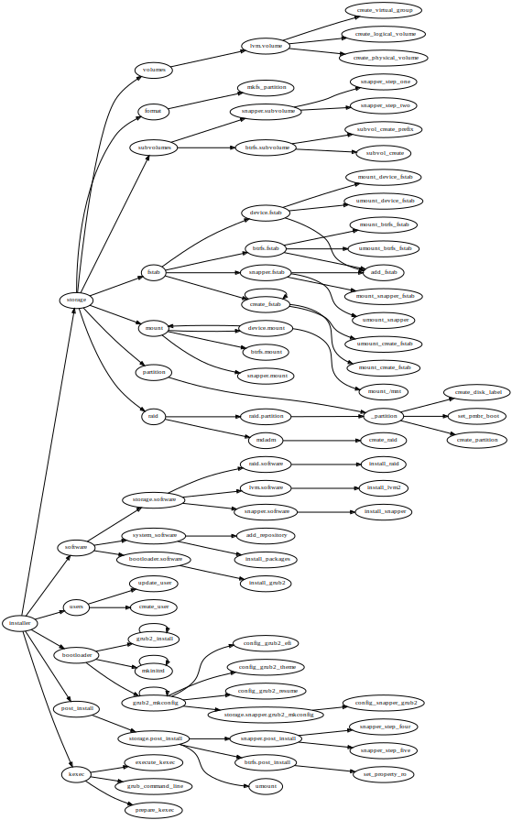
Organization of states in Yomi
Installer
  Storage
    Partition
      …
    RAID
    Volumes
    …
  Software
    …
Installer (cont.)
  Users
    …
  Bootloader
  Services
  Post-install
    …
  Kexec
    …

Slide 13
Current status

Slide 14
The big plan
We defined a minimal viable product (MVP)
  https://etherpad.suse.de/p/salt-autoinstaller-mvp
TL; DR – If works for openSUSE, MicroOS and SLE we are done.
Caution: we only care about installation, not the rest of provisioning (configuration of exotic devices, fancy network configurations, etc)

Slide 15
Current status (storage)
Storage
  GPT / BIOS partition
  Explicit partition schema
  Smart partitioning using linear programming (based on the control.xml constraints)
    Ask me about this! It is super cool!

Slide 16
Current status (filesystem)
Filesystem
  EFI / UEFI FAT16 / FAT32 partition
  Ext2/3/4 and swap partitions
  Btrfs subvolumes
  Snapper snapshots
  RAID (over devices and over partitions)
  LVM

Slide 17
Current status (others)
Bootloader
  GRUB 2 (with optional theme)
  UEFI / Secure Boot
  Snapshot boot
Software
  Repository registration
  Initial software installation

Slide 18
Current status (others cont.)
Users
  Initial user (password) and group management
Sysconfig integration
Better chroot control
  No Python requirement / package freeze
Initial reboot via kexec / reboot

Slide 19
Current status (integration)
Salt-API for integration via REST
Example of integration:
  External monitoring
    Create events via macros
  Salt reordering of states
    Software required for grub, snapper, etc (outside of the pillars)

Slide 20
Work in progress
Storage
  LUKS
  Bcache / lvmcache
  Resize
Basic network configuration
Full control.xml import
AutoYaST converter
Multi architecture
CI via openQA

Slide 21
Development process
Implement a prototype of the feature
  https://github.com/openSUSE/yomi
Upstream the code to salt/develop
  Execution modules, salt states, grains, etc.
Refactor the Salt states of Yomi to remove complexity
Backport the Salt code to the openSUSE Fluorine version of the package
In OBS I have an ISO image and a Salt package with all the required changes

Slide 22
Live outside openSUSE

Slide 23
Moving Yomi out of openSUSE
Currently only tested for the openSUSE family
Not so far from an agnostic installer, similar to a Salt Formula
Some states are OK
  file, lvm, raid, btrfs
But there are problems with others

Slide 24
Missing abstractions
Partitioning (local to Yomi)
Boot loader (Jinja2, only for GRUB2)
Networking (SUSE gap)
Kexec (execution module)
…

Slide 25
Unify current abstractions
Root parameter:
  pkg
  users
  service
Networking
…
enable_service_{{ service }}:
module.run:
- service.enable:
- name: {{ service }}
- root: /mnt
- unless: systemctl --root=/mnt \
--quiet \
is-enabled {{ service }} 2> /dev/null

Slide 26
Improve composability
The pre-condition of one state must be compatible with the post-condition of a previous state
Some basic states do too much (granularity problem)
Ownership of resources (for example: fstab)
States parameters are expressed in different units
Some exit conditions do not signal a real fail
…

Slide 27
Q & A
?

