Slide 1
Yomi <3 SUMA
Integrating Yomi in Uyuni / SUMA
Alberto Planas
Python guy
aplanas@suse.de

Slide 2
What is Yomi

Slide 3
What is Yomi
A new type of installer for the [open]SUSE family (~AutoYaST)
For parallel installations on networks where the nodes have different hardware configurations
  Unattended
  Simple (YAML) and smart (Jinja2) configuration files
  Easy to orchestrate (single decision point)
Idempotent (Salt states)
Can work alone or integrated into a big solution

Slide 4
Use cases for Yomi
Unattended installation on a cluster with different profiles
  Roles like: control plane, storage, computation (OpenStack, k8s)
  Certain nodes needs to wait until other nodes are installed
When provisioning of nodes is part of your workflow, and you already use Salt
  DevOps oriented (Git, CMS, …)
  Easy to integrate and extend

Slide 5
Yomi is a Salt State

Slide 6
How Installers Work
List of ordered stages
  Partitioning
  Volume (RAID/LVM)
  File System
  Subvolumes (BtrFS)
  Software
…
  Users
  Configuration (network, services, etc)
  Bootloader
  Post installation tasks (snapper, BtrFS RO, etc)

Slide 7
The master plan
For each action on the installer build or reuse an execution module
For each high level action build or reuse a state that call one or more execution modules
Write the SLS states that drive the installation
Parameterize all the data via pillar
…
Profit! Yomi!

Slide 8
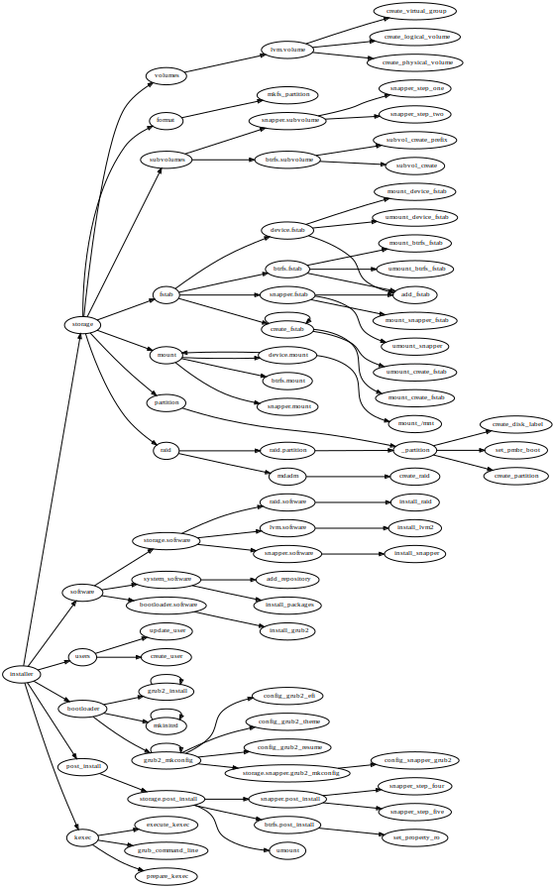
Organization of states in Yomi
Installer
  Storage
    Partition
      …
    RAID
    Volumes
    …
  Software
    …
Installer (cont.)
  Users
    …
  Bootloader
  Services
  Post-install
    …
  Kexec
    …

Slide 9
Example of a pillar
filesystems:
/dev/sda1:
filesystem: vfat
mountpoint: /boot/efi
/dev/sda2:
filesystem: btrfs
mountpoint: /
subvolumes:
prefix: '@'
subvolume:
- path: home
- path: opt
- path: root
- ...
filesystems:
...
{% let id = grains[‘id’] %}
{% if id.startswith(‘controller’) %}
/dev/sda2:
filesystem: btrfs
mountpoint: /
{% elif id.startswith(‘compute’) %}
/dev/sda2:
filesystem: ext4
mountpoint: /var/lib/images
{% endif %}
...

Slide 10
Example of salt states
mount_create_fstab:
mount.mounted:
- name: /mnt
- device: /dev/sda1
- fstype: ext4
- persist: False
{% set filesystems = pillar['filesystems'] %}
{% for device, info in filesystems.items() %}
mkfs_partition_{{ device }}:
formatted.formatted:
- name: {{ device }}
- fs_type: {{ info.filesystem }}
{% if info.filesystem in ('fat', 'vfat') and info.get('fat') %}
- fat: {{ info.fat }}
{% endif %}
{% endfor %}
prepare_kexec:
cmd.run:
- name: kexec -a -l /mnt/boot/vmlinuz --initrd=/mnt/boot/initrd --command-line="`cat /tmp/command_line`"
- onlyif: "[ -e /tmp/command_line ]"

Slide 11
RFC (PR#16)

Slide 12
A proposal for the integration of Yomi in SUMA
Where?
  https://github.com/uyuni-project/uyuni-rfc/pull/16
Why?
  A chance for a better integration of the installer
How?
  Via Formula with Forms (basic proposal)
When?
  Next version?
Who?
  I can try, any help?

Slide 13
Demo of the PoC

Slide 14
Points of discussion (I)
The current implementation of subforms is not optimal
  Inter-dependencies / ordering
Partial semantic overlap with other formula (e.g. locale, package installation)
  No way to unify all the fields, names and values
  Add states in Yomi that transform the pillar?
Problems when Highstate have Yomi and other states before the installation
  Breaks the rule of assigning all the configuration data before the installation of a new system
  … but after the installation is OK
  Is Yomi part of the Highstate?

Slide 15
Points of discussion (II)
SLE, Leap, MicroOS, … have different parameters that can be pre-initialized (e.g. Btrfs, Snapper, Subvolumes, …)
  SaltClass
UI/UX is different from Kickstart or AutoYaST in SUMA
Initial PXE-Boot configuration
Events / monitoring

Slide 16
Q & A
?

