Slide 1
NoteCollad
For Students, by Students

Slide 2
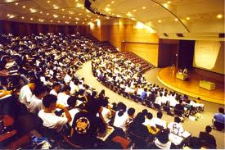
Today in education

Slide 3

Today in education

Slide 4
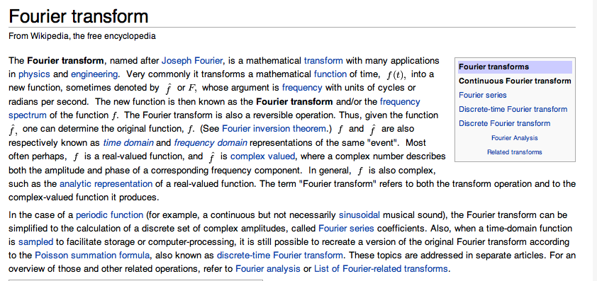
Today in education

Slide 5
Today in education
Lectures are impersonal and don’t help students learn
Group work is unstructured
Online knowledge tools (Wikipedia) are not structured for student learning

Slide 6
So how can we improve student learning?

Slide 7

Enter notecollab

