Slide 1

NoteCollab
Why Learn Apart,
When We Can Learn Together?
Notes:
Concept
Market Need
Competition
Financials (Revenue Model)
Management Team (who brings what to do the table?)
Marketing and Branding Strategy

Slide 2
Education today
Study Conducted by College Learning Association
Notes:
46 % of students have had no significant learning experiences after 2 years

Slide 3
Education today
Study Conducted by College Learning Association
Notes:
34% of students have had no significant learning experiences after 2 years

Slide 4

Education today
Notes:
Lectures are impersonal and passive

Slide 5

Education today
Notes:
Group projects are unstructured and not supportive of learning

Slide 6
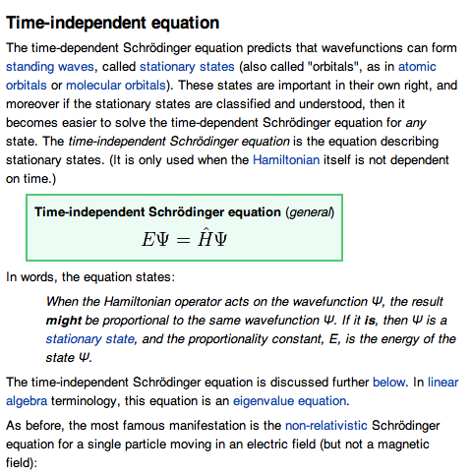
Education today
Notes:
Common online resources are written by industry experts and aren’t structured to learn from

Slide 7
Notes:
Presenting NoteCollab!

Slide 8
Professor Structured Activities
Analytics of Student Successes and Failures
Student Group and Collaborative Learning
Notes:
NoteCollab is an iterative three step process to improve student learning

Slide 9

Professor Structured Activities
Analytics of Student Successes and Failures
Student Collaborative Learning
Notes:
NoteCollab provides a framework for professors to build learning activities for student groups

Slide 10

Professor Structured Activities
Analytics of Student Successes and Failures
Student Collaborative Learning
Notes:
Student can then collaboratively tackle topics that would have been difficult in a passive lecture environment by finding and annotating high quality websites and taking notes

Slide 11

Professor Structured Activities
Analytics of Student Successes and Failures
Student Collaborative Learning
Notes:
And then analytics are sent back to the professor based on the activities to help him or her better tailor future activities and class time

Slide 12

Market
13.6 Million students attending 4-year colleges in America
Approximately 3.88 Million college courses each year in 4-year colleges
Notes:
13.6 Million Undergraduate students in 4-year colleges
3.88 Million College courses taught each year

Slide 13

Financials
At $79 a license, if NoteCollab is used in 200,000 courses during a school year, that works out to $1.6 Million in sales
Notes:
$79 pricepoint
If in 200,000 courses, $1.6 Million profit

Slide 14
Competition
 | NoteCollab | Blackboard/Moodle | Course Wikipedia | GroupNotes
Full Course Structure
Group Collaboration Tools
Class Collaboration Tools
Professor Analytics
Structure for Future Student Use
Student Rankings for Quality
Blackboard/Moodle
Full SIS, not built for group learning
Wikipedia(s)
Not structured for a course
Does not allow multiple submissions in a structured format
GroupNotes.ca
Great tool for annotating websites
Course and analytics structure not ideal
Class collaboration not considered
Notes:
There is competition, but nothing like us especially in analytics and collaboration tools

Slide 15
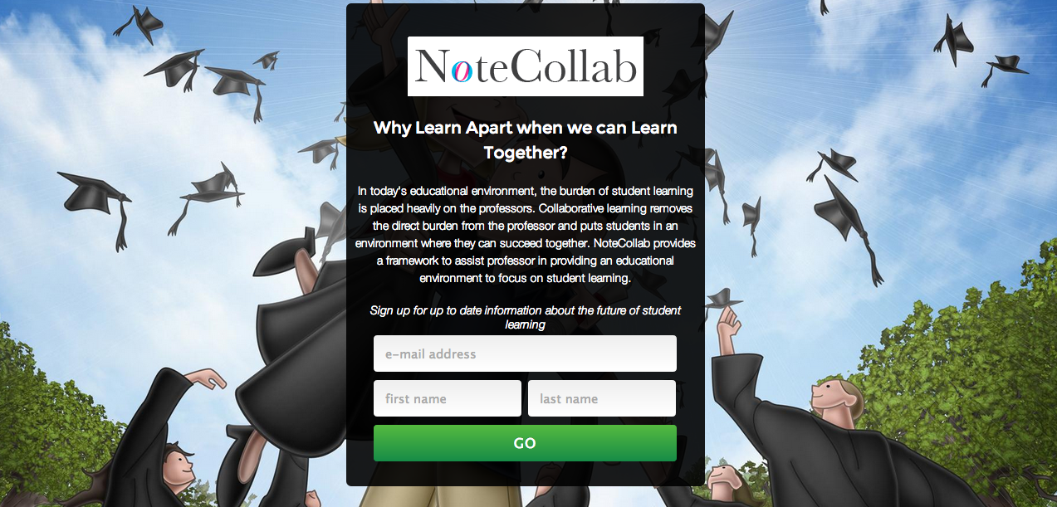
Notecollab.co

Slide 16
Questions?
www.facebook.com/NoteCollab
www.twitter.com/NoteCollab
www.NoteCollab.co

