Slide 1
Analysing Pop Songs with Natural Language Processing
Alina Platz, 02.02.2022

Slide 2
Structure
Used Data
Word Analysis
Pattern and Dependency Matching
Topic Modeling with Latent Dirichlet Allocation (LDA)

Slide 3




Data
Top songs of
  The 1960s
  The 1970s
  The 2000s
  The 2010s
  Each with ~85 songlyrics
5064 songs from top artists from the 1970s
  used for Topic Modeling

Slide 4
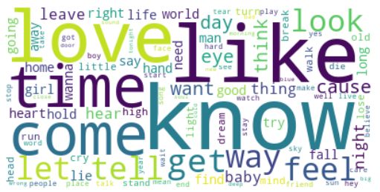
Word analysis through the decades

Slide 5
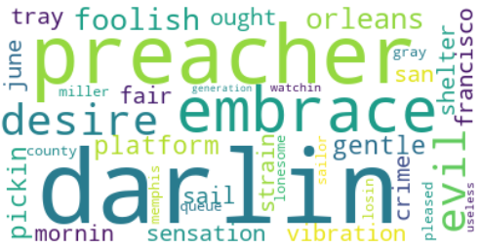
Words That were only Used in the 1960s

Slide 6
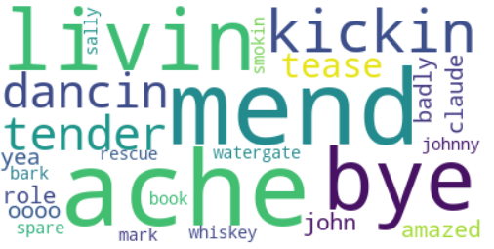
Words That were only Used in the 1970s

Slide 7
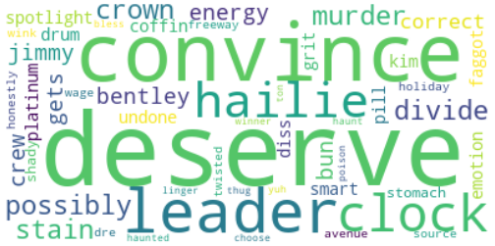
Words That were only Used in the 2000s

Slide 8
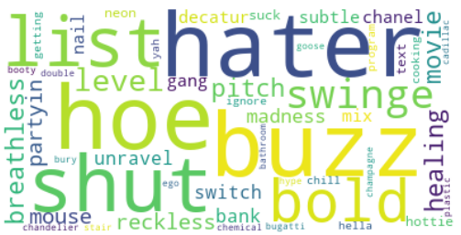
Words That were only Used in the 2010s

Slide 9

Pattern and Dependency Matching

Slide 10
Context of words: „watergate“
now we all did what
we could do
now watergate does not bother me
does your conscience bother you ?
I don't wanna be a candidate
for vietnam or watergate ' cause all I want to do is
bicycle, bicycle, bicycle
Sweet Home Alabama – Lynyrd Skynyrd
Bicyle Race
- Queen

Slide 11
Similies
follow like sheep
burning like flame
seemed like cardboard
swim like dolphins
shines like sun
shakes like fish
fly like planes
feel like circus
stick like glue
feel like home
floating like butterfly
stinging like bee
1960s
1970s
2000s
2010s

Slide 12

Topic Modeling

Slide 13
Topic Modeling
Love, know, time, heart, want, way, feel, let, tell, life, hold
love
lonely
away, day, go, come, time, run, look, night, like, home, leave , find
la, hear, sing, lord, come, time, people, song, god, world
faith
flirty
get, know, say, good, tell, man, go, way, hey, time, girl, women, come
bad, going, get, got, like, come, right, ready, well, know
crime
party
baby, come, want, get, let, wanna, girl, to, love, know, rock
little, man, boy, like, play, old, life, mother, song, sing, change, brother
friends
sad
lie, eye, light, cold, night, burn, die, high, soul, fire, cry, life, tear

Slide 14

Thank you for your attention!

