Slide 1
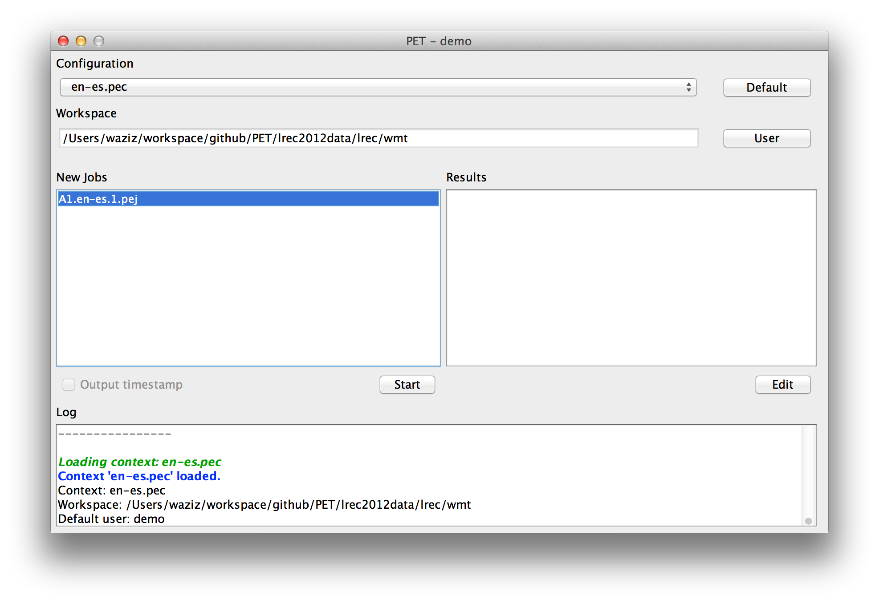
PET
The main page displays configurations. Each configuration comes with available jobs.

Slide 2
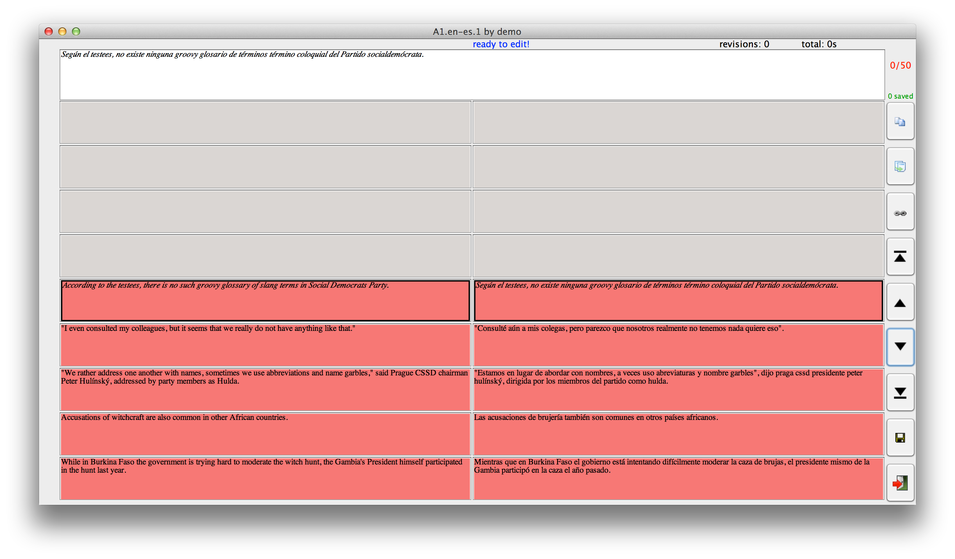
Standard job
Displays source units and their draft translations side by side

Slide 3
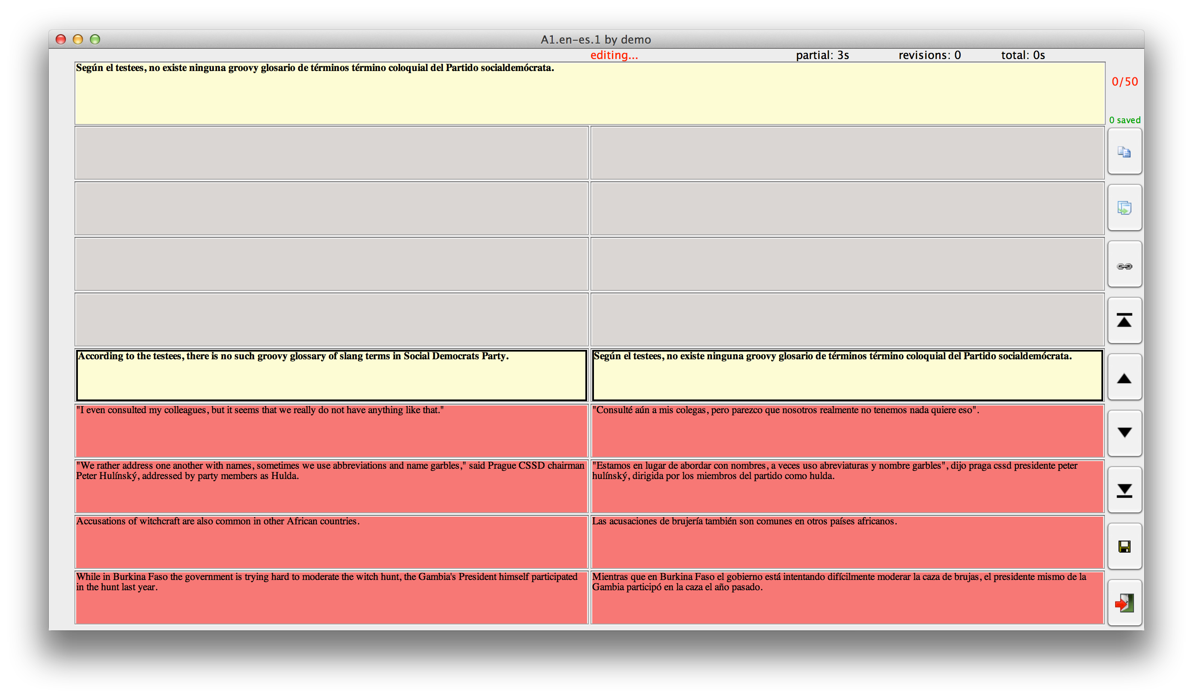
Editing
Logs edits, time, keystrokes, navigation, etc.

Slide 4
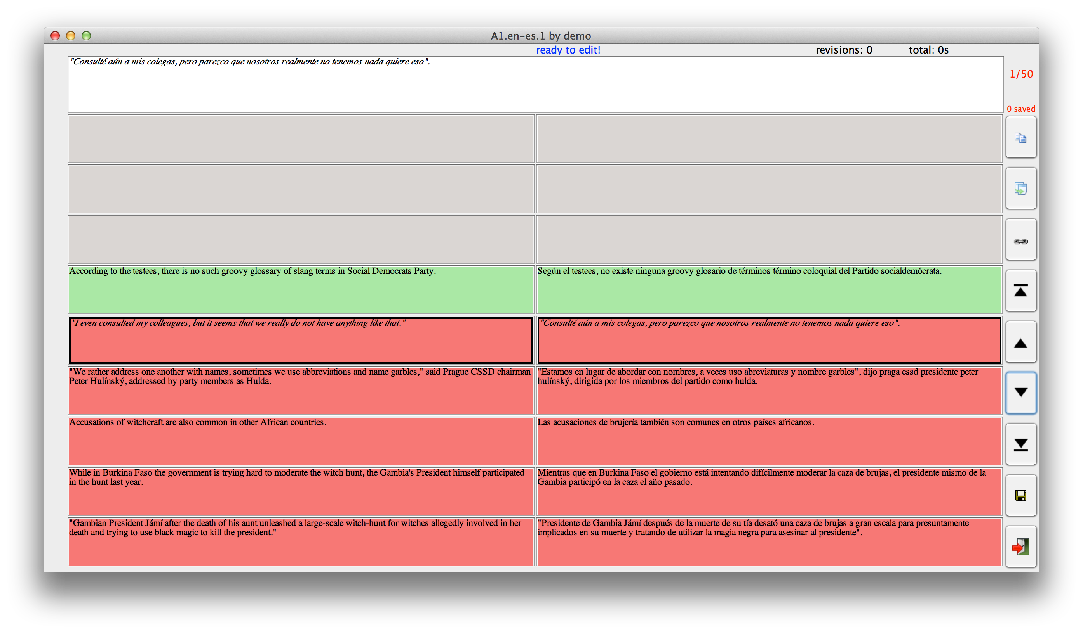
...
we log each and every unit (unit can be a segment, paragraph or whole text)

Slide 5
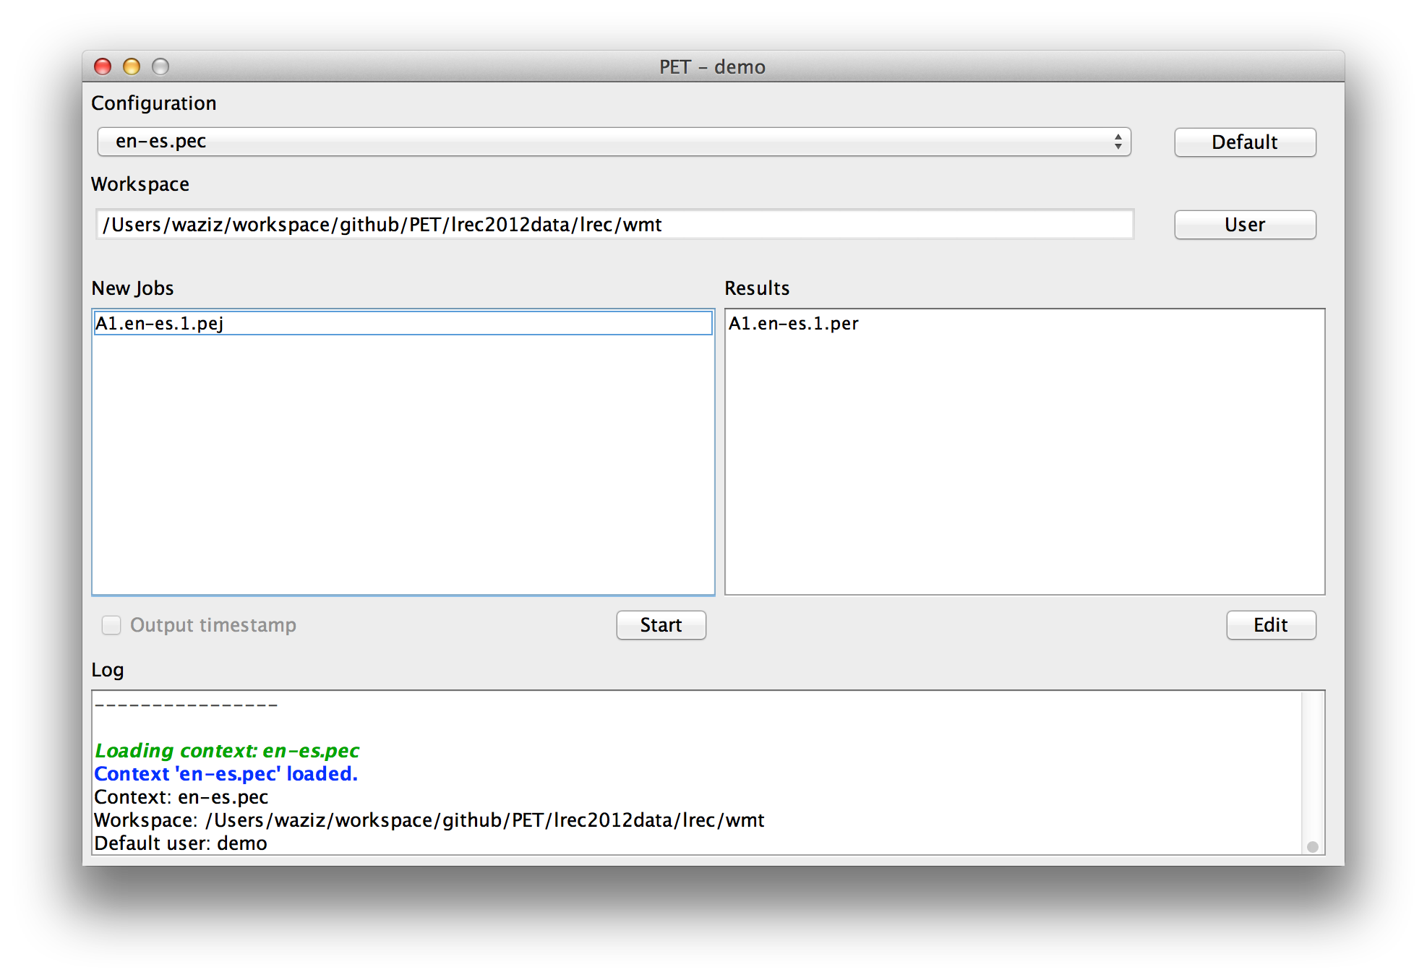
Back to menu

Slide 6
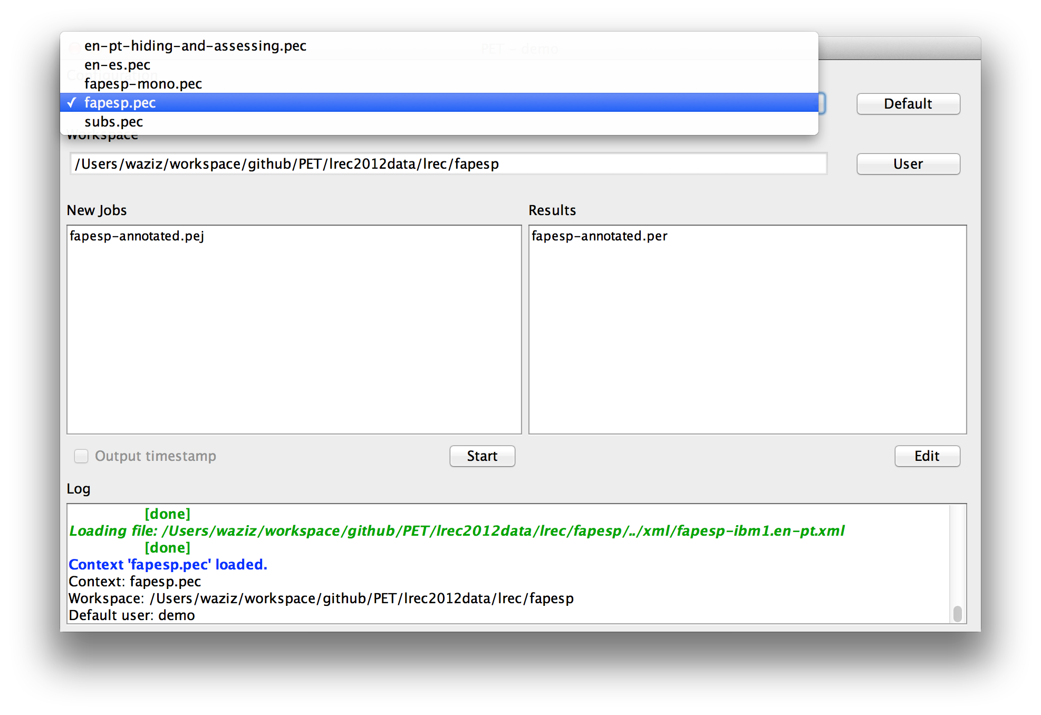
Other tasks
One can pre-configure a number of different tasks

Slide 7
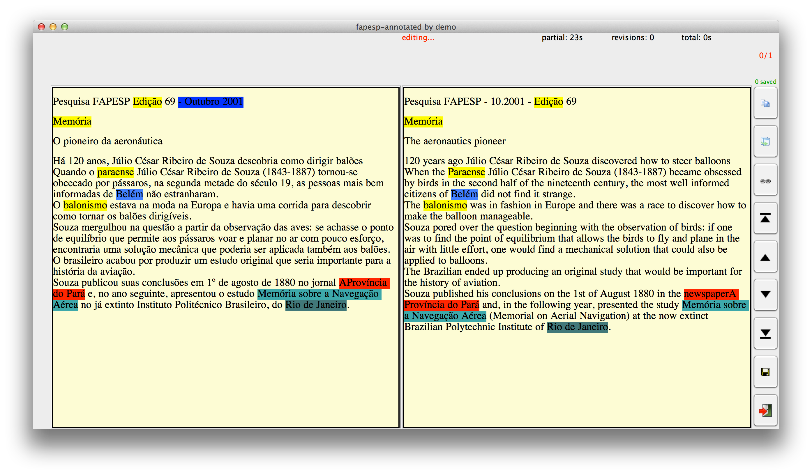
...
such as post-editing of a whole document

Slide 8
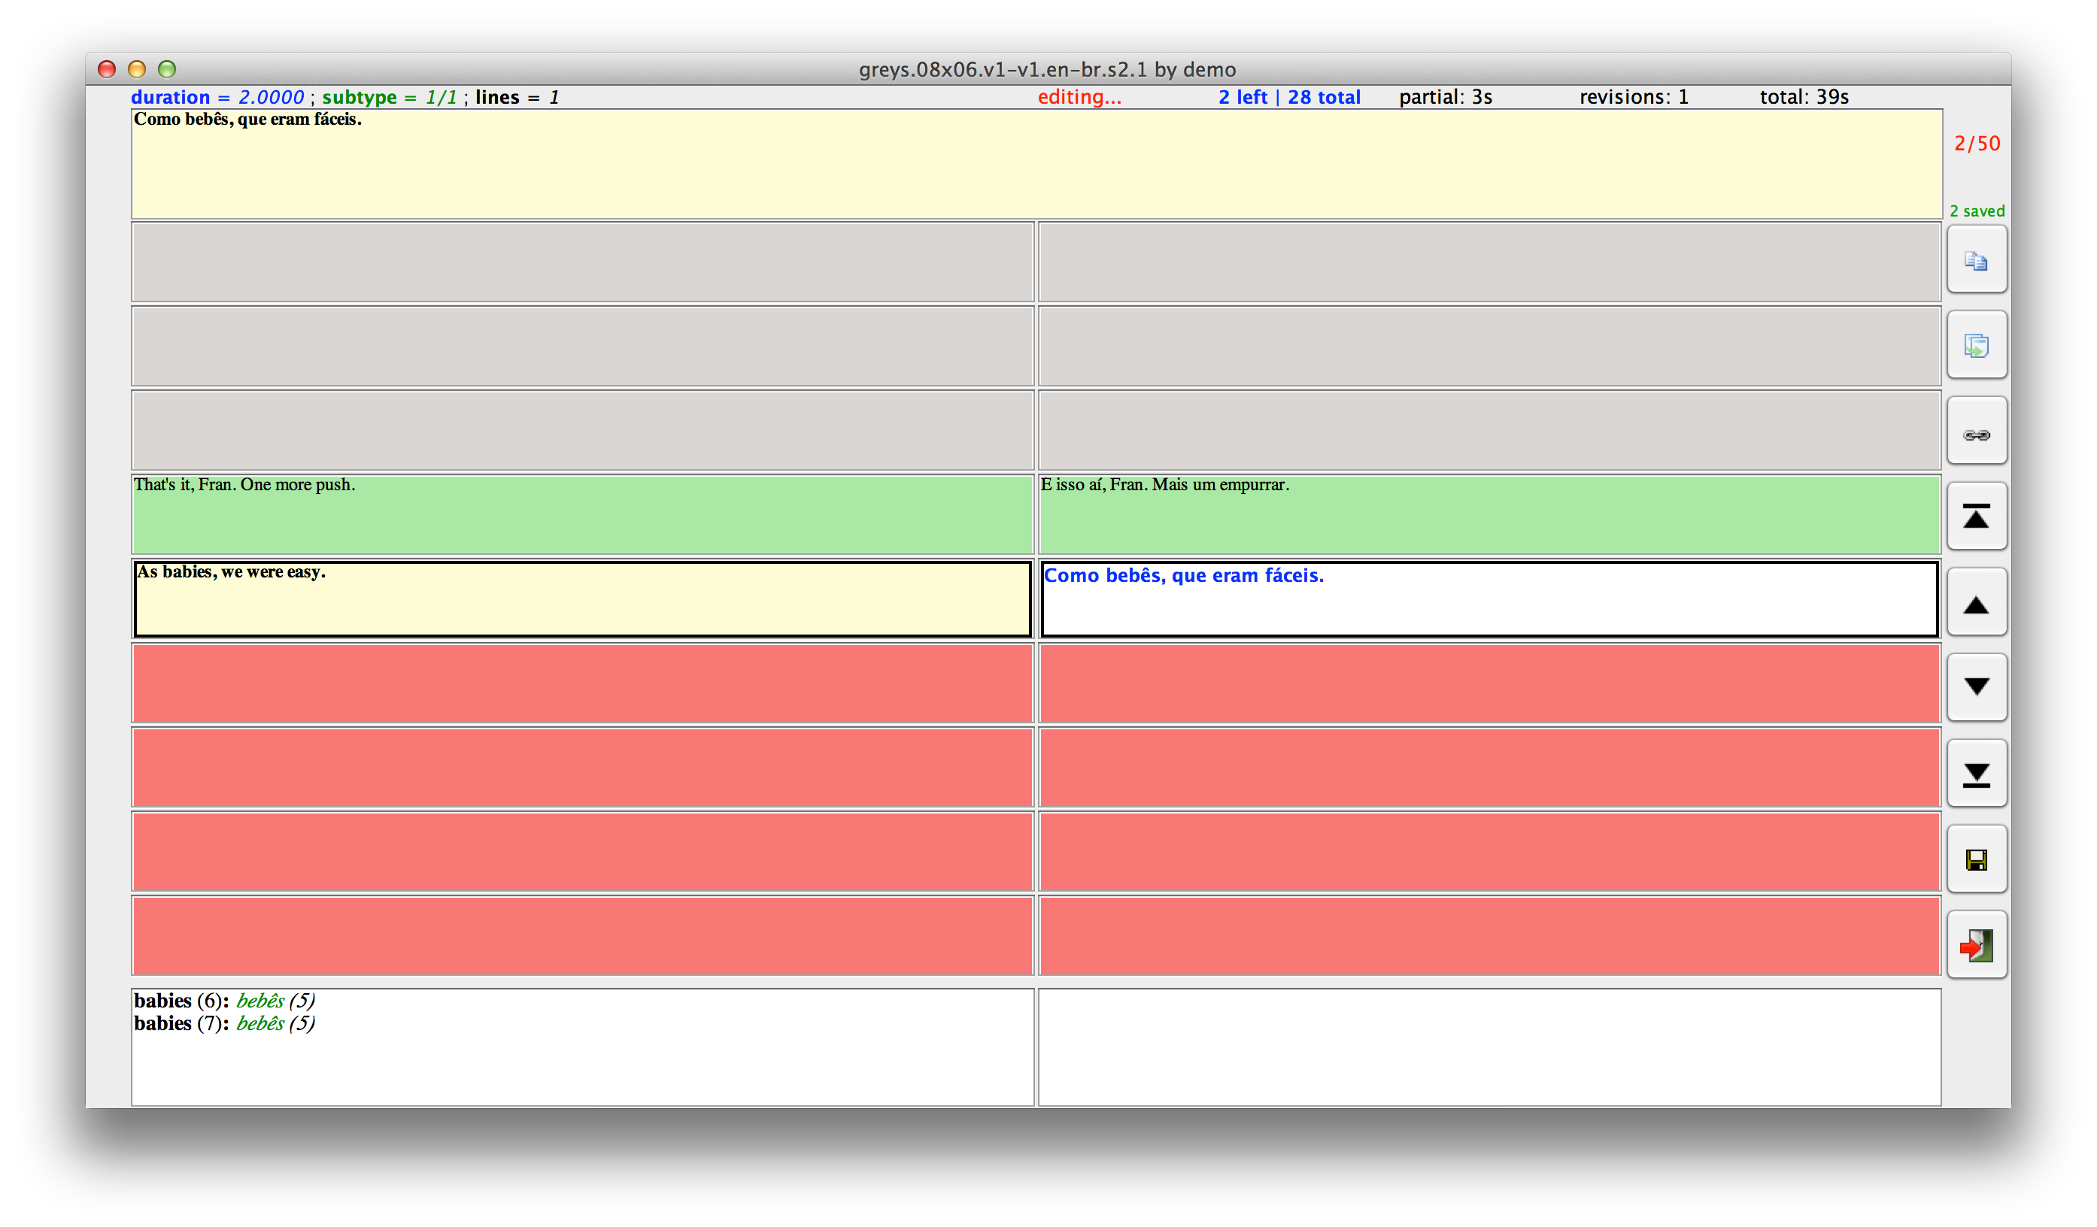
...
one segment at a time (hiding forthcoming segments)

Slide 9
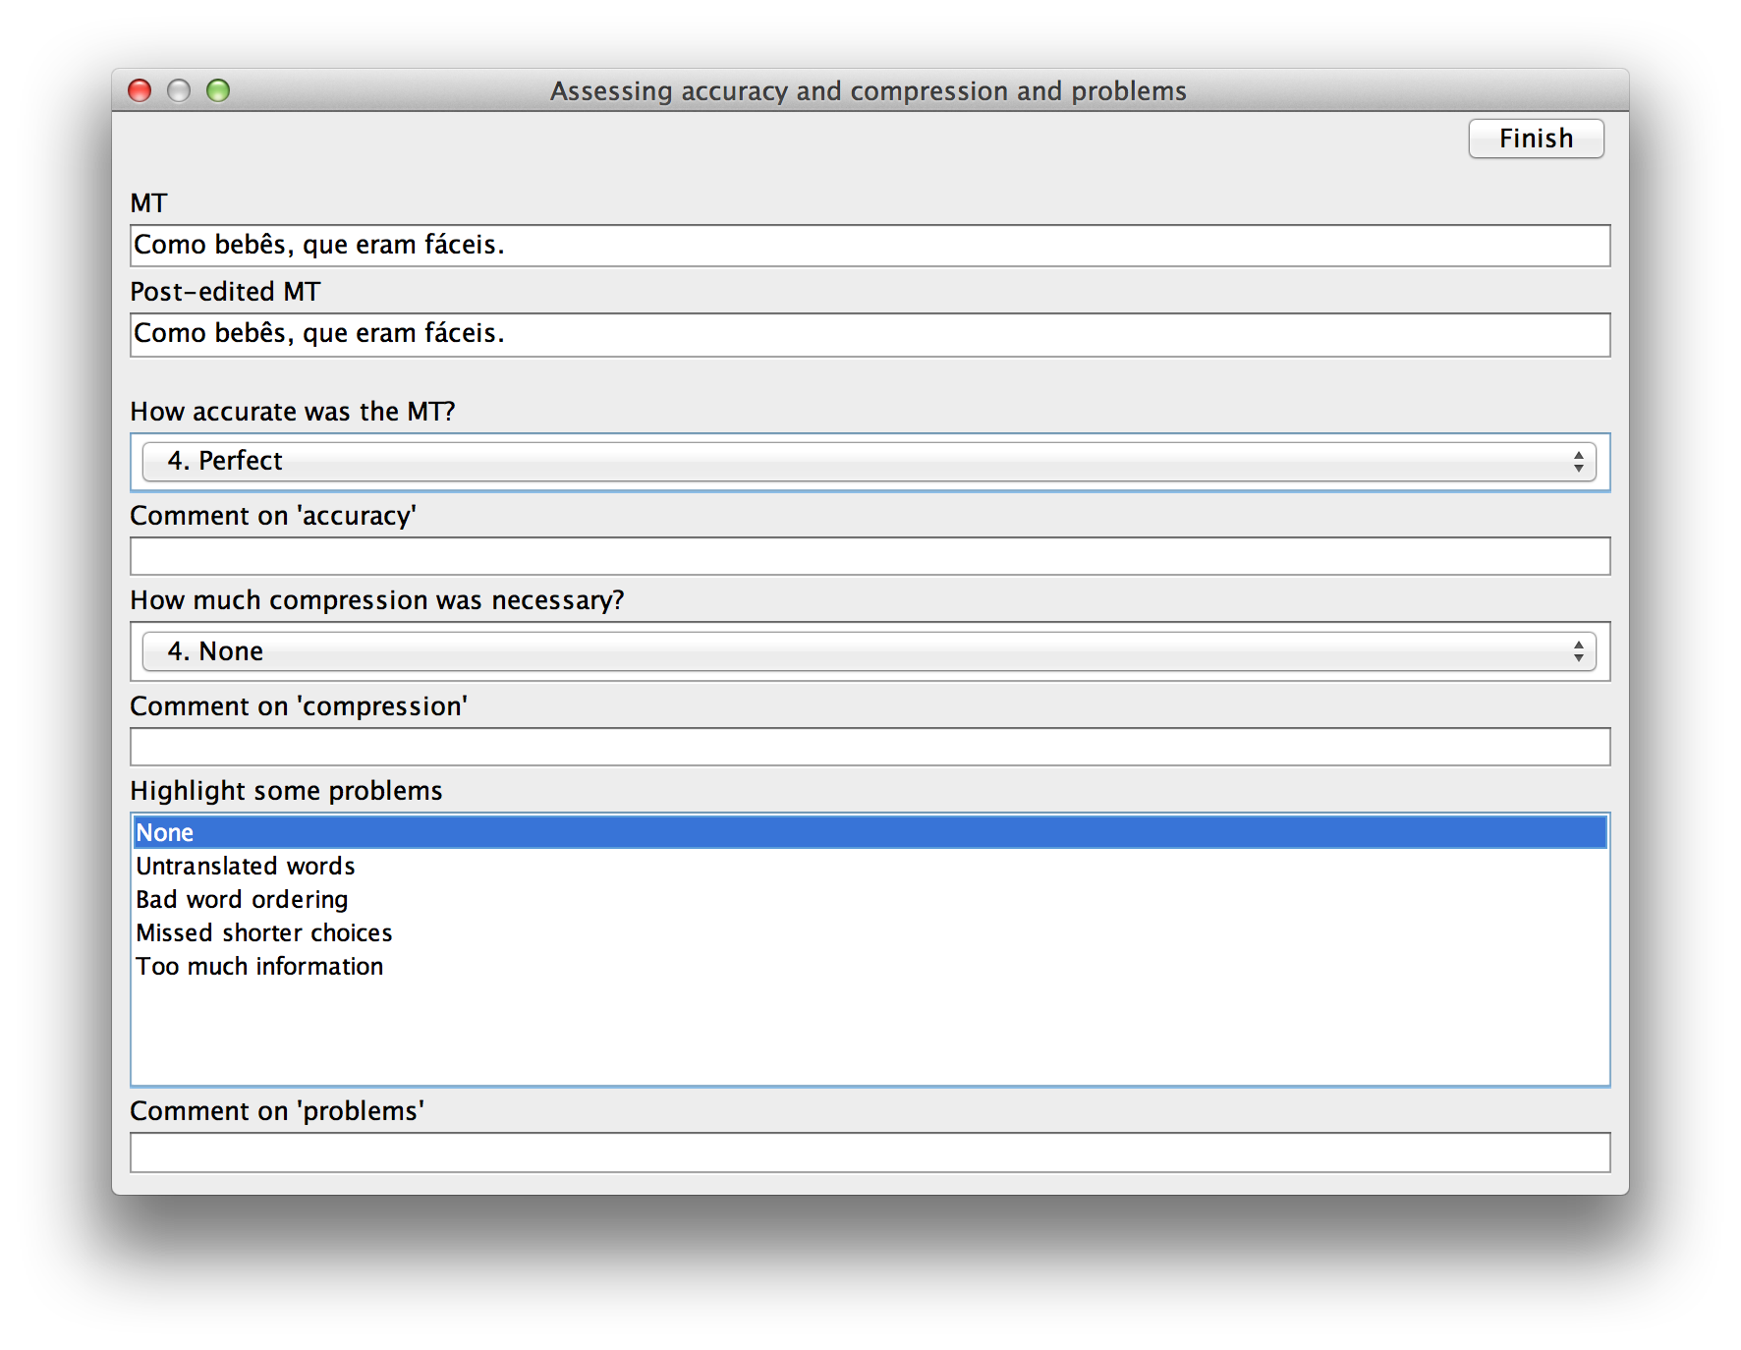
...
collecting explicit assessments after each unit

Slide 10
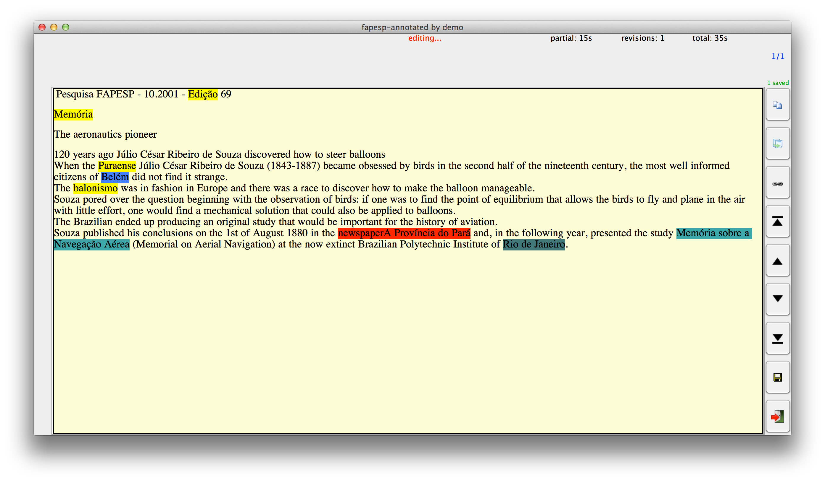
...
monolingual post-editing or revision

Slide 11
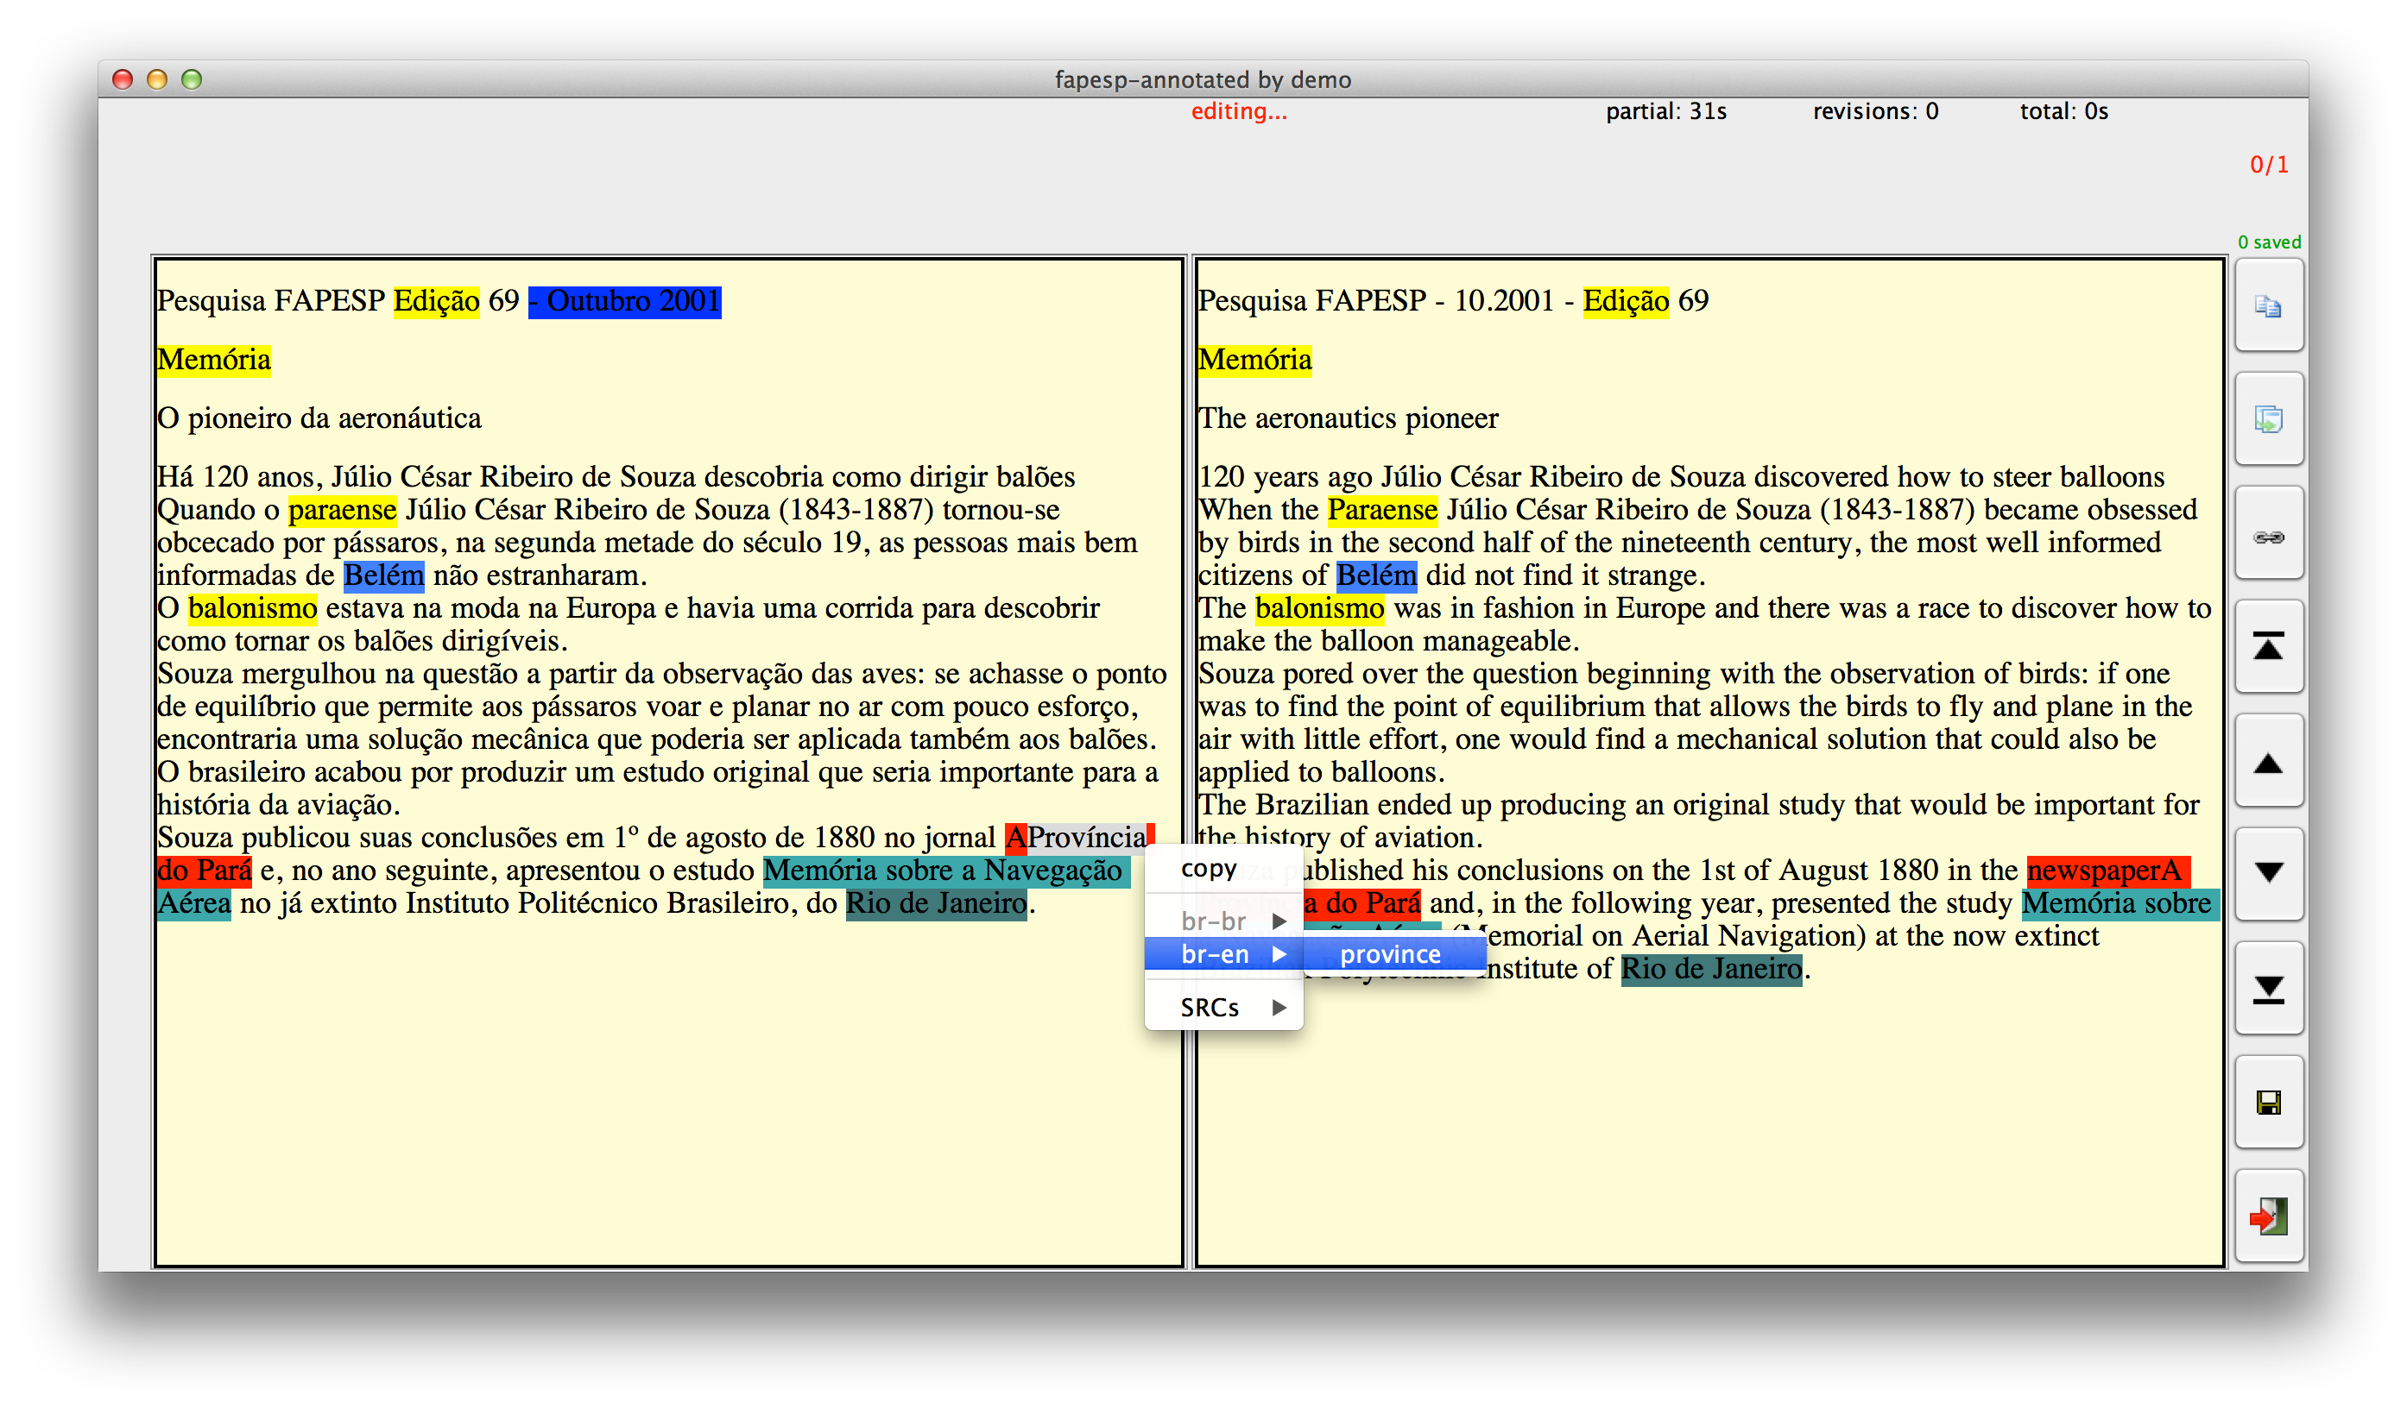
Dictionaries
monolingual and bilingual

Slide 12
...

Slide 13
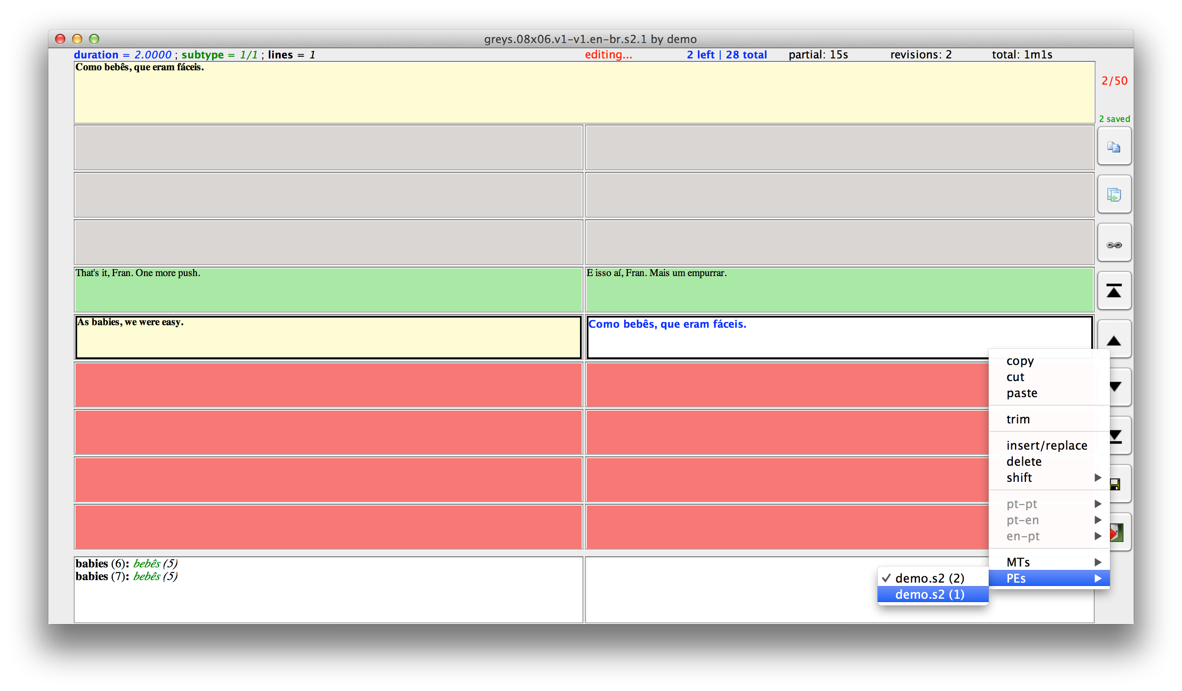
More
multiple MTs, version control, support to length constraints

Slide 14
For even more and to contribute features
https://github.com/wilkeraziz/PET

