Slide 1
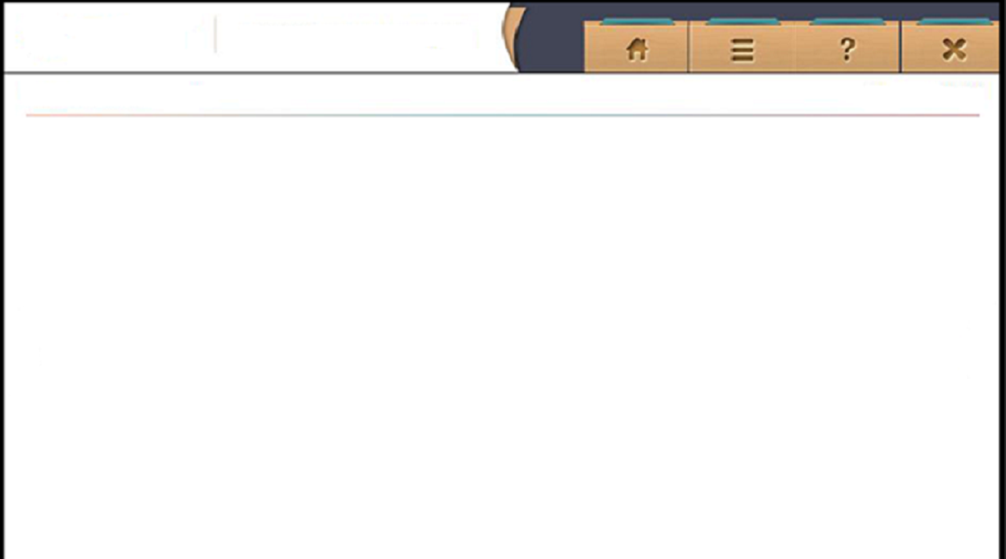
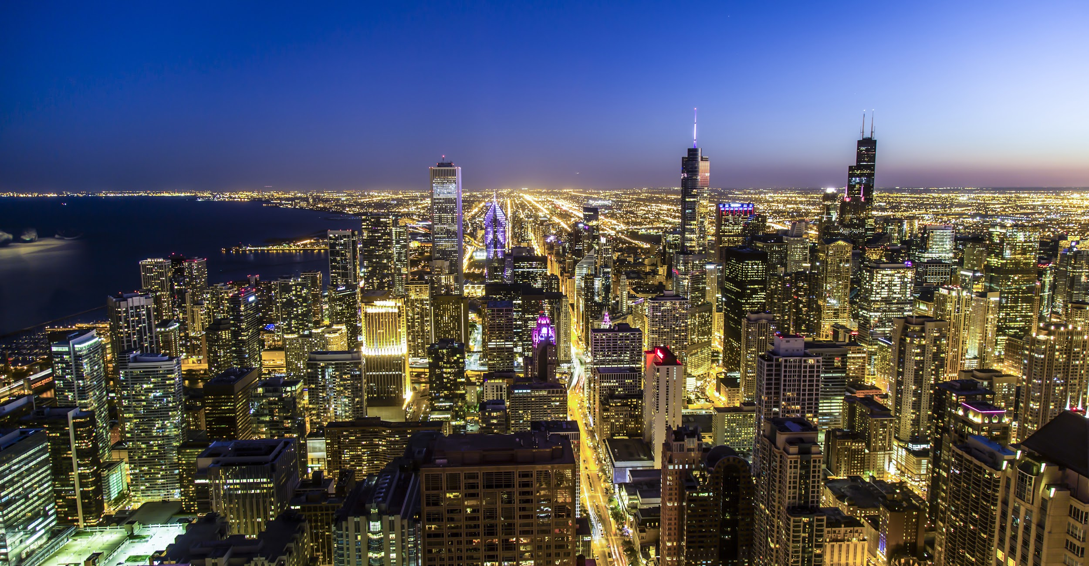
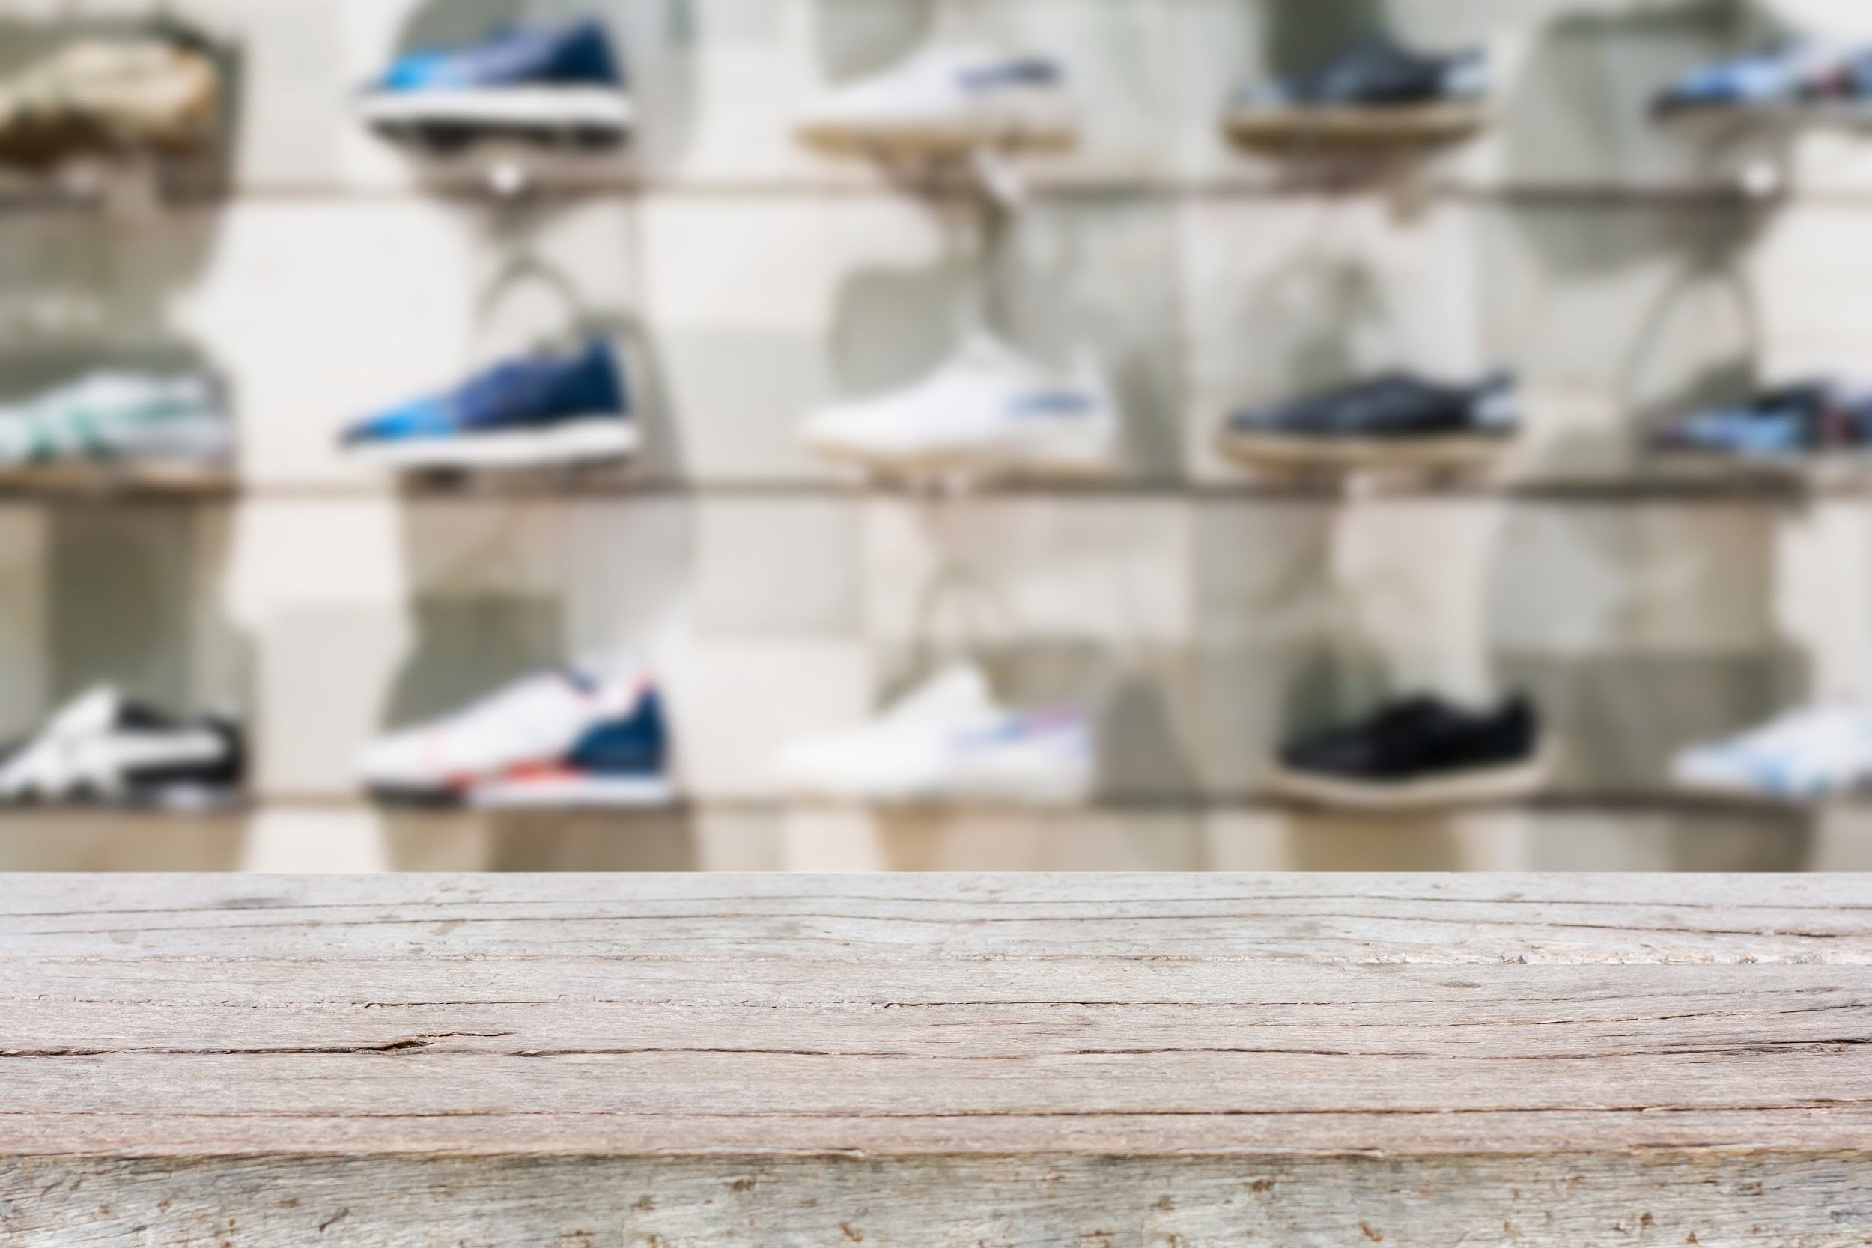
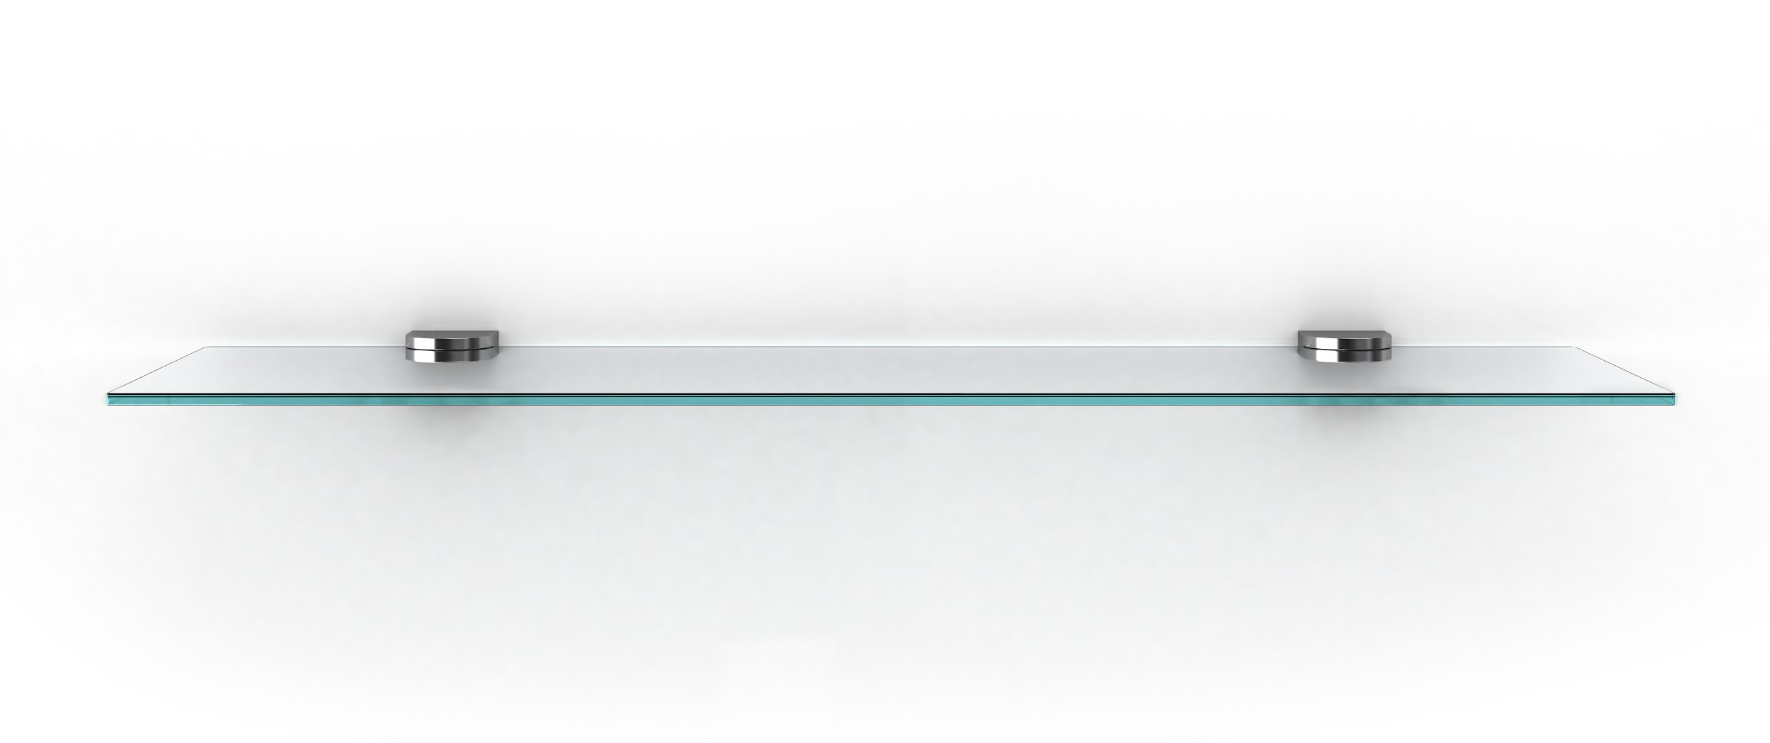

Store Inventory
Home
Add Product
Lookup Product

Slide 2

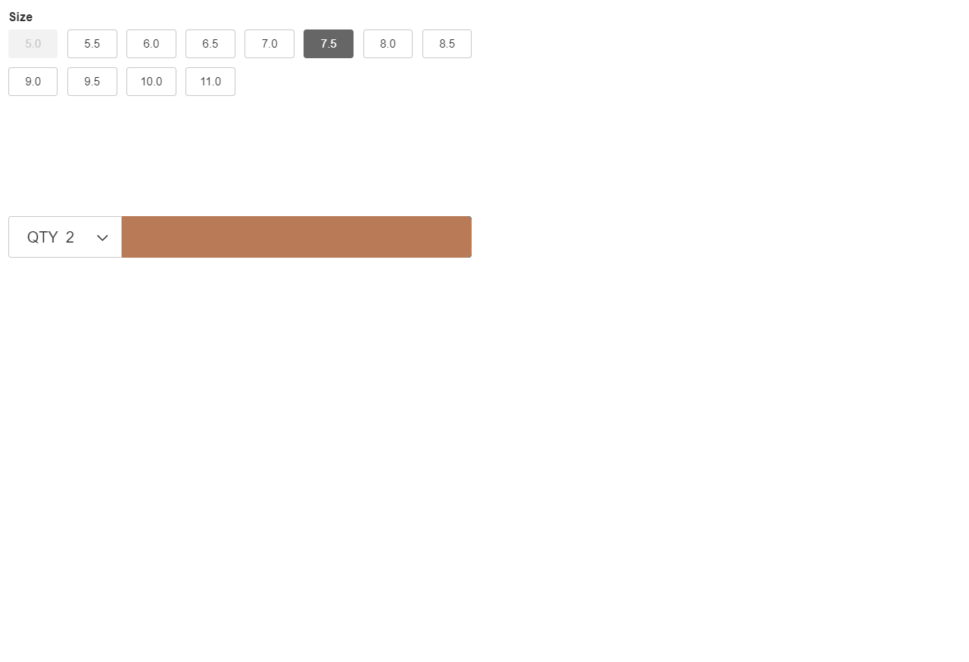
Store Inventory
Add Product
Enter Product Number:
Ex. 0000111111111
Enter Product Name:
Ex. Air Jordan 4
Enter Size:
Ex. 10.5
US
M
Quantity:
Ex. 4
Add Product Picture:
.jpg, .png
Add

Slide 3
Store Inventory
Add Product
Enter Product Number:
Ex. 0000111111111
Please correct fields.
Enter Product Name:
Ex. Air Jordan 4
Enter Size:
Ok
Ex. 10.5
Quantity:
Ex. 4
Add Product Picture:
.jpg, .png
Add

Slide 4
Store Inventory
Add Product
Enter Product Number:
Ex. 0000111111111
Please enter valid product number, integer with 0-12 digits.
Enter Product Name:
Ex. Air Jordan 4
Please enter valid product name, string with 0-40 digits.
Enter Size:
Ex. 10.5
US
M
Please enter valid shoe size for category.
Quantity:
Ex. 4
Please enter valid quantity, integers only.
Add Product Picture:
.jpg, .png
Please enter valid image, .jpg and .png only.
Add

Slide 5
Store Inventory
Add Product
Enter Product Number:
Ex. 0000111111111
Product Added!
Enter Product Name:
Ex. Air Jordan 4
Enter Size:
Return Home
Add Another
Ex. 10.5
Quantity:
Ex. 4
Add Product Picture:
.jpg, .png
Add

Slide 6
Store Inventory
Lookup Product
Enter Product Number:
Ex. 0000111111111
Lookup Product

Slide 7
Store Inventory
Delete Product
Enter Product Number:
Ex. 0000111111111
Product not found, please try again.
Ok
Lookup Product

Slide 8
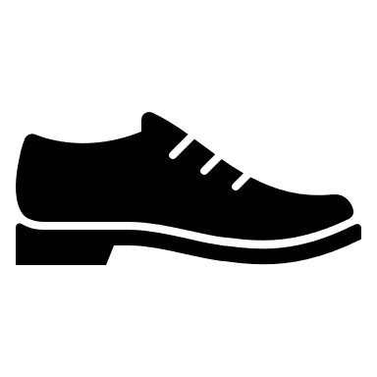
Store Inventory
Product Info
Product #: _____________
Name: _________________
Amount In Stock: __________
Check Sizes
Delete Product(s)

Slide 9
Store Inventory
Product Info (Sizes)
Product #: _____________
Name: _________________
Amount In Stock: __________
Sizes
7.5(3) 9.5(8) 10(4) 10.5(2)
Delete Product(s)

Slide 10
Store Inventory
Delete Product
DELETE

Slide 11
Store Inventory
Delete Product
Delete 7.5(2) | Are you sure?
Delete
Cancel
DELETE

Slide 12
Store Inventory
Delete Product
Delete Successful!
Ok
DELETE

Slide 13
Store Inventory
Product Info (Sizes)
Product #: _____________
Name: _________________
Amount In Stock: __________
Sizes
7.5(1) 9.5(8) 10(4) 10.5(2)
Delete Product(s)

