Slide 1
Blockchain
A technical primer
- Rahul Jadhav
Notes:
Take a survey before I begin (very important for me to guage):
How many of you have heard of BitCoin? Any investors?
Of Blockchain?
Of Ethereum
Briefly introduce my stand:
Not an investor. Do not have any opinion on BitCoin.
Have opinion on Blockchain/Ethereum though

Slide 2
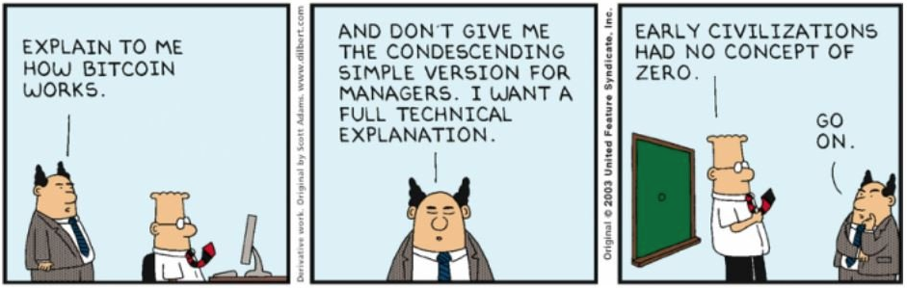
Quoting Dilbert…

Slide 3
Blockchain: you may have heard
A Distributed ledger which
contains entries of (monetary) transactions
Is Tamperproof
Is Immutable
Open/Trustless participation
All this while been accessible to everyone on Internet (even Hackers)!

Slide 4
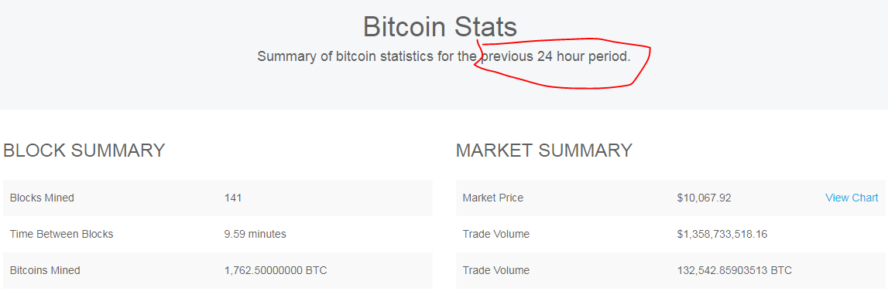
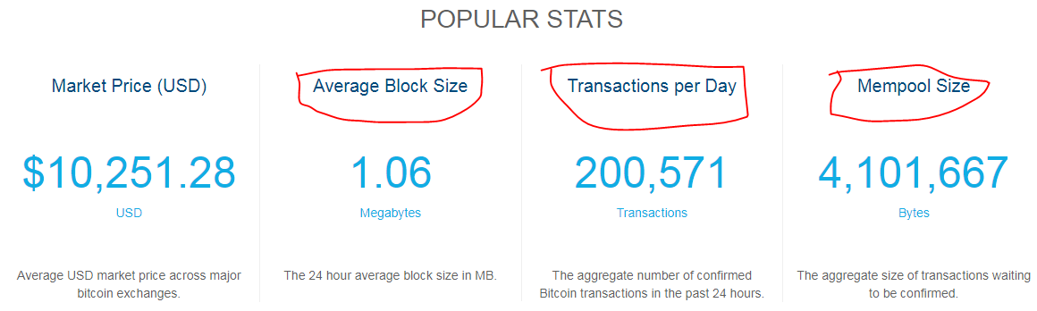
Get a feel …
http://blockchain.info/

Slide 5
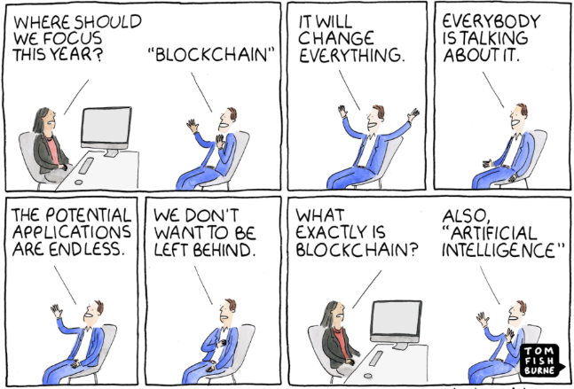
BlockChain, not a holy grail

Slide 6
But its not all about money…
Distributed storage and computing
Storage and computing is ubiquitous
But not really distributed, under-utilized
Trust Disrupted
Today’s model: Intermediaries everywhere
Government, Banks, Visa, MasterCard
Blockchain’s model: Network is the intermediary
Notes:
Trust Disrupted

Slide 7
Thou shalt know…
Public/Private key
You use it for auth when you access https://
Hash Function (SHA256 in our case)
Every programmer has used it
Digital Signatures
In Huawei, you get your Form16 digitally signed
Distributed P2P network
BitTorrents? Yeah, They have much bigger purpose ☺

Slide 8
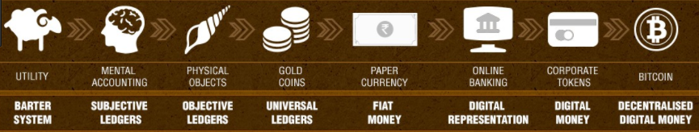
Show me the money!
It’s important to understand
What’s a CryptoCurrency?
At what point money became centralized?

Slide 9


Some background…
“The” Network
Alice: Give Bob 20 units from my account
Currency characteristics
Universal acceptability
Recognized Issuer - Government
Account Management - Banks
Wallet Management - Users

Slide 10
CryptoCurrency - Challenges
How to issue new currency?
No physical mint
Where to store the transactions?
No central authority
How to ensure transactions cannot be tampered?
Transaction initiation:
How to ensure that the source account has enough funds?
How would users identify each other?

Slide 11
But it can be trivially solved…
[Announce Transaction:
Src act: Alice(pub key)
Dst act: Bob(pub key)
Amt: 20 units
Signed using Alice(priv key)

Slide 12
Ponder…
Who has the right set of transactions?
How will “The Network” decide?
Consensus problem
Where did Alice got her 20 units from in the first place?
Where is the mint?
Even though the network can’t change the value, they can still delete the transaction at later point of time.

Slide 13
Now lets talk blockchain
For a truly open cryptocurrency, we need a backend: BlockChain
A Distributed ledger which is
Immutable, Tamperproof
You can’t delete the transactions nor modify
But everyone can see & validate the transactions
Network together decides which is the right set of transactions

Slide 14
Further about blockchain…
Trustless open network
Anyone can participate. Does not need permission from any central authority or from the network itself for participating.
All you have to do is play by the rules
Most importantly the rules are part of the software which is open sourced.

Slide 15
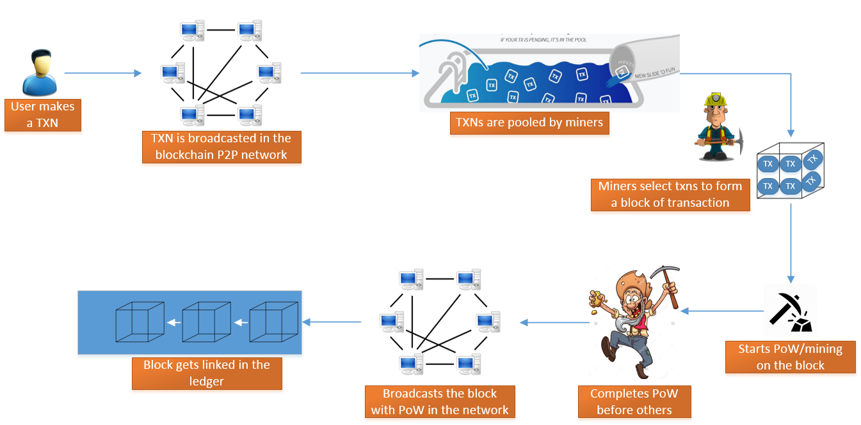

Slide 16
How does Blockchain get thEsE Characteristics?
Unraveling the mystery…

Slide 17
Hash function Primer
HASH
SHA256
Any
Sized
Input
Fixed
256b size
output
Any size input → Fixed size output
Same input → Same output
Anyone can use the same input with the same hash function and get the same output
Slight change in input → Complete change in output

Slide 18
Hash Primer
~:rahuljadhav$ for((nounce=0;nounce<10;nounce++)); do echo "rahularvindjadhav$nounce" | shasum -a 256; done
50add82e952c0576d92b9f427fc08018654c948b4217be7deb6b7e404a05f368 -
f100f16b5d61df9c66c0b5b6153ffc64563528a62bcb28305d02b35600f5726e -
eacc0436420aab21881c81cac310bf14b5b6db3c532eddc93c68835dadd09571 -
74d1523faa9585a43246ff35d55f72f4495274307b1512866beba4454050f3fd -
5fe6d82026120c90598910c1db9d6f10b3140d75cf2db0f4b91d994ef6443723 -
0d0d2bcbfab885864b8290e228ed81d1f52870c6f6f897f4152213a4e1c6909d -
5c989d795d929617bc45acb590f00af8adb7caa0125fc8410f2de5fdd5db5a56 -
10f24a6b4328f592576e7638802db4089178d6bf9ae617e769bf9e2725037c9e -
d5e4dbe86edc500671efe92af27bfbae4f5abda494b004a0c671de087abb51ed -
f5080d2391ff0bf6ad424f4acfc98846690d9938bd436aaa9d422e901ec3d586 -
- Collisions are possible but impossible to cause it

Slide 19
Hash Primer
What is the probability that the first bit is zero for any HASH output?

Slide 20
Hash Primer
What is the probability that the first 40 bits are zero for any HASH output?
Introducing Difficulty Target…

Slide 21
Introducing Mining or Proof of work…
A Miner assembles a set of transactions and starts mining with an objective
To find a nounce which will satisfy the difficulty target.
How does PoW map to approx time?
PoW, a moving target because of advancements in computing platforms
PoW of avg 10 minutes prevails on public blockchain

Slide 22
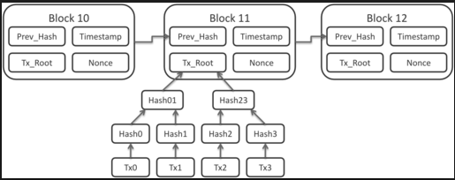
What does a block contain?
Daisy-chained blocks
Single bit change in any previous blocks will result in whole chain getting invalidated
Genesis Block – First block mined

Slide 23
Miner’s Fee
Concept of Coinbase
Value slashing of a coinbase
Incentive for validation
Collecting transaction fees
Implications of having transaction fees
Electricity/Maintenance cost vis-à-vis coinbase earnings
Mining bases shifting to China
Shifting to colder places where heat dissipation is easier
Tremendous improvements in hardware mining

Slide 24
Question
Why is having a difficulty target which maps to physical time so important?
PoW is what provides immutability characteristic to Blockchain.

Slide 25
Question
What happens if two or more miners mine the same block number at relatively similar times?
Note that miners decide which transactions to select by themselves.
Did it ever happened that multiple branches kept on increasing at the same height?
Highly improbable, but it happened. Why?

Slide 26
Branching in Ledger
X
Block_x1
Block_x2
Block_x3
Block_x4
→
Block_x3’
Block_x4’
Block_x5
Block_x6
What happens to transactions in orphaned blocks ?
How do I know my transaction is accepted ?

Slide 27
Achieving Consensus
Understanding chain branches
Consensus: Maps to longest branch
How to decide that the branch is long enough?

Slide 28
Fallout of Consensus mechanism
Transaction CONFIRMATION time
Transactions from unaccepted branches are as good as not processed
Different apps may choose to have different confirmation times

Slide 29
Miner’s Computational Race
Why does it makes sense for miners to abandon the current block if someone else solves it first?
Mining future blocks in advance: There is no way miners can start mining future blocks because of the dependency on previous block header.

Slide 30
Empty Block Mining Issue
Miners can choose to mine a block with empty transactions
Why would miners do that?
Adding transaction to the block means validating them
Checking if there are duplicates
All this takes time
Relation to coinbase value which will drop over a period of time.

Slide 31
Double Spending Issue
What is Double Spending?
How is Double Spending possible?
Why Confirmation time so important?
How does it tackle double spending issue?

Slide 32
Attacks on Blockchain
Are really attacks on Wallet systems?
Someone steals your wallet, you can’t blame the bank, can you?
Blockchain ledger has never been compromised
Been on open Internet for a decade now
Bugs in the code, but it didn’t undermine the existing ledger’s security
Attacks are possible though
But practically infeasible to mount (51% attack)
As more and more blocks get added, the security improves exponentially

Slide 33
Limitations of Public Blockchain
Ltd txn processing capability
Resulting in longer confirmation wait time
Increasing transaction fee
Increase in ledger size over time
With 1K txn size per block, we have 150 GB ledger size today.
PoW burns electricity
Anonymity
Privacy issue … anyone can track your spending
Mapping a public key to an identity is non-trivial

Slide 34
Blockchain Applications
Bitcoin is just one application of Blockchain
Consider other applications
Slock.it
DAO (Decentralized Autonomous Organizations)
International Trade
Worldwide Freelancing
Democratic: Content by the people, for the people

Slide 35
Blockchain Revamped
What is Blockchain 1.0/2.0/3.0?
1.0 – Turing incomplete – Public Blockchain
2.0 – Turing Complete – Ethereum
3.0 – External Data Oracles – MS Bletchely
Unfair to call versions
1.0 is still applicable to lot of problem statements without adding the complexity of 2.0/3.0
Note Complexity adds software issues

Slide 36
FAQs
Miscellaneous

Slide 37
FAQs
What is public vs private blockchain?
What is Bitcoin-Cash fork?
What is HyperLedger?
What are ICOs?
What is Blockchain-As-A-Service (BaaS)?
What is Ethereum and how is it different from Bitcoin network?
What are Smart Contracts?
Why does IoT and blockchain goes hand in hand?
What is Proof-Of-Stake?

Slide 38
FAQs
What is Microsoft Bletchely Project?
Microsoft’s strategy for BaaS
What are governments doing about it?
Taxation rules in India?
ICO regulations?
What are DAOs (Decentralized Autonomous Organizations)?
What are DAPPS (Decentralized APPS)?
Was there a fraud in such systems?
What steps were taken for recovery?
50mn DAO virtual currency siphoned off

Slide 39
Thank You
Questions?

Slide 40
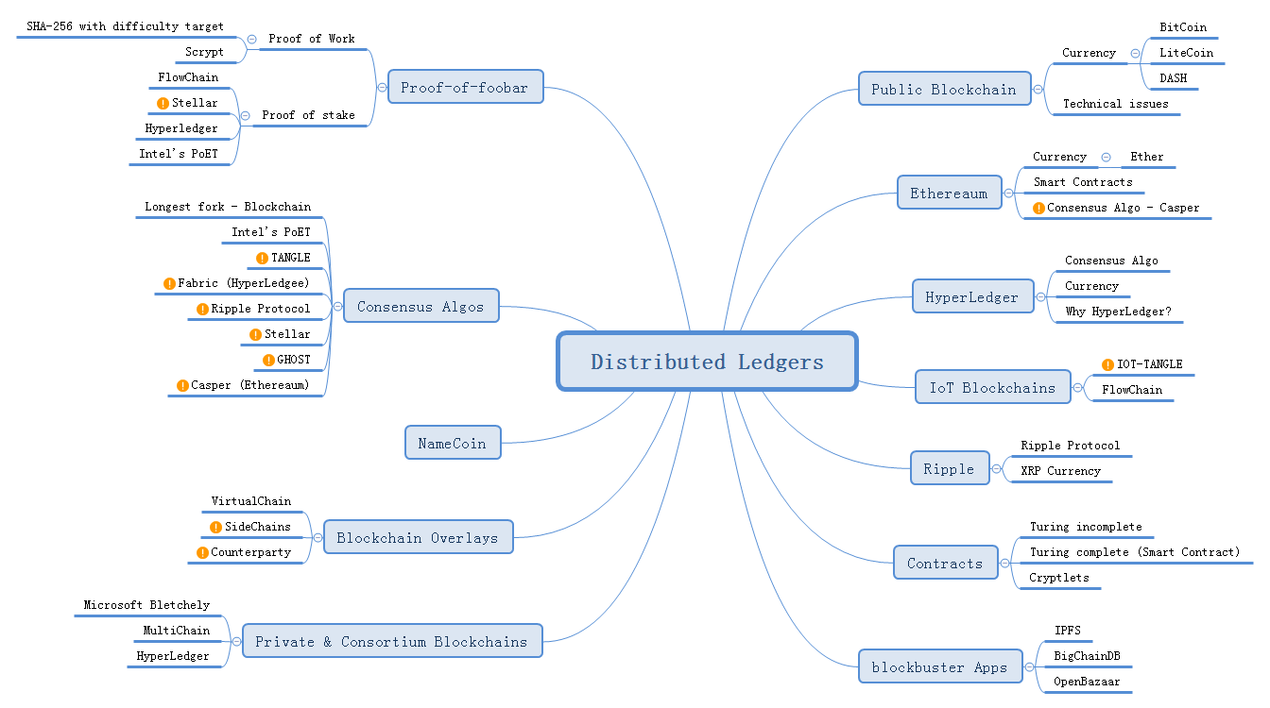
My MindMap
What is Microsoft Bletchely Project?
Microsoft’s strategy for BaaS

