Slide 1
Applying Lean Startup Methodology to Develop an Electronic Examination System
Juho Pekkinen
21.05.2019

Slide 2
Outline
1. Introduction
2. Research question & methods
3. Results
4. Conclusion

Slide 3
Introduction
Computer science education has advanced enormously by adopting new learning activities and environments
The availablity of software tools, instant feedback and documentation are currently taken for granted in programming courses
However these tools have not been adopted successfully in exams in a large scale

Slide 4
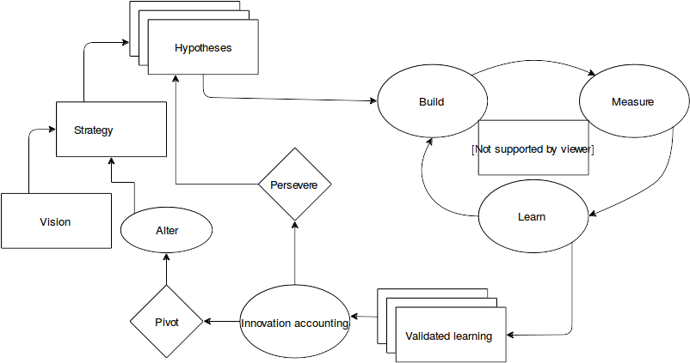
Introduction: Lean Startup
Agile methodology for product and business development that combines agile software development methods with customer development
Emphasizes measuring the
behavior of the users as
the input for the
development work
MVP

Slide 5
Research problem
“How can lean startup methodology support the development of an electronic examination method?”
RQ1 What kind of electronic examination system suits the needs of the computer science education?
RQ2 Which lean startup practices can be applied for the development of an electronic examination system?
RQ3 Which lessons can be learned from applying lean startup practices for electronic examination systems?

Slide 6
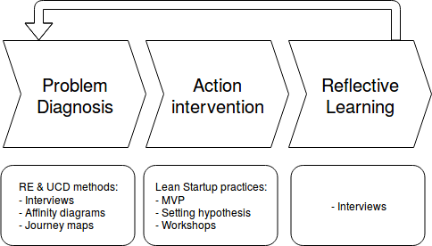
Research method: Action research
21/05/19
Notes:
Hypothesis should be concise, easy to validate and target a rather small part of the system

Slide 7
Results – Requirements for the examination system

Slide 8
The process for teachers
The most of time spent designing new exam questions and grading exams
There is already a concern that more questions need to be designed
Currently practical arrangements with the department work well
Notes:
What works well:
Coordination of practical matters, e.g.. printing out and distributing exam questions

Slide 9
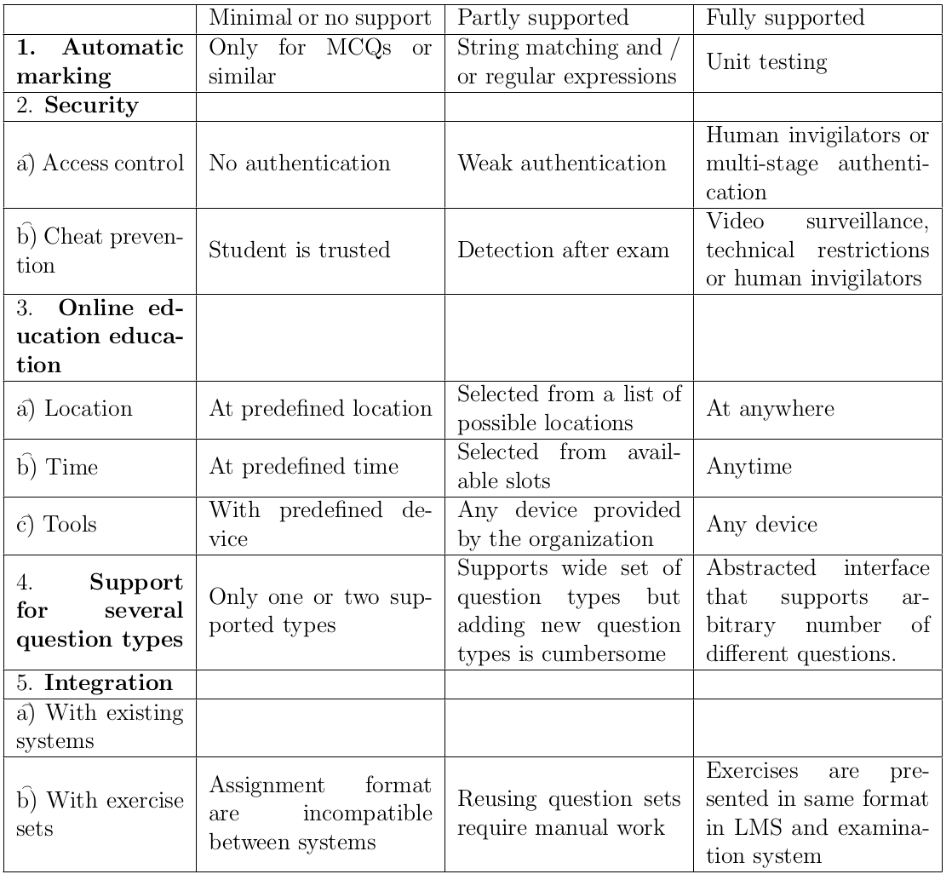
Criteria for examination system
Based on criteria presented by Arnow and Barshay (1999)
Notes:
What works well:
Coordination of practical matters, e.g.. printing out and distributing exam questions

Slide 10
The First MVP
(Developed based on a model by Rytkönen and Myyry [2014])

Slide 11
The First MVP

Slide 12
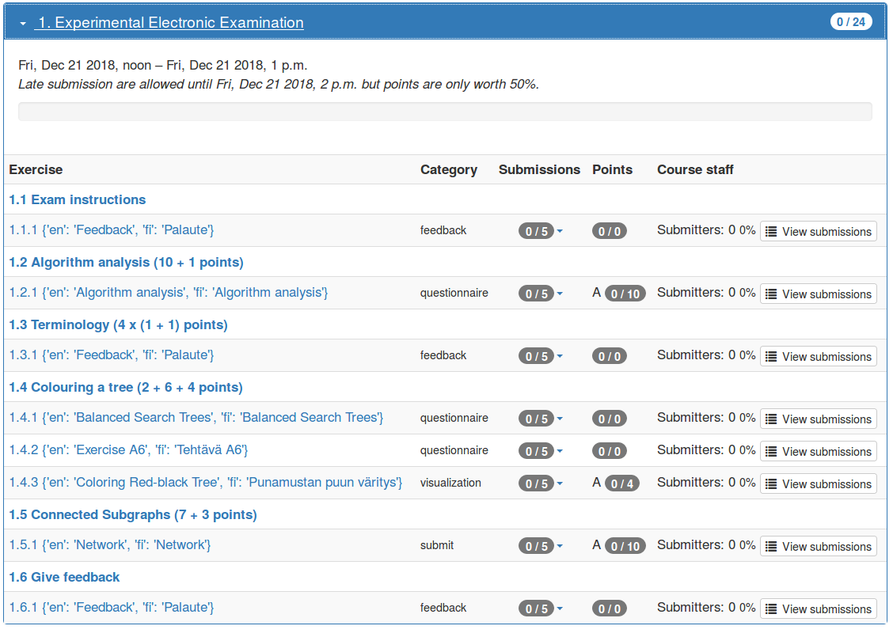
The second MVP

Slide 13
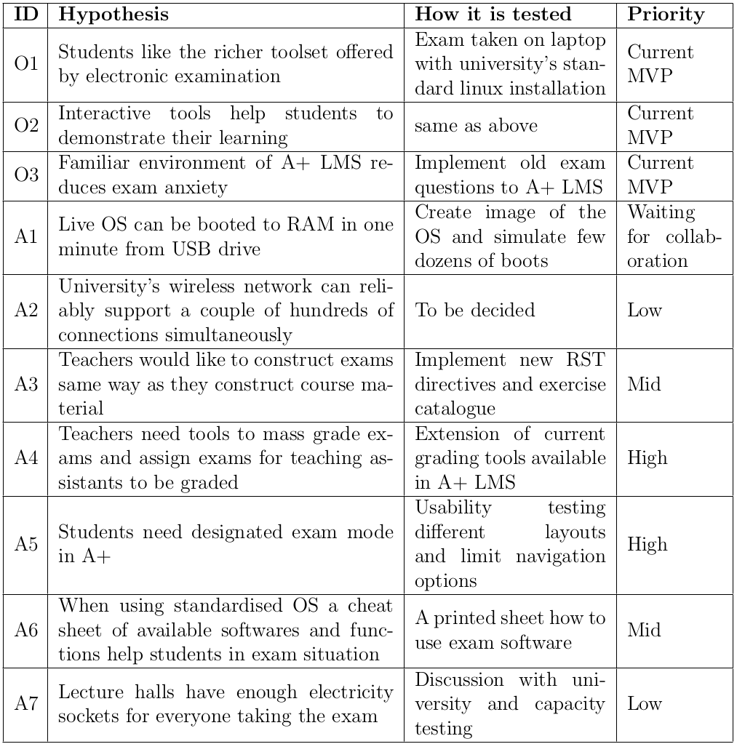
Hypotheses
New requirements emerged when building and testing the second MVP
Abstraction level varies a lot

Slide 14
The current design
Four components or subsystems:
Exam view for students
Exam design and construction tool box for teachers
Grading API for teachers and teaching assistants
Hardware, operating system, software tools and other infrastructure

Slide 15
Exam system in the future

Slide 16
Results – Applied lean startup methods

Slide 17
The current design
Two key practices chosen for the study:
- Setting hypotheses
- MVP

Slide 18
Results – Lessons learned

Slide 19
Setting hypotheses
- Hypotheses help to prioritize features
- Hypotheses are hard to simplify into one testable argument at
least early in the project
- Long iteration times work against testing small isolated changes
- Short description doesn’t necessarily capture the complexity of the task
- Formulating hypotheses instead of listing technical requirements forces deeper analysis and discussion

Slide 20
Minimum Viable Product
- When discussing complex concepts, MVP helps to make implicit assumptions visible and so help discussing design options
- User testing in real use context emphasizes the parts of the
solution that needs further attention
- Mission critical nature of the system limits how agile the MVP
can be

Slide 21
Workshops
- Group discussion reveals how differently people even in same position may view the process of arranging exams thus leading to misunderstandings
- Workshops may be a good way to reach consensus over a important design choice but that may cause minority to be ignored
- Workshops are a potential source of bias because of small sample size

Slide 22
Conclusions

Slide 23
Conclusions
Making the current examination online and using computers in current exam setup is a good start but not necessarily the best solution
Setting hypotheses and the Minimum Viable Product, MVP,
supported the development work well by conceptualising and evaluating the complex domain area

