Slide 1
Lecture 12
Chemical Reaction Engineering (CRE) is the field that studies the rates and mechanisms of chemical reactions and the design of the reactors in which they take place.

Slide 2
Lecture 12 – Tuesday 2/19/2013
Multiple Reactions
Selectivity and Yield
Series Reactions
Complex Reactions

Slide 3
4 Types of Multiple Reactions
Series: A → B → C
Parallel: A → D
A → U
Independent: A → B
C → D
Complex: A + B →C + D
A + C → E
With multiple reactors, either molar flow or number of moles must be used (no conversion!)

Slide 4
Selectivity and Yield
There are two types of selectivity and yield: Instantaneous and Overall.
 | Instantaneous | Overall
Selectivity
Yield

Slide 5
Selectivity and Yield
Example:
Desired Product:
Undesired Product:
To maximize the selectivity of D with respect to U run at high concentration of A and use PFR.

Slide 6
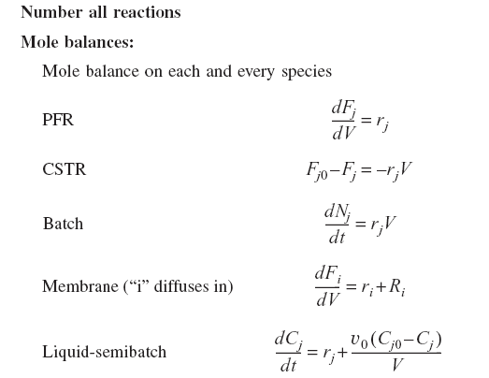
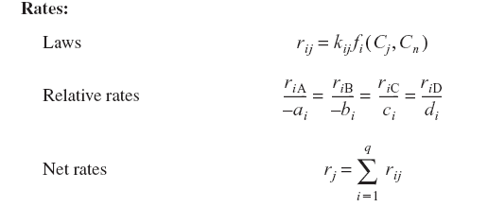

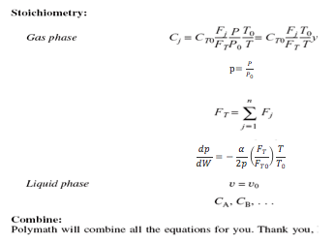
Gas Phase Multiple Reactions

Slide 7
Multiple Reactions
A) Mole Balance of each and every species
Flow Batch

Slide 8
Multiple Reactions
B) Rates
a) Rate Law for each reaction:
b) Net Rates:
c) Relative Rates:

Slide 9
Multiple Reactions
C) Stoichiometry
Gas:
Liquid:
Example: A → B → C
(1) A → B k₁
(2) B → C k₂

Slide 10
Batch Series Reactions
1) Mole Balances
V=V₀ (constant batch)

Slide 11
Batch Series Reactions
2) Rate Laws
Laws
Net rates
Relative rates

Slide 12
Example: Batch Series Reactions
C_{i}
A → B → C
(1) A → B
(2) B → C
B
A
C
t_{opt}
t
1) Mole Balances

Slide 13
Example: Batch Series Reactions
2) Rate Laws
Laws:
Relative:

Slide 14
Example: Batch Series Reactions
3) Combine
Species A:
Species B:

Slide 15
Example: Batch Series Reactions
Using the integrating factor,
at t = 0, C_{B}=0

Slide 16
Example: CSTR Series Reactions
A→B→C
What is the optimal ?
1) Mole Balances
A:
B:

Slide 17
Example: CSTR Series Reactions
A→B→C
2) Rate Laws
Laws:
Relative:
Net:

Slide 18
Example: CSTR Series Reactions
A→B→C
3) Combine

Slide 19
Example: CSTR Series Reactions
A→B→C
Find that gives maximum concentration of B

Slide 21
End of Lecture 12

Slide 22
Supplementary Slides

Slide 23
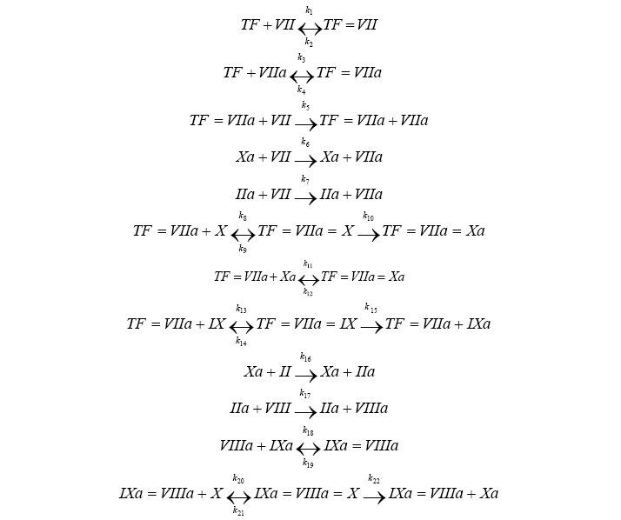

Blood Coagulation

Slide 24
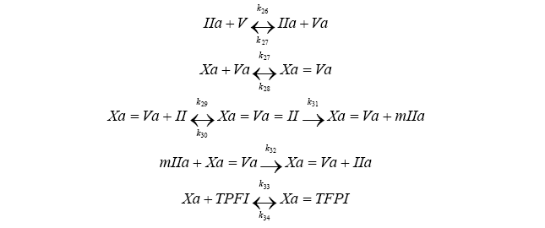
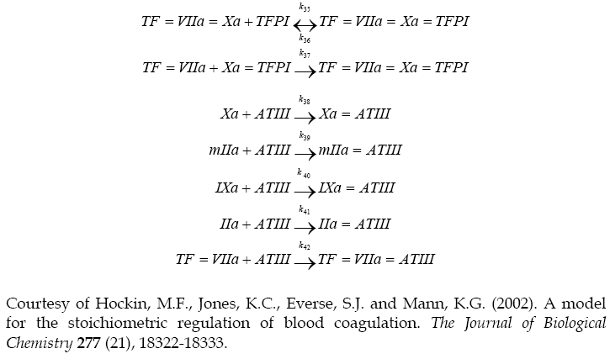

Slide 25
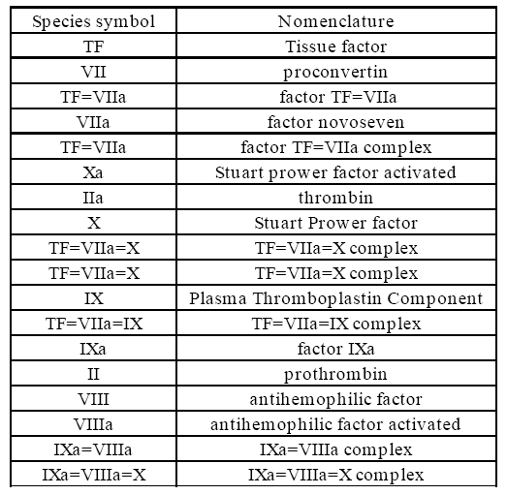
Notations

Slide 26
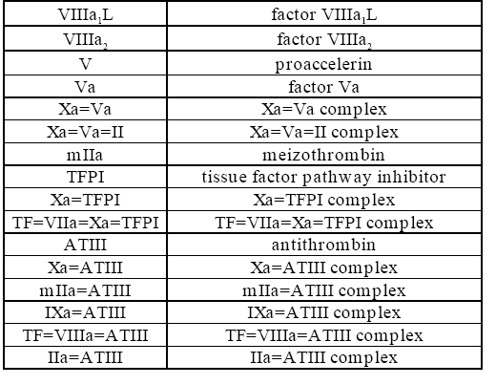
Notations

Slide 27
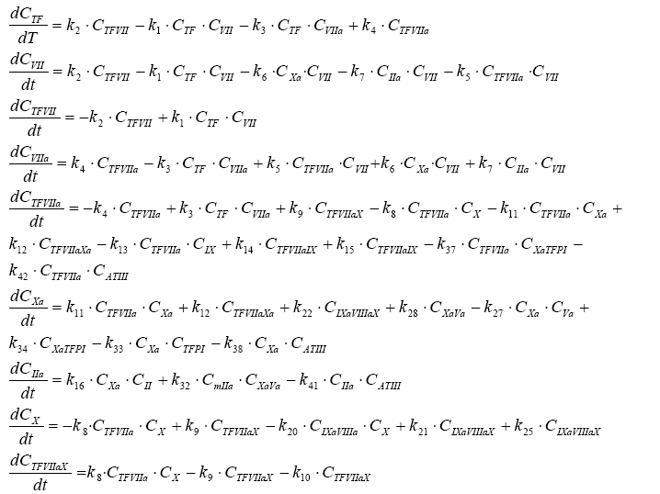
Mole Balances

Slide 28
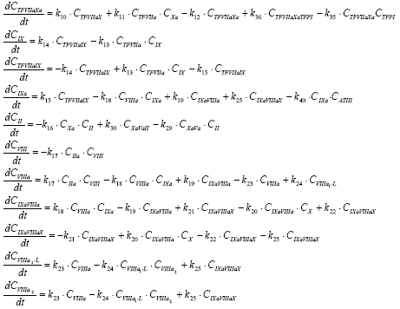
Mole Balances

Slide 29
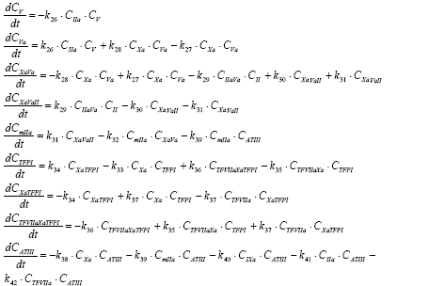
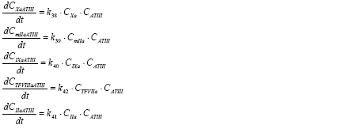
Mole Balances

Slide 30
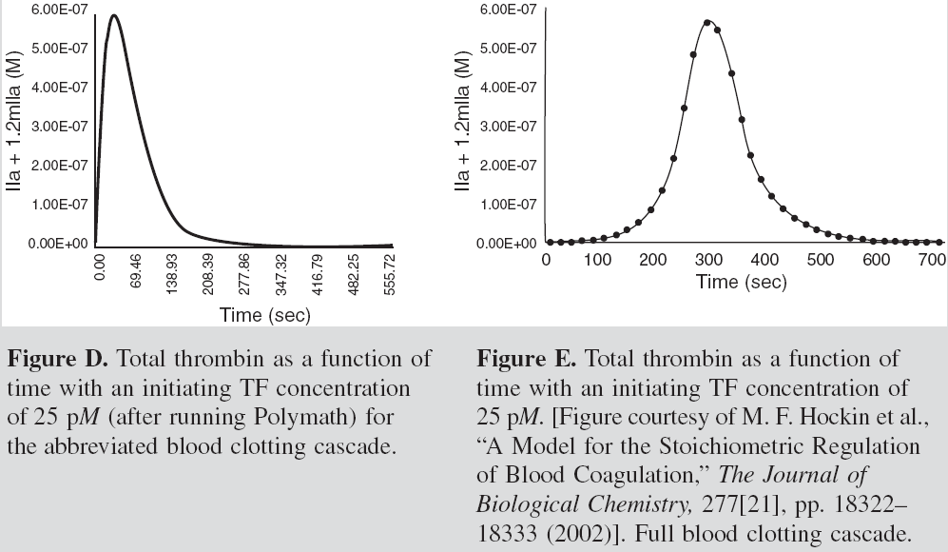
Results

Slide 31
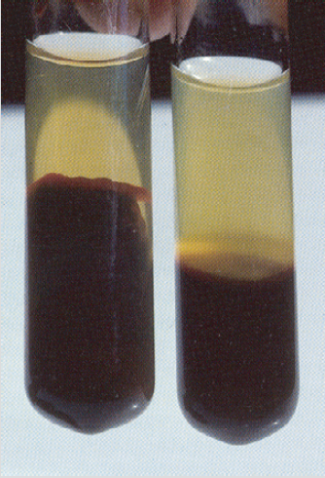
Blood Coagulation
Many metabolic reactions involve a large number of sequential reactions, such as those that occur in the coagulation of blood.
Cut → Blood → Clotting
Figure A. Normal Clot Coagulation of blood
(picture courtesy of: Mebs, Venomous and Poisonous Animals, Medpharm, Stugart 2002, Page 305)

Slide 32
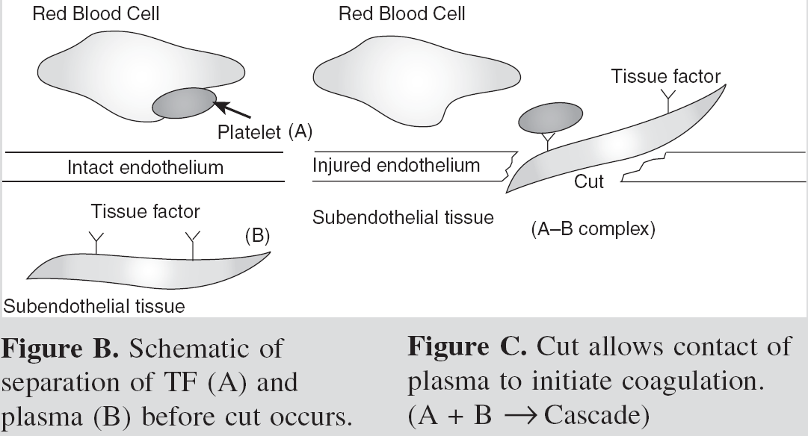
Schematic of Blood Coagulation

Slide 33
Cut
A + B
C
D
E
F
Clot

