Slide 1
Lecture 13
Chemical Reaction Engineering (CRE) is the field that studies the rates and mechanisms of chemical reactions and the design of the reactors in which they take place.

Slide 2
Lecture 13 – Tuesday 2/26/2013
Complex Reactions:
A +2B → C
A + 3C → D
Example A: Liquid Phase PFR
Example B: Liquid Phase CSTR
Example C: Gas Phase PFR
Example D: Gas Phase Membrane Reactors
Sweep Gas Concentration Essentially Zero
Sweep Gas Concentration Increases with Distance
Example E: Semibatch Reactor

Slide 3
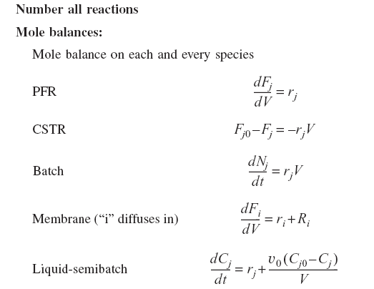
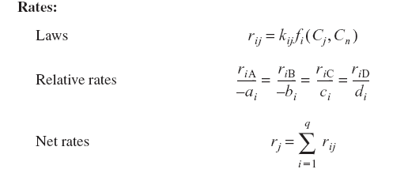
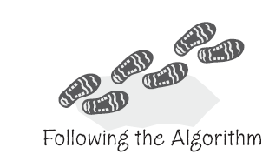
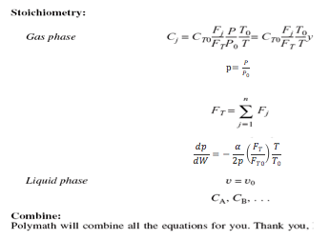
Gas Phase Multiple Reactions

Slide 4
New things for multiple reactions are:
1. Number Every Reaction
2. Mole Balance on every species
3. Rate Laws
(a) Net Rates of Reaction for every species
(b) Rate Laws for every reaction
(c) Relative Rates of Reaction for every reaction
For a given reaction i: (i) a_{i}A+b_{i}B →c_{i}C+d_{i}D:

Slide 5
Reactor Mole Balance Summary
Reactor Type | Gas Phase | Liquid Phase
Batch
Semibatch

Slide 6
Reactor Mole Balance Summary
Reactor Type | Gas Phase | Liquid Phase
CSTR
PFR
PBR
Note: The reaction rates in the above mole balances are net rates.

Slide 7
Batch
Flow

Slide 8
Stoichiometry
Concentration of Gas:
Note: We could use the gas phase mole balances for liquids and then just express the concentration as:
Flow:
Batch:

Slide 9
Example A: Liquid Phase PFR
The complex liquid phase reactions follow elementary rate laws:
NOTE: The specific reaction rate k_{1A} is defined with respect to species A.
NOTE: The specific reaction rate k_{2C} is defined with respect to species C.

Slide 10
Example A: Liquid Phase PFR
Complex Reactions
1) Mole Balance on each and every species
2

Slide 11
Example A: Liquid Phase PFR
2) Rate Laws:
Net Rates
Rate Laws
Relative Rates
Reaction 1

Slide 12
Example A: Liquid Phase PFR
Relative Rates
Reaction 2

Slide 13
Example A: Liquid Phase PFR
3) Stoichiometry
Liquid

Slide 14
Example A: Liquid Phase PFR
Others
4) Parameters

Slide 15
Example B: Liquid Phase CSTR
Same reactions, rate laws, and rate constants as Example A
NOTE: The specific reaction rate k_{1A} is defined with respect to species A.
NOTE: The specific reaction rate k_{2C} is defined with respect to species C.

Slide 16
Example B: Liquid Phase CSTR
The complex liquid phase reactions take place in a 2,500 dm³ CSTR. The feed is equal molar in A and B with F_{A0}=200 mol/min, the volumetric flow rate is 100 dm³/min and the reaction volume is 50 dm³.
Find the concentrations of A, B, C and D existing in the reactor along with the existing selectivity.
Plot F_{A}, F_{B}, F_{C}, F_{D} and S_{C/D} as a function of V

Slide 17
Example B: Liquid Phase CSTR
(1) A + 2B →C (2) 2A + 3C → D
1) Mole Balance

Slide 18
Example B: Liquid Phase CSTR
2) Rate Laws: (5)-(14) same as PFR
3) Stoichiometry: (15)-(18)
same as Liquid Phase PFR
4) Parameters:

Slide 19
Example B: Liquid Phase CSTR
In terms of molar flow rates
(1) A + 2B →C (2) 2A + 3C → D
1) Mole Balance (1–4) | 2) Rates (5–14) | 3) Stoichiometry: (15–19)
(=0)
Same as Example A
(=0)
(=0)
(=0)

Slide 20
Example B: Liquid Phase CSTR
In terms of concentration
(1) A + 2B →C (2) 2A + 3C → D
1) Mole Balance (1–4) | 2) Rates (5–14) | 3) Stoichiometry: (15–19)
(=0)
Same as Example A
(=0)
(=0)
(=0)

Slide 21
Example C: Gas Phase PFR, No ΔP
Same reactions, rate laws, and rate constants as Example A:
NOTE: The specific reaction rate k_{1A} is defined with respect to species A.
NOTE: The specific reaction rate k_{2C} is defined with respect to species C.

Slide 22
Example C: Gas Phase PFR, No ΔP
1) Mole Balance
2) Rate Laws: (5)-(14) same as CSTR

Slide 23
Example C: Gas Phase PFR, No ΔP
3) Stoichiometry:
Gas: Isothermal T = T₀
Packed Bed with Pressure Drop

Slide 24
Example C: Gas Phase PFR, No ΔP
4) Selectivity

Slide 25
Example D: Membrane Reactor with ΔP
Same reactions, rate laws, and rate constants as Example A:
NOTE: The specific reaction rate k_{1A} is defined with respect to species A.
NOTE: The specific reaction rate k_{2C} is defined with respect to species C.

Slide 26
Example D: Membrane Reactor with ΔP
Because the smallest molecule, and the one with the lowest molecular weight, is the one diffusing out, we will neglect the changes in the mass flow rate down the reactor and will take as first approximation:
1) Mole Balances
We also need to account for the molar rate of desired product C leaving in the sweep gas F_{Csg}

Slide 27
Example D: Membrane Reactor with ΔP
We need to reconsider our pressure drop equation.
When mass diffuses out of a membrane reactor there will be a decrease in the superficial mass flow rate, G. To account for this decrease when calculating our pressure drop parameter, we will take the ratio of the superficial mass velocity at any point in the reactor to the superficial mass velocity at the entrance to the reactor.

Slide 28
Example D: Membrane Reactor with ΔP
The superficial mass flow rates can be obtained by multiplying the species molar flow rates, F_{i}, by their respective molecular weights, Mw_{i}, and then summing over all species:

Slide 29
Example D: Membrane Reactor with ΔP
2) Rate Laws: (5)-(14) same as Examples A, B, and C.
3) Stoichiometry: (15)-(20) same as Examples A and B
(T=T₀)
4) Sweep Gas Balance:

Slide 30
Example E: Liquid Phase Semibatch
Same reactions, rate laws, and rate constants as Example A:
NOTE: The specific reaction rate k_{1A} is defined with respect to species A.
NOTE: The specific reaction rate k_{2C} is defined with respect to species C.

Slide 31
Example E: Liquid Phase Semibatch
The complex liquid phase reactions take place in a semibatch reactor where A is fed to B with F_{A0}= 3 mol/min. The volumetric flow rate is 10 dm³/min and the initial reactor volume is 1,000 dm³.
The maximum volume is 2,000 dm³ and C_{A0}=0.3 mol/dm³ and C_{B0}=0.2 mol/dm³. Plot C_{A}, C_{B}, C_{C}, C_{D} and S_{S/D} as a function of time.

Slide 32
Example E: Liquid Phase Semibatch
(1) A + 2B →C (2) 2A + 3C → D
F_{A0}
1) Mole Balances:
B

Slide 33
Example E: Liquid Phase Semibatch
2) Rate Laws: (5)-(14)
Net Rate, Rate Laws and relative rate – are the same as Liquid and Gas Phase PFR and Liquid Phase CSTR
3) Selectivity and Parameters:

Slide 34
End of Lecture 13

