Slide 1
Tube flow and flow across tube banks
Lect. Abeer

Slide 2
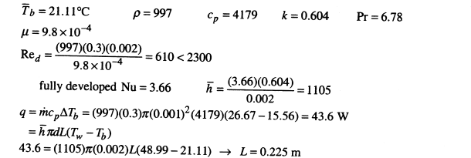
Water at 15.56◦C is to be heated in a 2-mm-ID tube until the exit temperature reaches 26.67◦C. The tube wall temperature is maintained at 48.99◦C and the inlet flow velocity is 0.3 m/s. Calculate the length of tube required in meters to accomplish this heating. Assume a fully develop flow

Slide 3
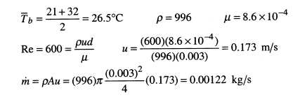
Water enters a 3-mm-diameter tube at 21◦C and leaves at 32◦C. The flow rate is such that the Reynolds number is 600. The tube length is 10 cm and is maintained at a constant temperature of 60◦C. Calculate the water flow rate

Slide 4

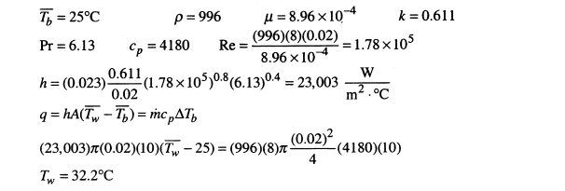

Slide 5
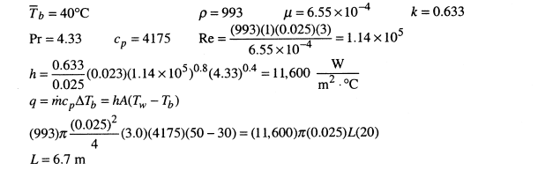
Water flows inside a smooth tube at a mean flow velocity of 3.0 m/s. The tube diameter is 25 mm and a constant heat flux condition is maintained at the tube wall such that the tube temperature is always 20◦C above the water temperature. The water enters the tube at 30◦C and leaves at 50◦C. Calculate the tube length necessary to accomplish the indicated heating

Slide 6
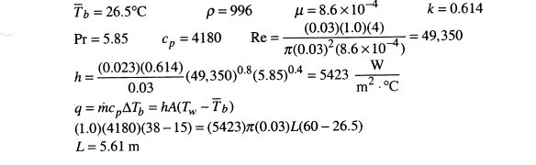
Water enters a 3.0-cm-diameter tube at 15◦C and leaves at 38◦C. The flow rate is 1.0 kg/s and the tube wall temperature is 60◦C. Calculate the length of the tube.

Slide 7
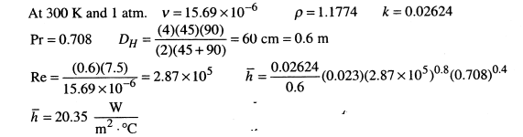
An air-conditioning duct has a cross section of 45 cm by 90 cm. Air flows in the duct at a velocity of 7.5 m/s at conditions of 1 atm and 300 K. Calculate the heat-transfer coefficient for this system.

Slide 8
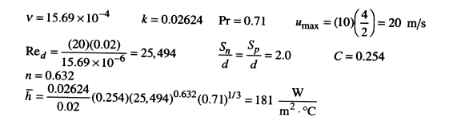
Air at 1 atm and 300 K flows across an in-line tube bank having 10 vertical and 10 horizontal rows. The tube diameter is 2 cm and the center-to-center spacing is 4 cm in both the normal and parallel directions. Calculate the convection heat transfer coefficient for this situation if the entering free-stream velocity is 10 m/s and properties may be evaluated at free-stream conditions.
Repeat it for a staggered-tube arrangement with the same values of Sp and Sn.

Slide 9
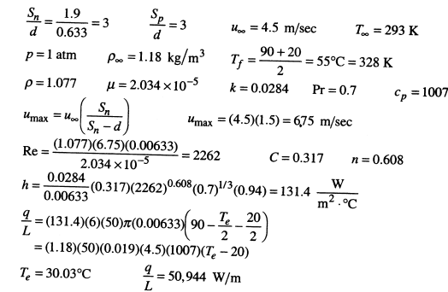
A tube bank uses an in-line arrangement with Sn = Sp = 1.9 cm and 6.33-mmdiameter tubes. Six rows of tubes are employed with a stack 50 tubes high. The surface temperature of the tubes is constant at 90◦C, and atmospheric air at 20◦C is forced across them at an inlet velocity of 4.5 m/s before the flow enters the tube bank. Calculate the total heat transfer per unit length for the tube bank

