Slide 1
Classes overview
Analog input and output
Extension for further hardware communication
GUI management
Program logic
- Configuration
- Loading/Saving Config
- Some global objects
- Centralized definition of GUI label texts
- Can be changed for other Program types (MOKE, VSM)
Measurement routines

Slide 2
Hardware related classes - AnalogIO

Slide 3
Hardware related classes – IO extensions

Slide 4
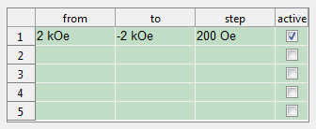

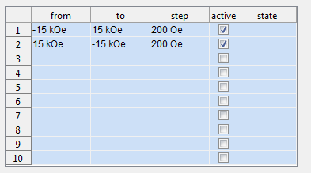
Hardware related classes – GUI extensions

Slide 5
Config

