Slide 1
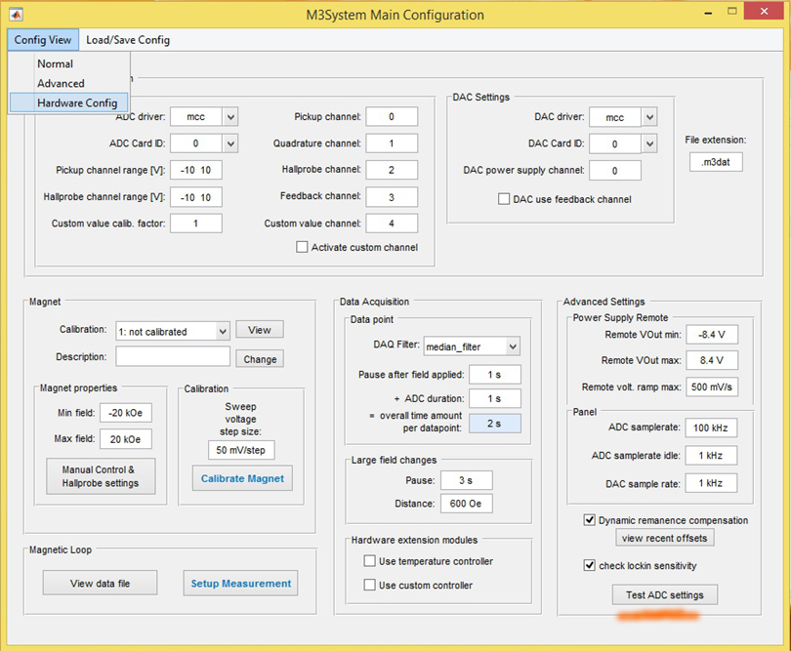
Setting up hardware configuration
Select Hardware Config
Driver & CardID on VSM setup
Driver: mcc
CardId: 0
Driver & CardID on MOKE setup
Driver: nidaq
CardId: Dev1
Click <Test ADC settings>
If test fails see “Troubleshooting”

Slide 2
Setting up hardware configuration
Option | Description
Dynamic remanence compensation | Readjust setpoints if yoke calibration differs from measured magnetic field value. (eg. due to yoke remanence)
Use temperature controller | Acquire temperature value using functions defined in PkgHardwExt.TempController
Use custom controller | Acquire a custom value using functions defined in PkgHardwExt.CustomController
Activate custom channel | Measure an additional analog value (Custom_ADC_channel) at Custom value channel and multiply it with Custom value calib. factor. Be aware of a reduced maximum ADC samplerate on multiplexed ADC cards

Slide 3
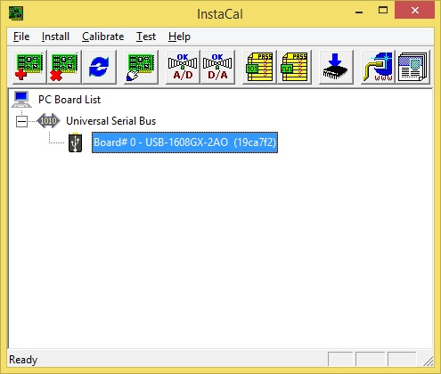
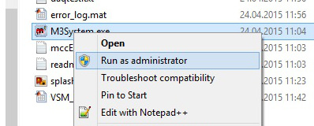
Troubleshooting hardware issues (Driver problems, unknown CardId)
Install appropriete software package from your card manufactor (InstaCal for Measurement Computing hardware or corresponding software from National Instruments)
Run measurement program as administrator as it might register the required toolbox on your windows pc if needed

Slide 4
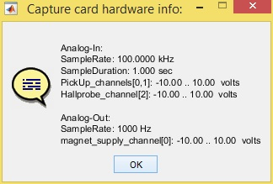
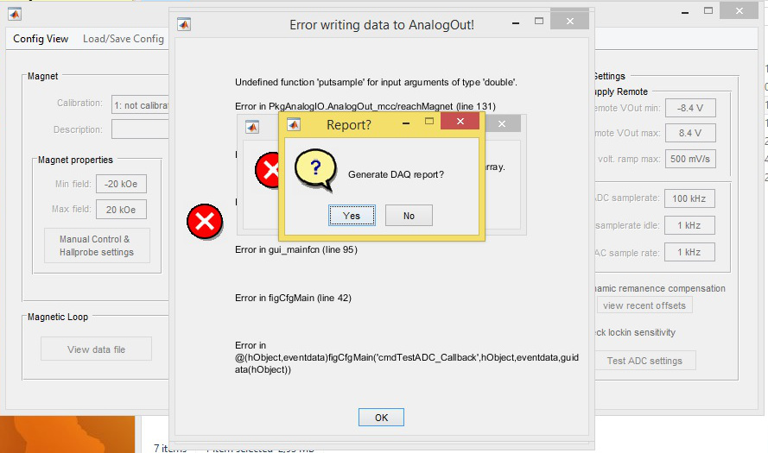
Troubleshooting hardware issues (Driver problems, unknown CardId)
Run <Test ADC settings> from advanced config menu
A window showing current card settings will appear if everything is working correctly
In case of an error instead answer “Generate DAQ report” with Yes

Slide 5
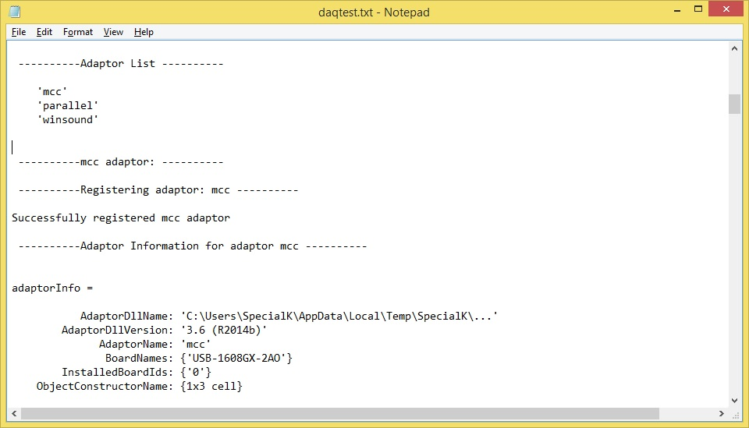
Troubleshooting hardware issues (Driver problems, unknown CardId)
A report window will appear
Search for any error messages inside daqtest.txt
Check if hardware settings in config window are correct and correspond to information from daqtest.txt
Search for your card name (eg. USB-1608GX-2AO)
AdaptorName means ADC driver in config window (mcc)
InstalledBoardIds means ADC Card ID (0)
Restart measurement application and retry Test ADC settings

