Slide 1
ECE 593 Final Project:
Asynchronous FIFO Design and Verification using UVM
S1, G4: Nick Allmeyer, Alexander Maso, Ahliah Nordstrom

Slide 2
AGENDA
01
02
03
04
05
06
07
08
TEAM INTRODUCTIONS
PROJECT INTRODUCTION
DEMO
DESIGN IMPLEMENTATION
CLASS BASED VERIFICATION
UVM BASED VERIFICATION
OVERALL CHALLENGES, FINDINGS AND LEARNINGS
Q&A

Slide 3
01
TEAM INTRODUCTIONS

Slide 4



SESSION 1: TEAM 4
NICK ALLMEYER (nall2@pdx.edu)
AHLIAH NORDSTROM (ahliah@pdx.edu)
-Current quarter at PSU: 9
- Graduation Date: Spring 2025
- Current Internship / Offer: N/A
-Current quarter at PSU: 14
- Graduation Date: June 2024
- Current Internship / Offer: PGE
ALEXANDER MASO (amaso@pdx.edu)
-Current quarter at PSU: 9
- Graduation Date: June 2024
- Current Internship / Offer: Interviewing

Slide 5
CONTRIBUTIONS
NICK ALLMEYER
ALEXANDER MASO
AHLIAH NORDSTROM
Created interface, coverage, transaction
Created initial bug injection idea for 1 point M5 submission
Assisted in Debugging/Testing code and editing documents
Main code contributor
DUT Grey encoder
Class-based TB Structure
Primary UVM Structure
Documentation
fifo_random_rd_seq
fifo_random_wr_seq
Test classes
DUT modules

Slide 6
02
PROJECT INTRODUCTION

Slide 7
VERIFY AN ASYNC FIFO
CLASS BASED
UVM
Code was split into reusable, class-based chunks used to verify the FIFO design
Class based code was used as a stepping stone for UVM
C. Cummings FIFO #1
Our design is based off FIFO #1, with half full/empty signals instead of almost.
SENDER
RECEIVER
-CLK FREQ: 80
-WRITE IDLE CYCLES: 0
-WRITE BURST SIZE: 120
-CLK FREQ: 50
-READ IDLE CYCLES: 0
Notes:
-> Binary pointers were added in the beginning for our own understanding, this is something
Clifford Cummings did not do. After about M2, we added a gray code counter that follows what C. Cummings talks about very closely.
-> Then Half flags added last, bc they are not in C. Cummings doc
-> Conventional TB very simple, built from 120 word burst of WRITE and READ to fully randomized

Slide 8
FIFO CALCULATIONS
The time required to write one items:
1 / 80 MHz = 12.5 x 10^-9 = 12.5ns
The time required to write all the data in the burst:
120 x 12.5ns= 1500ns
The time required to read one data item:
1 / 50 MHz = 20 x 10^-9 = 20ns
The number of data items that can be read in the time it takes to write all the data in the burst:
1500ns / 20ns = 75
Remaining number of bytes stored in the FIFO (minimum FIFO depth):
120-75= 45
However, we went with 64 as our minimum FIFO depth to ensure proper incrementing of the gray code pointer around the max and min value (boundary); it needed to be a power of 2.
Sender frequency = 80 MHz
Receiver frequency = 50 MHz
Write idle cycles = 0
Read idle cycles = 0
Write burst size = 120
Notes:
-> No idle cycle in reading or writing operations, thus, all the items in the burst will be written and read in consecutive clock cycles.
-> The time required to write one item is 12.5ns
->The time period of the sender clock is the inverse of the sender frequency
-> With a write burst size of 120, the total time to write all items is 1500ns
-> The time required to read one data item is 20ns
-> The time period of the receiver clock is the inverse of the receiver frequency.
-> So, every 20ns the receiver sends one data in the burst and in a period of 1500ns, 120 data items can be written.
-> The receiver reads one data item every 20 ns. Over a period of 1500 ns, the receiver can read 75 items
-> Since the FIFO must store the remaining items that have been written but not yet read, the remaining number of bytes stored in the FIFO (minimum FIFO depth) is 45
HOWEVER we made it 64 bc it needs to be a power of 2 to ensure proper incrementing of the gray code pointer around the max and min value (its boundary)
-> calculation does not account for the synchronization delay caused by the two-flop synchronizers used to transfer the Gray code pointers between clock domains.
-> B vs GC: Changing more than 1 bit each increment

Slide 9
03
DEMO

Slide 10
BUG INJECTION
WRITE_POINTER
The write pointer was accidentally made one bit smaller than intended
UVM Testbench shows mismatches on the 33rd read from the DUT
Notes:
Size of Write Pointer:
Binary wr_ptr
Half Full Flag: The half full flag will be triggered at FIFO depth 16 instead of 32
Flag_test can be used to specify the # of times the half full flag is toggled
Test also prints out reads and writes occurred before that point, making it clear how many writes it took to triggered half flag
When incorrect, write count to 16

Slide 11
04
DESIGN IMPLEMENTATION

Slide 12
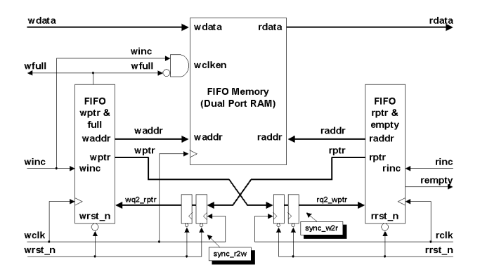
SOURCE OF ASYNC FIFO
SOURCE
Clifford E. Cummings FIFO #1 partitioning with synchronized pointer comparison
-
CONTRIBUTIONS
Memory Buffer:
Memory buffer was suited for our own specifications
Pointer Management:
Read and Write pointer logic was optimized to improve handling of pointer increments and detection of half empty/full conditions
Synchronization Logic:
Developed unified(ish) sync model
Notes:
CONTRIBUTIONS:
Memory buffer was suited for our own specifications
-> Everything is parameterized:
-> ADDR_WIDTH Size 6 bits (Depth - 64 words deep)
-> DATA_WIDTH Size 8 bits (1 byte)
Read and Write pointer logic was optimized to improve handling of pointer increments and detection of half conditions
Unified synchronization module as opposed to two that Cummings uses for w2r and r2w
> One sync module was instantiated twice in TOP as W2R sync and R2W sync
-> Binary pointers were added in the beginning for our own understanding, this is something
Clifford Cummings did not do. After about M2, we added a gray code counter that follows what C. Cummings talks about very closely.
-> Then Half flags added last, bc they are not in C. Cummings doc
-> Conventional TB very simple, built from 120 word burst of WRITE and READ to fully randomized

Slide 13
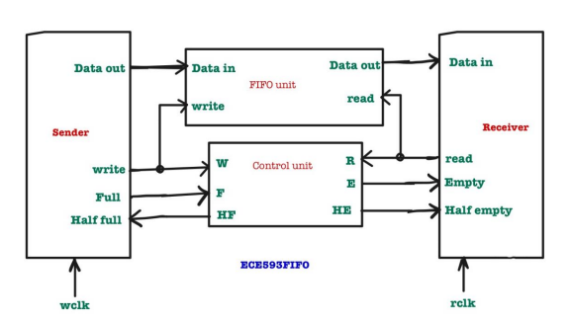
ASYNC FIFO DESIGN
Modules
Memory
-> Stores data in a dual-port memory array, allowing simultaneous read and write operations from different clock domains
Write Pointer
-> Determines if the FIFO is full by comparing the write pointer with the synchronized read pointer.
Read Pointer
-> Determines if the FIFO is empty
by comparing the read pointer with the synchronized write pointer.
Sync
-> Transfers multi-bit data between different
clock domains using double-flop synchronization.
Top
-> Integrates all the FIFO components
SPECIFICATIONS
- 80Mhz sender clk freq - 50Mhz receiver clk freq
- 0 WRITE idle cycles - 120 WRITE burst size
- 0 READ idle cycles

Slide 14
05
CLASS BASED VERIFICATION

Slide 15
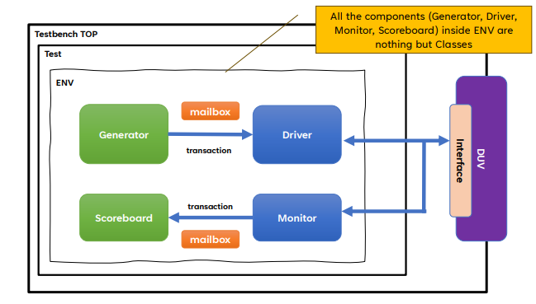
HOW WE VERIFIED DUT
Contains external signals for FIFO and internal signals for the BFM. Also contains a reset_fifo task to reset the FIFO and generates both the write and read locks for our two domains
ENVIRONMENT
Serves as the central structure that contains the major testbench components. Each component is implemented as a class, interacting and synchronizing through transactions and mailboxes
INTERFACE
Notes:
The initial class-based testbench that we developed utilized the structure seen here with a generator creating tx data and using mailboxes to transfer the data between the components and eventually into the DUT…
There were hierarchical difficulties during this stage, specifically with the `includes and the order of compilation in the run.do file
The mailboxes themselves were also a major difficulty as none of us had utilized mailboxes before => specifically using the constructors to pass the mailbox from components higher in the hierarchy to one’s lower
The class based testbench is also where we first encountered difficulty with our timing and the separate clock domains. In our class based testbench this problem was solved by creating separate mailbox paths from gen -> drv -> scb as well as from gen -> mon -> scb (Decided to make the monitor responsible for asserting the read enable signal so as to keep the domains separated)

Slide 16
HOW WE VERIFIED DUT: CLASSES
DRIVER
GENERATOR
MONITOR
- Generates transactions for W&R operations then sends them to driver and monitor
- Uses mailbox to communicate with driver and monitor
- Monitors read transactions from the FIFO and updates transaction with the current status of FIFO
- Uses mailbox to receive transactions from generator and send to scoreboard
- Drives transactions to FIFO and updates flags
- Uses mailbox to receive from generator and send to scoreboard
SCOREBOARD
TESTBENCH
TRANSACTION
- Checks data read from FIFO against data written by the driver
- Uses mailbox to receive transactions from the driver and monitor.
- Orchestrates execution of generator, driver, monitor, & scoreboard
- Hands mailboxes to the different components
- Defines data structure for a single transaction in the FIFO environment
- I/O signals and constraints for randomization

Slide 17
06
UVM BASED VERIFICATION

Slide 18
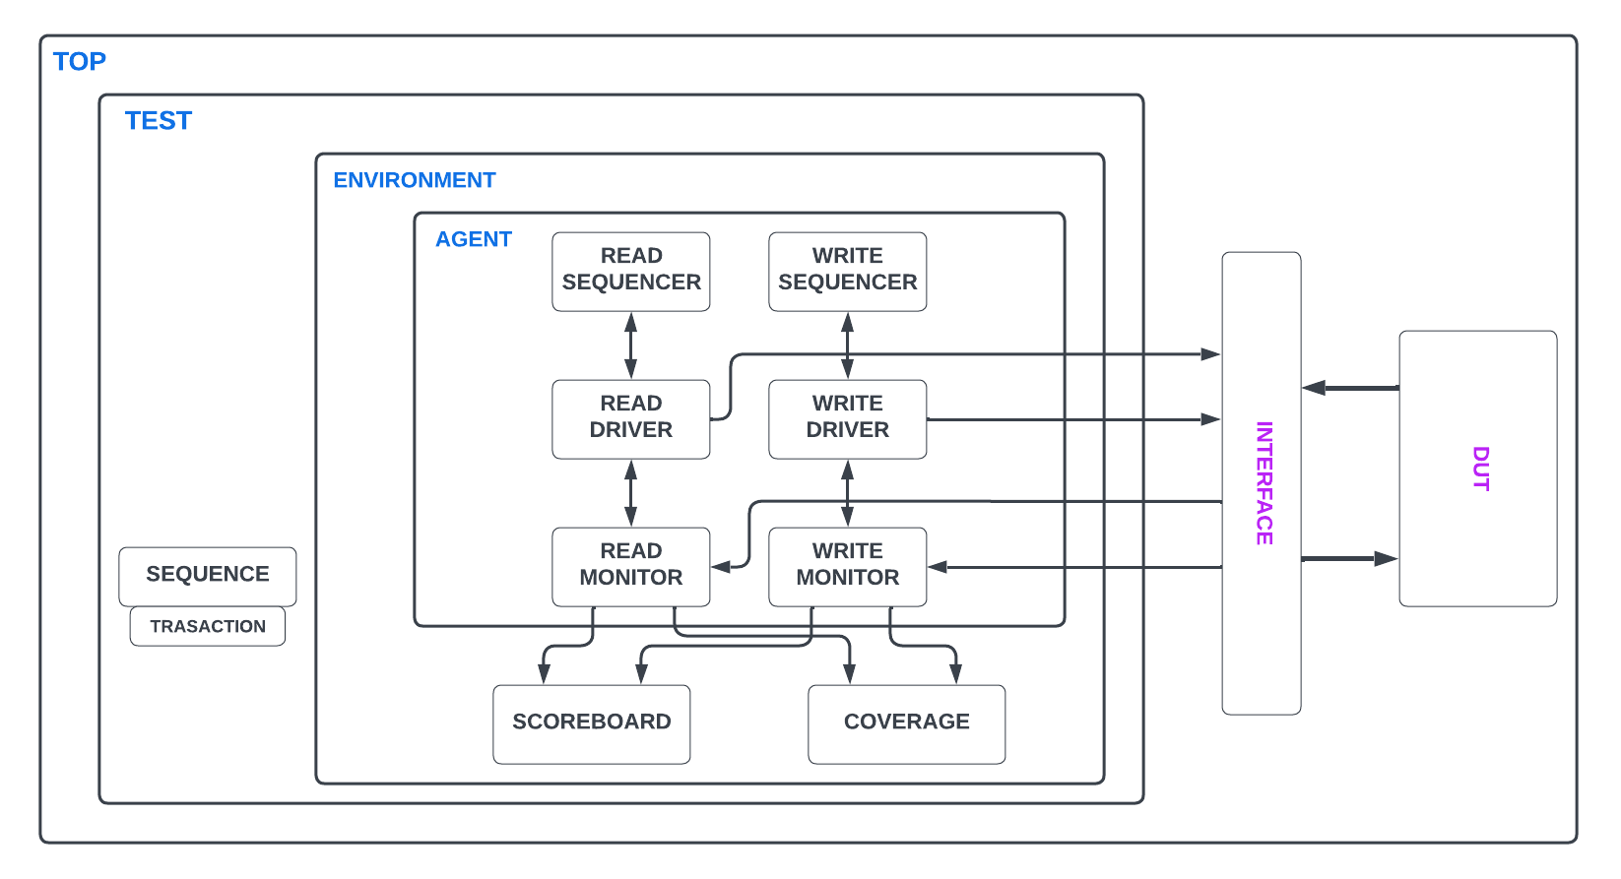

Slide 19
HOW WE VERIFIED DUT: ARCHITECTURE
01
02
03
Instantiates the verification environment
Encapsulates the set-up of the agent and thus the sequencer, monitor, and driver, as well as the scoreboard and coverage.
TOP
ENVIRONMENT
TEST
Instantiates the environment and controls the overall verification process by configuring and managing the execution of different test scenarios.
Notes:
Top - Connects everything, registers the BFM in the config_db and runs the test(s) themselves

Slide 20
HOW WE VERIFIED DUT: ARCHITECTURE
An active agent containing sequencers, drivers and monitors for both read and write operations. It's used to hold and instantiate these classes and we only have one interface and thus, only one agent.
MONITOR
SEQUENCER
Monitoring of read operations separately from write operations both extend the ‘uvm_monitor’
Manages the flow of transactions from sequence to driver by extending the ‘uvm_sequencer’. It acts as the intermediary that sequences transactions and ensures they are correctly managed and forwarded to the driver.
AGENT
DRIVER
Monitoring of read operations separately from write operations both extend the ‘uvm_monitor’

Slide 21
HOW WE VERIFIED DUT: ARCHITECTURE
SCOREBOARD
SEQUENCE
TRANSACTION
Extends ‘uvm_sequence_item’ and represents basic unit of data transfer in UVM environment. All necessary signals and data for a single transaction are encapsulated here.
Compares expected results with actual results of all operations. It verifies that data read from the FIFO matches data written to it and displays flag counts.
Generates sequences of read transactions separately from write transactions by extending the ‘uvm_sequence’ and vice versa.

Slide 22
07
OVERALL CHALLENGES, FINDINGS, AND LEARNINGS

Slide 23
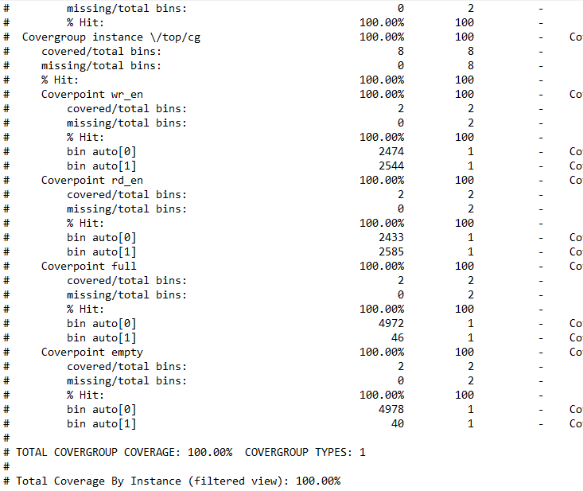
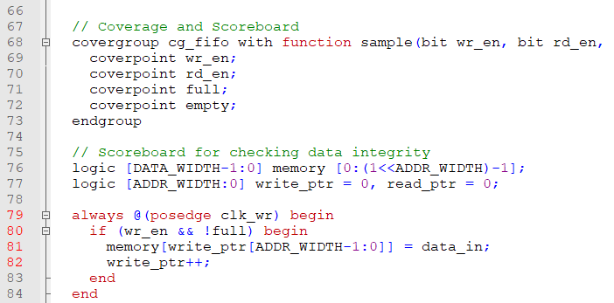
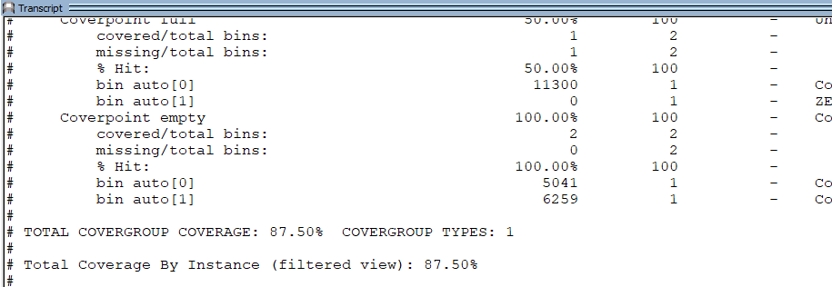
M1 and M2 Coverage
Initial coverage was good, but not substantive enough for what was to come. Coverage wasn’t our initial focus in the early milestones
Notes:
Coverage rapidly improved around M3 which has a coverage file that resembles our current coverage file
M3 coverage is at 79.54%
-fifo depth not covered
-data patterns not covered at the time
-has reset_n as a covergroup/point
M4 had no coverage file as we were still figuring out UVM framework
-thus no functional coverage
-code coverage was 37.58%

Slide 24
TEST SCENARIOS AND COVERAGE
Verification Plan Tests (Created during M1)
Final Covered Tests:
Test # | Desc.
T001 | Validate Full and Empty
T002 | Test fifo at various memory depths
T003 | Validate a range of data values
T004 | Observe behavior after reset
T005 | Test the Synchronization of the read and write pointers
T006 | Observe behavior during idle cycles
Test # | Desc.
T007 | Observe different ratios of reading and writing
T008 | Operation under errors
T009 | Validation testing between the full and empty flags
T010 | High frequency Read and Write tests
T011 | Random reset during operation
T012 | Verifying the throughput
T001 - cg_fifo/cg_abrupt_change
T002 - cg_fifo/cg_abrupt_change
T003 - cg_data_range/cg_data_patterns
T004 - observed by general operation/waveform
T005 - not included
T006 - cg_fifo/cg_abrupt_change, burst seq test
T007 - cg_fifo/cg_abrupt_change, burst seq test
T008 - bug injections
T009 - cg_fifo/cg_abrupt_change, flag seq test
T010 - not included
T011 - not included
T012 - not included
Notes:
CODE COVERAGE COMES FROM MONITOR
-> Monitor is not active when the FIFO is reset so we were not able to add reset coverage but we know it works bc initial state gives “X”s if it wasn't reset
-> We see in waveform going low
-> Reset in initial block
T1: GOOD – Validate signaling of FULL and EMPTY states
T2: GOOD – Test FIFO at various depth levels
-> FULL EMPTY and HALF go through (internal do not come through in monitor).
T3: GOOD – Validate data range across transfers
-> 0-63 or 0-255
T4: ~GOOD – Observe FIFO behavior following reset operations
T5: IN PROGRESS
T6: ~TOOK OUT – Monitor FIFO during idle cycles

Slide 25
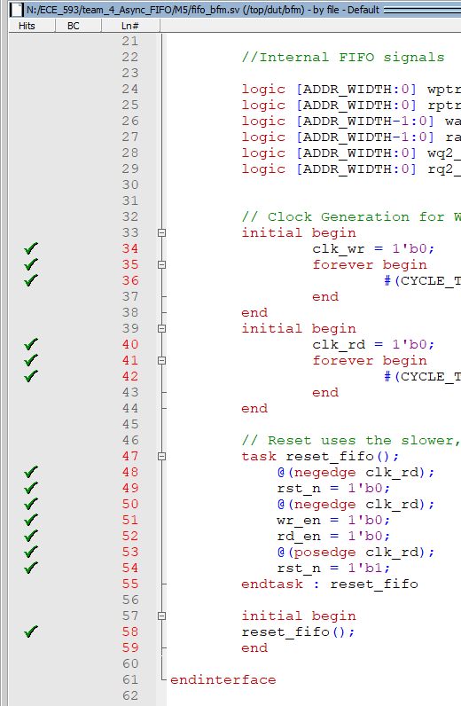
Coverage Challenges
Implicit Coverage Challenge
The lines in the reset fifo task in the bfm weren’t initially being taken. This resulted in 7 Xs (statement not taken) cases in the code coverage.
The solution is depicted in the image, and that was to call the reset fifo task in the bus functional model.
Notes:
A simple fix, but took awhile to find
We learned that calling the task in the driver was not sufficient to cover this task implicitly

Slide 26
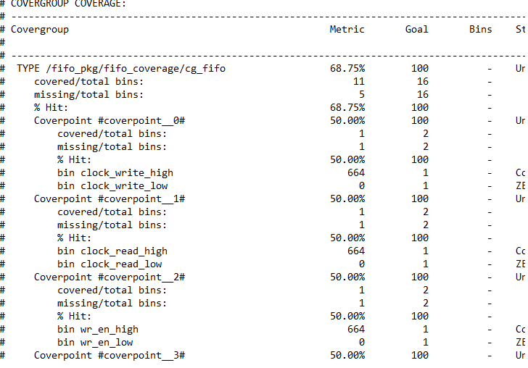
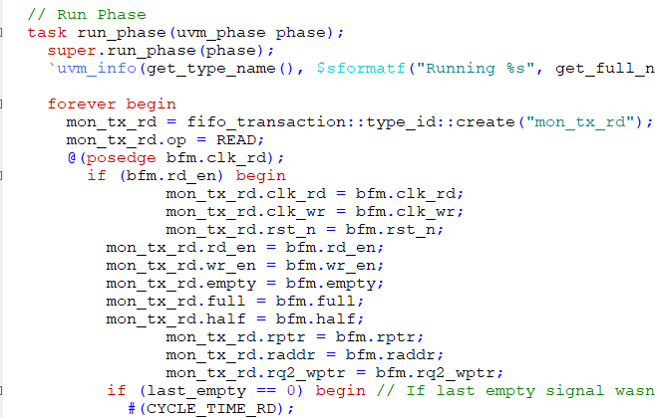
Coverage Challenges
Functional Coverage Challenge
Problem (including transitions).
Solution!
Notes:
Transactions were only being moved during the positive edge of the clocks, thus the low signals were never picked up. This obviously propagated to the transition bins. Adding all signals to both the read and write transactions allows them to be observed during both reads and writes. Given our number of transactions, and various tests (some of which include only writing for a while and later just reading with no writing).
This is also nice as it gives us a greater view of what is happening throughout the fifo at all important times.

Slide 27
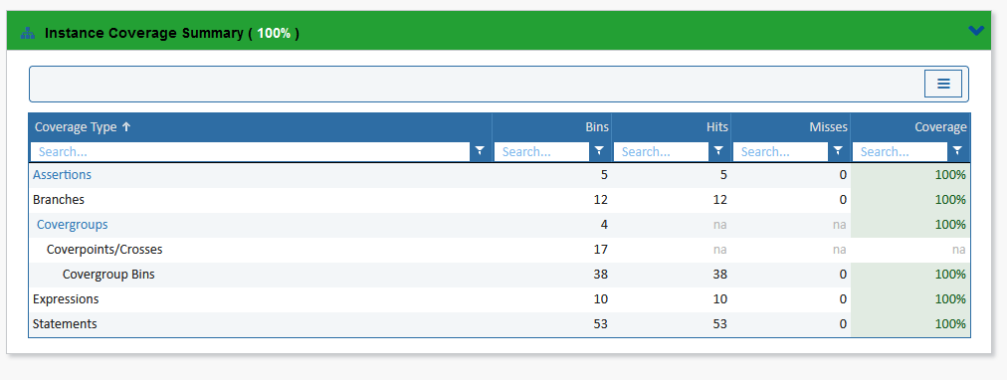
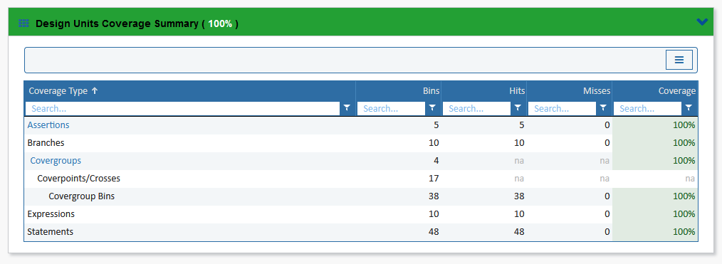
TEST SCENARIOS AND COVERAGE
100%
100%
FINAL CODE COV
FINAL FUNCTIONAL COV
Notes:
Note: if uvm error is not fixed, this is indicative of the error.
If it is fixed, then we can include the line to suppress mismatch from the implicit coverage, as we never need to take that branch if the fifo is working perfectly.

Slide 28
CHALLENGES AND FINDINGS
M2
M2
M3
M3
Read ptr pointed to stale data; off by single cycle
`Include order in run.do file
SCOREBOARD
TESTBENCH
SOLUTION
SOLUTION
If EMPTY signal asserted last cycle, the READ pointer may not yet be updated
Needed to instantiate “bottom up”
Notes:
DUT -> Binary pointers to gray code (follows C. Cummings very closely)
-> Half flags added last, bc they are not in C. Cummings doc
-> Conventional TB very simple, built from 120 word burst of WRITE and READ to fully randomized
-> Scoreboard read pntr did not take an extra read cycle (initial issue read pntr pointed to stale data, due to empty being asserted on read cycle while being written to,

Slide 29
CHALLENGES AND FINDINGS
M3
M3
M4
M5
Transaction packets that get sent between mailboxes needed separate MB paths for READ and WRITE domains
Lost data/transactions due to inconsistent fluctuation difference in READ and WRITE clk timing
MAILBOXES
CLOCK DOMAINS
SOLUTION
SOLUTION
Transaction packets that get sent between mailboxes needed separate MB paths for READ and WRITE domains
Separate Drivers, Monitors, and Sequences each for READ and WRITE domains
Notes:
CLASS BASED: MAILBOXES
-> Gen-> Drv -> SB
-> Gen -. Drv -> Mon -> SB
UVM:
-> Separate Drivers and Monitors and Sequences for each domain (READ and WRITE)
TIMING IS TRICKY, FIFO HAS DIF TIMING

Slide 30
08
Q&A

