Slide 1
CSU44000 School of Computer Science and Statistics Internet Applications
Apnatva Singh Rawat
21354929
Assignment 1 – Reactive Internet Application

Slide 2
Core Features for the Weather Application
Packing: if there is rain anytime over the next 4-days indicate that the user should bring an umbrella.
Indicate the type of weather that the user should pack for Cold (temperatures below 12C), Mild (temperatures from 12C to 24C inclusive), or Hot (temperatures above 24C).
Give a summary table for the next 4 days showing: Temperature, Wind Speed, and Rainfall level.
You can then use these in the AIR Pollution API to get the PM2_5 2 of 4 forecasts for the next 5 days. If this exceeds 10, then you should advise the user to wear a mask

Slide 3

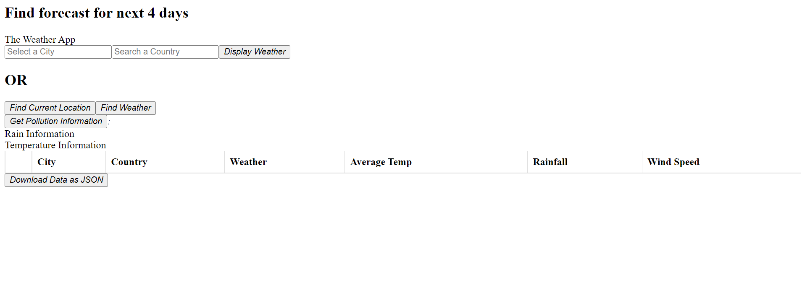
Basic HTML Structure (before running query)
Trinity College Dublin, The University of Dublin

Slide 4
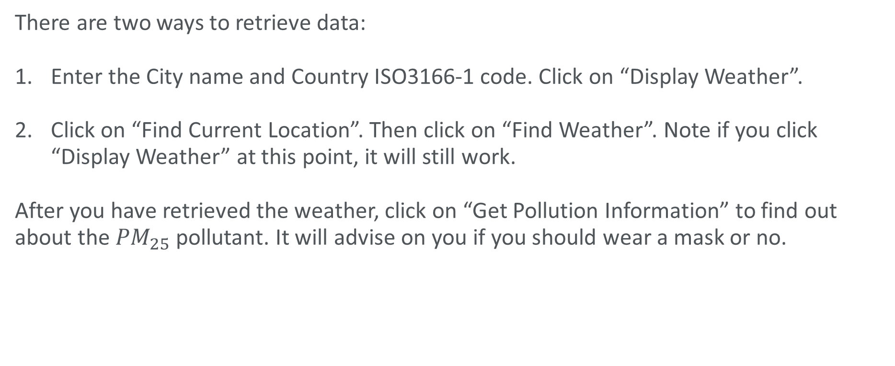
How to Run the Weather Application
There are two ways to retrieve data:
Enter the City name and Country ISO3166-1 code. Click on “Display Weather”.
Click on “Find Current Location”. Then click on “Find Weather”. Note if you click “Display Weather” at this point, it will still work.
After you have retrieved the weather, click on “Get Pollution Information” to find out about the ${PM}_{25}$ pollutant. It will advise on you if you should wear a mask or no.

Slide 5
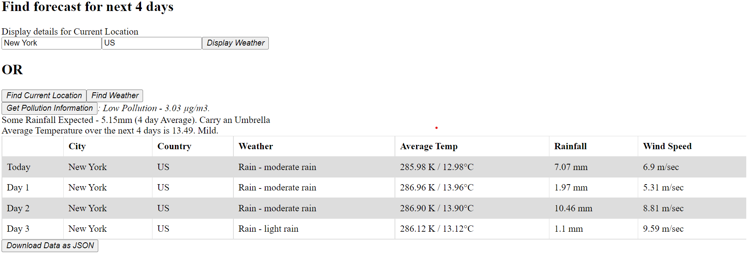
Basic HTML Structure (after Running Query) Using Random Location
Trinity College Dublin, The University of Dublin

Slide 6
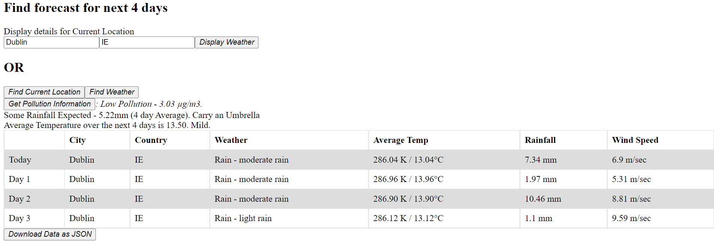
Basic HTML Structure (after Running Query) Using Current Location
Trinity College Dublin, The University of Dublin

Slide 7
Unique Features for the Weather Application
Weather Data for Current Location: Using the “navigator.geocoding” API https://developer.mozilla.org/en-US/docs/Web/API/Navigator/geolocation . This allows the program to retrieve the user’s current location after requesting permission. If permission is not granted the user can still search for any location manually.
Exporting Data: Users can export the data that they searched for. It is not limited to the data visible on the screen but includes the entire data that the user looked up in that session.

Slide 8
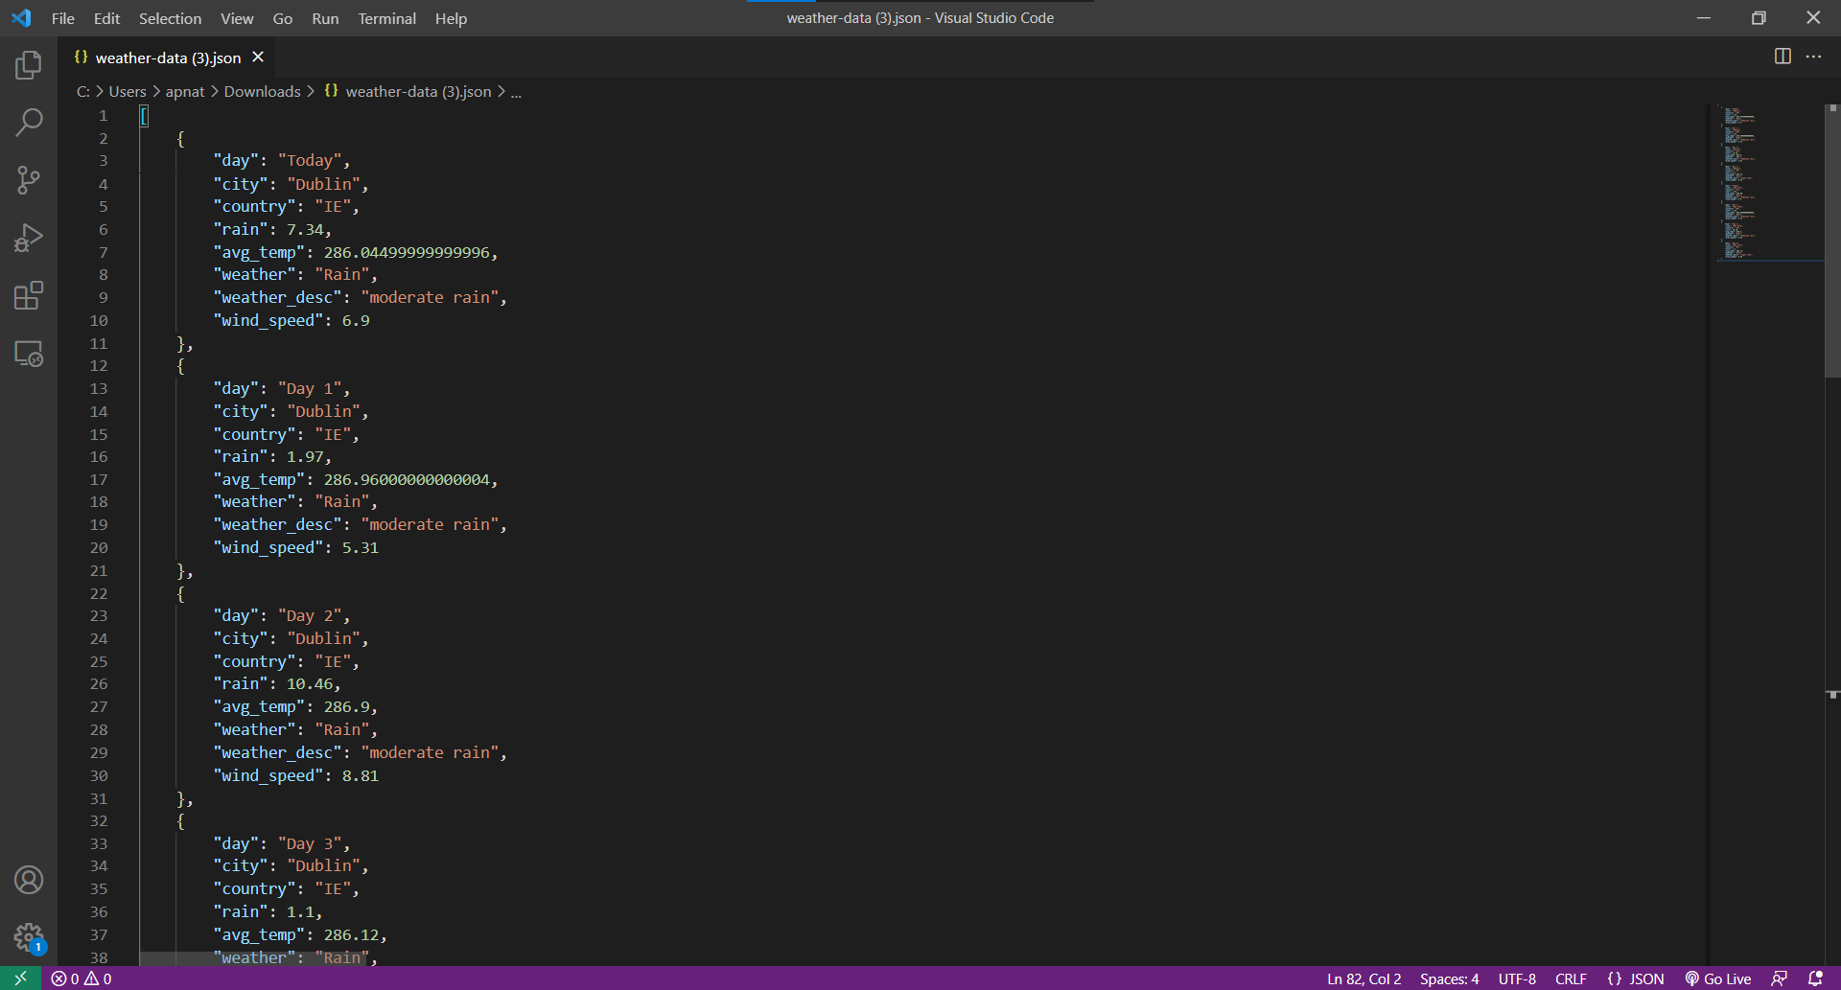
Example of Data the Client can download.
Trinity College Dublin, The University of Dublin

Slide 9
Quote Slide Option 1
The End

