Slide 1
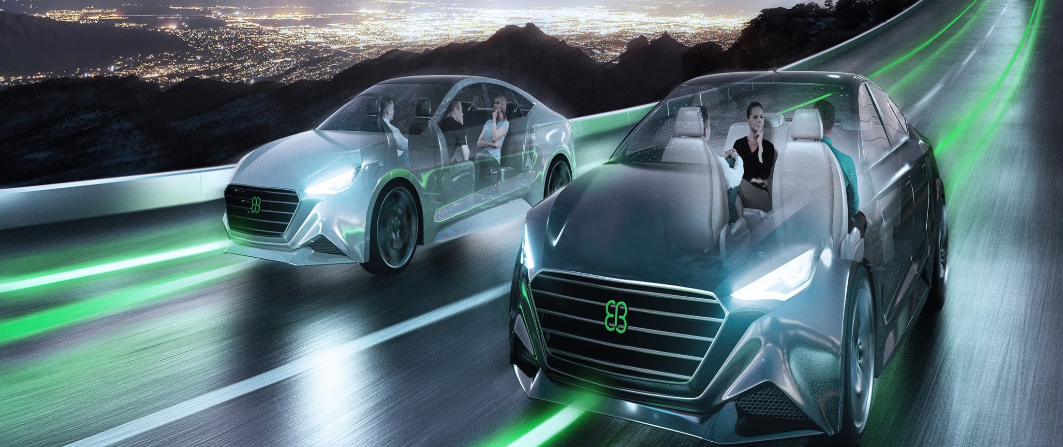
VIT & EB Hackathon ideas

Slide 2
Digital manual for the Car
Problem Statement: Many a times when in need, it is difficult to go through the user manual to understand what the warning indication of the tell tale indicates or we don’t know many features of the infotainment system at all just as some example. To overcome all this, and to know your car as you need, what, if I had a genie which can tell me exactly at that moment what is wrong with the car or what are the features supported in my infotainment system. It would be really great! This is the idea of “The Digital Manual”. The Digital Manual is a smart phone application which can help create a audio and visual experience of the “OEM user manual” and beyond.
For reference : In Maruti Arena showcase the accessory configuration system is touch input driven, where in the entire 3D model of the car is present and provides virtual visualisation of the accessory selected.
Details:
Develop a software tool which can
Generate the digital content of the manual.
The digital manual App should not need any enhancements in any of the ECUs in the car. It shall have no connectivity to any of the ECUs on-board the automobile.
Based on the VIN, that is registered for the digital manual , the software tool shall pick the relevant digital content from the cloud for presenting to the user.
Tool can generate a Holographic representation of car/3D display of car to showcase the features provided. Basically, the tool has to provide a good user experience of the requested feature
Multiple language support to be provided
User experience enhancement can be with both Voice and Video etc.
Technology : Android or a iOS App on the Smart Phone

Slide 3
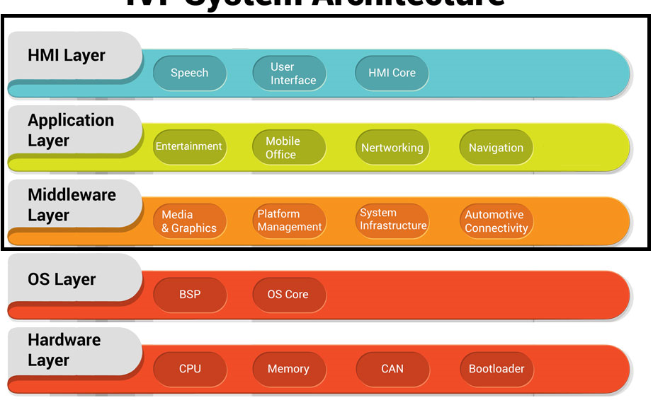
Instrument Cluster Stack based on Realtime OS
Problem Statement: Create a Software platform(HMI layer, Application layer and Middleware layer as in the architecture shown) for housing the features required for low cost Instrument Cluster stack.
Details:
The platform shall be demonstrated on HW platforms like Raspberry Pi, Arduino or similar boards
It is necessary that the IC Platform is hosted on a Realtime Operating System
This platform should take care of the software components required to realise the functionalities required for the Instrument Cluster in the Middleware, Application and HMI layer.
You are free to choose suitable open source frameworks and OS that have free license for commercial use
Following features shall be demonstrated by the developed stack
Switch ON\OFF Animation
BT Profiles to be supported HFP, AVRCP
Develop also a Companion App on the Smart phone to demonstrate the communication with the cluster on BLE
Better and faster emergency care during accidents and vehicle impact.
A software/module to refer the prescribed penalty for violating traffic rules accomplished using intervehicle communications in the IoV framework
https://www.edn.com/the-basics-of-automotive-cluster-device-architectures-and-applications-part-i/

Slide 4
ADAS Software algorithms
Problem Statement
Customized ADAS solution platform for Indian market. The main idea here is to use minimal hardware and focus on the software algorithms to realize the driver assistance functionality.
Details
Below are only a few suggestive use cases
Emotion recognition of driver
Stationary vehicle / object detection and alert
Blind spot detection while driving
eg: Blind spots in car due to pillars, Blind spots in Huge vehicles such as trucks and busses, Lane warning
Rider Assistance: Driver assistance focusses on partial or fully automatic driving including the scenarios of operational assistance in heavy traffic on lanes or parking areas, in-lane or in highways.
Vehicle Telematics : A crash resistant duplex black box ensures car safety and guides in going on the correct track
What technologies do you need so that autonomous and manual cars can co-exist in harmony
Sensing environment around vehicle using AI and ML with more software and less hardware. To use camera-based input for face, emotion, object detection and blind spot in the car
Pick a use case and develop the Software algorithm for the same
Technologies used :linux Virtual Machine or High end controller like NVIDIA.

Slide 5
In Vehicle Infrastructure
Problem Statement
Imagine enhancements to the Vehicle Infrastructure to address Safety and convenience needs of the passengers in the Car. In order to cater to these needs, what are the solutions that can be added / modified in the car.
Details
Possible use-cases for enhancements (only suggestions)
A way to find out the oxygen content and temperature present inside the car (this will help in taking the right pre-caution if any people are there inside the car when all the windows are closed, and ignition is off)
Can we have a de-centralized locking system
A visual Dashboard based on data analytics for percentage utilization of vehicle facilities and utilities using IOT
Cabin air quality monitoring
Automatic A/C control based on Passenger occupancy
Battery maintenance and control for Electric Vehicles
Infant Identification and alert system
Anti Theft Monitoring Systems for 4 wheelers linked with the overall system (namely wheels, fuel etc) along with ignition
An embedded solution (HW + SW) shall be proposed and designed to the chosen use-case
Use suitable HW boards and open source SW platforms and framework to show case the solution

Slide 6
Car as the Third Living Space
Problem Statement: Car As the Third Living Space
How would you visualize the environment of an semi-autonomous / fully autonomous car.
CAD drawings showing how the dash board will look like in future
How would the interiors look like?
Would you need steering?
How can the car seating be remodelled?
How can the Infotainment system be?
How would the third living space (Car) look like?
Let your creativity and imagination run wild!

Slide 7
Connected Platform
Problem Statement
To develop a connected platform in cloud which can securely use the data in the vehicle and provide personalized services to the users.
Smart Parking System comprising prediction of geolocation, space availability accounting the vehicle dimensions through live interaction with the parking database
Module that integrates the paid parking stations in a particular location so that the user will get the parking vacancy details instantly/pre book
Connected Cars: City navigation, location-based services, drive assist applications, car-on-demand services, usage-based insurance, remote diagnostics, car security services
Predictive Maintenance : Vehicle maintenance application that periodically updates the oil status, aging of parts both interior and exterior and finally intimates the user in the form of a decision to proceed with maintenance, mileage and part replacement in tandem with the manufacturers database
A connected Platform used by Malls, theaters, shops to advertise their products. Some of the examples of how this platform can be utilized are:
Localization results for user search while driving on the way.
Highlighting the localization during on his travel (Ex: ATM, hospital, mall with distance on his left side. Petrol bunk, restaurant, post office on his right side )
Consider a user traveling from X position to Y position, during his travel he would like to know about the best neurologist hospital for consultation. So App will list down all the hospitals within certain radius in the navigation with the distance.
- In a connected platform, identify ways to provide monetary benefits to the vehicle owner.
Technology areas (involved):
Cloud Infrastructure, Android, GPS, Content Management

Slide 8
Get in touch!
sales@elektrobit.com
www.elektrobit.com

