Slide 1

Predicting West Nile Virus
Andrew Norton
Frank Hiemstra
December 3rd, 2015
1
Notes:
1

Slide 2

Motivation
Aid the City of Chicago in the fight to stop the spread of West Nile virus
binghammemorial.org
2
Notes:
2
The motivation of this project

Slide 3
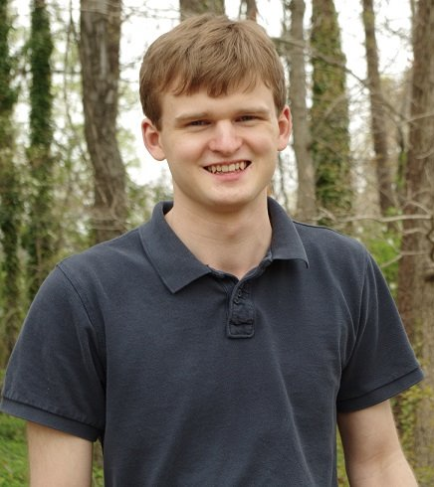
Background (Andrew)
Background:
Undergraduate CS Major
Math double-major
Contribution and Workload
Programming Lead
Assisted with experiment design
Statistics + Engineering + Math + Computer Science = Success
Notes:
3

Slide 4
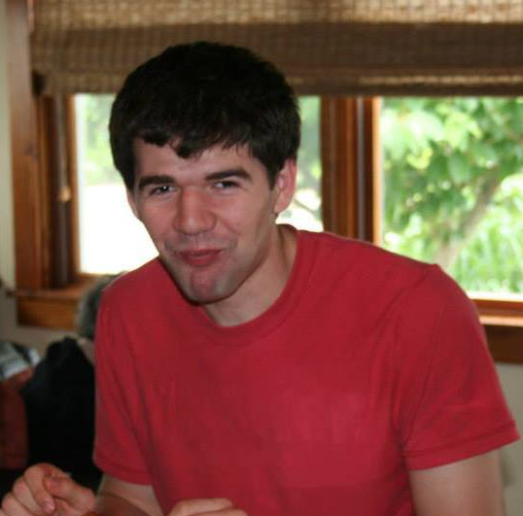
Background (Frank)
Background:
Graduate EE
Control Theory
Undergraduate EE
Contribution and Workload
Experimental Design Lead
Assisted with programming
Statistics + Engineering + Math + Computer Science = Success
Notes:
4

Slide 5
Related Work
Research by the National Center of Atmospheric Research in Boulder, CO
Research by the Geographic Information Systems and Spatial Analysis Laboratory at University of Illinois at Urbana-Champaign
Credit Card Fraud Detection
5
Notes:
5

Slide 6
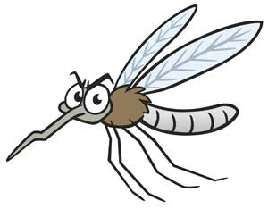
Claim / Target Task
Predict when and where in Chicago mosquitos will be infected with West Nile virus
Imagebasket.net
6
Notes:
6
Here, we make the claim of this project.

Slide 7
Proposed Solution
View as solely a classification problem
Consider weather and mosquito collection data
Need to account for imbalanced training data
Used a Naïve Bayes Classifier to do classification
Notes:
Here is our proposed solution.
7

Slide 8
Implementation
Weather Data (csv)
Relevant Features
Combined Data
Mosquito Data (csv)
Relevant Features
Imputing
Scaling
OneHot
Learning Models
Training Set
8
Notes:
8
In the rest of this presentation, I’m going to talk about following contents:

Slide 9
Data Summary
Imbalanced training data
10,506 samples
~5% WNV present
~95% not present
Features from 2 given sources:
Weather data
Mosquito data
9
Notes:
9
In the rest of this presentation, I’m going to talk about following contents:

Slide 10
Experimental Results
Classification Technique | Prediction Accuracy (%)
Naïve Bayes | 53.19
Ensemble Approach | 53.144
Decision Tree | 53.057
K-Nearest Neighbor (K=5) | 50.726
Random Forest | 50.307
SVM | 50
10
Notes:
10
Naïve Bayes: 53.19%
Random Forest: 50.307%
Decision Tree: 53.057%
K-nearest neighbor (K =5): 50.726%
SVM: 50%

Slide 11
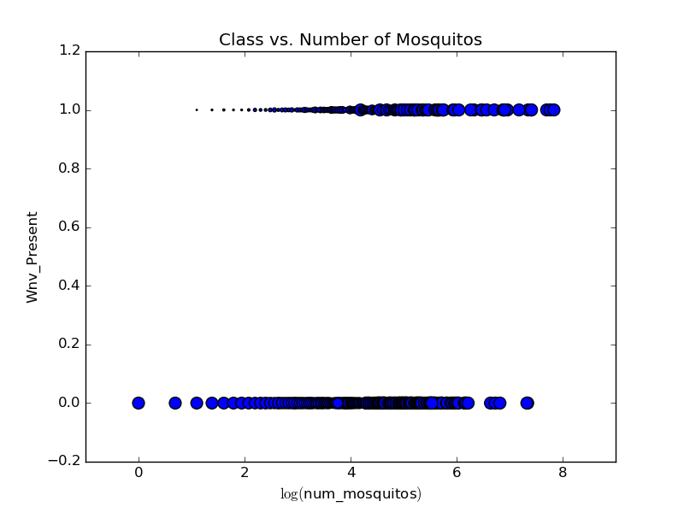
Experimental Analysis
11
Notes:
11
Given the experimental results we have obtained, this is how we intend to move forward

Slide 12
Conclusion and Future Work
Predict number of mosquitos per trap, as it is a good indicator of WNV present
Use a Hellinger distance based decision tree to do classification
Find prior probability of a certain species of mosquito containing WNV
12

Slide 13
References
Hahn, M., Monaghan, A., Hayden, M., Eisen, R., Delorey, M., Lindsey, N., . . . Fischer, M. (2015). Meteorological Conditions Associated with Increased Incidence of West Nile Virus Disease in the United States, 2004-2012. American Journal of Tropical Medicine and Hygiene, 1013-1022.
Ruiz, M., Chaves, L., Hamer, G., Sun, T., Brown, W., Walker, E., . . . Kitron, U. (n.d.). Local impact of temperature and precipitation on West Nile virus infection in Culex species mosquitoes in northeast Illinois, USA. Parasites Vectors Parasites & Vectors, 19-19.
West Nile Virus Prediction. (n.d.). Retrieved October 12, 2015, from https://www.kaggle.com/c/predict-west-nile-virus
13

